Slide 1
Selling Cloud Infrastructure with AppDirect
September 2024

Slide 2
Why sell cloud infrastructure?
Advisor-facing slides

Slide 3
What does Cloud Infrastructure consist of?
Public Cloud | Private Cloud | Hybrid Cloud | Co-Location | Disaster Recovery
Computing resources are shared by multiple organizations making it a cost-effective and scalable solution. Top providers: AWS, Azure, GCP | Computing resources are dedicated to a single organization or entity, providing increased security and control. | Combines private cloud with public cloud resources, allowing organizations to leverage the benefits of both while addressing specific needs and constraints. | A service where a company rents space in a data center facility to house its servers and other IT equipment. | A process designed to minimize the impact of a disruptive event on a business's operations and data.
Notes:
Cloud services offer many benefits, but isolation may also be required for security or
regulatory reasons. Private cloud offers complete isolation and the convenience and ease
of use of cloud services. Private and public cloud are at opposite ends of the isolation
spectrum. Public cloud providers offer virtual private cloud, dedicated instances,
dedicated hosts and distributed cloud offerings. Thus, there are a variety of isolation
choices between public and private cloud.

Slide 4
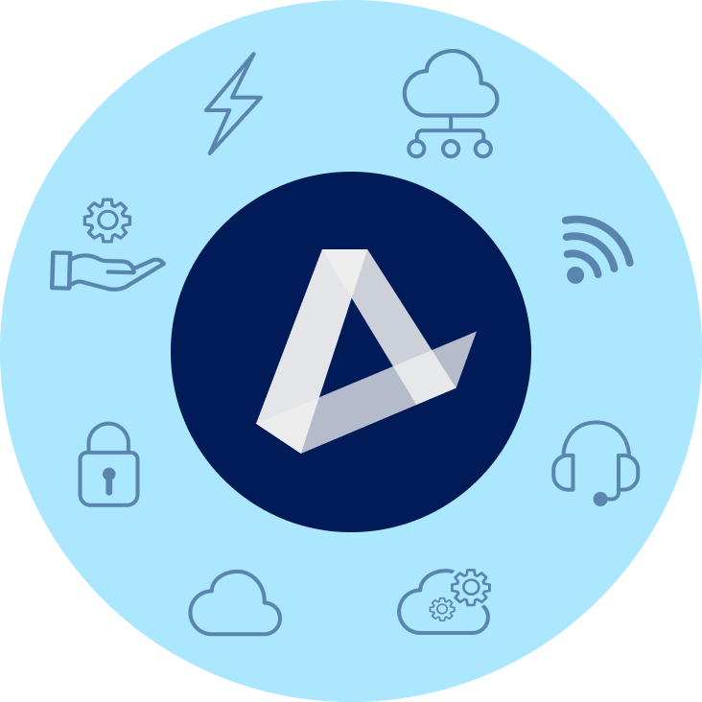
Add Cloud Infrastructure solutions to your portfolio with our catalog
ENERGY
CONNECTIVITY & SD-WAN/SASE
EV Charging | Water & Waste Electricity | Natural Gas | Solar
Fiber | Cable | Wireless | Satellite | TEM
MANAGED SERVICES
MOBILITY & IoT
NOC | SOC | Professional Services SmartSupport | Asset Management
Wireless Services | Internet of Things (IoT) Managed Mobility | Expense Management (WEM)
SECURITY
CUSTOMER EXPERIENCE (CX)
Physical Security | Network Security Endpoint Security | Cloud Security | SASE
UCaaS | Contact Center | CPaaS | SMS Analytics | Artificial Intelligence (AI)
CLOUD INFRASTRUCTURE
SOFTWARE AS A SERVICE
Public, Private, & Hybrid Cloud Data Center & Colocation | Disaster Recovery
Microsoft | Google | ERP | CRM | Productivity | Business Applications | IT Management | BI
‹#›

Slide 5
What’s happening in the market
Increased demand for low-cost IT infrastructure and fast data accessibility
High growth
IaaS market is expected to grow to USD $738B by 2032
Multi-cloud adoption
As much as 85% of businesses are using two or more cloud platforms
Rising prices
Providers have increased pricing by 20% - 30% YoY
Notes:
Ways that customers can optimize that can keep their prices stable.

Slide 6
Add Infrastructure to your portfolio
Shared cloud accounts for 45% of total infrastructure spending. Sell IaaS solutions to help customers adapt to a cloud-based workforce. As your customers explore new solutions and make additional purchases, you’ll benefit from a larger share of their spending.
INCREASE WALLET SHARE
GAIN RECURRING REVENUE STREAMS
Offer customers solutions from a diverse portfolio to stay ahead of their evolving business needs.
Ex: Complement Microsoft purchases with Azure to keep earning more revenue from your customers.
Solidify your position as a trusted partner and increase customer loyalty by helping customers get ahead of rising prices and coming scarcity.
INCREASE VALUE TO YOUR CUSTOMERS
Notes:
Tie back to market trends
If you can get your customers to shift their wallet share of IaaS to you, you’ll increase your sales every year without doing every work. Prices are increasing, usage is increasing, you won’t have to do any work you’ll just gain more commission. How do you do that? Offer them more value than their current provider. You don’t have to know how to do that, we can help you.

Slide 7
Extend your team with our specialists
Sales Engineers
Solution Architects
Data Center Experts
Boost solution designs with technical expertise in customer discovery and qualification.
Confidently present solutions scoped, designed, and vetted by experts.
Leverage multiple vetted vendors for projects or new environments.
Notes:
Find a good opportunity and we’ll do it for you. Here’s what a good opportunity looks like.
Procuring technology is increasingly complex—lean on AppDirect as an extension of your sales team.
We provide you with the digital back office and tools you’re used to, and a 250+ bench of back office specialists, engineers, and responsive support teams.
Leverage a team of solution engineers and solution architects to identify business problems and offer expert advice to your customers on the solutions that best fit their business model.
From engaging the providers to deal registration, demonstration, quoting, and post-sales support, AppDirect is there every step of the way.

Slide 8
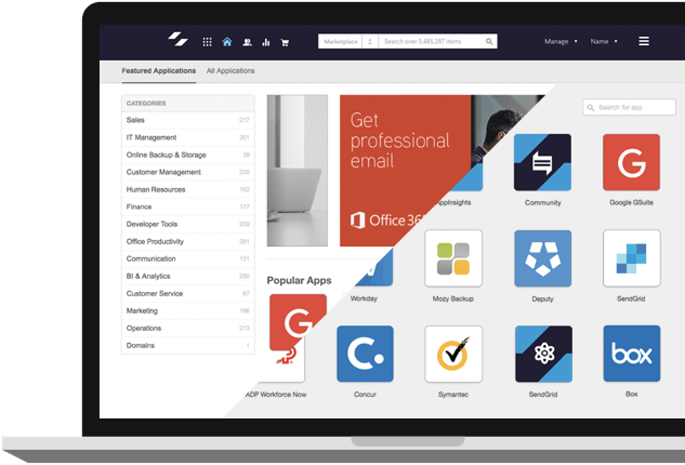
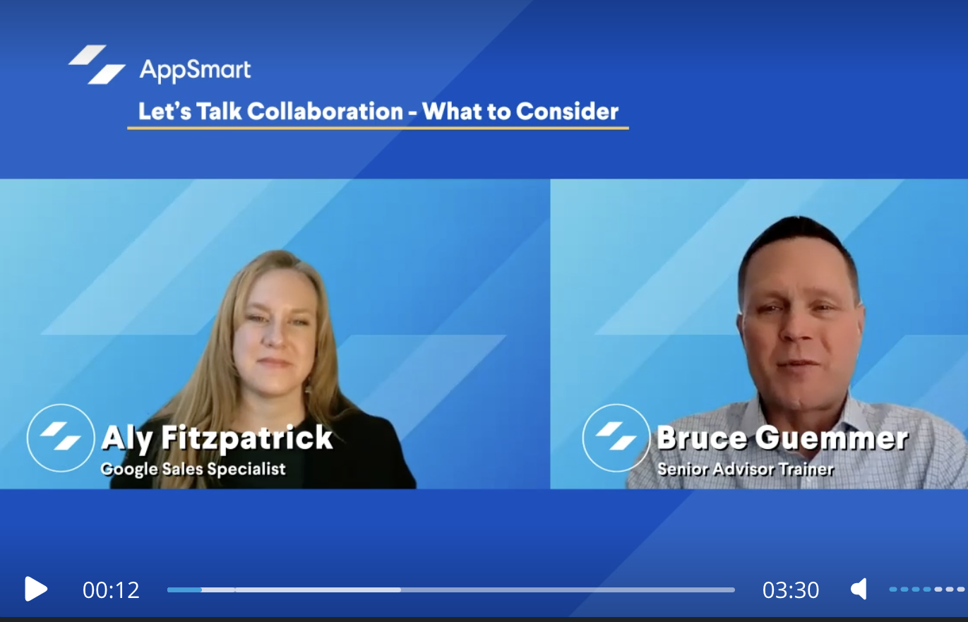
Resources to help you sell
IaaS
Learning Plans
Level up your customer experience advisory skills and learn to position and sell IaaS with comprehensive training tools and events
Live workshops
Learning plans
Customer Marketing Toolkit
Instructor-led sessions with practical sales activities and scenarios. Learn alongside like-minded advisors and technology providers.
In-depth insights into the evolving IaaS landscape and tips to position and sell.
Co-brandable datasheets, guides, pitch decks, email templates, and more.

Slide 9
End-customer facing slides

Slide 10
Main challenges companies face buying and managing infrastructure
TECHNICAL EXPERTISE
Companies lack the expertise or human resources to discover, procure, implement, maintain, and troubleshoot cloud infrastructure
It’s time-consuming and complex to understand all of the tools that are offered by infrastructure providers, as well as which are the right fit for their business.
MARKET KNOWLEDGE
SECURITY CONCERNS
Companies are concerned about data privacy, compliance, security, and control over cloud infrastructure. 52% of SMBs say that stolen data is their biggest security concern.
COMPLEX BILLING & COST
Tracking cloud expenditures is complex and companies need help understanding how cost is incurred and how to allocate those costs across their cost centers, project, or product budgets

Slide 11
AppDirect can help
TECHNICAL
EXPERTISE
AppDirect offers professional and managed services to help companies migrate and maintain their workloads in the cloud.
BUSINESS EVALUATION
Our engineers and experts evaluate each business, from their industry, to their size, and considering their unique needs— bringing an array of implementation specialists and consultants, as required.
SECURITY CONSULTATIONS
AppDirect is partnered with leading cybersecurity software and service providers.
COST OPTIMIZATION
AppDirect evaluates a company’s technology processes in search of cost-saving options. Additionally, companies can visualize spend and usage across infrastructure services to inform business decisions and identify cost savings.
Notes:
AppDirect is partnered with leading cybersecurity software and service providers

Slide 12
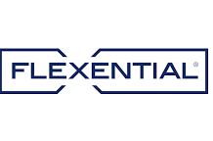
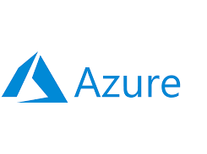
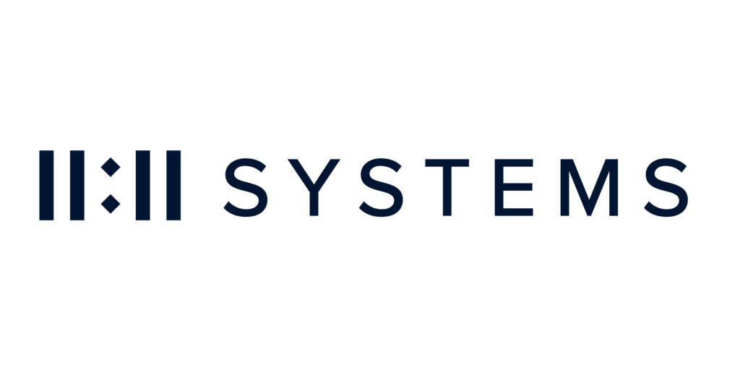
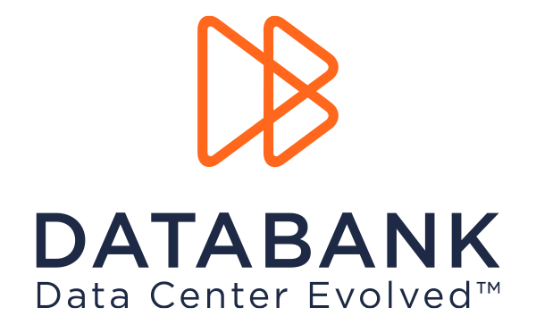
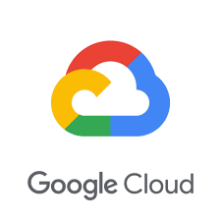
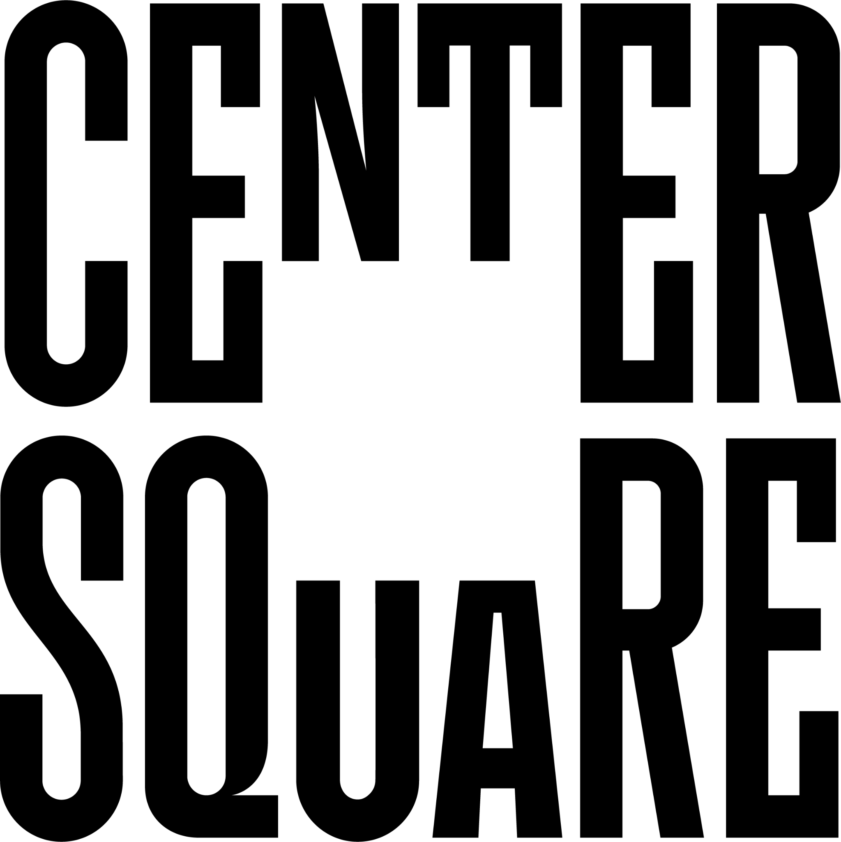
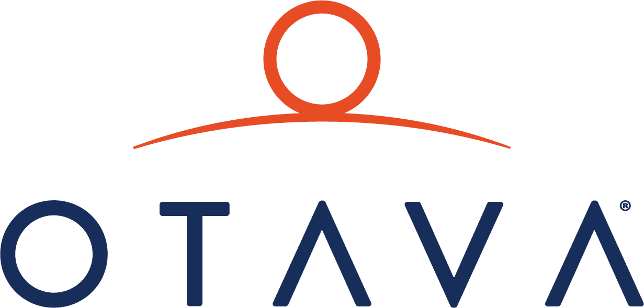
The leading providers
Hybrid
Public Cloud
Co-location
Private cloud
Position Cloud Infrastructure solutions that are vendor-agnostic with experts to guide you.
Notes:
We are the only company to offer all 3 hyperscalers and private cloud.

Slide 13
IaaS benefits
Cost savings
No need to invest in expensive hardware. Pay only for the resources you use, often on a pay-as-you-go basis.
Scalability
Scale resources, like computing power or storage, up or down depending on demand.
Flexibility
Deploy applications and services quickly without the long lead times needed for hardware procurement and setup.
Maintenance-free
Since the cloud provider maintains the physical hardware, you don’t have to worry about managing the underlying infrastructure.

Slide 14
Case study

Slide 15
Ideal customers
Our solutions are a good fit for:
Companies looking to optimize overall infrastructure spend, for a forklift upgrade, or to
rapidly scale their capacity
IT teams lacking resources to understand, implement, and maintain infrastructure and speciality workloads
Companies that require robust security measures and adherence to industry regulations
Industries: IT & Telecom, Retail & Ecommerce, Healthcare, Government, Higher Ed, Manufacturing

Slide 16
Key IaaS Win
$156K ARR for CTG who helped chemical manufacturing company shift from private to public cloud
Challenge
Solution
Results
Wanted to transition from private to public hosted cloud but had challenges:
Navigating the shifting channel landscape, aiming to introduce cloud to customers
Decoding cloud complexity, including complex licensing from providers
Balancing multiple priorities, limited time to build Microsoft expertise
CTG engaged AppDirect specialists to introduce cloud solutions
Introduced Azure Virtual Desktop alongside exploring additional licenses
Unblocked potential revenue of $13,000 MRR or $156,000 annually
Notes:
Case study
Anatomy of the deal

