Slide 1
Devs.ai Agentic AI Platform
Easily create & manage custom AI agents
December 2025

Slide 2
GPT-5
Claude 4
10²⁵
Gemini 2.5 Pro
Llama 4
~70
Gemini 2.5
Major LLMs
Grok-2
Claude 3.5 Sonnet
10¹⁵
Lama 3
~2
LLMs are
released weekly
Lama 3
GPT-4 Classic
10⁵
2023
2024
2025
Notes:
Today, there is a very saturated LLM release cycle.
In 2023, major LLMs were released every few months, primarily by companies like OpenAI, Meta, and Google.
By 2024, the pace accelerated significantly.
Now, in early 2025, we’re seeing 1-2 new LLMs released every week, particularly with smaller, specialized models and fine-tuned versions entering the market at a rapid rate.
What makes this landscape challenging is that LLMs don’t function like traditional software. With software, updates are automatic and often included in existing plans. But with LLMs:
Newer models aren’t just better in performance—they often come with more competitive pricing.
This forces companies to either cancel existing plans or manage multiple LLMs, which isn’t financially or operationally scalable.
The bigger issue arises when AI systems built on older LLMs are deeply embedded into workflows and tech stacks. Switching to a new LLM often requires rebuilding integrations and reworking strategies, which can be costly and time-consuming.
The takeaway:
For companies trying to scale their AI strategy, this fast-moving LLM landscape creates two major challenges:
Keeping up with the latest LLMs without disrupting existing AI workflows.
Maintaining financial and technical flexibility to train and switch models efficiently.

Slide 3




AI is already in your company
Who is monitoring it?
Employees are exposing sensitive data
No oversight = compliance nightmares
Is your company prepared to handle the risks?
+75% of the workforce is using unapproved AI tools without oversight
77% of companies lack a strategy to manage AI risk and governance
Organizations that invest in AI governance will experience 40% fewer risks
Source: Microsoft, Deloitte, Gartner
Notes:
Your customers’ employees are using AI tools every day—whether it’s ChatGPT, Copilot, or Gemini. But without proper oversight, AI adoption comes with serious risks.
Here’s the challenge we’re seeing today:
More than 75% of AI users are bringing their own AI tools to work (BYOAI), creating serious security and compliance risks.
Less than 25% of employees have regulated access to AI tools, meaning the majority are using unapproved AI without oversight.
Meanwhile, only 23% of companies are actually prepared to manage AI risk and governance.
This lack of control has led to a major issue: Shadow AI. Shadow AI refers to AI tools being used without IT or security oversight, leading to several risks that should be emphasized to customers:
No visibility or control – Your IT teams can’t track who is using AI, how it's being used, or where data is going.
Data security threats – Your employees are likely unknowingly input sensitive company or customer data into public AI models.
Regulatory and compliance risks – Unauthorized AI use can violate industry regulations, exposing your company to legal consequences.
Proprietary data leakage – Public AI models (like OpenAI or Anthropic) can absorb and use confidential data for future training.
Are you investing in the right tools to monitor AI usage in your company, ensuring it’s safe and compliant? If not, you’re exposing your business to serious legal and security risks.
Source: Microsoft, Deloitte, Gartner

Slide 4




Companies need to stay up to date
A multi-LLM approach is key for balancing cost & utility
Cost-efficiency
Newer models offer better performance capabilities at a lower cost
Tailored Capabilities
A multi-LLM approach gives companies the flexibility to use the best model for each task
Better Performance
Newer models can deliver faster,
more accurate, and context-aware responses
End of life risks
Older models become incompatible, outdated,
and pose security risks
Notes:
To build a successful and scalable AI strategy, companies must evolve with the rapidly changing LLM landscape. Staying agile and ready to adopt new models is crucial as the market becomes more saturated. Here’s why a multi-LLM approach is key for your customers:
Cost Efficiency: A multi-LLM strategy allows businesses to balance cost and performance, switching between models to achieve optimal results at a lower cost. Newer models often come with more affordable pricing, offering better value for money.
Tailored Capabilities: Different LLMs excel at different tasks. By leveraging multiple models, companies can choose the best one for each task, ensuring maximum efficiency and effectiveness.
Better Performance: Newer models deliver faster, more accurate, and context-aware responses, resulting in improved outcomes for your customers.
End-of-Life Risks: Older models can become outdated, incompatible with current tech stacks, and pose security risks. Staying up-to-date ensures these risks are mitigated.

Slide 5



Switching LLMs is challenging
It’s not as simple as an update
Transition overhead costs including training, fine-tuning, and infrastructure changes.
Managing multiple subscriptions with different AI vendors.
Integration costs for API updates, data migration, and system reconfigurations.
The financial burden
Workflow interruptions while adapting to new models and adjusting processes.
Employee retraining to learn new systems and workflows.
Testing and quality assurance to ensure the new model meets performance standards.
Operational disruptions
Differences in model outputs requiring retraining or a workflow reconfiguration.
Service disruptions and delays during the transition to new models.
Hallucinations if the new model isn't fine-tuned properly.
Performance risks
Notes:
However, switching LLMs can be a complex undertaking today—impacting costs, workflows, and overall performance. From integration challenges to operational risks, businesses must navigate multiple hurdles to ensure a smooth transition.
Switching LLMs is Complex and Costly
1. High Transition Costs
Moving to a new LLM requires more than a simple update—it involves training, fine-tuning, and infrastructure changes. Businesses must also juggle multiple AI vendor subscriptions and navigate complex integrations like API updates, data migration, and system reconfigurations.
2. Financial & Productivity Burdens
Switching disrupts workflows, requiring employee retraining and process adjustments. Extensive testing is needed to ensure the new model meets performance standards, adding both time and cost.
3. Operational & Performance Risks
Different LLMs produce varied outputs, often necessitating workflow reconfiguration. Transitions can lead to service disruptions, delays, and AI hallucinations if the model isn’t properly fine-tuned.

Slide 6

AI agents are on the rise
Are you enabling your workforce?
By 2028
80%
15%
of humans will engage with agents on a daily basis
of day-to-day work decisions will be made autonomously through agents
Source: Gartner
Notes:
Finally, a major shift happening in 2025: AI is moving beyond simple chat interfaces to agentic AI – systems that can make decisions and take action without human input.
And it’s happening fast. By 2028
80% of people will interact with AI agents daily
15% of routine business decisions will be made by AI
With rising pressure to scale AI quickly and responsibly, companies need platforms that make adoption simple, secure, and scalable for their workforce.

Slide 7
Devs.ai can help

Slide 8



A comprehensive solution for agentic
AI creation & management
Private AI Workspaces
A secure environment for your team and data
Access To
Every LLM
Stay ahead of the AI lifecycle with every new model release
No-Code
Agent Builder
Empower anyone to create AI agents—no code required
Notes:
This is where Devs.ai comes in – Devs.ai gives companies private AI workspaces with full admin control so admins can monitor their employees usage, set permissions, and ultimately centralize all AI activity on one platform to overcome shadow AI.
Devs.ai gives companies access to 70+ LLMs in one plan, with new models added as soon as they’re released. This means no subscription juggling, no switching costs, and no vendor lock-in—just the flexibility to choose the right model for any use case.
And of course, it lets users, regardless of their technical background, build custom AI agents with low- or no-code tools, that they can securely train on internal data to securely build impactful solutions.

Slide 9
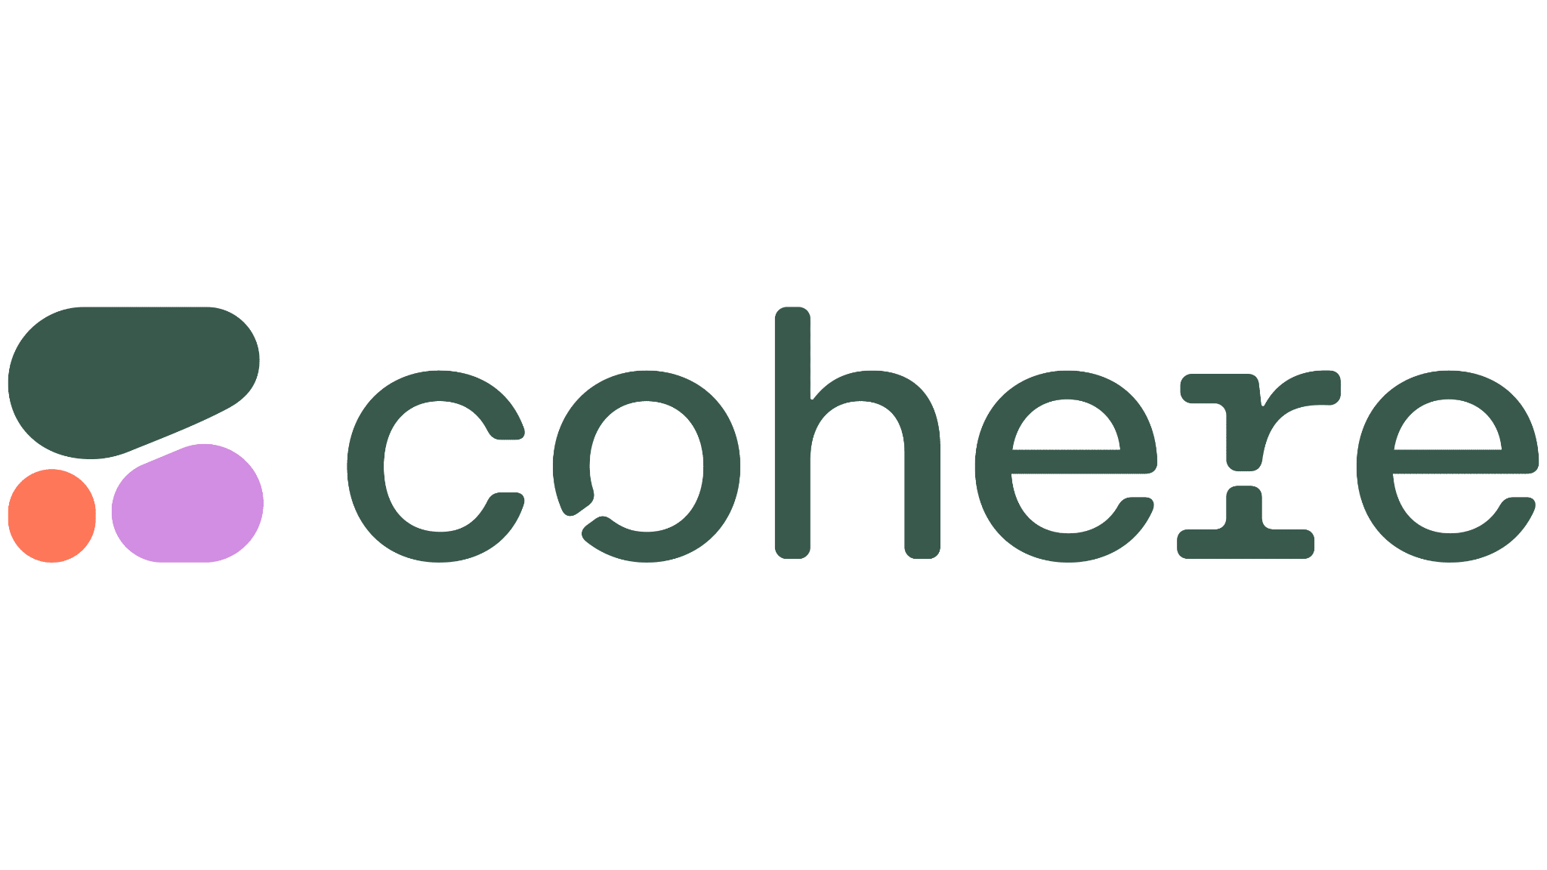


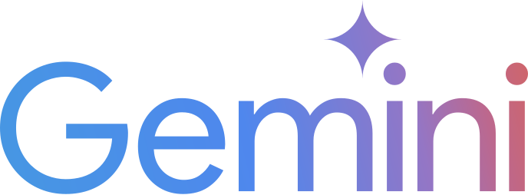
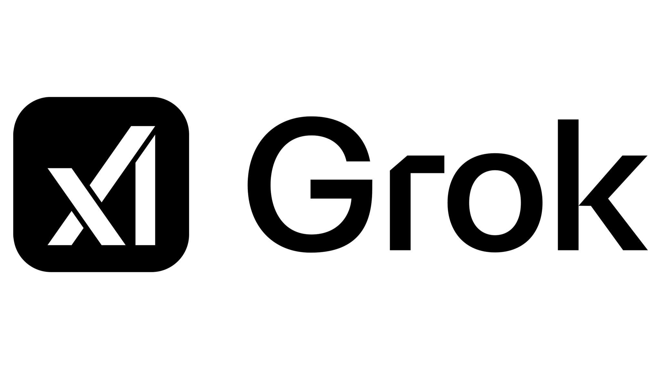


One platform
50+ LLMs
Notes:
We offer all the leading LLMs under one plan. With Devs.ai, you can consolidate all your employees’ AI usage under one plan, saving up to 75% compared to using a single AI vendor.

Slide 10



We help you stay ahead of the LLM landscape
Evolve with the latest LLMs
Access the latest LLMs as they emerge with our constantly updated library
Easy model swaps
Test and switch LLMs without costly integration headaches
LLM-agnostic
Choose the best LLM for each use case without being locked into a single model
Notes:
With Devs.ai, we help you stay ahead of the ever-evolving LLM landscape. You’ll have access to the latest LLMs as they emerge, thanks to our continuously updated library.
Switching models is easy — you can test and swap LLMs without the expensive integration headaches.
And best of all, we’re LLM-agnostic. You’re never locked into a single model, so you can choose the one that’s best suited for each task, giving you maximum flexibility and performance.

Slide 11
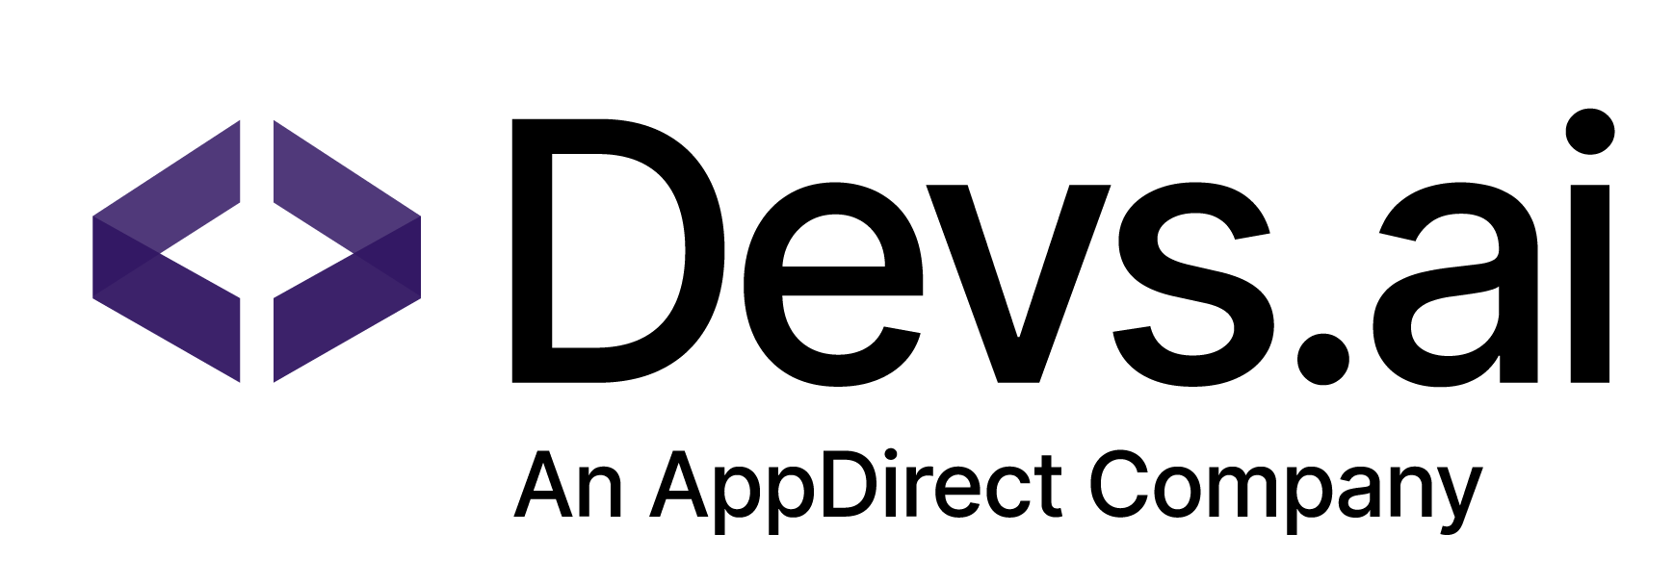
Build & deploy first-class agents
01
02
Customize your agent
Train your agent using your own data sources and select the LLM tailored to your needs
Augment agent knowledge
Utilize predefined data pipelines to augment the agent’s knowledge w/o coding
01
01
02
04
02
Deploy at scale
Embed agents into your business workflows or integrate via APIs
03
04
Orchestrate complexity
Build sophisticated agents that manage complex workflows and perform tasks autonomously
03
Notes:
With Devs.ai, building and deploying top-tier AI agents has never been easier. Start by customizing your agent with your own data and selecting the perfect LLM for your needs. Next, augment your agent’s knowledge using predefined data pipelines — no coding required. Once you’re ready, deploy at scale by embedding agents directly into your business workflows or integrating via APIs. And for more complex use cases, orchestrate sophisticated workflows that allow your agents to perform tasks autonomously, simplifying your operations.

Slide 12








Scale across your business applications
Easily integrate throughout your organization’s ecosystem
Deploy anywhere
Launch in your applications, websites, and workflows to enhance user experiences
Connect with your systems
Connect with CRMs, internal tools, and business applications for a unified experience
Leverage APIs for flexibility
Enable custom integrations, ensuring AI agents work within your existing infrastructure
…& more
Notes:
You can then easily scale your agent across your applications, ensuring seamless integration into every part of your business ecosystem. Whether it’s your website, CRM, or internal tools, the agent works consistently across all platforms

Slide 13

Manage the lifecycle of your agents
Iterate & optimize
Continuously refine your agent to enhance performance and expand capabilities
Automate data updates
Ensure your agent is trained on the most up-to-date data sources
Monitor metrics & spend
Gain visibility into agent performance and resource usage
Upgrade LLMs as needed
Easily swap LLMs to adapt to business needs and stay current with the LLM landscape
Notes:
We make it easy to manage the entire lifecycle of your agents:
Automate data updates to keep your agent trained on the latest data.
Iterate & optimize to refine performance and expand capabilities.
Monitor metrics & spend for full visibility into agent performance and resource usage.
Upgrade LLMs seamlessly as your business needs evolve, keeping you current with the LLM landscape."

Slide 14
We’re enterprise-first
Guarantee safe & compliant AI use across your company
Your data, your control
✔ Your data is not used to train public LLMs
✔ You decide who can see your data
✔ You can delete your data at anytime
You manage access
✔ Secure access with SSO verification
✔ Role-based access control
Comprehensive security & compliance
✔ SOC 2 Type 1 compliance
✔ GDPR compliance
✔ Hosted on a secure Azure instance
✔ Custom on-prem options
Notes:
With Devs.ai, you can rest assured that your data is secure and fully under your control. We prioritize enterprise-level security and compliance, ensuring that your proprietary data remains private and is never used for training public LLMs. You manage access and data usage, eliminating the risks of shadow AI and maintaining a trusted environment for your AI solutions.

Slide 15
Customer stories & use cases

Slide 16

What agents can do
Top use cases for AI agents today
Marketing |  | Sales |  | Human Resources
Content generation
Product recommendation
Recruitment advice
Campaign ideation
Sales data analysis
Resume comparison
Market research
Sales pitch creation
Onboarding automation
CTA optimization
Objection handling
Employee goal tracking
Audience segmentation
Product comparison
HR policy compliance
Product Management |  | IT/Software Dev |  | Legal
Feature prioritization
API documentation
Contract review
User feedback analysis
Coding
Legal documentation
Roadmap planning
IT troubleshooting
Compliance verification
Product documentation
Technical documentation
Risk assessment
Competitive analysis
System integration advice
Legal pitch support

Slide 17



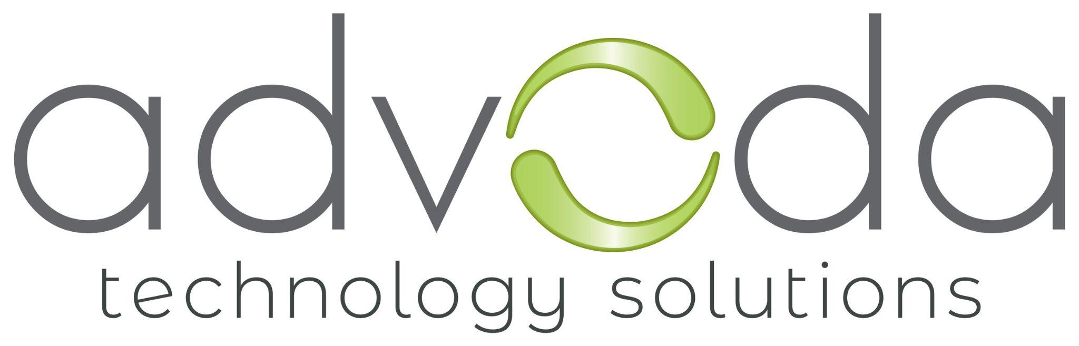


Customers using Devs.ai today

