Slide 1
Optimize Cloud Infrastructure with AppDirect
April 2025

Slide 2
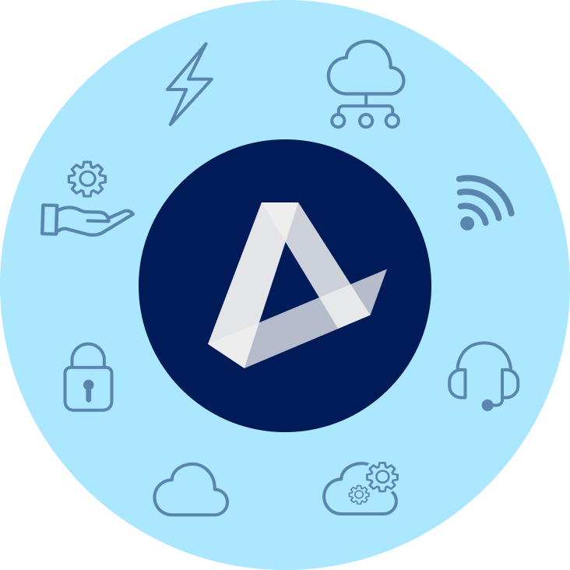
TRANSITION
ENERGY
COMMUNICATIONS SOLUTIONS
EV Charging | Water & Waste Electricity | Natural Gas | Solar
Data | Network | Mobility & IoT | Satellite SD-WAN | SASE | TEM | UCaaS | CCaaS
MANAGED & PRO SERVICES
SOFTWARE AS A SERVICE
Network (NOC) & Cloud Monitoring | SOC Technical Support | Professional Services
Microsoft | Google | ERP | CRM | Productivity Business Applications | IT Management | BI
HARDWARE & LOGISTICS
ARTIFICIAL INTELLIGENCE
PCs | Laptops | Phones | Monitors | Digital Displays Hardware Services & Logistics
Large-Language Models | Agentic AI | Copilot | Gemini | Chat Bots | Customer Experience
SECURITY
INFRASTRUCTURE
Physical Security | Network Security Endpoint Security | Cloud Security
Public, Private, & Hybrid Cloud Data Center & Colocation | Disaster Recovery
‹#›

Slide 3
Main challenges companies face buying and managing infrastructure
TECHNICAL EXPERTISE
Companies lack the expertise or human resources to discover, procure, implement, maintain, and troubleshoot cloud infrastructure
It’s time-consuming and complex to understand all of the tools that are offered by infrastructure providers, as well as which are the right fit for their business.
MARKET KNOWLEDGE
SECURITY CONCERNS
Companies are concerned about data privacy, compliance, security, and control over cloud infrastructure. 52% of SMBs say that stolen data is their biggest security concern.
COMPLEX BILLING & COST
Tracking cloud expenditures is complex and companies need help understanding how cost is incurred and how to allocate those costs across their cost centers, project, or product budgets

Slide 4
AppDirect can help
TECHNICAL
EXPERTISE
AppDirect offers professional and managed services to help companies migrate and maintain their workloads in the cloud.
BUSINESS EVALUATION
Our engineers and experts evaluate each business, from their industry, to their size, and considering their unique needs— bringing an array of implementation specialists and consultants, as required.
SECURITY CONSULTATIONS
AppDirect is partnered with leading cybersecurity software and service providers.
COST OPTIMIZATION
AppDirect evaluates a company’s technology processes in search of cost-saving options. Additionally, companies can visualize spend and usage across infrastructure services to inform business decisions and identify cost savings.
Notes:
AppDirect is partnered with leading cybersecurity software and service providers

Slide 5
What does Cloud Infrastructure consist of?
Public Cloud | Private Cloud | Hybrid Cloud | Co-Location | Disaster Recovery
Computing resources are shared by multiple organizations making it a cost-effective and scalable solution. Top providers: AWS, Azure, GCP | Computing resources are dedicated to a single organization or entity, providing increased security and control. | Combines private cloud with public cloud resources, allowing organizations to leverage the benefits of both while addressing specific needs and constraints. | A service where a company rents space in a data center facility to house its servers and other IT equipment. | A process designed to minimize the impact of a disruptive event on a business's operations and data.
Notes:
Cloud services offer many benefits, but isolation may also be required for security or
regulatory reasons. Private cloud offers complete isolation and the convenience and ease
of use of cloud services. Private and public cloud are at opposite ends of the isolation
spectrum. Public cloud providers offer virtual private cloud, dedicated instances,
dedicated hosts and distributed cloud offerings. Thus, there are a variety of isolation
choices between public and private cloud.

Slide 6
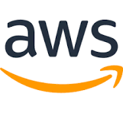
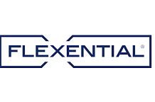
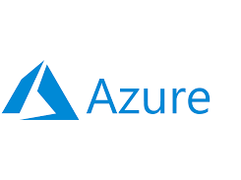
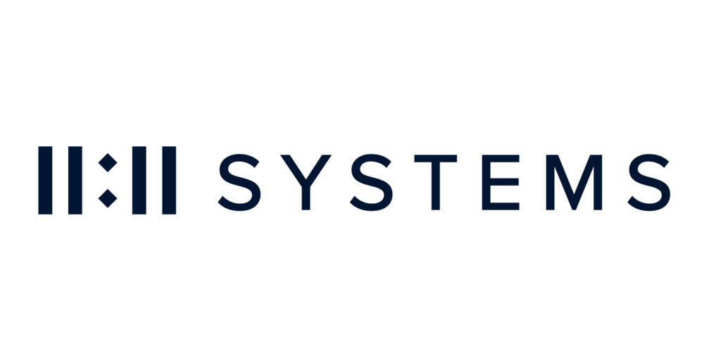
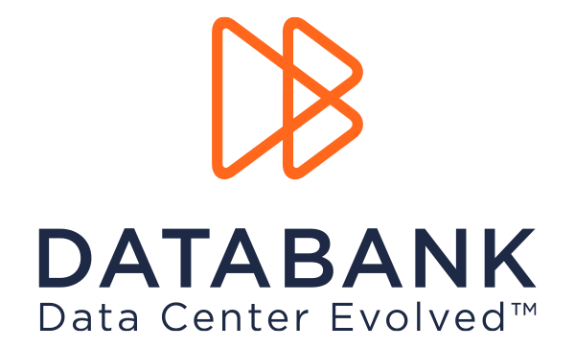
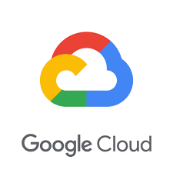
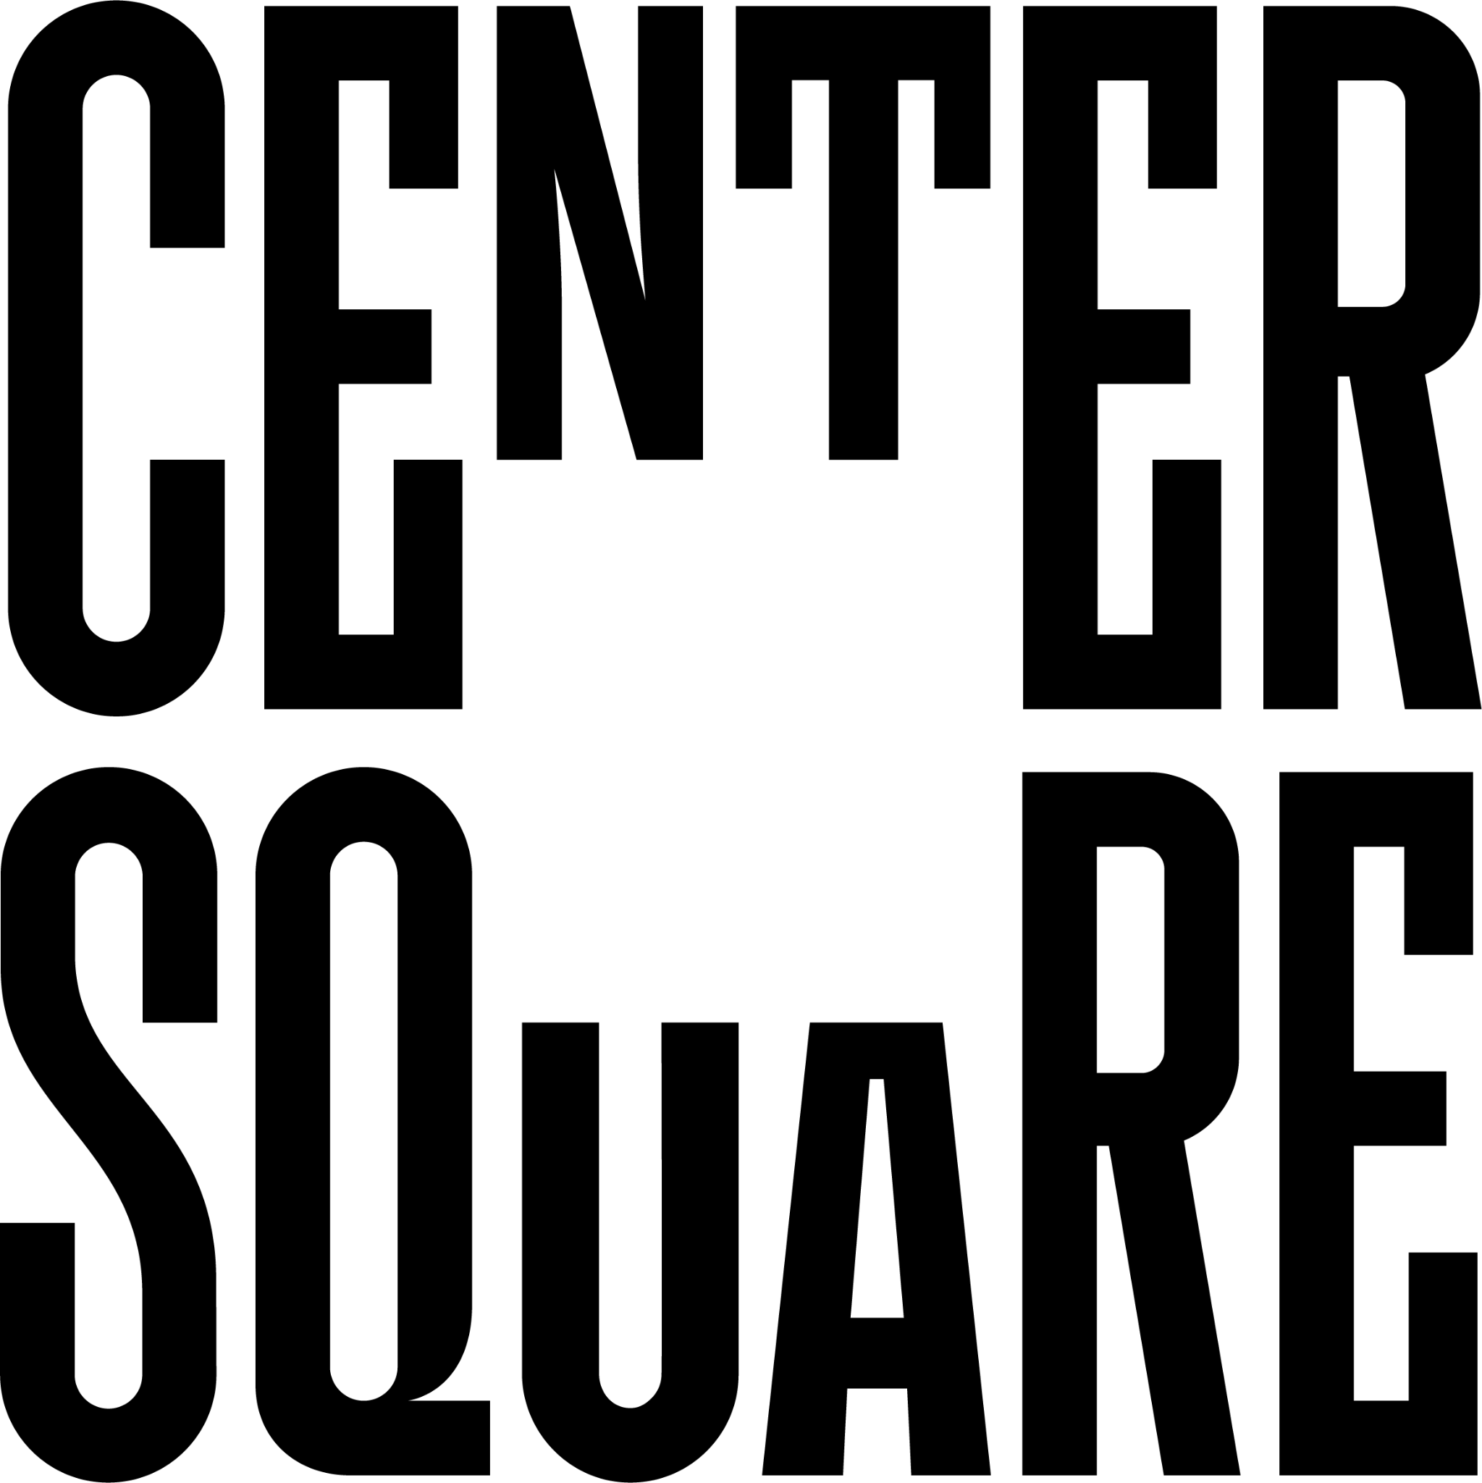
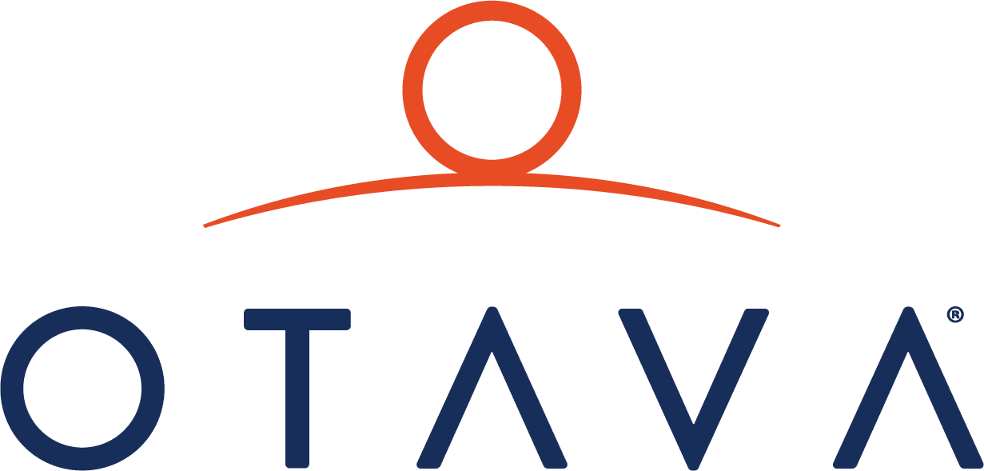
The leading providers
Hybrid
Public Cloud
Co-location
Private cloud
Position Cloud Infrastructure solutions that are vendor-agnostic with experts to guide you.
Notes:
We are the only company to offer all 3 hyperscalers and private cloud.

Slide 7
IaaS benefits
Cost savings
No need to invest in expensive hardware. Pay only for the resources you use, often on a pay-as-you-go basis.
Scalability
Scale resources, like computing power or storage, up or down depending on demand.
Flexibility
Deploy applications and services quickly without the long lead times needed for hardware procurement and setup.
Maintenance-free
Since the cloud provider maintains the physical hardware, you don’t have to worry about managing the underlying infrastructure.

Slide 8
Case study

Slide 9
Our solutions are a good fit for:
Companies looking to optimize overall infrastructure spend, for a forklift upgrade, or to
rapidly scale their capacity
IT teams lacking resources to understand, implement, and maintain infrastructure and speciality workloads
Companies that require robust security measures and adherence to industry regulations
Industries: IT & Telecom, Retail & Ecommerce, Healthcare, Government, Higher Ed, Manufacturing

Slide 10
Key IaaS Case Study
$156K ARR for CTG who helped chemical manufacturing company shift from private to public cloud
Challenge
Solution
Results
Wanted to transition from private to public hosted cloud but had challenges:
Navigating the shifting channel landscape, aiming to introduce cloud to customers
Decoding cloud complexity, including complex licensing from providers
Balancing multiple priorities, limited time to build Microsoft expertise
CTG engaged AppDirect specialists to introduce cloud solutions
Introduced Azure Virtual Desktop alongside exploring additional licenses
Unblocked potential revenue of $13,000 MRR or $156,000 annually
Notes:
Case study
Anatomy of the deal

