Slide 1
Selling Cloud with AppDirect
Tap into the leading B2B commerce platform
September 2023
Notes:
TO ADVISOR: WHAT ARE THE PROBLEMS BUYERS ARE FACING, & WHY YOU SHOULD SELL CLOUD WITH APPDIRECT

Slide 2
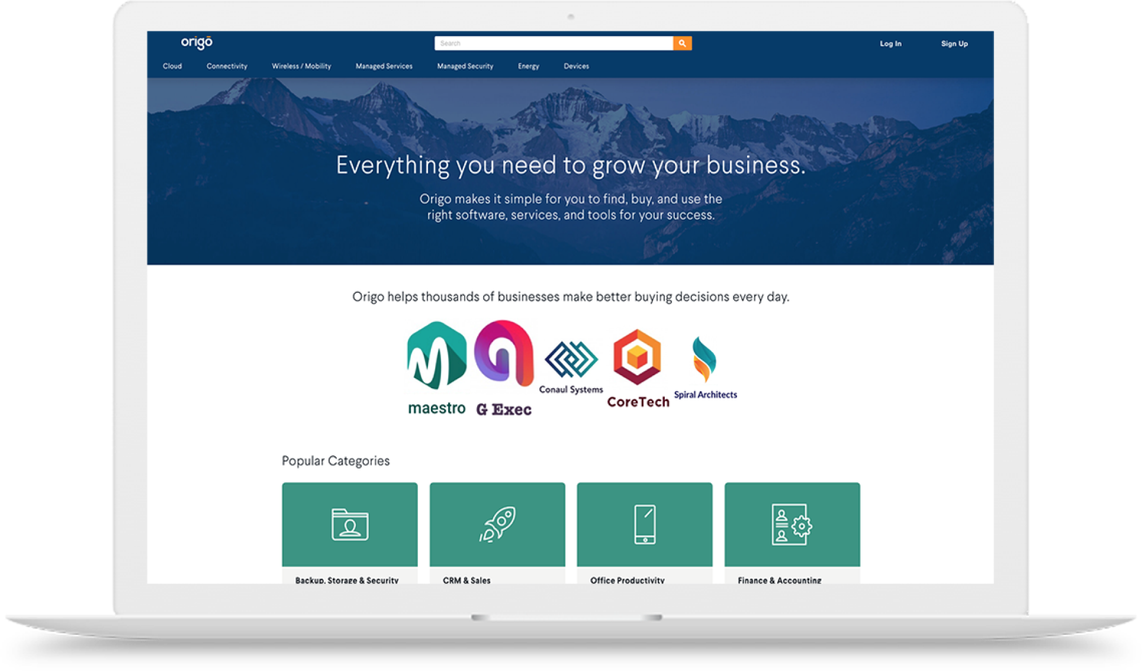
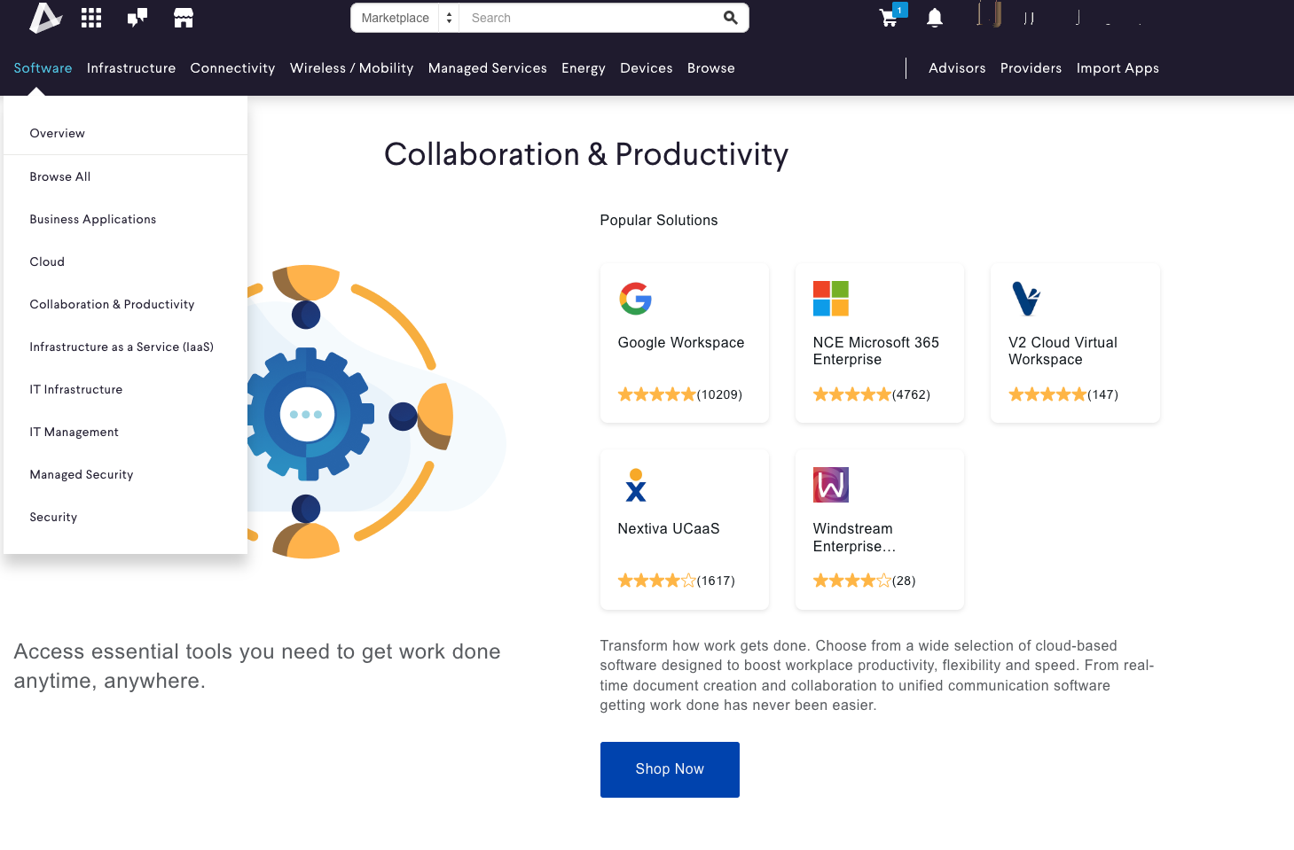
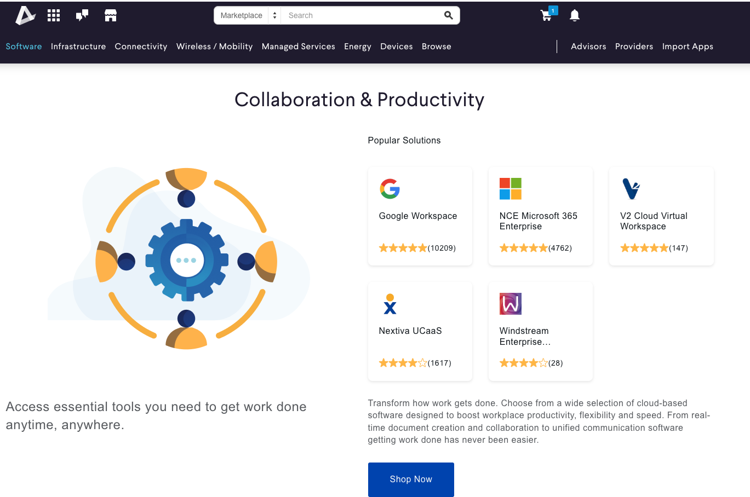
Future-proof your business with a full cloud portfolio
Grow share of wallet
Extend your team
Use our platform
By adding consultative support through AppDirect to the trust you’ve already established with customers
With cloud expertise combined with pre- and post-sales SaaS and IaaS consultative support
To bring more value to customers and increase retention
Notes:
FUTURE PROOF YOUR BUSINESS BY SELLING CLOUD WITH APPDIRECT
With the huge opportunity selling cloud today now is the time to either start or scale your advisor business with cloud solutions. 87% of businesses are embracing a multi-cloud approach that includes a mix of private, public or hybrid solutions. With this, comes complexity and businesses are in need of help to optimize their cloud investment. Selling cloud with AppDirect sets advisors up to uniquely to take advantage of rapid shifts in the cloud market. Have you tried selling cloud as a trusted advisor? How has it been?
Advisors can future proof their business by offering cloud-based technology and lean on the valuable trust they’ve already built with their clients at the same time. Expanding into selling cloud with AppDirect lets you rely on sought-after pre- and post-sales cloud support with a team of unbiased experts with a unique offering to set you apart from the competition.
AppDirect is the leading B2B subscription commerce platform company and a leader in marketplace development platforms (published by Forrester New Wave research).

Slide 3
Companies are channel-first:
Advisors offering a consultative approach will continue to win business
>35% switching channel partners
>96% had ROI on SaaS spend with a technology advisor
Shifting spend to channels that support cloud strategies
Notes:
BUYERS NEED HELP - and switching channel partners to get the consultative support they need for cloud
You’ve probably seen that due to complexity in cloud, buying habits are shifting. Businesses are changing channel partners and looking for consultative support. How equipped are you to offer end-to-end consultation and support in cloud that businesses seek?
Positioning cloud solutions opens the door for more money for you. Companies prefer partners that offer long-term consultative support and strategic services to assist with a complex market. Advisors who provide these services with additional strategic advice are set to grow and capture wallet share in today’s cloud market. For those who get consultative support through a technology advisor, a large majority (>96%) say they had ROI on their SaaS spend.
Businesses need help
Specifically buyers looking for::
Preference for remote human interactions and digital experiences (70-80%) McKinsey, Salesforce
>35% of SMBs have switched and continuing to switch channel partners in past 12 months in the search for more consultative support Analysys Mason 2022
Buyers are shifting their spending to channels that support cloud strategies Analysys Mason 2022 Analysis Mason 2023
> 96% had ROI when purchasing with a technology advisor AppDirect Small Business Software Trends Report, 2021
Sources:
https://www.mckinsey.com/capabilities/growth-marketing-and-sales/our-insights/these-eight-charts-show-how-covid-19-has-changed-b2b-sales-forever https://www.salesforce.com/content/dam/web/en_us/www/documents/research/salesforce-state-of-the-connected-customer-4th-ed.pdf
Analysys Mason 2022 Analysis Mason 2023 Flexara State of the Cloud Report 2023
Ibid.
AppDirect Small Business Software Trends Report, 2021
Other:
Gartner
Accenture Midsize Enterprise IT Organizational Design: 3 Structural Archetypes to Meet Discrete Enterprise Needs https://financesonline.com/saas-software-statistics/

Slide 4
Technology advisors who help clients adopt & manage new technologies will increase their share of IT spending
Notes:
The technology advisors who do this, will grow share of wallet. You can be one of these.
Technology advisors who sell cloud with AppDirect are well positioned to meet the future head on. They can simplify real challenges businesses face due to complexity of finding, buying, and managing the cloud technology they need to run and grow their business.
This is the path forward to increasing your share of growing IT spend on cloud technology.
Source: ANALYSYS MASON
SMBs are shifting IT-related spending to channels that can support digital transformation & cloud strategies to help implement, manage & optimize new technology

Slide 5
The right partner can make all the difference
Get the right platform and expertise behind you
Simplify business processes to scale your business
Diversify your portfolio with next-generation cloud solutions
Become the go-to resource for your customers’ cloud strategies
Notes:
Advisor Challenges
Cloud technology is increasingly complex and ever-changing, making end-to-end expertise hard to come by. Advisors who sell cloud need access to the right platform and people to support them. We’ve got you covered. When you sell cloud with AppDirect, you joining with a partner that simplifies complexity for your customers, capture more market share & become the end-to-end advisor. You need a partner that can help you:
Simplify business process and/or drive operational efficiencies to scale your business
Diversify your portfolio with next-generation cloud solutions
Become more valuable to your customers
Maximize your return on investment
Your trusted provider should remove complexity, not add to it You have confidence in leveraging an enterprise-trusted platform to support your expansion in new categories
AppDirect leverages the same leading commerce SaaS platform that powers some of the top enterprise businesses in the world (i.e. Comcast, Vodafone, etc.)
Over 2,600+ technology merchants across a wide range of industry verticals
One of the largest master agent’s with over 5,000 advisors leveraging our platform
AppDirect is a founder-led Silicon Valley born technology startup with over 500 engineers (NextGen messaging)
Recognized by Forrester & Gartner as a leader in subscription commerce
Later: Upgrade path to a white labeled Marketplace through Falcon to build your brand as you grow

Slide 6
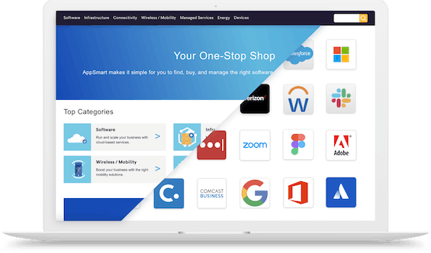
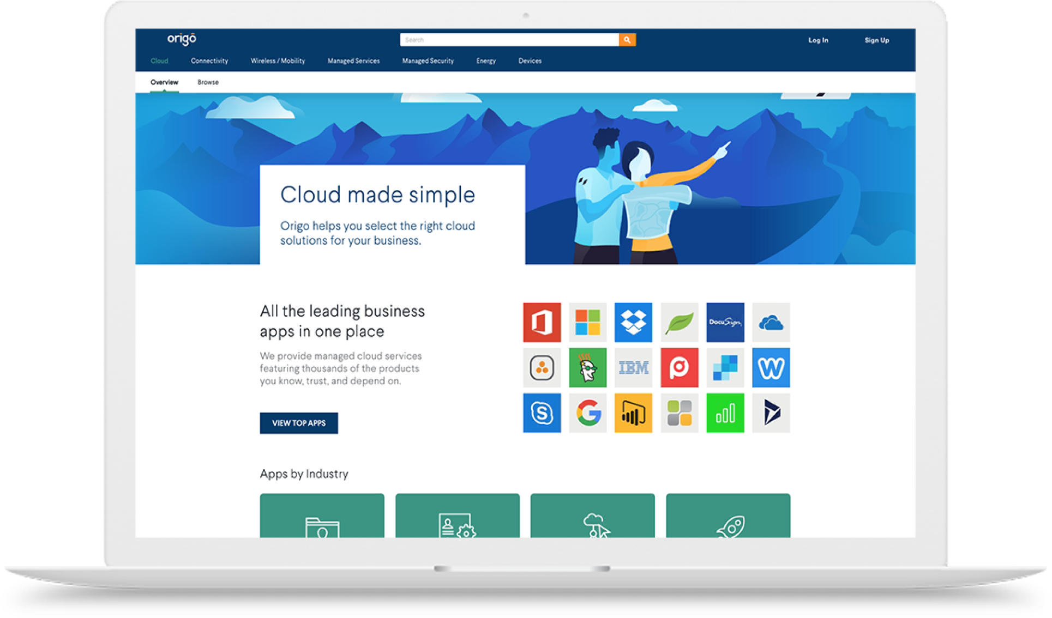
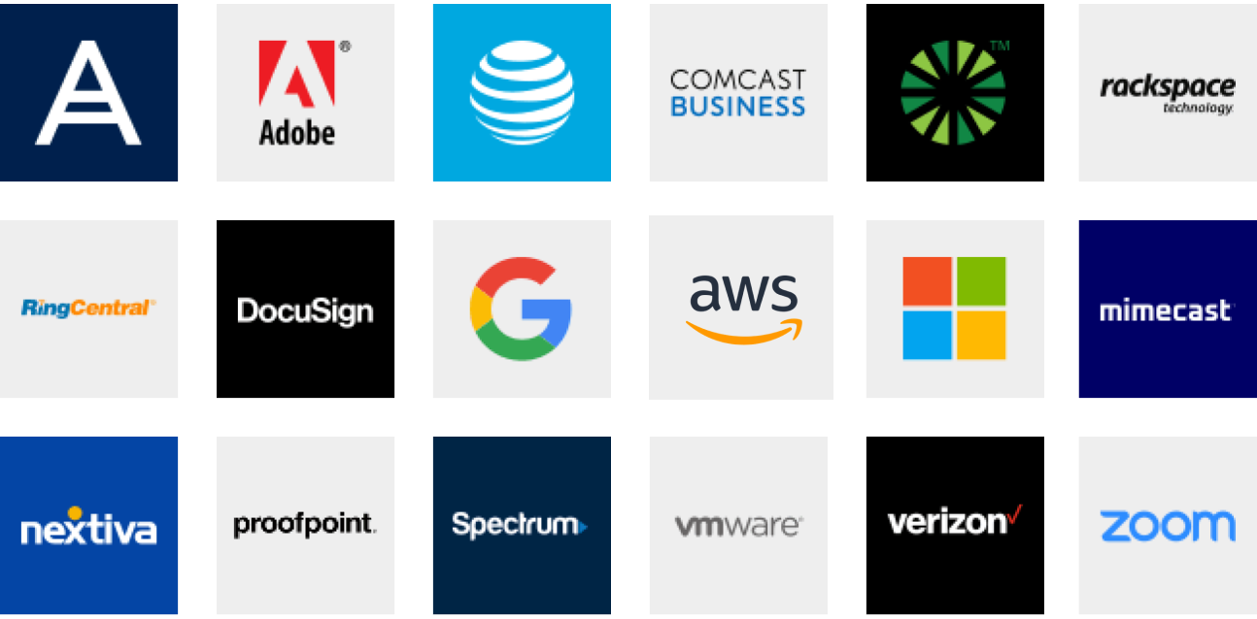
Expand into cloud with confidence
Cloud Portfolio
Enablement & Support
Confidently complement your connectivity portfolio with 100s of new cloud solutions
Leverage training courses and product experts to increase cloud competency
Notes:
WHY SELL CLOUD WITH APPDIRECT - BENEFITS FOR ADVISORS
To succeed in selling cloud you need the right tools and support. Selling cloud with AppDirect gives you automatic access to new capabilities to drive your success:
Cloud portfolio
Unlike other providers that tend to focus primarily on cloud or telecommunications, AppDirect provides a full stack portfolio. This allows you to easily complement your existing (connectivity) portfolio with cloud services
It’s easy to diversify your portfolio into cloud and differentiate yourself in the market with a leading catalog and platform for your customers
Cloud enablement and support
Access to product and industry experts to help you expand into cloud and close more deals
Learning resources - Cloud Academy with on-demand and in person training courses and access to product experts throughout the sales process to increase cloud competency at your own pace

Slide 7
Offer your customers a full technology stack
ENERGY
CONNECTIVITY & SD-WAN
EV Charging | Water & Waste Electricity | Natural Gas | Solar
Fiber | Cable | Wireless | Satellite | TEM
MANAGED SERVICES
MOBILITY & IoT
NOC | SOC | Professional Services SmartSupport | Asset Management
Wireless Services | Internet of Things (IoT) Managed Mobility | Expense Management (WEM)
SECURITY
CUSTOMER EXPERIENCE (CX)
Physical Security | Network Security Endpoint Security | Cloud Security | SASE
UCaaS | Contact Center | CPaaS | SMS Analytics | Artificial Intelligence (AI)
CLOUD INFRASTRUCTURE
SOFTWARE AS A SERVICE
Public, Private, & Hybrid Cloud Data Center & Colocation | Disaster Recovery
Microsoft | Google | ERP | CRM | Productivity | Business Applications | IT Management | BI
‹#›
Notes:
SELLING CLOUD WITH APPDIRECT - TAP INTO A MULTI-CATEGORY CATALOG THAT INCLUDES CLOUD SOLUTIONS
In addition to the extensive connectivity and wireless solutions you’re used to, you can expand your portfolio and increase revenue and wallet share with cloud-based solutions. Businesses are already buying solutions for each category on this wheel today, so they don't necessarily have to find new budget for the spend.
Cloud and SaaS are easy conversations to have, with so many businesses actively interested in or already shifting to cloud-based strategies to stay competitive and secure. This represents loads of commission potential waiting for you, don’t leave money on the table! https://financesonline.com/saas-software-statistics/

Slide 8
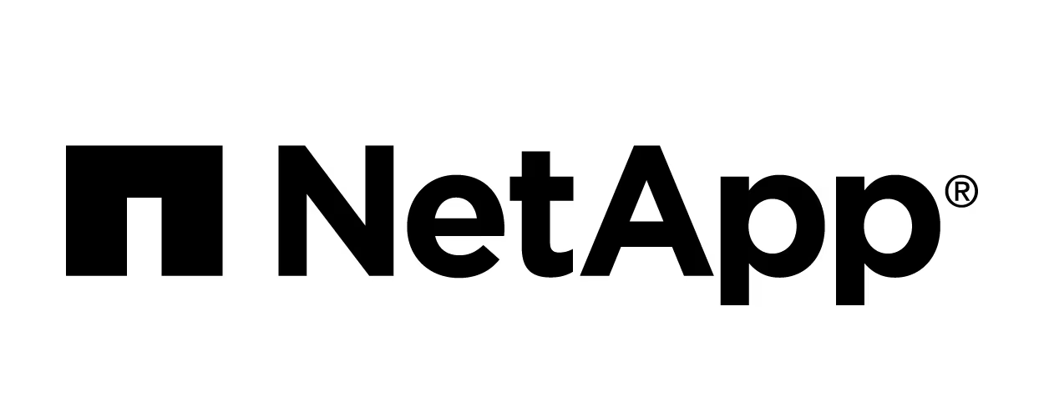
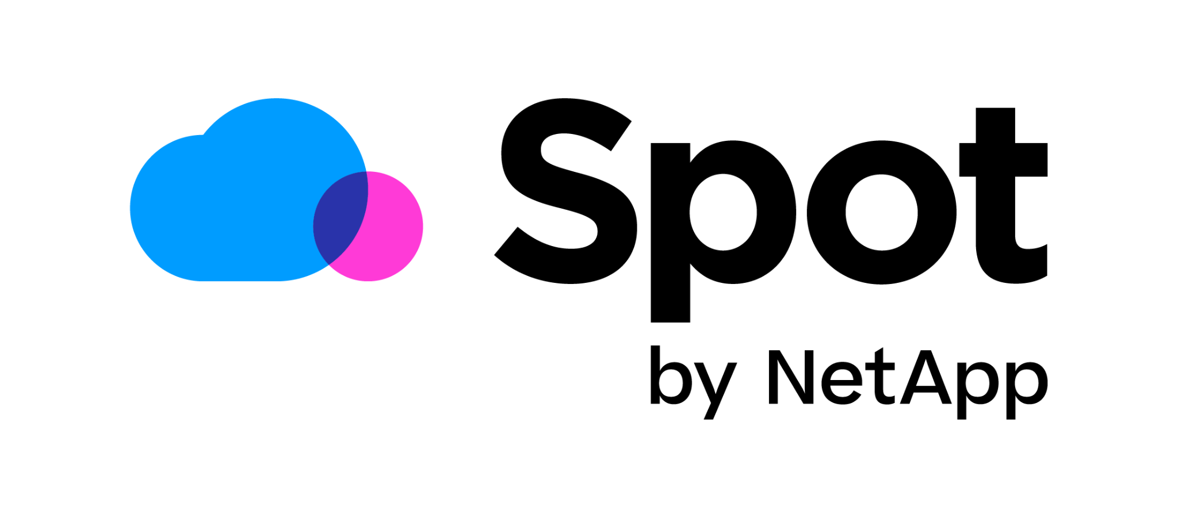
All the leading cloud apps from brands you trust
Cloud Infrastructure
Cloud Applications
Position cloud solutions that are vendor-agnostic with cloud experts to guide you.
Notes:
ADVISORS CAN TAP INTO A MULTI-CATEGORY CATALOG AND OFFER NEW POPULAR CLOUD SOLUTIONS
It’s easy to start selling the top 3 public cloud infrastructure solutions plus leading cloud apps today, and bypass the hassle of developing commercial relationships. The AppDirect catalog has all the leading cloud apps from trusted brands and providers that you can offer customers.
It’s great to know there’s a team of vendor-agnostic cloud experts who can guide you and your customer through the complexity of choosing the right cloud mix and strategy. Customers get support for their cloud strategy from the leading top tier solutions in a comprehensive catalog.
Software resale - don’t support the whole catalog, we support the top tier solutions

Slide 9
The product portfolio is one of AppDirect’s key elements – they have more offerings than what most others have. This differentiates them in the market, they’re doing something that no other master agent is doing.
Watch video for more success stories
John Schwarze Founder, Tin Can Distributors
Scaled cloud deals by 20x
Notes:
HOW ADVISORS ARE SUCCEEDING BY SELLING CLOUD WITH APPDIRECT
Advisors selling cloud with AppDirect are expanding into new revenue streams and reaping the benefits. You can too. Tin Can Distributors leaned on AppDirect’s national network of tech advisors and expansive cloud portfolio to make smarter technology decisions, and grew sales expanded his business into cloud.
Download the case study here: https://www.appdirect.com/resources/case-study-tincan
EXAMPLE - ADVISOR TAPS INTO APPDIRECT’S B2B SUBSCRIPTION COMMERCE PLATFORM TO EXPAND AND CLOSE MORE DEALS IN CLOUD Here’s how one advisor took advantage of the procurement marketplace and multicategory catalog to grow his business Tin Can Distributors Scales Deal by 20X in Partnership with AppDirect
They maximized cross-selling opportunities by leveraging a complete portfolio of technology solutions. By selling cloud with AppDirect, Schwarze could access over 600 providers and cloud experts He could spend more time focusing on cross-selling, and spend less time managing these relationships himself.
Not long ago, selling only connectivity solutions was enough to meet your client's needs. But, the industry has made a dramatic shift.
For John Schwarze, founder of Tin Can Distributors, it all started with MPLS, Internet, and voice in his portfolio, and it soon evolved to selling cloud solutions.
Today, Tin Can offers connectivity and many other solutions, such as SaaS, cybersecurity, UCaaS, CCaaS, and even professional services.
Access to the AppDirect Marketplace and a team of experts has allowed Schwarze to diversify his portfolio of solution offerings, closing more valuable deals.

Slide 10
Cloud support
Don’t do it alone. Turn to cloud product specialists and resources to confidently diversify your portfolio.
Cloud Product Specialists
Cloud Academy
Envision Sessions
AppHelp
Boost solution designs with technical expertise from sales engineering and cloud product specialists
Learn to position and sell cloud with on-demand videos and in-person training sessions
Drive your cloud business and boost your customers' productivity
Provide end-user Help Desk services, migration services, and on-boarding support
Notes:
SELLING CLOUD WITH APPDIRECT OPENS ADVISORS UP TO ENABLEMENT AND RESOURCES TO GROW YOUR BUSINESS
Selling cloud with AppDirect means you don’t have to go it alone. You're in a great position to grow your business with access to cloud specialists and guidance in finding and offering the best cloud solution fit for your customers. Tap into technical expertise from sales engineering and cloud product specialists, along with training resources to grow your cloud sales confidence at your pace. You get sales support with free Envision sessions to explore customer cloud needs and end-user help desk services to provide your customers sought-after migration services and onboarding support. You’re in a great position to differentiate as a channel partner selling cloud with AppDirect because you can offer the long term support and strategic services that businesses buying cloud favor. Source:
Analysis Mason 2023

Slide 11
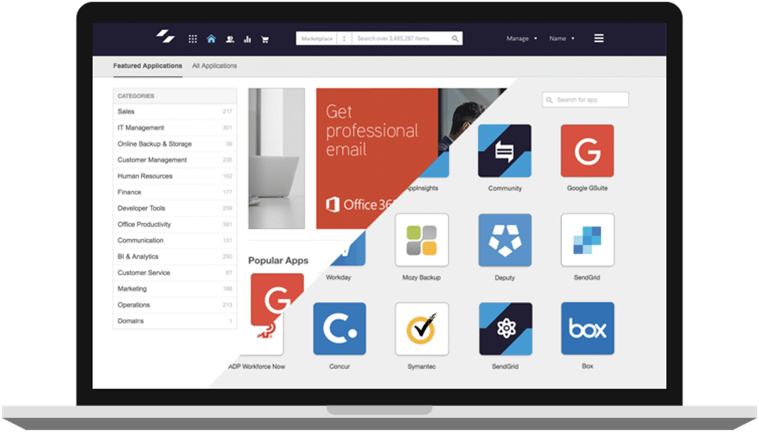
Cloud Academy
Your one-stop-shop for educational content and resources to master the art of selling cloud
Notes:
SELLING CLOUD WITH APPDIRECT GIVES INSTANT ACCESS TO EDUCATION AND RESOURCES
If you’re new to cloud, the Cloud Academy can assist you in gaining skills and confidence in positioning new cloud solutions and moving discussions forward in different cloud categories. Courses include short, engaging video-based lessons given by our industry cloud experts who share real-life examples, tips, and practical insights to nurture cloud opportunities. You’ll learn how to position and qualify software, cloud infrastructure, security, productivity, as well as what you can do when you spot an opportunity.
What the Cloud Academy offers:
Online courses: Grow your confidence and test yourself in positioning, preparing for and qualifying new revenue streams
Product experts: Learn to position and qualify software, cloud infrastructure, security and productivity from industry experts and real-life examples
Short video-based lessons: Learn at your own pace with easy-to-digest video lessons and impactful training

Slide 12
Envision Sessions
Build your cloud sales funnel with free customer sessions
Productivity
Collaboration
Communication
Infrastructure (IaaS)
Find the right product, pair it with the right practices, and source all of the assistance you need implementing and managing your technology.
Security
Notes:
SELLING CLOUD WITH APPDIRECT GIVES YOU FREE SESSIONS FOR YOUR PRESALES TOOLKIT
Envision sessions are available to assist you in selling the right cloud solutions. They are free sessions to drive conversations with you prospects and customers, and build your cloud sales funnel at the same time.
Simply book a meeting as a simple entry point for selling the most popular cloud solutions. Our team takes care of the arrangements and Opens the door to upselling and cross-selling other cloud-based solutions.
Attend pre-sales conversations with your customers and offer the implementation and management services businesses need with cloud technology. With an Envision session you have a streamlined and predictable path to guide customers in purchasing the most popular cloud solutions and simplify cloud buying. Envision sessions speed up the process of gaining trust and credibility as an advisor in cloud solutions. Envision sessions work with three easy steps:
Complete the Envision session sign-up form (see examples below)
Work with an AppDirect cloud expert to conduct a SaaS discovery assessment
After the discovery, AppDirect provides a detailed report and recommendations
Envision sign-up forms:
Productivity/Collaboration/Communication: https://www.appdirect.com/resources/envision-saas - help in optimizing your Microsoft contract
Infrastructure: https://www.appdirect.com/resources/envision-azure,
Security, Identity/Threat Protection, Devices and App Management: https://www.appdirect.com/resources/envision-security

Slide 13
AppHelp
Helping millions on their cloud journey
Calls Annually
Migrations
Customer Satisfaction
100K+
End-user Help Desk services and on-boarding support
14K+
Customer migrations to cloud productivity tools (Office 365, Google Workspace)
93%
End-customers rate us highly for on-boarding, migration, and end-user support
Notes:
SELLING CLOUD WITH APPDIRECT AND OFFER SOUGHT-AFTER PREMIUM SUPPORT
When you sell cloud with AppDirect you can offer customers white-glove support for the cloud services you sell. Businesses are choosing channel partners who offer services that span the cloud lifecycle: migration, install and setup, onboarding, and end-user support. Stand out from the competition as an end-to-end trusted advisor by offering innovative cloud support services and a premium customer experience.
AppHelp cloud support statistics:
Productivity Suite Migrations
- 1380 Migration projects completed
- 13200 Mailboxes migrated
100k+ Support interactions per year
93% Customer Satisfaction
+78 Net Promoter Score
96% First Call Resolution
More information about AppHelp https://www.appdirect.com/platform/apphelp?tab=comprehensive-service-offerings

Slide 14
Increase value and commissions
Extend cloud sales with a unique procurement platform to ease your customer’s cloud challenges
Increase value
Retain customers
Grow wallet share
Augment your cloud advisor services by offering a free digital procurement platform
Create customer stickiness with a platform to procure and manage cloud apps
With customers procuring and managing more IT spend on a platform provided by you
Notes:
INCREASE YOUR VALUE AND COMMISSIONS WITH A UNIQUE PROCUREMENT PLATFORM FOR CUSTOMERS
Increase value to customers - you can provide SaaS and IaaS apps customers are looking for, and solve a need in the market around procurement, saas & spend management
Bring inherent value to cloud apps
Increase customer retention & prevent churn
Value is compounded with more and more applications, entrenching your customers in the ecosystem and incentivizing them to purchase more apps through you as their advisor
To that end, increase share of wallet - your customers will give more share of wallet because they see so much value and want to bring in all their technology
This is not just for advisors, it benefits providers as well
Source:
Analysis Mason 2023

Slide 15
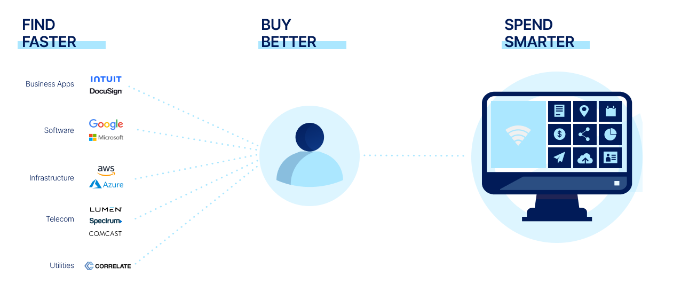
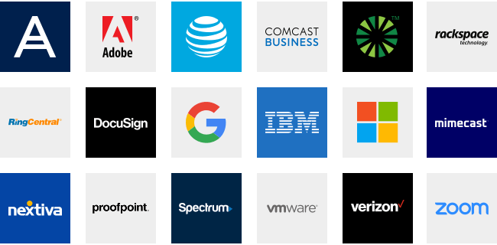
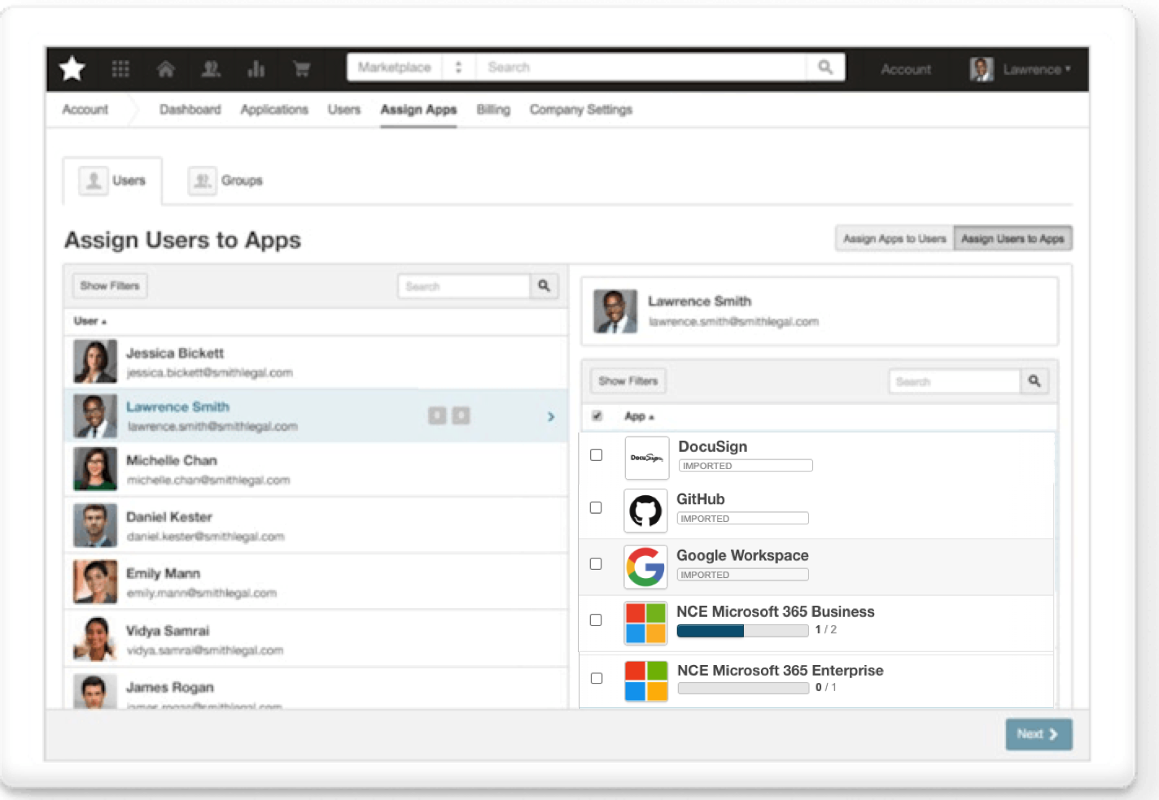
Bring more value to your customers
Notes:
BRING MORE VALUE BY SIMPLIFYING CLOUD PROCUREMENT AND MANAGEMENT FOR CUSTOMERS
Customers already turn to you because they value the expertise and solutions you bring.
Selling cloud with AppDirect lets you offer a digital procurement management platform that helps businesses streamline procurement, manage SaaS applications and spend, and manage their workforce. AppDirect Advisors make finding, buying, and managing cloud technology easier -— by offering one solution to procure and manage technology, which customers get access to for free by purchasing cloud apps through an advisor.
AppDirect Advisor simplifies finding, buying, and managing recurring cloud purchases by: 1. Procurement Marketplace – offer customers a way to save time with a single location to find and buy all the technology services to power their business 2. An easy way to consolidate spend management by managing cloud invoices, subscriptions, and renewals in one convenient location
3. Workforce identity and Data Management - provide functionality to reduce IT costs by streamlining onboarding and offboarding, centralized access, and secure authentication
Each service has just enough functionality to power a customer’s business, saving the hassle of purchasing individual solutions with extra functionality that businesses don’t need (e.g, Okta) without competing with the individual categories in any one area
And don’t have to go it alone, because there is strong support team of AppDirect cloud experts to assist in selling

Slide 16
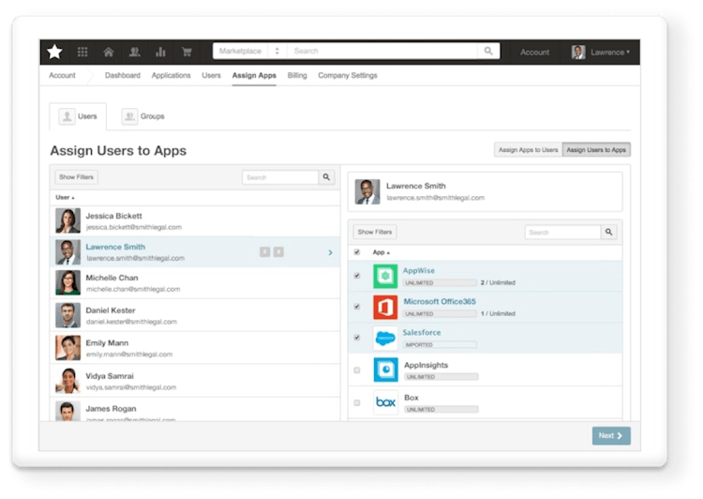
Procurement Platform
Offer customers a platform to procure cloud technology, manage spend and secure their workforce
Procurement Marketplace
Spend Management
Workforce Identity & Data Management
Save time with a single location to find and buy all the technology services that power your business
Consolidate application and subscription management and gain insights to drive business decisions
Reduce IT costs with automated onboarding, centralized access and secure authentication
Notes:
BEAT THE COMPETITION IN THE CLOUD MARKET - SOLVE A NEED YOUR CUSTOMERS HAVE WITH A PROCUREMENT PLATFORM
Sell with AppDirect and get a unique opportunity you can offer customers. When a customer purchases cloud apps through you, they have free access a platform to procure and manage applications for their company. We know procuring and managing cloud technology is really difficult, especially across various vendors with different agreements, pricing, renewal dates, and more. Businesses are trying to solve these challenges on their own, either manually through spreadsheets and costly labor, or they pay for expensive applications with more functionality than they need to tackle each challenge one by one (e.g., Productiv for e, Lumos for Spend/SaaS management, Okta for workforce identity management)
Selling cloud as an AppDirect Advisor sets you apart in a big way. Advisors not only can provide the cloud solutions businesses need, but also solve the real challenges businesses face. You can remove the friction business have buying cloud, managing their applications and SaaS spend, and the costs in managing their workforce including: onboarding, offboarding, and secure access. Customers can turn to you more and more for their cloud technology needs — creating stickiness for your business and increasing your share of wallet. When you offer a single solution to procure and manage technology, combined with the trust you’ve already established and new expertise to back you, you create a one-stop destination for your customers cloud needs.

Slide 18
Backup slides

Slide 19
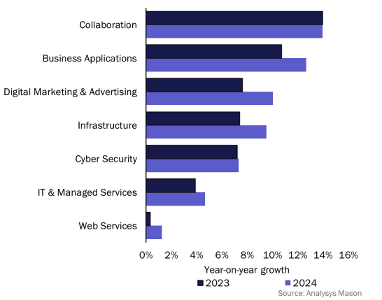
Your cloud opportunity is huge
“Anything as a Service” cloud market will grow to $344.3B by 2024
>80%
want to buy more than connectivity from you
62%
plan to optimize cloud use in 2023
Notes:
CLOUD REPRESENTS A HUGE OPPORTUNITY FOR ADVISORS
Companies will continue to spend big on cloud going into 2024 and beyond. Businesses are shifting IT-related spending to channels that can support digital transformation & cloud strategies. They are looking for support to help implement, manage & optimize new technology. At the same time, traditional markets in connectivity are seeing compression with falling prices and more competition. (Prices of internet fell by 2.7% over the past year)
If you sell connectivity today, you are in the best position to expand into this growing opportunity. Businesses need cloud technologies to optimise operations, support hybrid work, and stay competitive and secure. Optimizing existing use of cloud (cost savings) is the top initiative (62%) and progressing on a cloud-first strategy jumped to 55% this year from 40% in 2022.
The growth in cloud represents a huge opportunity for advisors. Advisors can build on the trust already established by offering unbiased advice in mission-critical areas like business application and collaboration tools, infrastructure, and cyber security. If you’re not offering cloud services, you’re leaving money on the table.
SOURCES:
Gartner, Inc. Analysis Mason 2023
Flexara State of Cloud Report 2023 https://financesonline.com/saas-software-statistics/
ANALYSYS MASON, FORECASTER DATA 2021 SMB cloud spending is projected to grow at a CAGR of ~10% from 2021 to 2026 growing from $194B to $342B
Accenture

Slide 20
SMBs are looking for your
guidance when purchasing cloud solutions
Spending too much time with vendors
Pandemic SaaS purchases weren’t a good fit
Manual and time-consuming to procure and manage
70%
50%
Say they spend too much time with vendors
Find pandemic purchases weren’t a good fit
Notes:
BUYING CLOUD IS INCREASINGLY COMPLEX → SMBs NEED GUIDANCE
Buying cloud technology is difficult and time-consuming, with SaaS purchases not meeting expectations. This represents huge opportunities for advisors with an overwhelming number of cloud options and complex buying process involving multiple vendor contracts, negotiations, options, and pricing. The challenges in buying the right cloud technology is driving a need for trust and unbiased advice with only 38% fully trusting vendor content. Businesses need independent and 3rd party research that is untainted by vendor bias. For those who get consultative support through a technology advisor, a large majority (>96%) say they had ROI on their SaaS spend.
Buying cloud is difficult
> 70% spent too much time with vendors AppDirect Small Business Software Trends Report, 2021
> 50% pandemic SaaS purchases weren’t a good fit AppDirect Small Business Software Trends Report, 2021
Procurement is manual, less trust in direct channels with only 38% fully trusting vendor’s content Salesforce
Sources:
AppDirect Small Business Software Trends Report, 2021
https://www.salesforce.com/content/dam/web/en_us/www/documents/research/salesforce-state-of-the-connected-customer-4th-ed.pdf
Flexara State of the Cloud Report 2023

Slide 21
Scaled cloud deals by 20x
Turned initial $1.7K UCaaS deal into cloud sale with $20K recurring revenue
John Schwarze Founder, Tin Can Distributors
John Schwarze Founder, Tin Can Distributors
Watch video for more success stories
Notes:
HOW ADVISORS ARE SUCCEEDING BY SELLING CLOUD WITH APPDIRECT
Advisors selling cloud with AppDirect are expanding into new revenue streams and reaping the benefits. You can too. Tin Can Distributors leaned on AppDirect’s national network of tech advisors and expansive cloud portfolio to make smarter technology decisions, and grew sales expanded his business into cloud.
Download the case study here: https://www.appdirect.com/resources/case-study-tincan
EXAMPLE - ADVISOR TAPS INTO APPDIRECT’S B2B SUBSCRIPTION COMMERCE PLATFORM TO EXPAND AND CLOSE MORE DEALS IN CLOUD Here’s how one advisor took advantage of the procurement marketplace and multicategory catalog to grow his business Tin Can Distributors Scales Deal by 20X in Partnership with AppDirect
They maximized cross-selling opportunities by leveraging a complete portfolio of technology solutions. By selling cloud with AppDirect, Schwarze could access over 600 providers and cloud experts He could spend more time focusing on cross-selling, and spend less time managing these relationships himself.
Not long ago, selling only connectivity solutions was enough to meet your client's needs. But, the industry has made a dramatic shift.
For John Schwarze, founder of Tin Can Distributors, it all started with MPLS, Internet, and voice in his portfolio, and it soon evolved to selling cloud solutions.
Today, Tin Can offers connectivity and many other solutions, such as SaaS, cybersecurity, UCaaS, CCaaS, and even professional services.
Access to the AppDirect Marketplace and a team of experts has allowed Schwarze to diversify his portfolio of solution offerings, closing more valuable deals.

Slide 22
AppDirect Cloud Services Portfolio
COLLABORATION & PRODUCTIVITY
BUSINESS APPLICATIONS
IT MANAGEMENT

Slide 23
Access to the Leading Cloud Providers in a Single Platform
SECURITY
INFRASTRUCTURE

