Slide 1
Connectivity & SD-WAN/SASE
Make communication the backbone of your business
March 2025

Slide 2
What’s happening in the market?

Slide 3
Connectivity is the foundation of a remote workforce
What’s happening in the market
Businesses use the cloud to store and manage their information, applications, and services.
To leverage the benefits of cloud, companies need strong connectivity services to maintain productivity and minimize disruptions.
90-95%
of apps will be cloud-native in 2025
Notes:
In today's digital landscape, many companies are realizing the benefits of migrating their operations and data to the cloud.
Businesses use the cloud to store and manage their information, applications, and services.
This requires strong connectivity services to maintain productivity and minimize disruptions
Connectivity services are needed for daily tasks like retrieving files, running applications, or collaborating with remote teams

Slide 4
Main challenges companies face buying and managing connectivity services
Companies lack the expertise or human resources to discover, procure, implement, maintain, and troubleshoot connectivity solutions.
TECHNICAL
EXPERTISE
It’s time-consuming and complex to understand all of the solutions that are offered by connectivity providers, as well as which are the right fit for their business.
MARKET KNOWLEDGE
Tracking connectivity expenditures is complex and companies need help understanding how cost is incurred.
COMPLEX BILLING
& COST
Notes:
AppDirect is partnered with leading cybersecurity software and service providers

Slide 5
AppDirect can help
Expertise and professional and managed services to help companies implement connectivity solutions.
TECHNICAL
EXPERTISE
Engineers and experts evaluate each business, from their industry, to their size, and considering their unique needs— bringing an array of implementation specialists and consultants, as required.
BUSINESS EVALUATION
Tools that visualize connectivity spend and usage across services to inform business decisions and identify cost savings. Vendor relationships under one Master Service agreement (MSA) and within a single platform for complete visibility and control.
COST OPTIMIZATION
Notes:
AppDirect is partnered with leading cybersecurity software and service providers

Slide 6
AppDirect can help implement a holistic approach to connectivity services

Slide 7
Add Connectivity & SD-WAN/SASE with our catalog
ENERGY
CONNECTIVITY & SD-WAN/SASE
EV Charging | Water & Waste Electricity | Natural Gas | Solar
Fiber | Cable | Wireless | Satellite | TEM
MANAGED SERVICES
MOBILITY & IoT
NOC | SOC | Professional Services SmartSupport | Asset Management
Wireless Services | Internet of Things (IoT) Managed Mobility | Expense Management (WEM)
SECURITY
CUSTOMER EXPERIENCE (CX)
Physical Security | Network Security Endpoint Security | Cloud Security | SASE
UCaaS | Contact Center | CPaaS | SMS Analytics | Artificial Intelligence (AI)
CLOUD INFRASTRUCTURE
SOFTWARE AS A SERVICE
Public, Private, & Hybrid Cloud Data Center & Colocation | Disaster Recovery
Microsoft | Google | ERP | CRM | Productivity | Business Applications | IT Management | BI
‹#›

Slide 8
The leading providers

Slide 9
All the solutions you need to keep your business connected
Connectivity Sub-Categories
Network Connectivity | Network Elements | Network Applications
Secure Access Service Edge (SASE) Software-Defined Wide Area Network (SD-WAN) | Fiber Cable Wireless & Mobility Telecom Expense Management (TEM) | UCaaS CCaaS
Supporting Services
Mobile Lifecycle Management (MLM)
Network Lifecycle Management (NLM)
Network Monitoring and Managed Services
Cloud Infrastructure & Cloud Management
Technical Support
Hardware and Logistics
Professional Services (truck rolls, field services)

Slide 10
Value-Added Services
Project Managers that assist in onboarding, organizing and streamlining strategic initiatives, technology upgrades, and lifecycle management.
PROJECT MANAGEMENT
Complete technical support for your operating systems, security, and device management. Expert help for all your technology - from computers and phones to peripherals and smart devices.
PREMIUM
TECHNICAL SUPPORT
End-to-end network management including 24/7 monitoring, incident response, and on-site support for all your network devices. Complete lifecycle services from procurement and staging to maintenance of your entire network infrastructure.
NETWORK MANAGEMENT
(MONITORING & FIELD SERVICES)
Deliver and manage end-user hardware (laptops, phones, etc); including inventory management, staging, configuration, testing, assembly, retrieval, secure disposal, and more.
HARDWARE & LOGISTICS

Slide 11
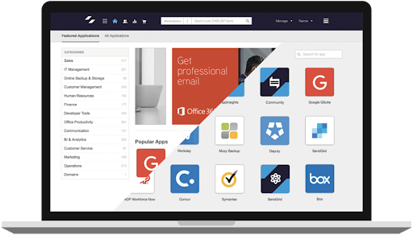
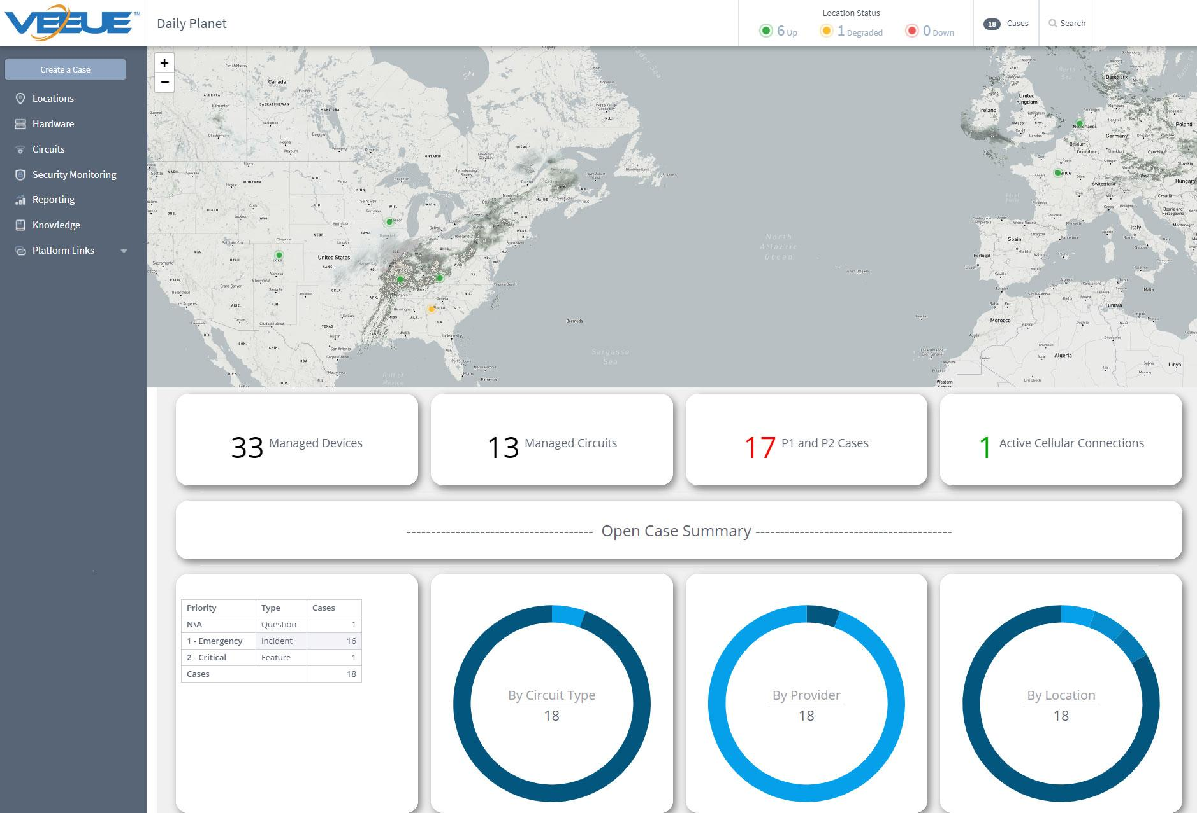
NOC as a Service
Maximize uptime with a best-in-class networking management and monitoring platform
Team of Analysts
We proactively manage & ensure the performance of your networked environment
Integrated Toolset
All of the capabilities of ServiceNow and LogicMonitor in a single integrated platform
Centralized View of Network Health
A single-pane of glass to monitor everything with an IP Address

Slide 12
Premium Technical Support
100K+ calls annually
End-user Help Desk services from troubleshooting, to installs, to malware removal
93% customer satisfaction
End-customers rate us highly for on-boarding, migration, and level 1 help desk support
96% first call resolution
Most end-customer issues are resolved on the first call

Slide 13
Manage your spend end-to-end
Find, buy, and manage network infrastructure and mobility device vendors, assets, and recurring expenses all through vCom.
PLANNING AND PROCUREMENT | EXPENSE MANAGEMENT | OPERATIONS MANAGEMENT
Solution design | Invoice management | Order management
Sourcing | Accounting | Asset management
Contract management | Analytics | Service and support
Planning and procurement | Expense management | Operations management
Solution design | Invoice management | Order management
Sourcing | Accounting | Asset management
Contract management | Analytics | Service and support

