Slide 1
Selling Customer Experience with AppDirect
July 2024

Slide 2
Why sell CX services?
Advisor-facing slides

Slide 3



What’s happening in the market
Adoption of distributed and remote workforce approaches is accelerating the demand for cloud communications
Cloud communications market is expected to grow to USD ~4B by 2028
211 average number of apps for >2000 employee organizations
85% of companies supporting 'Bring Your Own Device' (BYOD) policies
Notes:
The current business landscape demands solutions for an increasingly remote workforce to stay productive and maintain an exceptional customer experience (CX). Instant communication trends favor collaboration, video conferencing, and messaging, displacing traditional PBX systems. Cloud-based communication platforms are growing at a high rate, reflecting the increased demand for flexible and scalable CX solutions. CX solutions address this market shift, as they offer increased reliability, mobility, operational efficiency, productivity, and cost reduction. With ongoing innovations like advanced analytics and Artificial Intelligence (AI), the cloud communications market is expected to grow to USD 33.88 billion by 2028 (ReportLinker, Grand View Research, "Cloud Communication Platform Market Size & Share Analysis - Growth Trends & Forecasts (2023 - 2028)", 2023).
As businesses build their tech stack, complexity creeps in and introduces friction. Businesses seek end-to-end, single-provider solutions and benefit from working with advisors who can recommend cutting-edge CX products and services that streamline their existing communication tech stack and simplify their cloud billing process. Your role as a Trusted Advisor is crucial to helping customers navigate complex technological landscapes and reducing operational expenses and employee attrition.
Factors driving remote work:
Increasing adoption of smart mobile devices.
Advancements in collaboration tools.
Complexity creeps in and introduces friction: 211 average number of apps for >2000 employee organizations (Okta: Businesses at Work 2023 report).
BYOD Policy Implementation:
Organizations implementing 'Bring Your Own Device' (BYOD) policy aim to increase productivity, enhance internal communication, and reduce costs.
Around 85% of companies already permit BYOD environments for employees and partners (Bitglass data).
Source: Fortune Business Insights, 2023
Advisor-impacting stats
The premise-to-cloud market is only at 15-20% penetration, leaving a significant untapped market for advisors (How to Take Advantage of the Hot CCaaS Market, 2022).
The Generative AI market is projected to reach a staggering $1 trillion by 2031, with an impressive compound annual growth rate (CAGR) of 48.05% (Our Culture Mag, Generative AI to Become a $1 Trillion Market, 2024).
The Cloud Communication Platform Market size is expected to grow from USD 14.54 billion in 2023 to USD 33.88 billion by 2028, at a CAGR of 18.44% during the forecast period (2023-2028), reflecting the increased demand for flexible and scalable CX solutions (ReportLinker, Grand View Research, "Cloud Communication Platform Market Size & Share Analysis - Growth Trends & Forecasts (2023 - 2028)", 2023).

Slide 4
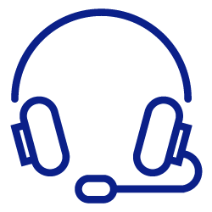

Maximize earnings
Consider moving existing Microsoft customers to Teams Phone
Less than 5% of 300 million users have enabled Microsoft Teams Phone
Revenue opportunity of almost $1.5 billion in 2028
Migration to Microsoft Teams Phone can reduce total cost of ownership by up to 45%
Notes:
UCaaS market is maturing, creating an opportunity to transition to Microsoft Teams Phone and position it as a feature to be enabled on an existing platform.
Microsoft Teams has approximately 300 million monthly active users. Less than 5% have enabled Microsoft Teams Phone, indicating a significant untapped market.
Less friction for the customer, as the organization already uses Teams.
Offers a less disruptive sale and potential cost savings.
Research from Microsoft indicates migration to Microsoft Teams Phone can reduce total cost of ownership by up to 45%.
Typically delivers a return on investment measured in months, not years (Sippio, 2023).
Frost & Sullivan has forecasted a revenue opportunity of almost $1.5 billion in 2028 solely for Microsoft Teams Direct Routing and Operator Connect solutions offered in North America. That forecast is based on a strong belief that a significant portion of SIP trunking services will be leveraged to support cloud PBX platforms by 2028.
Source: Fortune Business Insights, 2023
AppDirect offers Microsoft-specific CX products further streamlining your customer’s CX—e.g. RingCentral and Nextiva can be integrated with Microsoft Teams. UCaaS players like RingCentral & Nextiva can integrate with MS Teams (Vonage, Zoom, and Dialpad as well). AppDirect also offers a number of Direct Routing & Operator Connect providers such as BCM One (PureIP), Call Tower, CBTS, Momentum, NuWave, SCB Global, Sinch, NTT, & Coeo Solutions. Although Teams can offer PBX functionality, the voice piece needs to be added by a provider. AppDirect has all the leading providers for voice alongside Teams PBX functionality.

Slide 5



Increase your value and commissions
Sell complementary and additional CX services in a unified way to help customers adapt to an increasing remote workforce.
As your customers explore new solutions and make additional purchases, you’ll benefit from a larger share of their spending.
INCREASE WALLET SHARE
GAIN RECURRING REVENUE STREAMS
Offer customers solutions from a diverse portfolio to stay ahead of their evolving business needs.
Example: complement traditional telecommunications services with reliable voice connectivity to keep earning more revenue from your customers.
Solidify your position as a trusted partner and increase customer loyalty by providing customers with a one-stop shop for their diverse technology needs, from connectivity to cloud.
INCREASE VALUE TO YOUR CUSTOMERS

Slide 6
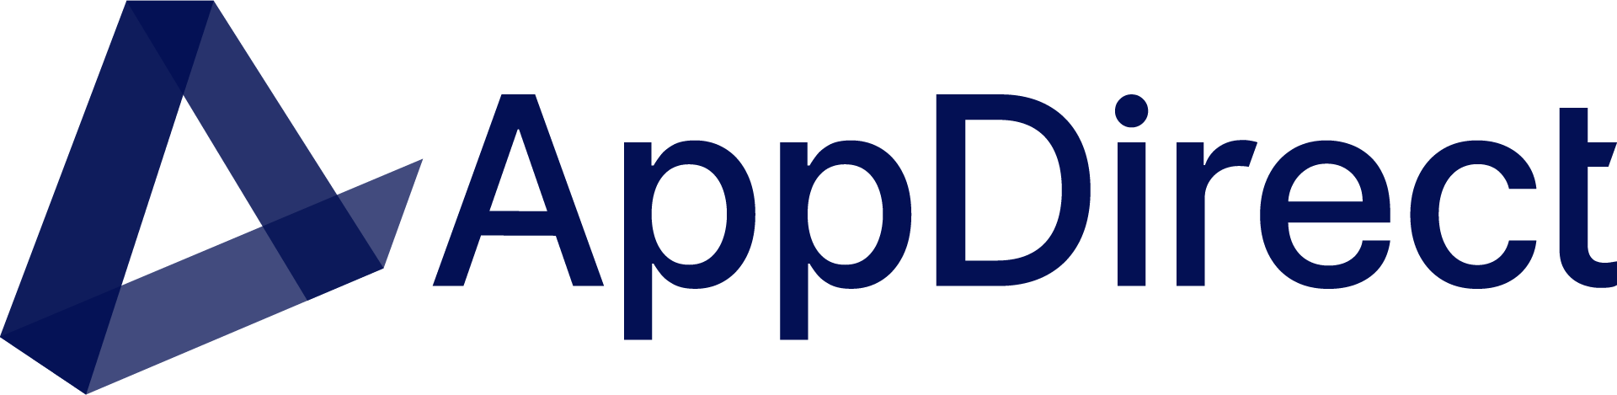




Extend your team with our specialists
Solution Engineers
Solution Architects
Boost solution designs with technical expertise in customer discovery and qualification.
Confidently present solutions scoped, designed, and vetted by CX experts.
Notes:
Procuring technology is increasingly complex—lean on AppDirect as an extension of your sales team.
We provide you with the digital back office and tools you’re used to, and a 250+ bench of back office specialists, engineers, and responsive support teams.
Leverage a team of solution engineers and solution architects to identify business problems and offer expert advice to your customers on the solutions that best fit their business model.
From engaging the providers to deal registration, demonstration, quoting, and post-sales support, AppDirect is there every step of the way.

Slide 7
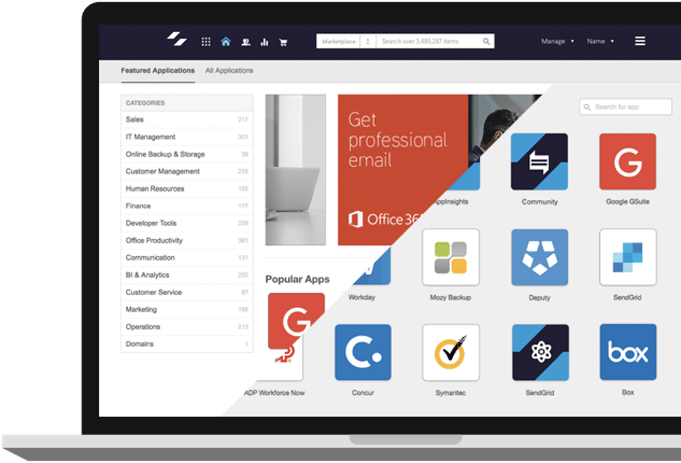
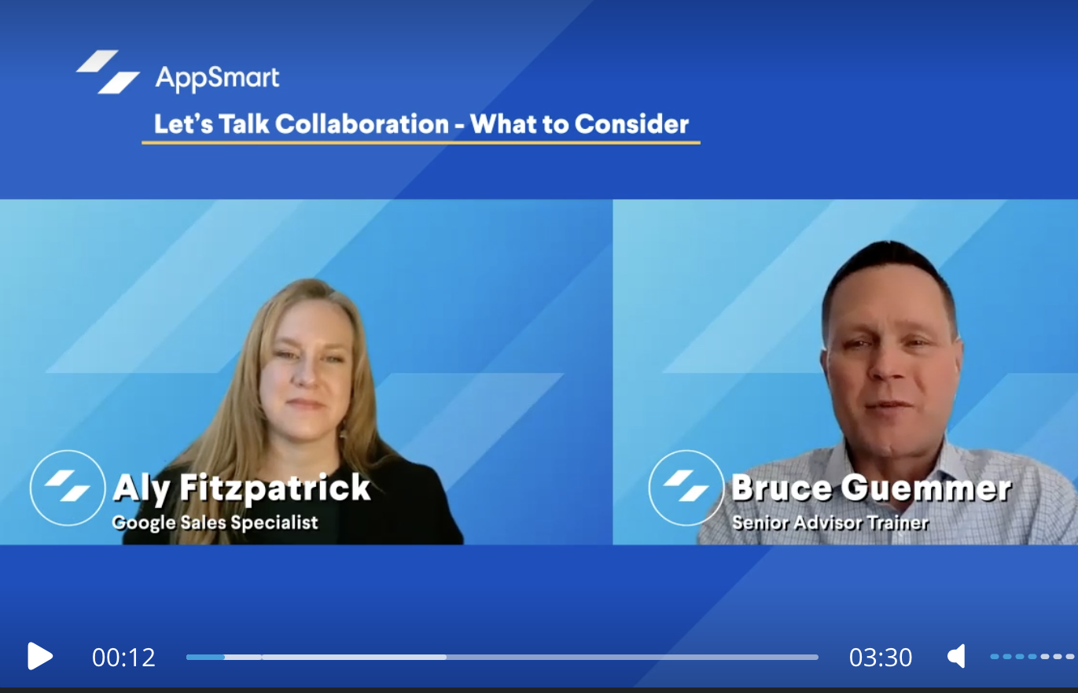




Resources to help you sell
CX
Learning Plans
Level up your customer experience advisory skills and learn to position and sell UCaaS and CX with comprehensive training tools and events
Live workshops
CX learning plans
Customer Marketing Toolkit
Instructor-led sessions with practical sales activities and scenarios. Learn alongside like-minded advisors and technology providers.
In-depth insights into the evolving U- and CCaas landscape with certificates to showcase your expertise
Co-brandable datasheets, guides, pitch decks, email templates, and more.
Notes:
Live Workshops
The Channel Enablement and Education team is available for on-site meetings with your sales staff and customer calls.
Emerging Tech Sales workshops across the U.S. to learn to position new solutions and grow revenue
Instructor-led sessions that include practical sales application activities and scenarios.
Access relationships and community:
Opportunities to connect with providers
Meeting engineering team members
Learn how other companies do business and best practices
On-Demand Digital Learning
Academy is your one-stop-shop for educational content and resources.
Sales education you can follow at your own pace with certificate programs, short videos, expert interviews, reference materials, and impactful training that enable you to build new skills and scale or optimize your business.
Master cross-category sales for sales growth opportunities – with business coaching and learn how to confidently sell cloud solutions
Learn how to prepare, position, and qualify new revenue streams (Initial focus on Microsoft and Google)
Watch interviews with industry and subject matter experts on how to sell and position productivity, security, and more so you can close deals outside your current expertise.
Learn about industry changes, technology advancements, and refreshers on the basics
Product Education – speed up the time it takes to learn a new platform and make the most of AppDirect products.
Get familiar with tools that simplify your business processes so that you can increase revenue and growth through the optimization of AppDirect products and services.
Learn how to successfully sell connectivity and cloud on the AppDirect platform.
Customer Marketing Toolkits
Available to assist you with the development of:
White-labeled collateral pieces (customer-facing)
Data sheets - Download new content to share directly with your customers.
Co-brandable data sheets - Add your logo and company details so you can share them with customers.
Emails - Download templates to help sell cloud solutions to your customers

Slide 8
AppDirect can help

Slide 9
Why CX matters
Customer Experience expectations are at an all-time high
Customer expectations
Employee expectations
Impact
Why we care
60%
80%
180%
140%
of consumers who will switch vendors after just one or two bad experiences
of employees will leave a company for a competitor with better CX technology
out-performance on revenue of companies excelling in CX compared to peers
increase in buyer spending following a positive experience
Notes:
Customer Experience expectations are at an all-time high and there is higher customer churn and the continued rise of customer expectations for “premium” customer service. Customers now expect to be able to reach businesses at any time of day, on a variety of channels, and they also expect support to be fast and accurate. They do not want to have to start over or repeat themselves if they are transferred between agents or from a chatbot to a voice call. A recent CCW (Customer Contact Week) study showed that 60% of customers would take their business to your competitors after just one or two bad experiences. Another challenge is shifting agent expectations. Now it’s not necessarily that agent quality has gotten worse over time, but customer support agents - whether they’re at home or in a contact center - are being asked to handle more calls, manage more channels, and sometimes take on sales responsibilities - and do it all with a bunch of tools and software that still don’t work well together. In a recent report from Metrigy, 34% of businesses said they’d experienced longer call durations over the past 24 months. Of those, 56% named “more complex issues” as the cause. In summary, it’s harder to be a successful agent these days.
Buyer-impacting stats
Customer Expectations:
60% of consumers will switch brands after just one or two bad experiences (CCW Digital Survey market study, June 2022).
81% of consumers say having a positive experience with a brand makes them more likely to recommend it to a friend or family member. (Genesys, "The State of Customer Experience 2021")
71% of consumers expect companies to personalize their interactions, 76 percent get frustrated when this doesn’t happen. (McKinsey, "What is Personalization?", 2023)
Consumers are willing to pay a 16% price premium in return for a superior customer experience (CX Index, 20 Statistics to Understand the Rise and Value of CX,
72% of customers say they expect the businesses they buy from to recognize them as individuals and know their interests. (McKinsey, "The value of getting personalization right—or wrong—is multiplying", 2021)
Customers are likely to spend 140% more after a positive experience rather than a negative one (Zippia, Contact Center Solutions, 2022).
Employee Expectations:
80% of employees say they would leave a company for a competitor with better technology. (Salesforce, State of the Connected Customer - Sixth Edition, 2023)
80% of employees worldwide believe collaboration and productivity tools improve employee engagement. However, only 26% of employees fully agree they have the tools to streamline work processes (Monday, Global Productivity Survey, 2023).
67% of employees say outdated technology creates stress and frustration. (Cisco, "Global Workforce Trends Report 2023")
Impact of Meeting Expectations:
Of the companies that focus on CX, there’s an 80% increase in revenue (Zippia, 25 MUST-KNOW CUSTOMER EXPERIENCE STATISTICS [2023]: THE BENEFITS OF A POSITIVE CUSTOMER EXPERIENCE, 2023)
McKinsey research reveals that improving the customer experience has increased sales revenues by 2 to 7% and profitability by 1 to 2%. In addition to this, the overall shareholder return has increased by 7 to 10 percent. (McKinsey, Prediction: The future of Customer Experience, 2022)
Engaged employees are 21% more productive and have a 59% lower chance of leaving their jobs. (Gallup, "State of the American Workplace Report 2023")

Slide 10




Challenges companies like yours face
Companies need to automate and upgrade existing infrastructure and/or migrate workloads to the cloud to increase customer satisfaction and employee productivity.
OUTDATED
EQUIPMENT
Companies need to unify their multi-cloud environments and BYOD culture by integrating cloud communication & collaboration platforms.
DISJOINTED
SYSTEMS
Distributed employees need a common communication experience, ensuring seamless connectivity regardless of user location.
MULTIPLE
LOCATIONS
In an effort to reduce OPEX, companies can outsource expertise to make CX purchasing decisions and maintain their infrastructure.
LACK OF SKILLS
& RESOURCES
Notes:
In any organization, ensuring exceptional customer experience (CX) is a collective responsibility shared by every employee. Companies that excel in customer experience outperform their peers by up to 80% in revenue growth (Temkin Group, "CX Benchmarking Report 2023"). In addition, 72% of employees believe having the right tools would make them more productive (Okta, "Employee Experience Index 2023") and engaged employees have a 59% lower chance of leaving their jobs (Gallup, "State of the American Workplace Report 2023"). CX has become indispensable for businesses in providing not only powerful communication solutions that contribute to increased customer satisfaction and spend, but in also reducing employee attrition. Once adopted, they seamlessly integrate into customers’ operations, eliminating the hassles of traditional update cycles and equipment struggles. It’s important to understand the complexities customers face in making CX the cornerstone of their IT strategy. Migrating workloads to the cloud, ensuring security, and deciphering intricate bills from cloud providers can be challenging.
Buyer pain points
Dealing with outdated, end-of-life equipment that results in low customer satisfaction and decreased employee productivity and motivation.
Facing the need for renewal of maintenance contracts.
Dealing with PBX from manufacturers undergoing changes (bankruptcy, cloud model).
Managing disjointed communication across multiple locations or a mobile workforce and lack of easy-to-use communication/collaboration tools and a unified conferencing solution.
Challenges in managing call centers and meeting strict regulatory requirements.
Small and medium businesses are more likely to lack the necessary skills internally to make CX purchasing decisions.
For larger enterprises that already have these skill sets, they may look to outsource the expertise for new projects, capital expenditures, or as part of a general effort to reduce infrastructure OPEX, upgrade or outsource the maintenance of their infrastructure.
Buyers have challenges in migrating their workloads to the cloud, maintaining them once they’re there..

Slide 11
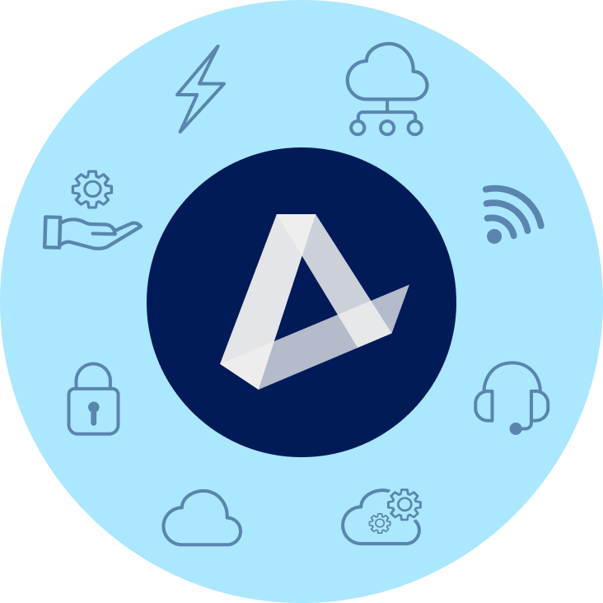
Add CX solutions to your portfolio with our catalog
ENERGY
CONNECTIVITY & SD-WAN
EV Charging | Water & Waste
Electricity | Natural Gas | Solar
Fiber | Cable | Wireless | Satellite | TEM
MANAGED SERVICES
MOBILITY & IoT
NOC | SOC | Professional Services
SmartSupport | Asset Management
Wireless Services | Internet of Things (IoT)
Managed Mobility | Expense Management (WEM)
SECURITY
CUSTOMER EXPERIENCE (CX)
Physical Security | Network Security
Endpoint Security | Cloud Security | SASE
UCaaS | Contact Center | CPaaS | SMS Analytics | Artificial Intelligence (AI)
CLOUD INFRASTRUCTURE
SOFTWARE AS A SERVICE
Public, Private, & Hybrid Cloud
Data Center & Colocation | Disaster Recovery
Microsoft | Google | ERP | CRM | Productivity | Business Applications | IT Management | BI
‹#›
Notes:
Migrating workloads to the cloud, ensuring security, and deciphering intricate bills from cloud providers can be challenging. What sets AppDirect apart is our commitment to providing customers with an end-to-end multi-cloud strategy and single-provider solution through our extensive catalog of leading CX products, procurement platform, and deep bench of specialists and engineering support that simplify solution design, implementation, maintenance, and billing.
AppDirect's extensive CX portfolio of products and add-on services (that includes hyperscalers like Microsoft), procurement platform, and team of experts can not only help you recommend and implement a multi-cloud strategy for customers, but also support you throughout their journey. What’s more is that as you scale, we offer unique value-added services that streamline key aspects of your business operations and customer relationships such as network monitoring & managed services, help desk support, sales desk as a service, and account managements. AppDirect's procurement platform also makes it easy to manage customer accounts, billing, and support—customers can independently purchase additional services, ensuring ongoing commissions for you, even when you’re not actively involved. For buyers, AppDirect’s platform (procurement marketplace, spend & SaaS management capabilities, workforce & identity management) removes the complexity associated with technology procurement and automates cloud service and business management, ultimately reducing overhead.

Slide 12
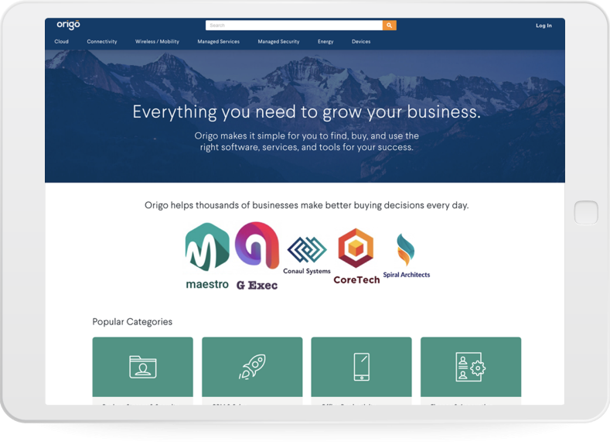
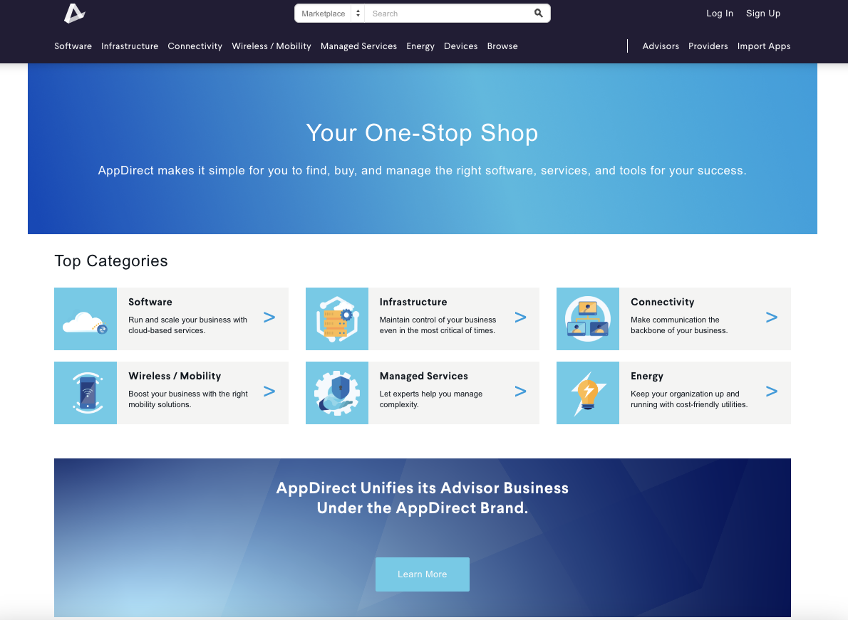

Simplify the experience of finding & buying CX solutions
CX Catalog
Expertise
All the CX solutions needed to enhance business communications, from one place
Leverage our product experts and trainings to increase your CX competency
Notes:
CX Catalog
Sell complementary and additional CX services in a unified way to help your customers adapt to an increasing remote workforce and expand your portfolio of CX products and services.
AppDirect takes a vendor-agnostic approach—have access to all the provider category leaders through an industry-leading portfolio to find and provide the right solution to solve customers’ business needs and provide a full technology stack.
Leverage AppDirect’s partnerships with hyperscalers (Google, AWS, Microsoft) and top CX providers, giving you a wide range of solutions to offer your customers.
AppDirect offers Microsoft-specific CX products further streamlining your customer’s CX—e.g. RingCentral and Nextiva can be integrated with Microsoft Teams. UCaaS players like RingCentral & Nextiva can integrate with MS Teams (Vonage, Zoom, and Dialpad as well). AppDirect also offers a number of Direct Routing & Operator Connect providers such as BCM One (PureIP), Call Tower, CBTS, Momentum, NuWave, SCB Global, Sinch, NTT, & Coeo Solutions.
Expertise
Access training and support to help you understand the products you’re selling and succeed in the market.
You don’t need to be an expert in CX to sell—you can use our team of product experts, or you can directly enable your own team through the various learning resources we provide in our Academy on-demand and live workshops, as well as in our Customer Marketing Toolkits
Access community and relationships with other advisors to stay on top of market trends and new technologies and remain competitive.

Slide 13
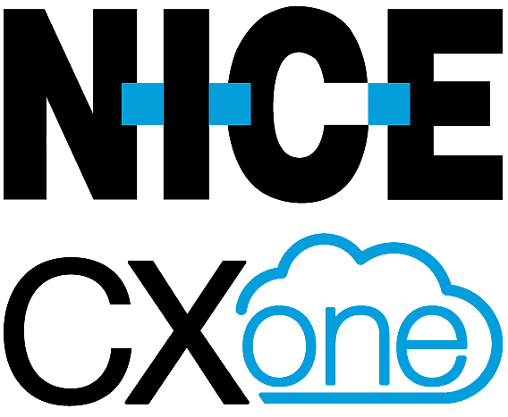
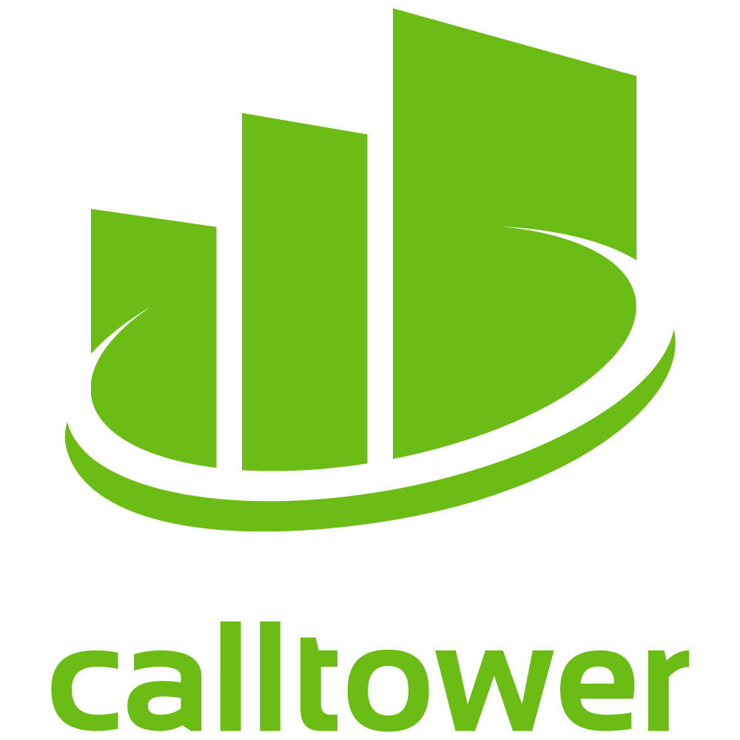
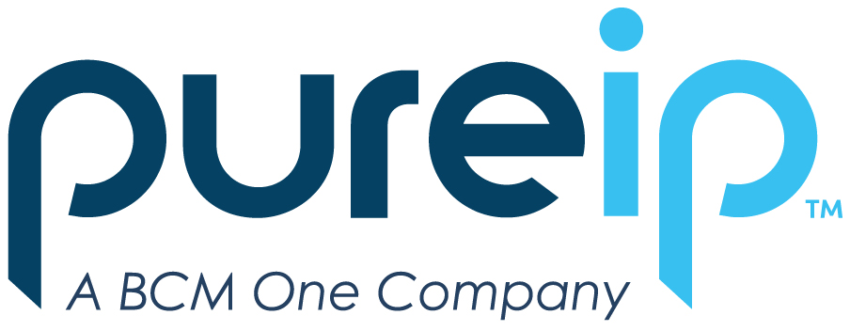

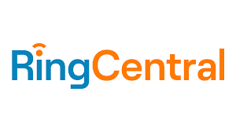






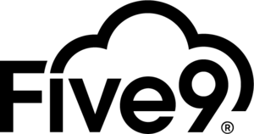
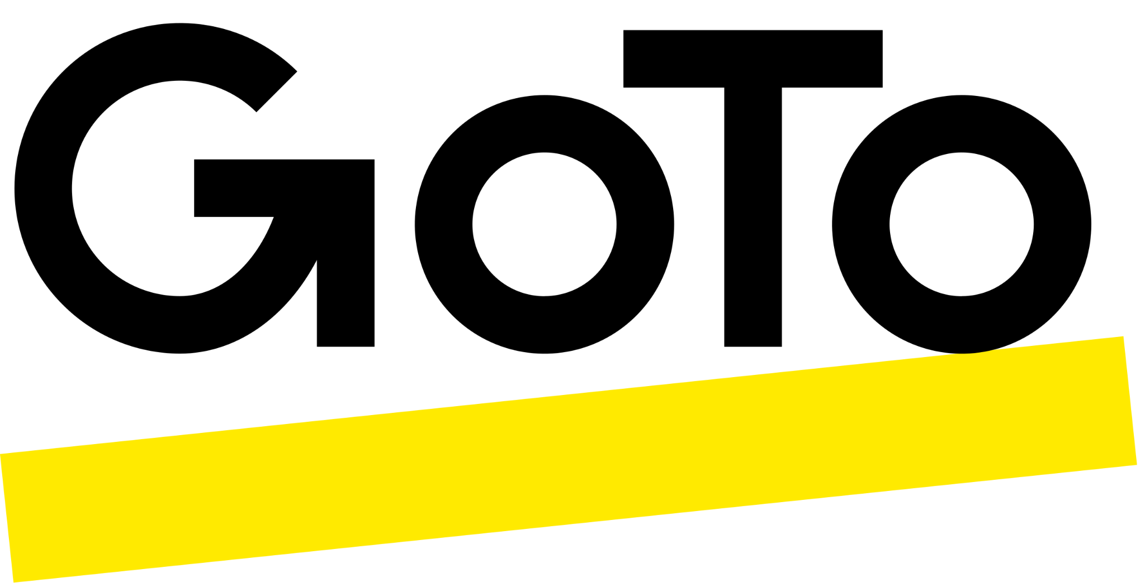

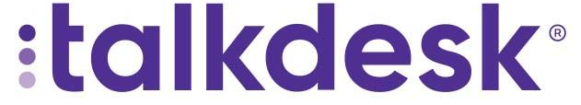
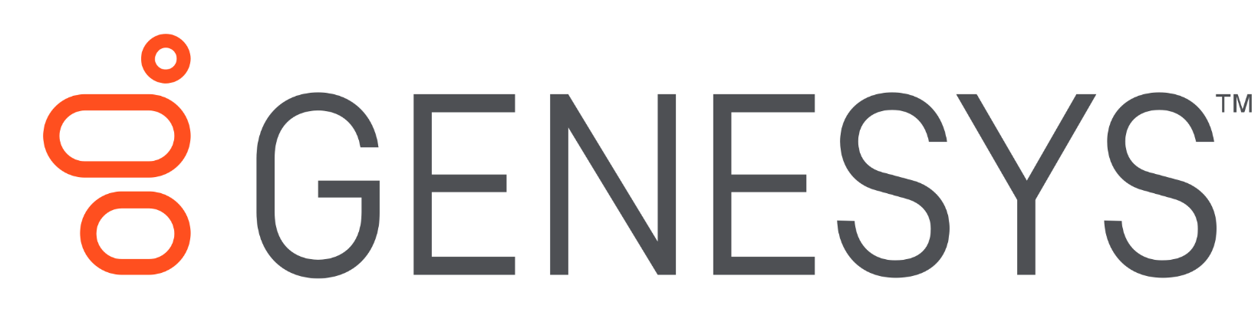
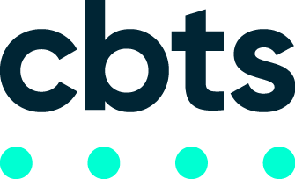
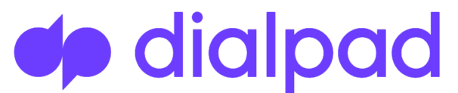
All the leading CX providers
Position CX solutions that are vendor-agnostic with CX experts to guide you.
…and many more

Slide 14
All the CX solutions you need to manage your business communications
CX Sub-Categories
UCaaS | CCaaS | CPaaS
Voice Telephony Video & Audio conferencing Messaging Mobility | Customer contact solutions Employee experience Omnichannel comms Quality management Performance management Workforce engagement Outbound interaction | Customization capabilities Rich Communication Services Multimedia Communication APIs
ANALYTICS
Additional CX Capabilities
Automation | Analytics | SMS | AI
Self Service Data Exchange Business Process Workflow Repetitive Task Elimination Standardization Regulatory Compliance | Real-Time Historical Descriptive Diagnostic Predictive Prescriptive Cognitive | Marketing Alert Notification Event Management Support Sales Surveys Reminders 2FA Confirmations | Omnichannel Virtual Agent Agent Coaching Interaction Summary Sentiment Analysis Predictive Analytics
SMS
ARTIFICIAL INTELLIGENCE
AUTOMATION
APIs
Notes:
Our comprehensive catalog contains CX solutions with key capabilities outlined in the wheel illustration, to support a company’s cloud communication needs end-to-end.
AppDirect’s CX catalog:
Empowers you to help customers shift to a UCaaS model for more cost-effective and efficient communication solutions.
Ensures a stable and future-proof communication infrastructure by helping you help customers adopt CX.
CX services in contract catalog provide a unified and common communication experience, ensuring seamless connectivity regardless of user location. AppDirect works with several providers who offer unified CX solutions.
Cloud-based UCaaS solutions in contract catalog offer scalability, unified regulatory tracking, and integration with CRM platforms, addressing compliance concerns.
Offers CCaaS solutions that can help companies reduce operational expenses. You can leverage a team of CX product specialists and solution architects to identify business problems and offer expert advice to customers on the solutions that best fit their business model.

Slide 15

Stay ahead of the curve with CPaaS
Contact Centers with integrated communications are trending
These solutions help improve customer experience and KPIs:
Productivity (occupancy rate, workforce management, etc.)
Quality (CSAT, NPS, etc.)
Performance (ROI, customer lifetime value, etc.)
Build a Seamless Experience
CPaaS allows you to integrate communications solutions together and create seamless integrated customer experience solutions
Make it your own
Extensible platforms like CPaaS allow you to differentiate by building unique features leveraging the extensibility of platform technology
Notes:
CCaaS-impacting:
Companies in various industries are increasingly adopting Contact Center as a Service (CCaaS) solutions.
CCaaS solutions are used to manage routine inquiries through automated responses, improving the performance of remote employees.
CCaaS providers incorporate advanced analytics systems and offer statistical dashboards on user interfaces for real-time updates on customer experiences—a significant market development..
Manage diverse communication channels, including messages, live chats, emails, phone calls, and SMS.
Major firms are actively developing API-based customer experience contact centers.
This contributes to market growth in the realm of online customer care.
UCaaS-impacting:
Rising Usage of API-driven Programmable Communication to Aid Market Growth
Business Applications Features:
Enabled with audio, messaging, programmable video, and other services.
Aimed at automating the communication process within applications.
Built-in features allow developers to concentrate on the application's critical aspects.
Increasing significance of API-driven programmable communication features—anticipation of exponential market growth due to these advancements.
CX KPIs
Productivity:
Occupancy Rate: Measures agent activity and call wrap-up time, aiming for an ideal rate of 75%.
Workforce Management (WFM): CCaaS tools assist in scheduling agents efficiently, ensuring proper staffing and identifying workflow improvements.
Automation and Integration: Integration with CRMs and AI assistants automates tasks, improves workflow efficiency, and saves time.
Usage of collaborative features, such as video conferencing, messaging, and file sharing and increasing in productivity levels by X%.
Quality:
Customer Satisfaction (CSAT): Assessed through post-interaction surveys, with response rates typically ranging from 10-30%.
Net promoter score
Sentiment Analysis: Modern CCaaS solutions offer real-time tracking of customer emotions, aiding in agent coaching, workflow redesign, and enhancing satisfaction.
Performance:
Data Analysis: Crucial for organizations with inside sales teams or engaged in marketing outreach to minimize costs and maximize revenue.
CCaaS Solutions for Data Analysis: Integration with CRMs and ERP systems provides tools to measure performance, design efficient outreach campaigns, optimize digital campaigns, and utilize historical and real-time data for better analytics.

Slide 16


SmartSupport
Premium tech support to troubleshoot any software and device issues
Calls Annually
Customer Satisfaction
First Call Resolution
100K+
End-user Help Desk services from troubleshooting, to installs, to malware removal
93%
End-customers rate us highly for on-boarding, migration, and level 1 help desk support
96%
Most end-customer issues are resolved on the first call.
Notes:
AppDirect takes a vendor-agnostic approach—have access to all the provider category leaders through an industry-leading portfolio to find and provide the right solution to solve customers’ business needs and provide a full technology stack. However, AppDirect also offers 1st party help desk support services that complement these solutions such as help desk support services called SmartSupport.

Slide 17
Case studies

Slide 18

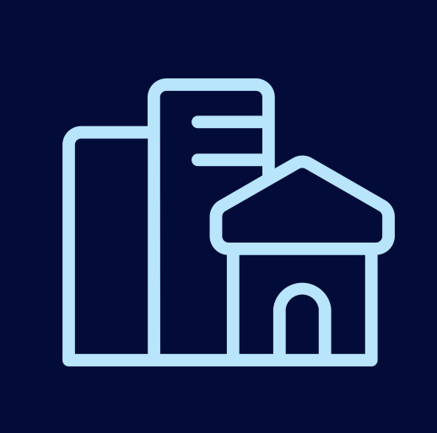

Ideal customers
Our solutions are a good fit for:
Companies with employees working remotely and/or are widely distributed
IT teams lacking resources to procure a full communications tech stack and upgrade outdated voice systems
Industries that serve many customers like: healthcare,
finance, retail,
manufacturing
Notes:
But remember, all companies, no matter the size or industry, need to connect and communicate efficiently.
IT decision-makers are looking to:
Consolidate communications systems across multiple locations and for remote employees e.g. real estate agents always on the go
Manage less systems and vendors overall
Solve for remote communication needs
Implement complex communications integrations
Businesses of every size and type, from SMB to Enterprise, will save cost on infrastructure spend by migrating CX to the cloud.
98% of IT business leader respondents agree they obtain a good return on investment on their business technology. However, challenges persist in areas like training staff, maintenance, troubleshooting, and service migration (The IT Business Leaders 2024 Outlook Report).
Small and medium businesses are more likely to lack the necessary skills internally to make CX purchasing decisions.
For larger enterprises that already have these skill sets, they may look to outsource the expertise for new projects, capital expenditures, or as part of a general effort to reduce infrastructure OPEX, upgrade or outsource the maintenance of their infrastructure.

Slide 19
Key CX Win: UCaaS
Voice solution for a manufacturer and distributor improved international
communication for 50+ locations
Challenge
Solution
Results
An international manufacturer sought a cost-effective voice solution for 50+ locations, facing high operational costs, decreased productivity from legacy PBX systems, disjointed systems, and lack of centralized management.
Moved phone systems to the cloud
Provided a centralized, user-friendly portal
Implemented geo-routing algorithms for international communication
Reduced costs and legacy maintenance
Increased scalability
Optimized quality and reduced latency.
Notes:
An international manufacturer and distributor of vital component parts was in need of a streamlined, cost-effective voice solution for its 50+ locations. The company was challenged with high operational costs, a decrease in productivity due to legacy PBX systems, disparate systems across locations, and no central point of management.
An AppDirect CX Solutions Architect was engaged to vet providers and find the appropriate fit for the company’s business needs. A UCaaS provider was presented to the customer to deliver the best-suited solutions to their communications needs. due to their global presence, reliable network infrastructure, redundancy, and geo-routing patents.
AppDirect’s back-office supported the project from inputting the initial opportunity to project managing the installation. These solutions solved all the customer’s pain points. By hosting the managed provider’s phone system in the cloud, operational costs decreased significantly, and the customer no longer had to worry about supporting legacy systems and the tedious tasks required to keep them up-to-date through patching, repair, and general maintenance.
On top of that, this provider’s UCaaS enables centralized management from a portal allowing the IT staff to make adjustments and modifications anywhere.
To support the company’s international locations, the provider’s geo-routing algorithms allow communications to be routed quickly and efficiently to the closest available data center for high fidelity audio and low latency communication.
The provider successfully deployed its UCaaS solution for 4,000+ users globally. A contract was signed an MRC of 70,000 over 36 months.

Slide 20
Key CX Win: Artificial Intelligence (AI)
AI solution for a contact center increased client and agent satisfaction
Challenge
Solution
Results
In this company scenario, 80% of agent-client interactions involve password resets, diverting attention from personalized, quality customer service for more challenging requests.
AI solutions that automate repetitive operations:
Chatbot to handle routine inquiries with self-service options
AI-powered routing system to connect clients to the right agent
AI Analytics tools to analyze historical data and trends
Increased customer satisfaction.
Reduced call transfer time
Enhanced future demand predictions
Notes:
Time wasted on repetitive tasks: 60% of a person’s time at work is spent on work about work, not on skilled work (Asana, How work about work gets in the way of real work, Oct 2022).
70% of consumers believe AI has become a modern part of customer service (Zendesk, CX Trends, 2024).
Organizations are heavily investing in AI solutions within contact centers to gain significant value, cost reduction, and efficiency.
Shift in IT spending toward AI will be fast and dramatic, impacting nearly every industry and application. By 2025, Global 2000 (G2000) organizations will allocate over 40% of their core IT spend to AI-related initiatives, leading to a double-digit increase in the rate of product and process innovations (IDC, IDC FutureScape: Artificial Intelligence Will Reshape the IT Industry and the Way Businesses Operate, 2023).
The Generative AI market is projected to reach a staggering $1 trillion by 2031, with an impressive compound annual growth rate (CAGR) of 48.05% (Our Culture Mag, Generative AI to Become a $1 Trillion Market, 2024).
Chatbots and AI features are utilized to handle routine inquiries, providing self-service options and enhancing customer satisfaction.
AI-powered routing systems improve efficiency by connecting customers to the right agent, reducing call transfer time.
Analytics tools and AI algorithms analyze historical data, identify trends, and make data-driven decisions for better-predicted future demand.
Balancing automation and human expertise is crucial for delivering a personalized, high-quality customer service experience.

Slide 21
Key CX win: Business Process Outsourcing (BPO)
BPO solution for an entertainment industry customer reduced client churn and optimized customer experience
Challenge
Solution
Results
An entertainment industry customer frequently hosted events, making them often unavailable to readily access their phone or booking system, causing client calls to be dropped.
Off-site solution where a third-party BPO, or a provider outsourced to answer client calls, handles all call duties.
Instead of capturing information, BPO would already have all the necessary client details and can focus more on customer experience.
Increased client interactions and appointments
Increased client satisfaction
Notes:
Additional details…
Generally used in Contact Centers that are seasonal e.g. see a huge spike in calls in the spring and hire a BPO Contact Center contractually to handle this influx.
This use case typically occurs when there is an overflow of calls (BPO receives the overflow)
BPOs really understand customer needs and have staff trained on customer use cases
In the scenario on the slide, they couldn’t answer because they were inundated with calls, but literally weren’t available to pick up or if they did, they might not be in front of their computer and booking systems. Since the customer couldn’t answer the phone or did not always have access to their booking system while on the event floor, AppDirect didn’t need to provide them with an onsite or cloud solution to be able to answer the phone. Instead, AppDirect provided a creative solution from their portfolio: BPOs who are providers outsourced to answer client calls.
In this case, the BPO got access to this customer’s client details and booking system and had a form fill already on hand so that when clients call, they would be forwarded to the BPO, who was trained to handle this booking.
Customer was no longer losing potential clients who, when unanswered, would end up finding another company who did answer the phone and provide them service.

