Slide 1
Devs.ai Agentic AI Development Platform
Easily create & manage custom AI agents
March 2025

Slide 2
Market trends & customer challenges
Customer-facing slides
Notes:
Use the next slides to help your customers uncover hidden challenges in the evolving AI landscape—challenges they may not yet realize but will likely face as they scale AI in the coming months and years.

Slide 3
Claude 3.7 Sonnet
Gemini 2.0
GPT-o1
DeepSeek-R1
Gemini 1.5
~2
Grok-2
LLMs are
released weekly
Claude 3.5 Sonnet
Lama 3
Lama 3
GPT-4 Classic
2023
2024
2025
Notes:
Today, there is a very saturated LLM release cycle.
In 2023, major LLMs were released every few months, primarily by companies like OpenAI, Meta, and Google.
By 2024, the pace accelerated significantly.
Now, in early 2025, we’re seeing 1-2 new LLMs released every week, particularly with smaller, specialized models and fine-tuned versions entering the market at a rapid rate.
What makes this landscape challenging is that LLMs don’t function like traditional software. With software, updates are automatic and often included in existing plans. But with LLMs:
Newer models aren’t just better in performance—they often come with more competitive pricing.
This forces companies to either cancel existing plans or manage multiple LLMs, which isn’t financially or operationally scalable.
The bigger issue arises when AI systems built on older LLMs are deeply embedded into workflows and tech stacks. Switching to a new LLM often requires rebuilding integrations and reworking strategies, which can be costly and time-consuming.
The takeaway:
For companies trying to scale their AI strategy, this fast-moving LLM landscape creates two major challenges:
Keeping up with the latest LLMs without disrupting existing AI workflows.
Maintaining financial and technical flexibility to train and switch models efficiently.

Slide 4
Companies need to stay up to date
A multi-LLM approach is key for balancing cost & utility
Cost-efficiency
Newer models offer better performance capabilities at a lower cost
Tailored Capabilities
A multi-LLM approach gives companies the flexibility to use the best model for each task
Better Performance
Newer models can deliver faster,
more accurate, and context-aware responses
End of life risks
Older models become incompatible, outdated,
and pose security risks
Notes:
To build a successful and scalable AI strategy, companies must evolve with the rapidly changing LLM landscape. Staying agile and ready to adopt new models is crucial as the market becomes more saturated. Here’s why a multi-LLM approach is key for your customers:
Cost Efficiency: A multi-LLM strategy allows businesses to balance cost and performance, switching between models to achieve optimal results at a lower cost. Newer models often come with more affordable pricing, offering better value for money.
Tailored Capabilities: Different LLMs excel at different tasks. By leveraging multiple models, companies can choose the best one for each task, ensuring maximum efficiency and effectiveness.
Better Performance: Newer models deliver faster, more accurate, and context-aware responses, resulting in improved outcomes for your customers.
End-of-Life Risks: Older models can become outdated, incompatible with current tech stacks, and pose security risks. Staying up-to-date ensures these risks are mitigated.

Slide 5
Switching LLMs is challenging
It’s not as simple as an update
Transition overhead costs including training, fine-tuning, and infrastructure changes.
Managing multiple subscriptions with different AI vendors.
Integration costs for API updates, data migration, and system reconfigurations.
The financial burden
Workflow interruptions while adapting to new models and adjusting processes.
Employee retraining to learn new systems and workflows.
Testing and quality assurance to ensure the new model meets performance standards.
Operational disruptions
Differences in model outputs requiring retraining or a workflow reconfiguration.
Service disruptions and delays during the transition to new models.
Hallucinations if the new model isn't fine-tuned properly.
Performance risks
Notes:
However, switching LLMs can be a complex undertaking today—impacting costs, workflows, and overall performance. From integration challenges to operational risks, businesses must navigate multiple hurdles to ensure a smooth transition.
Switching LLMs is Complex and Costly
1. High Transition Costs
Moving to a new LLM requires more than a simple update—it involves training, fine-tuning, and infrastructure changes. Businesses must also juggle multiple AI vendor subscriptions and navigate complex integrations like API updates, data migration, and system reconfigurations.
2. Financial & Productivity Burdens
Switching disrupts workflows, requiring employee retraining and process adjustments. Extensive testing is needed to ensure the new model meets performance standards, adding both time and cost.
3. Operational & Performance Risks
Different LLMs produce varied outputs, often necessitating workflow reconfiguration. Transitions can lead to service disruptions, delays, and AI hallucinations if the model isn’t properly fine-tuned.

Slide 6
AI is already in your company
Who is monitoring it?
Employees are exposing sensitive data
No oversight = compliance nightmares
Is your company prepared to handle the risks?
+75% of the workforce is using unapproved AI tools without oversight
77% of companies lack a strategy to manage AI risk and governance
Organizations that invest in AI governance will experience 40% fewer risks
Source: Microsoft, Deloitte, Gartner
Notes:
Your customers’ employees are using AI tools every day—whether it’s ChatGPT, Copilot, or Notion AI. But without proper oversight, AI adoption comes with serious risks.
Here’s the challenge we’re seeing today:
More than 75% of AI users are bringing their own AI tools to work (BYOAI), creating serious security and compliance risks.
Less than 25% of employees have regulated access to AI tools, meaning the majority are using unapproved AI without oversight.
Meanwhile, only 23% of companies are actually prepared to manage AI risk and governance.
This lack of control has led to a major issue: Shadow AI. Shadow AI refers to AI tools being used without IT or security oversight, leading to several risks that should be emphasized to customers:
No visibility or control – Your IT teams can’t track who is using AI, how it's being used, or where data is going.
Data security threats – Your employees are likely unknowingly input sensitive company or customer data into public AI models.
Regulatory and compliance risks – Unauthorized AI use can violate industry regulations, exposing your company to legal consequences.
Proprietary data leakage – Public AI models (like OpenAI or Anthropic) can absorb and use confidential data for future training.
Are you investing in the right tools to monitor AI usage in your company, ensuring it’s safe and compliant? If not, you’re exposing your business to serious legal and security risks.
Source: Microsoft, Deloitte, Gartner

Slide 7
25% of companies using GenAI will pilot agentic AI in 2025, growing to 50% by 2027.
Source: Deloitte
Notes:
Nearly every company has generative AI (GenAI) investments as a top priority in their business plans. But the real opportunity this year—the space where Devs.ai is uniquely positioned—is agentic AI. This shift from GenAI to Agentic AI is where the market is heading, and where businesses will be prioritizing their AI investments next.

Slide 8
AI agents are on the rise
Are you enabling your workforce?
By 2028
80%
15%
of humans will engage with agents on a daily basis
of day-to-day work decisions will be made autonomously through agents
Source: Gartner
Notes:
Agentic AI is set to lead the workforce of the future. If your customers aren’t investing in it and empowering their teams, they risk falling behind. According to Gartner, by 2028, 80% of people will interact with agents daily, enabling 15% of everyday decisions to be made autonomously. This shift will drive significant time and cost savings for businesses, making it crucial to stay ahead of the curve.

Slide 9
Devs.ai value propositions & offerings
Customer-facing slides

Slide 10
A comprehensive solution for agentic
AI creation & management
CENTRAL ACCESS TO 30+ LLMs
NO-CODE & PRO-CODE
AGENTIC TOOLS
ENTERPRISE-FIRST
AI LIFECYCLE
MANAGEMENT
Notes:
This is where Devs.ai comes in — providing businesses with a powerful solution to seamlessly manage and scale their AI strategy. Here are the key value benefits of Devs.ai to speaker to your customers about:
One location to access all the top LLMs: Access the top-performing models from one centralized platform, eliminating the need to manage multiple subscriptions and accounts.
Significant cost savings: Consolidate all your LLM subscriptions under a single plan and save up to 75%—offering a more competitive price than purchasing directly from individual vendors.
LLM agnostic: Choose the best LLM for each AI use case without being locked into a single model, ensuring optimal performance. Easily test and compare LLMs to train agents tailored to their specific roles.
AI lifecycle management: Manage your agent's entire lifecycle—from customization and spend management to ongoing data and LLM updates, promising continuous performance, utility, and cost optimization.
Automated updates: Keep AI knowledge bases current with real-time data from drives, websites, and other sources.
Tracking & monitoring: Gain centralized insights into AI performance and health metrics, ensuring optimal efficiency.
Agile LLM swaps: Easily switch to new LLM advancements without the burden of costly reconfigurations or downtime.
Spend management: Track token and input/output limits to maintain control over AI-related expenses and avoid unnecessary costs.
Agentic AI tools: Access the agentic AI tools your company needs (through Devs.ai’s agentic AI creation studio) to build and deploy intelligent agents that simplify your work—all from one platform.
No-code AI development: Build and deploy AI agents effortlessly, without the need for coding expertise.
Customizable AI agents: Tailor AI behavior to your needs by selecting the ideal LLM, training it with your data sources, and enhancing its intelligence with RAG. Easily integrate preferred data sources to deliver smarter, more contextual responses and actions.
Task automation: Define triggers, actions, and responses with a simple graphical interface, ensuring AI agents follow structured processes and take meaningful action.
Enterprise-first: Devs.ai is designed to meet the needs of large-scale organizations, focusing on robust security, governance controls, and extensive integrations, enabling businesses to scale AI solutions safely and compliantly across their operations.
Secure Environment: Devs.ai ensures sensitive corporate data is kept private and not used to train public LLMs. Installed on an Azure instance, all data is dedicated to training purpose-built AI agents, maintaining privacy and security.
Access & Governance: Devs.ai empowers IT admins to manage data sources, AI agent usage, and approvals across the organization. This reduces the IT burden and ensures compliance with policies and regulations, controlling "shadow AI."
Flexible Integrations: Devs.ai integrates seamlessly with platforms like OneDrive, GitHub, Jira, and Confluence, enabling scalable AI solutions that deliver value across systems and workflows.
*NOTE: Slides 11-16 demonstrate these value propositions in more detail.

Slide 11
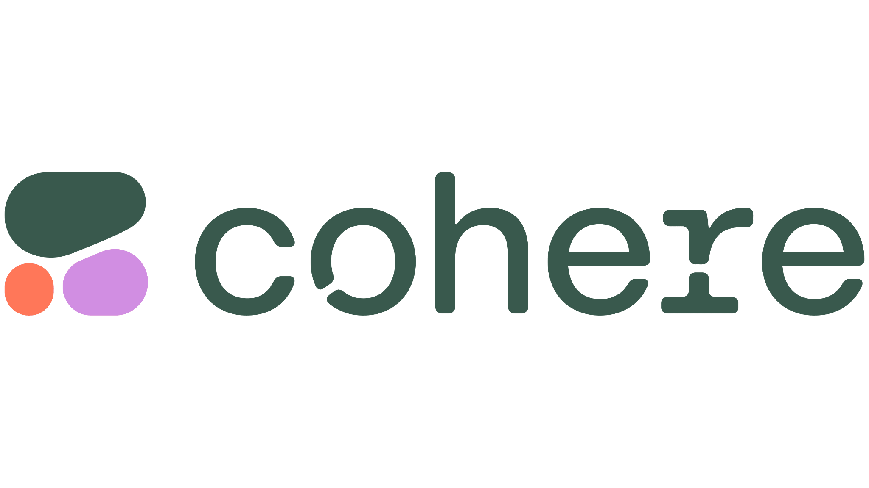
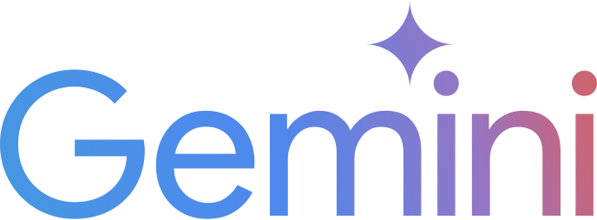
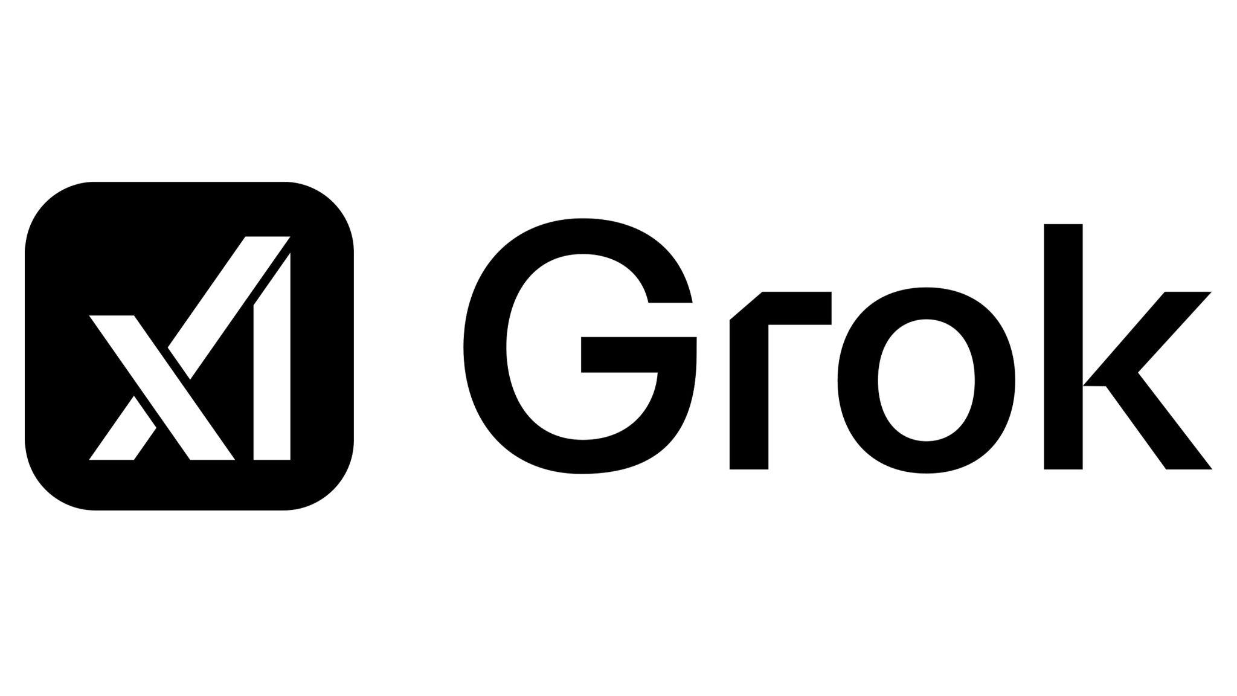
One platform
30+ LLMs
75% of the cost
Notes:
We offer all the leading LLMs under one plan. With Devs.ai, you can consolidate all your employees’ AI usage under one plan, saving up to 75% compared to using a single AI vendor.

Slide 12
We help you stay ahead of the LLM landscape
Evolve with the latest LLMs
Access the latest LLMs as they emerge with our constantly updated library
Easy model swaps
Test and switch LLMs without costly integration headaches
LLM-agnostic
Choose the best LLM for each use case without being locked into a single model
Notes:
With Devs.ai, we help you stay ahead of the ever-evolving LLM landscape. You’ll have access to the latest LLMs as they emerge, thanks to our continuously updated library.
Switching models is easy — you can test and swap LLMs without the expensive integration headaches.
And best of all, we’re LLM-agnostic. You’re never locked into a single model, so you can choose the one that’s best suited for each task, giving you maximum flexibility and performance.

Slide 13
Build & deploy first-class agents
devs.ai
01
02
Customize your agent
Train your agent using your own data sources and select the LLM tailored to your needs
Augment agent knowledge
Utilize predefined data pipelines to augment the agent’s knowledge w/o coding
01
01
02
04
02
Deploy at scale
Embed agents into your business workflows or integrate via APIs
03
04
Orchestrate complexity
Build sophisticated agents that manage complex workflows and perform tasks autonomously
03
Notes:
With Devs.ai, building and deploying top-tier AI agents has never been easier. Start by customizing your agent with your own data and selecting the perfect LLM for your needs. Next, augment your agent’s knowledge using predefined data pipelines — no coding required. Once you’re ready, deploy at scale by embedding agents directly into your business workflows or integrating via APIs. And for more complex use cases, orchestrate sophisticated workflows that allow your agents to perform tasks autonomously, simplifying your operations.

Slide 14
Scale across your business applications
Easily integrate throughout your organization’s ecosystem
Deploy anywhere
Launch in your applications, websites, and workflows to enhance user experiences
Connect your systems
Sync with CRMs, internal tools, and business workflows for a unified experience
Leverage APIs for flexibility
Enable custom integrations, ensuring AI agents work within your existing infrastructure
…& more
Notes:
You can then easily scale your agent across your applications, ensuring seamless integration into every part of your business ecosystem. Whether it’s your website, CRM, or internal tools, the agent works consistently across all platforms

Slide 15
Manage the lifecycle of your agents
Iterate & optimize
Continuously refine your agent to enhance performance and expand capabilities
Automate data updates
Ensure your agent is trained on the most up-to-date data sources
Monitor metrics & spend
Gain visibility into agent performance and resource usage
Upgrade LLMs as needed
Easily swap LLMs to adapt to business needs and stay current with the LLM landscape
Notes:
We make it easy to manage the entire lifecycle of your agents:
Automate data updates to keep your agent trained on the latest data.
Iterate & optimize to refine performance and expand capabilities.
Monitor metrics & spend for full visibility into agent performance and resource usage.
Upgrade LLMs seamlessly as your business needs evolve, keeping you current with the LLM landscape."

Slide 16
We’re enterprise-first
Guarantee safe & compliant AI use across your company
Your data, your control
✔ Your data is not used to train public LLMs
✔ You decide who can see your data
✔ You can delete your data at anytime
You manage access
✔ Secure access with SSO verification
✔ Role-based access control
Comprehensive security & compliance
✔ SOC 2 Type 1 compliance
✔ GDPR compliance
✔ Hosted on a secure Azure instance
✔ Custom on-prem options
Notes:
With Devs.ai, you can rest assured that your data is secure and fully under your control. We prioritize enterprise-level security and compliance, ensuring that your proprietary data remains private and is never used for training public LLMs. You manage access and data usage, eliminating the risks of shadow AI and maintaining a trusted environment for your AI solutions.

Slide 17
Customer stories & use cases
Customer-facing slides

Slide 18
Lakefield College School increases AI proficiency and productivity
Challenges
28% of Lakefield staff had zero AI experience
Data privacy concerns with consumer-grade AI tools
Lack of scalable, no-code AI solutions available for academic applications
Results
43%
+70%
+50
of school is now proficient in AI, up from 21%
of staff reported that devs.ai increased their productivity
agents created w/o code to enhance learning experiences
View the case study here
Notes:
Learn how Devs.ai (formerly AppDirect.ai) helped Lakefield enhance their AI proficiency, drive productivity gains, and improve educational outcomes in our detailed case study here.

Slide 19
What agents can do
Top use cases for AI agents today
Marketing |  | Sales |  | Human Resources
Content generation
Product recommendation
Recruitment advice
Campaign ideation
Sales data analysis
Resume comparison
Market research
Sales pitch creation
Onboarding automation
CTA optimization
Objection handling
Employee goal tracking
Audience segmentation
Product comparison
HR policy compliance
Product Management |  | IT/Software Dev |  | Legal
Feature prioritization
API documentation
Contract review
User feedback analysis
Coding
Legal documentation
Roadmap planning
IT troubleshooting
Compliance verification
Product documentation
Technical documentation
Risk assessment
Competitive analysis
System integration advice
Legal pitch support

Slide 20
Customers using Devs.ai today

Slide 21
A platform built for scale
2K+
Agents created
10M+
Agent messages
30+
LLMs available out-of-the-box

Slide 22
Demos
Customer-facing slides

Slide 23
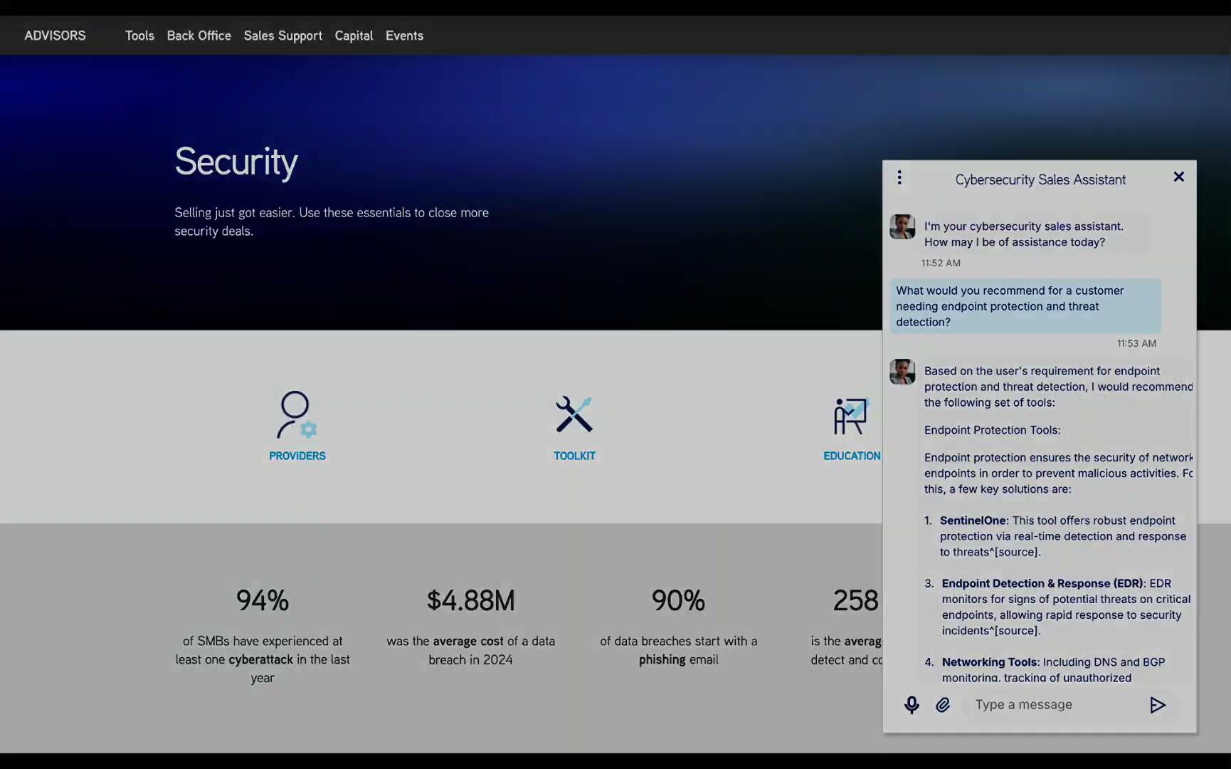
Security Agent Demo
Speak with the Security Assistant here
Notes:
Included here is a demo showcasing an embedded agent in action. Here is how you can speak to customers about the ability to embed their agents:
“With Devs.ai, you can easily embed agents wherever you need them—on your marketplace, website, or applications. The process is simple: just copy and paste the provided HTML code from the creation studio. Plus, you can fully customize the branding, from button designs to images and the overall look of the chat interface, ensuring your AI app reflects your unique brand identity and delivers value exactly where it's needed."

Slide 24
Positioning
Advisor-facing slides

Slide 25
There are no ‘business-ready’ agentic AI solutions
CHALLENGING
LLM RELEASE CYCLE
The proliferation of new LLMs and rising costs of outdated models create financial and integration pressures to keep AI strategy current.
Users lack the tools and visibility to easily train, monitor, and maintain their agents to ensure they remain current and perform optimally.
INEFFICIENT MANAGEMENT
Building sophisticated agents is time consuming, expensive, and requires technical resources that many organizations lack.
RESOURCE & SKILLS GAP
PRIVACY & COMPLIANCE
RISKS
Most AI solutions aren't designed for the enterprise and rely on public LLM platforms, raising the risk of exposing sensitive proprietary data.
Notes:
Challenging LLM release cycle
Each model excels at different tasks, meaning companies need a scalable, flexible approach to AI.
To stay ahead, businesses must efficiently test, swap, and integrate multiple LLMs as new ones emerge.
Resource & Skills Gaps
Scaling AI strategies—especially AI agents—is still new territory for many organizations.
Building, training, and maintaining AI agents is complex and requires time and expertise.
Inefficient Management
Companies need tools to monitor AI adoption, usage, and performance.
Example: Tracking how many employees use an AI agent and ensuring it’s pulling from up-to-date, reliable knowledge sources.
Privacy & Compliance Risks
Without proper controls, AI usage can compromise sensitive data and violate compliance regulations.
Shadow AI—where employees use unapproved AI tools—creates security blind spots with no monitoring or governance in place.

Slide 26
Devs.ai can bridge the gap for your customers
Devs.ai provides centralized access to top LLMs, allowing companies to stay adaptable to new models without managing multiple plans.
ONE PLATFORM, 30+ LLMS
Devs.ai allows users to track performance and resource consumption, automate data updates, and easily swap LLMs to optimize both performance and costs.
AI AGENT
MANAGEMENT
USER-FRIENDLY
AGENTIC TOOLS
Devs.ai equips users with the tools they need to harness agentic AI and build agents that automate workflows and take autonomous actions.
ENTERPRISE
FIRST
Devs.ai provides better security & compliance than any foundational LLMs, allowing users to maintain the proprietary nature of their data.
Notes:
Centralized Access to 30+ LLMs
One subscription, 75% of the cost—Devs.ai provides businesses with access to any leading LLM at 75% of the cost of a single model, delivering a more adaptable and cost-effective alternative to standalone LLMs.
Continuously updated library—new LLMs are added regularly to keep companies ahead of the curve.
Stay adaptable—access the latest and best LLMs without managing multiple plans.
No vendor lock-in—swap between models easily, ensuring the best fit for each use case.
Track & Manage AI Agents with Full Visibility
Test, swap, and update agents effortlessly as new LLMs are released.
Update knowledge sources to keep AI responses accurate and relevant.
Coming soon: Analytics dashboard
Monitor agent performance (sessions, messages, users, etc.).
Track data consumption & token consumption
Agentic AI Tools
Easy-to-use agentic tools—new features rolling out in the coming months.
Build advanced workflows—set triggers, automate task creation, and enhance AI-driven efficiency using agentic tools.
Enterprise-First
Data privacy by design—company data is never used to train external LLMs.
Access & governance controls—admins can monitor usage, enforce policies, and ensure compliance.

