Slide 1
Smarter energy buying with AppDirect
April 2025

Slide 2
ENERGY
COMMUNICATIONS SOLUTIONS
EV Charging | Water & Waste Electricity | Natural Gas | Solar
Data | Network | Mobility & IoT | Satellite SD-WAN | SASE | TEM | UCaaS | CCaaS
MANAGED & PRO SERVICES
SOFTWARE AS A SERVICE
Network (NOC) & Cloud Monitoring | SOC Technical Support | Professional Services
Microsoft | Google | ERP | CRM | Productivity Business Applications | IT Management | BI
HARDWARE & LOGISTICS
ARTIFICIAL INTELLIGENCE
PCs | Laptops | Phones | Monitors | Digital Displays Hardware Services & Logistics
Large-Language Models | Agentic AI | Copilot | Gemini | Chat Bots | Customer Experience
SECURITY
INFRASTRUCTURE
Physical Security | Network Security Endpoint Security | Cloud Security
Public, Private, & Hybrid Cloud Data Center & Colocation | Disaster Recovery
‹#›

Slide 3
Unprecedented demand is changing energy market dynamics
42%
88%
25%
expected growth in energy demand by 2035
forecasted increase in U.S. natural gas export capacity by 2030
of operational expenses are represented by energy costs
Notes:
With energy demand expected to grow by 42% by 2035 according to Gartner®, and U.S. LNG export capacity projected to increase by 88% by 2030 (EIA), competition for energy resources is intensifying. At the same time, energy costs represent up to 25% of operational expenses, making energy procurement central to strategic planning—focusing on cost control, risk management, and sustainability.

Slide 4
A comprehensive solution for smarter energy spending
100+ PROVIDERS
Largest retail energy network in North America
EXPERT GUIDANCE
Expertise in selecting, managing, and implementing energy solutions
COST OPTIMIZATION
The best pricing, cost analyses, and market forecasts to optimize your energy spend
Notes:
Leading Catalog: The AppDirect Catalog contains access to over 100 of the leading energy providers, including a broad network of electricity and gas suppliers across deregulated markets.
Expert guidance: Our experts guide you through the complex energy landscape, helping you select, implement, and manage the energy solutions tailored to your unique business needs, including finding alternative sources of energy that can improve environmental impact and cut costs long-term.
Cost optimization: Our Energy platform provides access to every major supplier in deregulated states. Compare rates, find the best daily deals, and guide your customers to smart, cost-saving decisions.

Slide 5
A holistic energy strategy to:
OPTIMIZE ENERGY SPENDING
IMPROVE ENERGY INFRASTRUCTURE
MEET SUSTAINABILITY GOALS
Notes:
Tap into the leading energy catalog and reduce your spend with access to competitive pricing on the solutions you need to power your business. With tools like live pricing platforms and daily market forecasts, our experts help you decrease energy spending, improve your energy infrastructure, and meet your ESG goals.
We shop all major suppliers to secure the best product and rate for your specific business needs
Negotiate best contract terms with the providers to benefit the customer
Pull from more than a million live price points daily to make sure customers are getting the best rate

Slide 6
Energy solutions portfolio
Electricity & Natural Gas Procurement
Waste Management
Energy Efficiency
Electric Vehicle Solutions
Building Management (Sensors & IoT)
Distributed Generation
Water Management
Energy Expense Management
Notes:
Electricity & Natural Gas Procurement: You have a choice who you get your power and gas from. Buy energy smarter, find long-term budget certainty and take advantage of the competitive supply landscape
Energy Efficiency: Update existing building infrastructure like lighting and HVAC system to reduce energy consumption and improve building comfort level satisfaction
Building Management (Sensors & IoT): Securely access and monitor critical building health information to control and proactively address areas of concern from virtually anywhere via cloud based software solutions
Water Management: Optimize the water flow to save money at the meter and utilize smart metering to stop leaks in real time and safeguard against facility damage
Waste Management: Find the most effective waste and recycling solution using a transparent data driven process
Electric vehicle solution: Leading turnkey certificated charging stations and flexible, open, and cloud-based software platform for managing the EV Charging ecosystem.
Distributed Generation: Deploy on-site generation such as solar to save on energy rates and take advantage of tax incentives and rebates. Installation-site fuel cells and battery storage to gain resilience against grid interruptions while offsetting your demand from the utility
Energy Expense Management: Integrate your bills in one platform. Shared savings bill audits ensure invoice accuracy and error resolution without any upfront costs

Slide 7
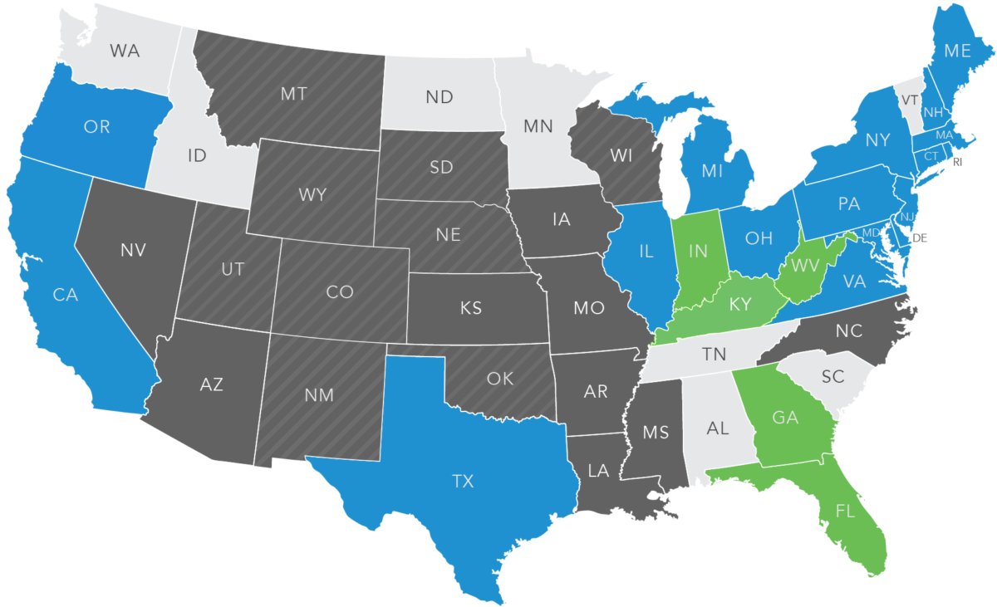
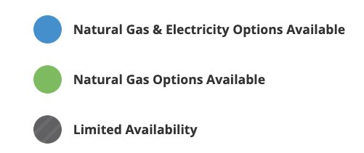
Get the most competitive rates with a broad network of electricity and gas suppliers across deregulated markets.
Notes:
Energy deregulation: Energy deregulation works through reverse auction, where each company offers to sell its energy at the lowest possible rate. Independent agencies purchase the energy needed to suit the demand they predict, and then set the best rate for their customers. Energy is thus delivered through the existing utility infrastructure. The utility companies that own the infrastructure are responsible for transmitting energy, but not for setting the rate energy users pay. This process allows energy users to receive the same service, but at a rate that fits their needs.
The benefits of energy deregulation
The deregulation of the energy industry brought multiple benefits to the energy user, and includes the following:
Power to choose. Deregulation allows energy users to choose where their energy comes from, and allows them to choose plans that are best for them.
Increased competition and better service. Deregulation promotes competition among energy firms, and motivates providers to offer excellent service to their customers.
Encouraged energy efficiency. Deregulation empowers users to be more energy efficient by choosing companies with more energy-efficient practices.
Improved energy consciousness. Energy deregulation helps energy users understand energy costs by evaluating different plans, and providers often help their customers to save and conserve energy.
New and enhanced services. By diversifying, competitive energy suppliers often offer additional services and benefits to their energy users that would otherwise have been unavailable.

Slide 8
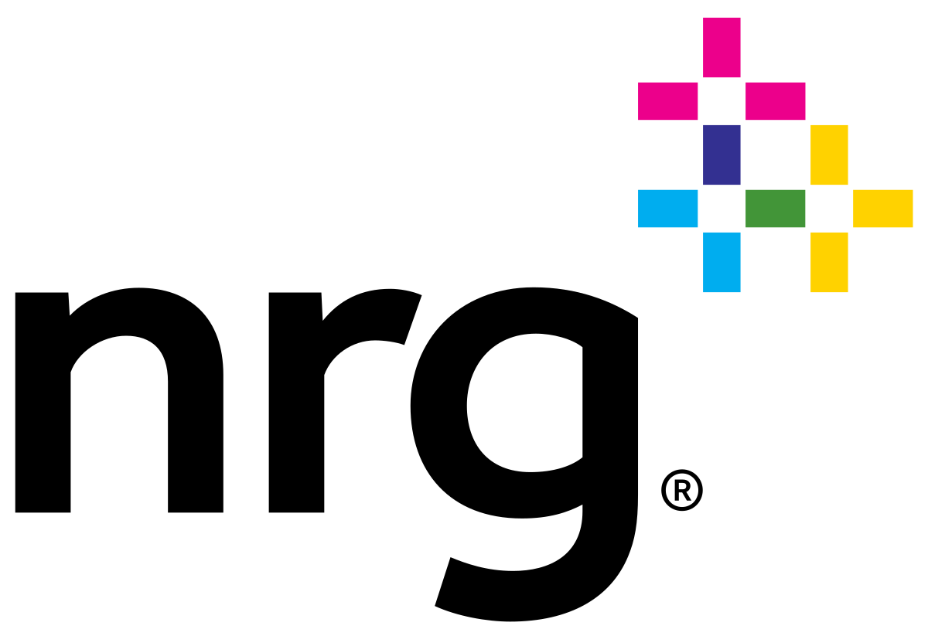
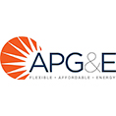
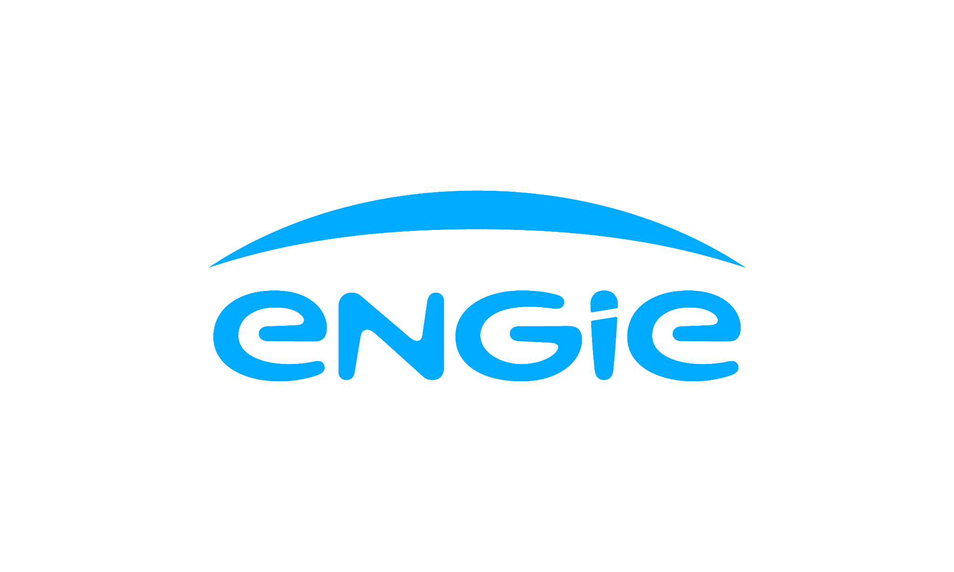
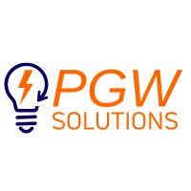
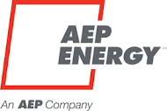
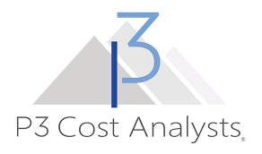
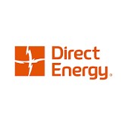
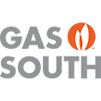
Our catalog contains access to over 100 of the leading energy providers

Slide 9
Case Studies

Slide 10
$1.6M in savings on electricity
Company Industry: Data Center
Location: Virginia
Challenge
Data Center was spending too much on energy
Solution
Implemented a layered hedge strategy, buying energy in stages at different times to take advantage of low prices.
Results
Over $1.6M in savings over a 4 year term with >37M KWh annual usage
Notes:
BOX's Strategic Solutions team noticed their new Virginia data center client was paying too much for
energy. To solve this, BOX created a layered hedge strategy. This strategy involved buying energy not all at
once, but at different times, focusing on when the prices were low. This case is a great example of how
BOX’s smart and innovative strategies can really help to cut down costs and reduce risk.

Slide 11
$192K per year savings on electricity
Company Industry: Document Solutions
Location: New Jersey
Challenge
Electricity prices rose dramatically over the last few years and wanted to see if Solar could help reduce costs
Solution
Design and installation of a $2M on-site solar solution
Video
Results
$192K/year in Net Operating Income (NOI) improvement
Project is a key contributor to their global sustainability objectives
Notes:
Fun fact: this project came at zero out of pocket expense to the company as they signed a 15-year agreement to purchase the solar electricity generated from the company that financed the project. There are tons of programs and incentives that we can find for your customers to help them achieve their energy goals.
Play the video of the aerial footage of the solar solution!

Slide 12
$200K in savings on natural gas
Company Industry: Garbage collection, recycling and waste management
Location: California
Challenge
Natural gas prices had been steadily increasing since 2021 and operating expenses tripled from previous years
Solution
AppDirect Energy Experts used Energy Seller to lock in a 3-year deregulated natural gas supply contract
Results
Savings of almost $200K to date on natural gas
Locked-in contract enables them to better plan and manage their monthly utility budget
Notes:
Company uses compressed natural gas (CNG) to fuel their fleet of collection trucks. They have historically purchased natural gas commodity supply from SoCalGas. Natural gas prices have been steadily increasing since 2021. In 2022, Marborg’s monthly operating expenses began to triple from previous years and they wanted to know if there was a way to purchase natural gas that would allow them to improve their utility operational expenses and mitigate their risk to future price increases in natural gas.
This new contract provides them with a known natural gas commodity rate that will allow them to better plan and manage their monthly utility budget. The contract has also saved them almost $200,000 to date against rates they would’ve paid for natural gas commodity if still buying from SoCalGas.

