Slide 1
Find, buy, and manage energy solutions with AppDirect
April 2025

Slide 2
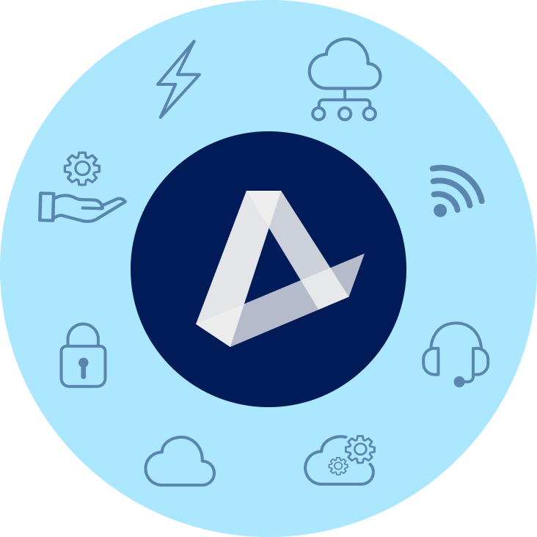
ENERGY
COMMUNICATIONS SOLUTIONS
EV Charging | Water & Waste Electricity | Natural Gas | Solar
Data | Network | Mobility & IoT | Satellite SD-WAN | SASE | TEM | UCaaS | CCaaS
MANAGED & PRO SERVICES
SOFTWARE AS A SERVICE
Network (NOC) & Cloud Monitoring | SOC Technical Support | Professional Services
Microsoft | Google | ERP | CRM | Productivity Business Applications | IT Management | BI
HARDWARE & LOGISTICS
ARTIFICIAL INTELLIGENCE
PCs | Laptops | Phones | Monitors | Digital Displays Hardware Services & Logistics
Large-Language Models | Agentic AI | Copilot | Gemini | Chat Bots | Customer Experience
SECURITY
INFRASTRUCTURE
Physical Security | Network Security Endpoint Security | Cloud Security
Public, Private, & Hybrid Cloud Data Center & Colocation | Disaster Recovery
‹#›

Slide 3
Energy commodity prices are soaring nationwide
What’s happening in the market
In the past 2 years, the cost of natural gas has increased by
Electricity prices are up YTD. in Texas, they have increased by
>350%
>100%
Notes:
Energy is a live commodity and prices are constantly changing for a variety of reasons. Over the previous years, the US has enjoyed a period where energy prices were relatively low. That has changed dramatically as the fundamental landscape for how energy is both generated and consumed has shifted. With this shift, energy prices are expected to continue to be both higher than normal and are expected to endure periods of extreme price volatility like we’ve witnessed recently.

Slide 4
WE HELP BY:
Sourcing and locking in multi-year deals by finding the best energy solutions and rates
Finding alternative sources of energy that can improve environmental impact and cut costs long-term
Notes:
If you want to go into more information about energy deregulation:
Energy deregulation: Energy deregulation works through reverse auction, where each company offers to sell its energy at the lowest possible rate. Independent agencies purchase the energy needed to suit the demand they predict, and then set the best rate for their customers. Energy is thus delivered through the existing utility infrastructure. The utility companies that own the infrastructure are responsible for transmitting energy, but not for setting the rate energy users pay. This process allows energy users to receive the same service, but at a rate that fits their needs.
The benefits of energy deregulation
The deregulation of the energy industry brought multiple benefits to the energy user, and includes the following:
Power to choose. Deregulation allows energy users to choose where their energy comes from, and allows them to choose plans that are best for them.
Increased competition and better service. Deregulation promotes competition among energy firms, and motivates providers to offer excellent service to their customers.
Encouraged energy efficiency. Deregulation empowers users to be more energy efficient by choosing companies with more energy-efficient practices.
Improved energy consciousness. Energy deregulation helps energy users understand energy costs by evaluating different plans, and providers often help their customers to save and conserve energy.
New and enhanced services. By diversifying, competitive energy suppliers often offer additional services and benefits to their energy users that would otherwise have been unavailable.

Slide 5
Energy solutions portfolio
Electricity & Natural Gas Procurement
Energy Efficiency
Building Management (Sensors & IoT)
Water Management
Waste Management
Electric Vehicle Solutions
Energy Expense Management
Distributed Generation
Notes:
Develop the energy solution “stack”. Not only can you sell electricity and natural gas, but you can also sell other energy solutions. Talk to your customers to see which solutions they can implement to meet their needs.
Electricity & Natural Gas Procurement: You have a choice who you get your power and gas from. Buy energy smarter, find long-term budget certainty and take advantage of the competitive supply landscape
Energy Efficiency: Update existing building infrastructure like lighting and HVAC system to reduce energy consumption and improve building comfort level satisfaction
Building Management (Sensors & IoT): Securely access and monitor critical building health information to control and proactively address areas of concern from virtually anywhere via cloud based software solutions
Water Management: Optimize the water flow to save money at the meter and utilize smart metering to stop leaks in real time and safeguard against facility damage
Waste Management: Find the most effective waste and recycling solution using a transparent data driven process
Electric vehicle solution: Leading turnkey certificated charging stations and flexible, open, and cloud-based software platform for managing the EV Charging ecosystem.
Energy Expense Management: Integrate your bills in one platform. Shared savings bill audits ensure invoice accuracy and error resolution without any upfront costs
Distributed Generation: Deploy on-site generation such as solar to save on energy rates and take advantage of tax incentives and rebates. Installation-site fuel cells and battery storage to gain resilience against grid interruptions while offsetting your demand from the utility

Slide 6
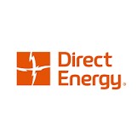
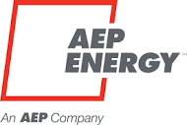
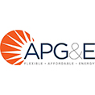
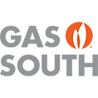
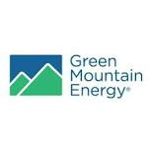
The AppDirect Catalog contains access to over 40 of the leading industry retail energy providers
Notes:
The AppDirect Catalog contains the leading industry retail energy providers for electricity and natural gas. Through our partnership with Zentility, we have extensive relationships with these providers and are able to negotiate the best rates for your customers. Check out our catalog to see how which providers can fulfill their energy needs.

Slide 7
Energy case studies

Slide 8
Energy solutions verticals
Commercial Property
SMB
Hospitality
Industrial/Manufacturing
Education
Multi-tenant
Hospital/Nursing Home/Assisted Living
Notes:
We’ve closed deals with companies across a spectrum of industries. Particularly, we’ve seen great success in the hospitality, multi-tenant, assisted living, and industrial/manufacturing sectors.

Slide 9
Reducing electricity spend by $192K per year
Company Industry: Document Solutions
Location: New Jersey
Challenge
Electricity prices rose dramatically over the last few years and wanted to see if Solar could help reduce costs
Solution
Design and installation of a $2M on-site solar solution
Video
Results
$192K/year in Net Operating Income (NOI) improvement
Project is a key contributor to their global sustainability objectives
Notes:
Fun fact: this project came at zero out of pocket expense to the company as they signed a 15-year agreement to purchase the solar electricity generated from the company that financed the project. There are tons of programs and incentives that we can find for your customers to help them achieve their energy goals.
Play the video of the aerial footage of the solar solution!

Slide 10
$200K in savings on natural gas
Company Industry: Garbage collection, recycling and waste management
Location: California
Challenge
Natural gas prices had been steadily increasing since 2021 and operating expenses tripled from previous years
Solution
AppDirect Energy Experts used Energy Seller to lock in a 3-year deregulated natural gas supply contract
Results
Savings of almost $200K to date on natural gas
Locked-in contract enables them to better plan and manage their monthly utility budget
Notes:
Company uses compressed natural gas (CNG) to fuel their fleet of collection trucks. They have historically purchased natural gas commodity supply from SoCalGas. Natural gas prices have been steadily increasing since 2021. In 2022, Marborg’s monthly operating expenses began to triple from previous years and they wanted to know if there was a way to purchase natural gas that would allow them to improve their utility operational expenses and mitigate their risk to future price increases in natural gas.
This new contract provides them with a known natural gas commodity rate that will allow them to better plan and manage their monthly utility budget. The contract has also saved them almost $200,000 to date against rates they would’ve paid for natural gas commodity if still buying from SoCalGas.

