Slide 1
Selling Energy with AppDirect
The leading relationship-driven marketplace
November 2023

Slide 2
What’s happening in the market?

Slide 3
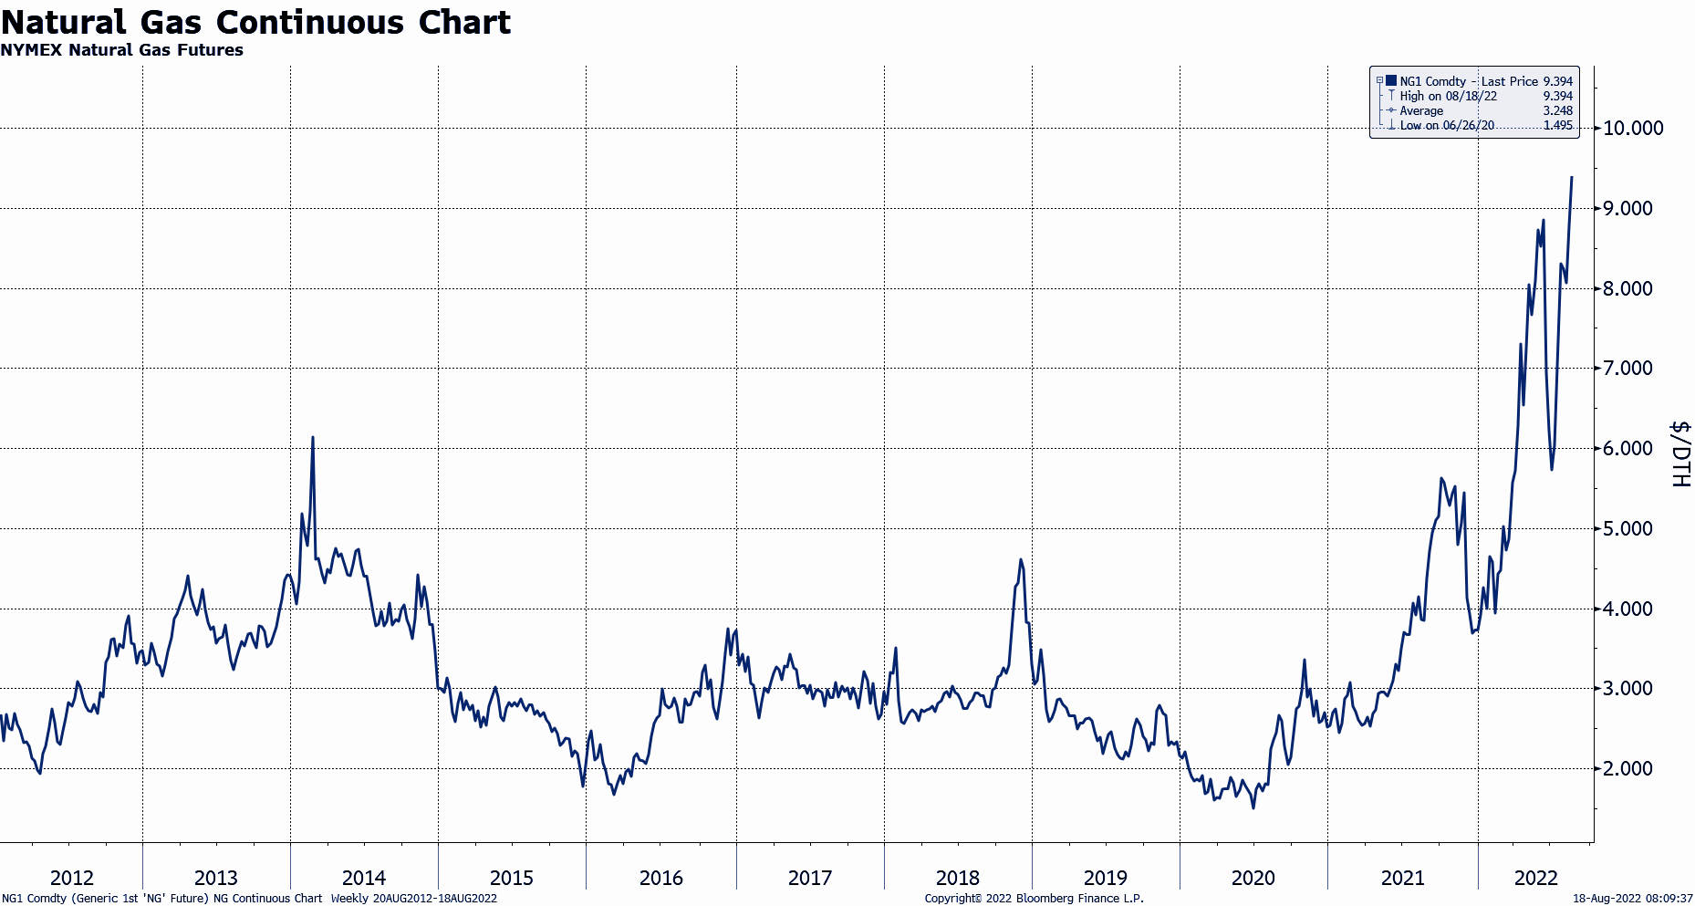
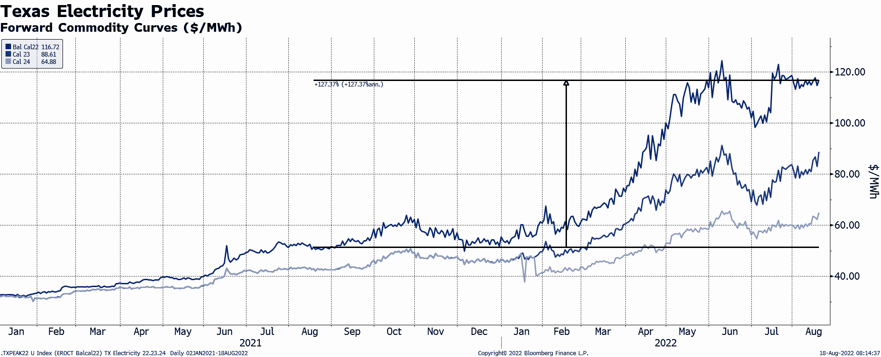
Energy commodity prices are soaring nationwide
What’s happening in the market
In the past 2 years, the cost of natural gas has increased by
Electricity prices are up YTD. in Texas, they have increased by
>350%
>100%
Notes:
Energy is a live commodity and prices are constantly changing for a variety of reasons. Over the previous years, the US has enjoyed a period where energy prices were relatively low. That has changed dramatically as the fundamental landscape for how energy is both generated and consumed has shifted. With this shift, energy prices are expected to continue to be both higher than normal and are expected to endure periods of extreme price volatility like we’ve witnessed recently.

Slide 4
Main Challenges
With so much volatility in the market, it’s difficult for companies to budget appropriately.
VOLATILE MARKET
Many are uninformed about available alternative energy solutions.
KNOWLEDGE GAP
Companies need help achieving their environmental commitments.
ENVIRONMENTAL REGULATIONS/
SUSTAINABILITY
Notes:
Businesses need help procuring energy and managing their spend. With so much volatility in the market, it’s making it very difficult for companies to budget appropriately.
They need a way to lock in multi-year rates so that they can manage their spend and ensure operational budget stability. They have a lack of understanding around energy; need to be informed about alternative energy solutions, like natural gas or solar, that will help them manage their energy spend as well as achieve environmental commitments.

Slide 5
AppDirect can help

Slide 6
This can be solved with a NOC
With the right tools and team in place, you can help customers lock in multi-year deals by finding the best energy solutions and rates.
We’ll also suggest alternative sources of energy that can improve environmental impact and cut costs long-term.
Notes:
If you want to go into more information about energy deregulation:
Energy deregulation: Energy deregulation works through reverse auction, where each company offers to sell its energy at the lowest possible rate. Independent agencies purchase the energy needed to suit the demand they predict, and then set the best rate for their customers. Energy is thus delivered through the existing utility infrastructure. The utility companies that own the infrastructure are responsible for transmitting energy, but not for setting the rate energy users pay. This process allows energy users to receive the same service, but at a rate that fits their needs.
The benefits of energy deregulation
The deregulation of the energy industry brought multiple benefits to the energy user, and includes the following:
Power to choose. Deregulation allows energy users to choose where their energy comes from, and allows them to choose plans that are best for them.
Increased competition and better service. Deregulation promotes competition among energy firms, and motivates providers to offer excellent service to their customers.
Encouraged energy efficiency. Deregulation empowers users to be more energy efficient by choosing companies with more energy-efficient practices.
Improved energy consciousness. Energy deregulation helps energy users understand energy costs by evaluating different plans, and providers often help their customers to save and conserve energy.
New and enhanced services. By diversifying, competitive energy suppliers often offer additional services and benefits to their energy users that would otherwise have been unavailable.

Slide 7
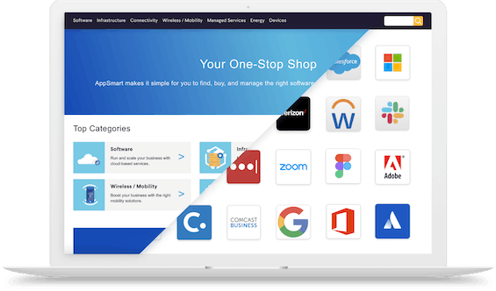
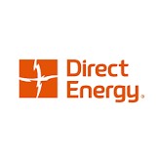
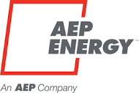
We make it easy to break into selling Energy with AppDirect
Energy Portfolio
Expertise
Energy Seller
Easily complement your connectivity portfolio with energy solutions
Leverage our product experts to increase energy competency
Automate energy procurement from pricing to booking with one tool
Notes:
Energy is a huge opportunity for you to differentiate yourself as an advisor and take advantage of this untapped space. But, we know it can be difficult to expand into a new market without the expertise.
To be able to sell energy you need the right portfolio, expertise, and tools. We’ll provide you with everything you need to make it easy to break into selling Energy.

Slide 8
Add Energy solutions to your portfolio with our catalog
ENERGY
CONNECTIVITY & SD-WAN
EV Charging | Water & Waste Electricity | Natural Gas | Solar
Fiber | Cable | Wireless | Satellite | TEM
MANAGED SERVICES
MOBILITY & IoT
NOC | SOC | Professional Services SmartSupport | Asset Management
Wireless Services | Internet of Things (IoT) Managed Mobility | Expense Management (WEM)
SECURITY
CUSTOMER EXPERIENCE (CX)
Physical Security | Network Security Endpoint Security | Cloud Security | SASE
UCaaS | Contact Center | CPaaS | SMS Analytics | Artificial Intelligence (AI)
CLOUD INFRASTRUCTURE
SOFTWARE AS A SERVICE
Public, Private, & Hybrid Cloud Data Center & Colocation | Disaster Recovery
Microsoft | Google | ERP | CRM | Productivity | Business Applications | IT Management | BI
‹#›
Notes:
By selling with AppDirect, you can be the one-stop-shop for your customers for all of their technology needs, including Energy.

Slide 9
Energy solutions portfolio
Electricity & Natural Gas Procurement
Energy Efficiency
Building Management (Sensors & IoT)
Water Management
Waste Management
Electric Vehicle Solutions
Energy Expense Management
Distributed Generation
Notes:
Develop the energy solution “stack”. Not only can you sell electricity and natural gas, but you can also sell other energy solutions. Talk to your customers to see which solutions they can implement to meet their needs.
Electricity & Natural Gas Procurement: You have a choice who you get your power and gas from. Buy energy smarter, find long-term budget certainty and take advantage of the competitive supply landscape
Energy Efficiency: Update existing building infrastructure like lighting and HVAC system to reduce energy consumption and improve building comfort level satisfaction
Building Management (Sensors & IoT): Securely access and monitor critical building health information to control and proactively address areas of concern from virtually anywhere via cloud based software solutions
Water Management: Optimize the water flow to save money at the meter and utilize smart metering to stop leaks in real time and safeguard against facility damage
Waste Management: Find the most effective waste and recycling solution using a transparent data driven process
Electric vehicle solution: Leading turnkey certificated charging stations and flexible, open, and cloud-based software platform for managing the EV Charging ecosystem.
Energy Expense Management: Integrate your bills in one platform. Shared savings bill audits ensure invoice accuracy and error resolution without any upfront costs
Distributed Generation: Deploy on-site generation such as solar to save on energy rates and take advantage of tax incentives and rebates. Installation-site fuel cells and battery storage to gain resilience against grid interruptions while offsetting your demand from the utility

Slide 10
The AppDirect Catalog contains access to over 40 of the leading industry retail energy providers
Notes:
The AppDirect Catalog contains the leading industry retail energy providers for electricity and natural gas. Through our partnership with Zentility, we have extensive relationships with these providers and are able to negotiate the best rates for your customers. Check out our catalog to see how which providers can fulfill their energy needs.

Slide 11
We’re here to help
Rely on our expertise from start to finish
Pre/post sales support
Engaging with Providers
Scoping the project
Preparing proposals
… and more
Notes:
We know that selling Energy is a new world, but you can rely on our expertise and support to help you from start to finish.

Slide 12
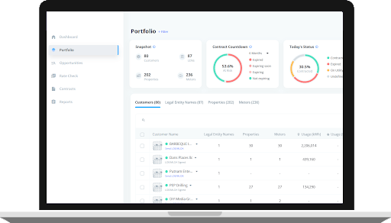
Energy made simple with Energy Seller
Offer your customers the best deals on energy
Automate energy procurement from pricing to booking with one tool
Quickly lock in rates with 1-click, instant contracting
Offer customers the best deals on energy
Automate energy procurement from pricing to booking with one tool
Access competitive supply markets
Quickly lock in rates with 1-click, instant contracting
Build your brand with a custom dashboard, communications and reports
Access competitive supply markets
Build your brand with a custom dashboard, communications and reports
Notes:
While we’re here to help you with your energy deals, we also have an amazing tool that can help you automate energy procurement; Energy Seller.
End-to-end energy procurement with smart technology automating the entire process.
Benefit from AI driven technology to assist in decision making and get nationwide deregulated energy supplier access overnight.
Energy Seller helps you set-up your energy procurement shop overnight!
AppDirect is the only company in this space to provide Energy Seller to all of our advisors.

Slide 13
Hot topic: EV charging stations
How you can win
Sell both the electricity and the SaaS platform to monitor and monetize charging assets
Unlock cross-sell opportunities
Projected EV sales increase from 2021 to 2025
+30%
Projected EV market share by 2030
60%
Notes:
Source: https://about.bnef.com/blog/net-zero-road-transport-by-2050-still-possible-as-electric-vehicles-set-to-quintuple-by-2025/
Electric vehicle sales are on the rise. With EVs comes the need for charging stations. It’s no longer a “wanted” future amenity, it’s a “needed” amenity for many verticals. Did you know that your customers can monetize these charging stations? The SaaS software embedded in the charging stations allows businesses to set their own fee structures for charging to determine what rates EV drivers pay to charge. For the charging station owner with multiple properties and multiple charging stations, the software has the ability to control the entire charging experience under a single pane of glass. Plus with access to “ 24 hour white glove” service from our provider, owners of the charging stations don’t have to worry about the monitoring of the day-to-day operations of these charging stations.

Slide 14
Energy case studies

Slide 15
Energy solutions verticals
Commercial Property
SMB
Hospitality
Industrial/Manufacturing
Education
Multi-tenant
Hospital/Nursing Home/Assisted Living
Notes:
We’ve closed deals with companies across a spectrum of industries. Particularly, we’ve seen great success in the hospitality, multi-tenant, assisted living, and industrial/manufacturing sectors.

Slide 16
Stabilize energy costs
Our portfolio is a good fit for any company looking to:
Have more predictable energy costs that are not impacted by market fluctuations
Find a more flexible provider than the large utility companies
Reduce their overall spend on electricity and/or natural gas

Slide 17
Key energy wins 2022
Secured >$2.5M in energy procurement deals with Energy Seller
$1.2M lighting retrofit for a major private university in NC
3-year natural gas supply contract for a waste management company in CA
$1.9M solar installation on a manufacturing plant in NJ
$60K in commissions
$120K in commissions
$40K in commissions
Notes:
There is a lot of money to be made in the energy space! Let’s look at some key energy wins from 2022.

Slide 18
Reducing electricity spend by $192K per year
Company Industry: Document Solutions
Location: New Jersey
Challenge
Electricity prices rose dramatically over the last few years and wanted to see if Solar could help reduce costs
Solution
Design and installation of a $2M on-site solar solution
Video
Results
$192K/year in Net Operating Income (NOI) improvement
Project is a key contributor to their global sustainability objectives
Notes:
Fun fact: this project came at zero out of pocket expense to the company as they signed a 15-year agreement to purchase the solar electricity generated from the company that financed the project. There are tons of programs and incentives that we can find for your customers to help them achieve their energy goals.
Play the video of the aerial footage of the solar solution!

Slide 19
$200K in savings on natural gas
Company Industry: Garbage collection, recycling and waste management
Location: California
Challenge
Natural gas prices had been steadily increasing since 2021 and operating expenses tripled from previous years
Solution
AppDirect Energy Experts used Energy Seller to lock in a 3-year deregulated natural gas supply contract
Results
Savings of almost $200K to date on natural gas
Locked-in contract enables them to better plan and manage their monthly utility budget
Notes:
Company uses compressed natural gas (CNG) to fuel their fleet of collection trucks. They have historically purchased natural gas commodity supply from SoCalGas. Natural gas prices have been steadily increasing since 2021. In 2022, Marborg’s monthly operating expenses began to triple from previous years and they wanted to know if there was a way to purchase natural gas that would allow them to improve their utility operational expenses and mitigate their risk to future price increases in natural gas.
This new contract provides them with a known natural gas commodity rate that will allow them to better plan and manage their monthly utility budget. The contract has also saved them almost $200,000 to date against rates they would’ve paid for natural gas commodity if still buying from SoCalGas.

