Slide 1
Cover all your IT bases
with Firstbase
Your Hardware & Logistics solution

Slide 2
What’s happening in the market?

Slide 3



What’s happening in the market
Manual IT asset management incurs massive costs
60% of workers are remote
1.7 billion devices deployed globally
30% of assets are lost, missing, or unaccounted for in large organizations
Notes:
Start by asking the audience a question: Do you remember you IT onboarding process as a new employee? Have you ever had to return equipment to IT or have your equipment serviced with little visibility into wait times? Have you heard from HR or IT managers themselves about the cumbersome process of processing onboarding and offboarding IT tickets?
With 62% of workers being remote, over 1.7 Billion devices deployed around the world, it’s no wonder 30 % of assets are lost, missing, or unaccounted for in large organizations.
IT assets are typically managed internally through manual processes, lack tracking, and incur massive costs.

Slide 4



What’s happening in the market
Manual IT asset management incurs massive costs
It takes an average of 30 minutes to provision an employee laptop manually
43% of employees spend two to three hours a week fixing IT issues
It represents $3,165 of wasted productivity per employee per year

Slide 5




Challenges companies face
Manual IT processes for managing employee equipment consume entire days of IT staff time.
HIGH TOUCH & MANUAL PROCESSES
IT teams are overwhelmed trying to manually support growing employee populations, leading to delays and a poor employee experience.
IT STAFFING & BUDGET CONSTRAINTS
Poor equipment retrieval processes expose companies to significant financial losses and security risks.
SECURITY & ASSET RECOVERY
Distributed companies struggle without local IT presence, making expansion challenging.
PROVIDING LOCAL SERVICES
Notes:
More specifically, IT and HR managers at companies struggle with:
Fragmented ticket submissions for new hires, equipment requests, and offboarding + disjointed systems = friction and security risks. Companies need to automate employee onboarding, offboarding, and upgrades, increasing productivity and minimizing security risks.
Companies that have poor to no visibility into equipment tracking need the the ability to automatically document tracking information for procurement, retrieval, and disposal.
Without asset management platform integration, IT staff must manually check out equipment and purchase tickets in multiple project management and PO systems, leading to increased human error and inefficiencies. Integrations and automated provisioning can streamline this process, reducing errors and the need to manage assets across multiple platforms.
Companies handle multiple country-based partner management systems and can simplify international operations by offloading the management of country-specific customs and vendors to us.

Slide 6
The right tools enable you to increase productivity and proactively identify and address potential issues before they escalate into major problems.
This helps minimize manual burden, productivity loss and data breaches that can negatively impact business operations.

Slide 7
70%
of organizations will adopt a managed device life cycle service offering by 2028.

Slide 8
Firstbase can help

Slide 9
How Firstbase helps
Firstbase's platform automates the entire equipment lifecycle from procurement to disposal, eliminating manual IT tasks
AUTOMATE PROCESSES
Services and automation off-load IT, allow support ratios to move from 1 IT person being able to support 300 to 2500.
EXTEND YOUR
TEAM
Asset recovery processes achieve 90%+ retrieval rates while ensuring secure data handling and device redeployment.
ASSET RECOVERY & RE-DEPLOYMENT
A global infrastructure network handles equipment deployment across 150+ countries through integrated logistics and compliance systems
GLOBAL NETWORK

Slide 10
A comprehensive solution for
Hardware & Logistics Management
SERVICES
STAGING, REPAIR, RETRIEVAL, REDEPLOYMENT
FIRSTBASE PLATFORM
HARDWARE PROCUREMENT
Notes:
The Firstbase platform gives companies a dedicated platform to manage the lifecycle of every device.
Alongside the Firstbase platform, customers can purchase services (also called actions) and procure hardware in a flexible and agnostic OEM approach.
Firstbase takes over all of the physical things that need to happen alongside that. From shipping, to imaging, repairs and recycling. Firstbase is a company's outsourced Hardware and Logistics management solution.

Slide 11
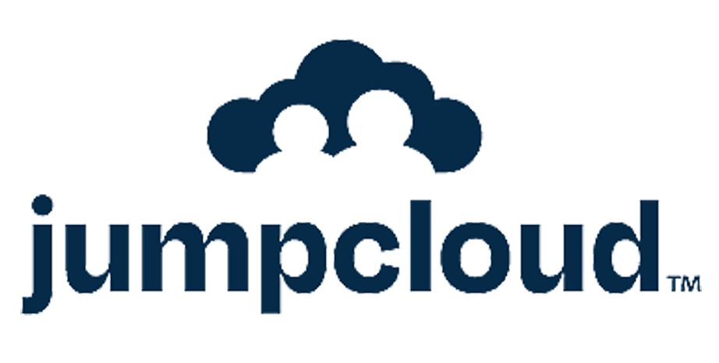














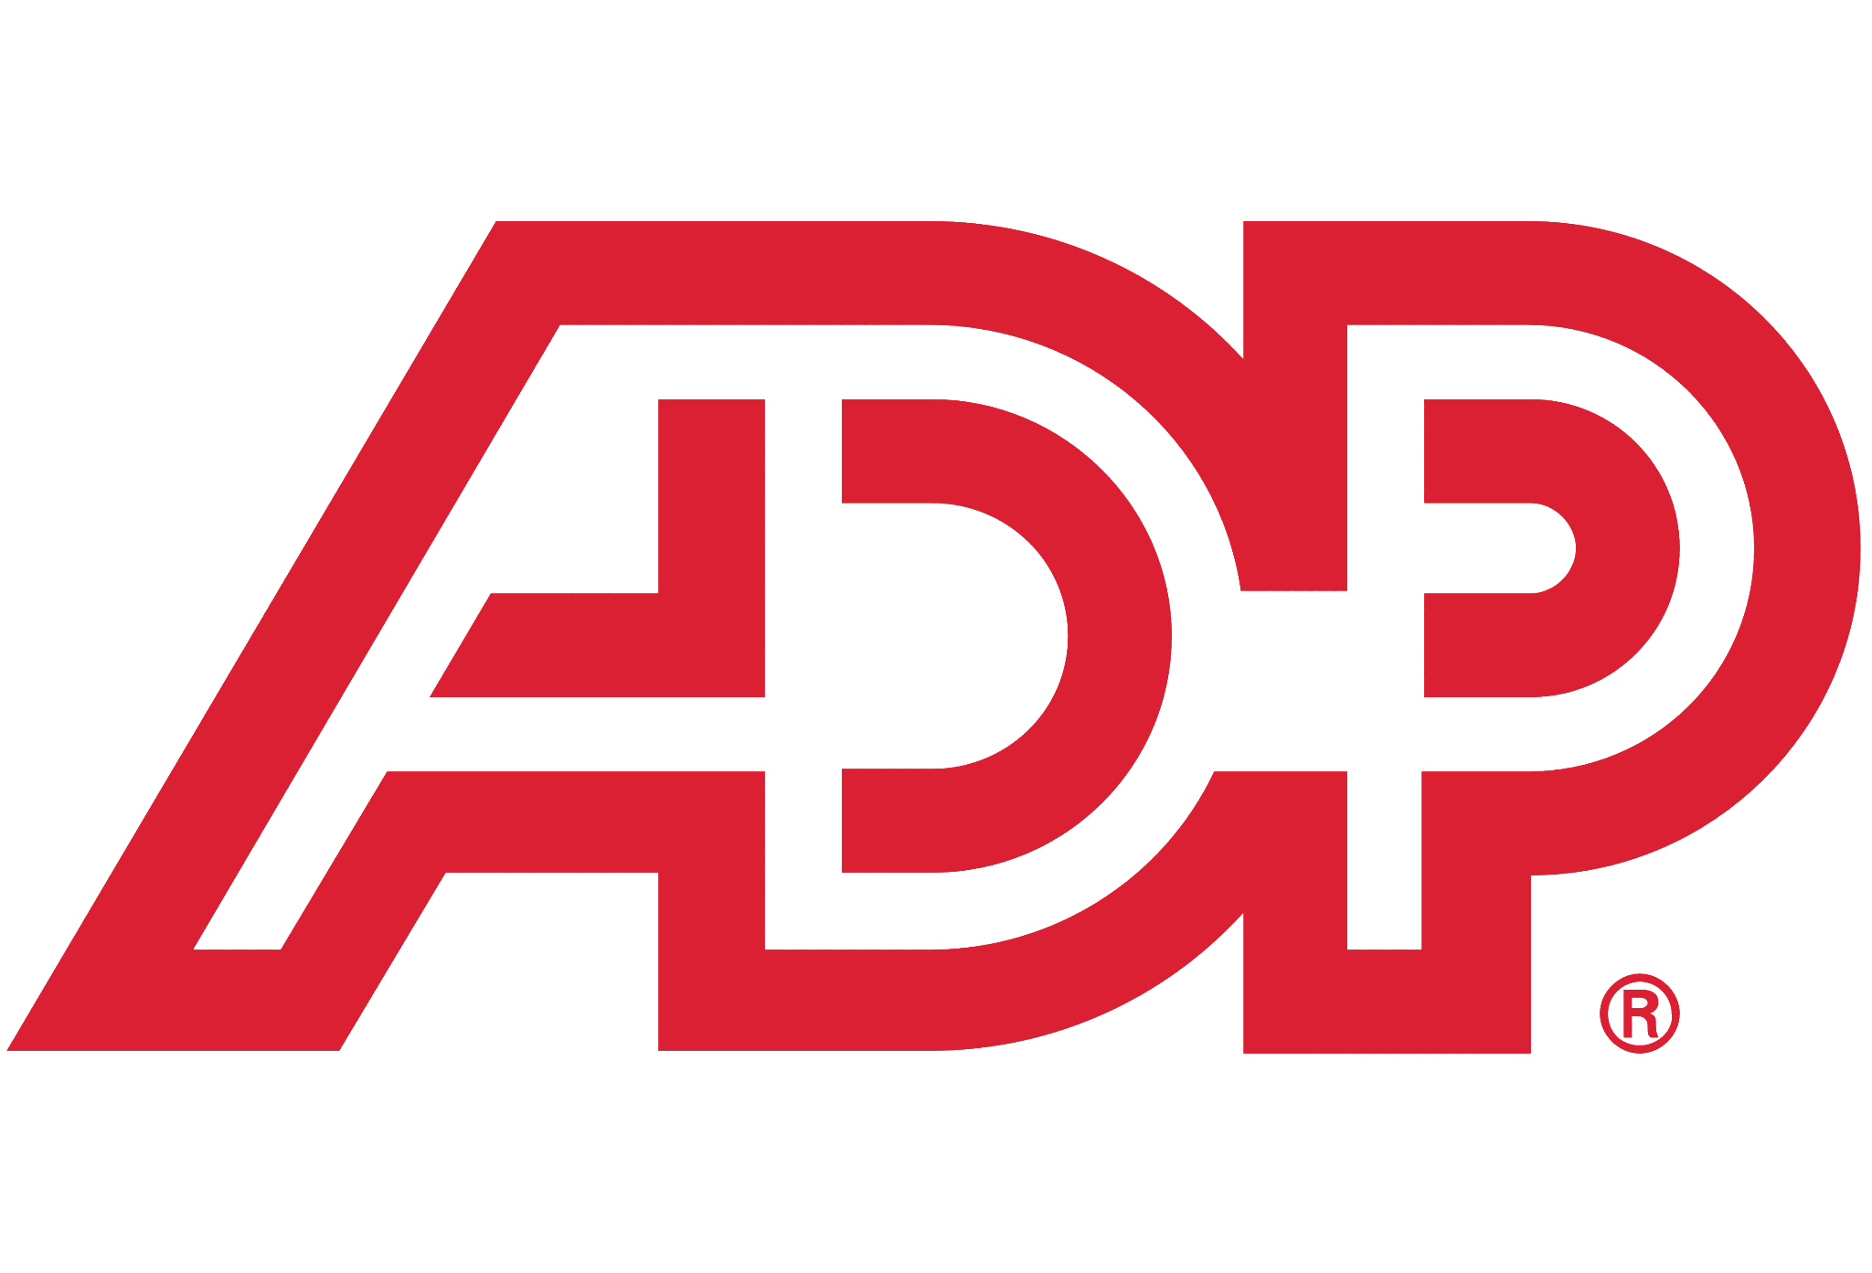

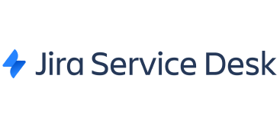
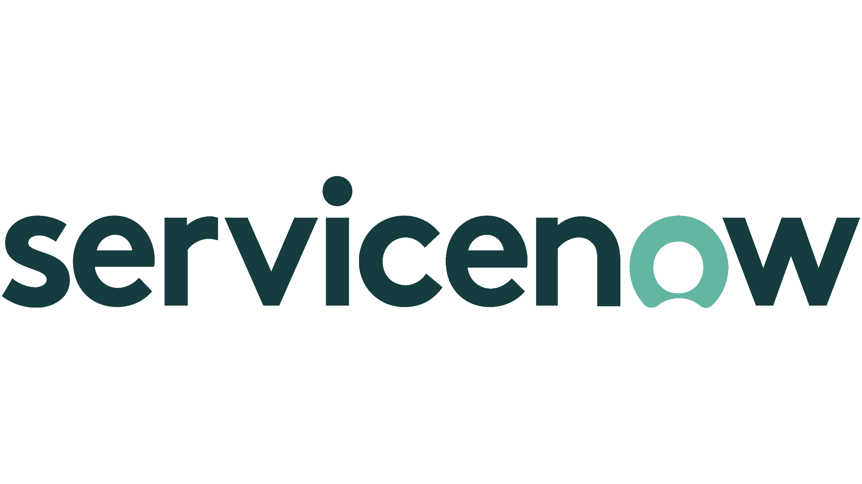
A single platform to equip teams and manage assets
Set up and stage equipment
Automate the lifecycle of every asset in your business.
Ensure the right person has the right equipment at the right time.
Get your equipment to and from employees wherever they are in the world.
Get a full history of actions taken on every device.
Recycle or dispose equipment
Procure equipment
Ship equipment
Retrieve & Store
ONBOARD
OFF-BOARD
Manage logistics
Employee
Off-boarding
Manage suppliers
Track, Manage, Repair
Manage onboarding requests
Notes:
So let’s talk about the Platform
Firstbase, now partnered with AppDirect, is that hardware and IT asset management solution. It lets customers automate the lifecycle of every asset in their business, ensuring the right person has the right equipment at the right time. They get equipment to and from employees wherever they are in the world, providing a full history and visibility of actions taken on every device.
But let’s understand first what we mean by asset management: it involves many moving parts and can be represented by this cycle diagram you see here - an infinite loop of things to manage.
*Go through each piece quickly starting with “Manage onboarding requests” and ending with “Recycle or dispose”*
When each of these components is automated or managed on behalf of customers, customers will see a significant reduction in IT tickets and an increase in IT & HR resources available to tackle other, more strategic initiatives within their business.

Slide 12

Complete Lifecycle Hardware Services
Orders
Equipping new hires
Returns
Retrieving equipment from leavers
Returns + Pickup Scheduling
Inbound receiving
Freight
Storage
Inbound Receiving
Order Mgmt and scheduling
Diagnostic, grading, cleaning, repack
Pick & Pack
OS Restore & Data Erase
Freight
Restock Fee
Asset Disposal (ITAD)
Recycle, Resell, Donate
Repairs
Warranty and Non Warranty
Replacements
Refreshes and Breakfixes
Imaging
US, UK, EU, Canada
Retrieve Equipment
Taking in customer inventory
Hash-ID Extraction
Notes:
As we previously said, alongside the Firstbase platform, your customers can purchase services (also called actions)
Here Firstbase can help you with your IT management by taking care of orders, returns, asset disposal, repairs, replacements, imaging, equipment retrieval and Hash ID extractions

Slide 13



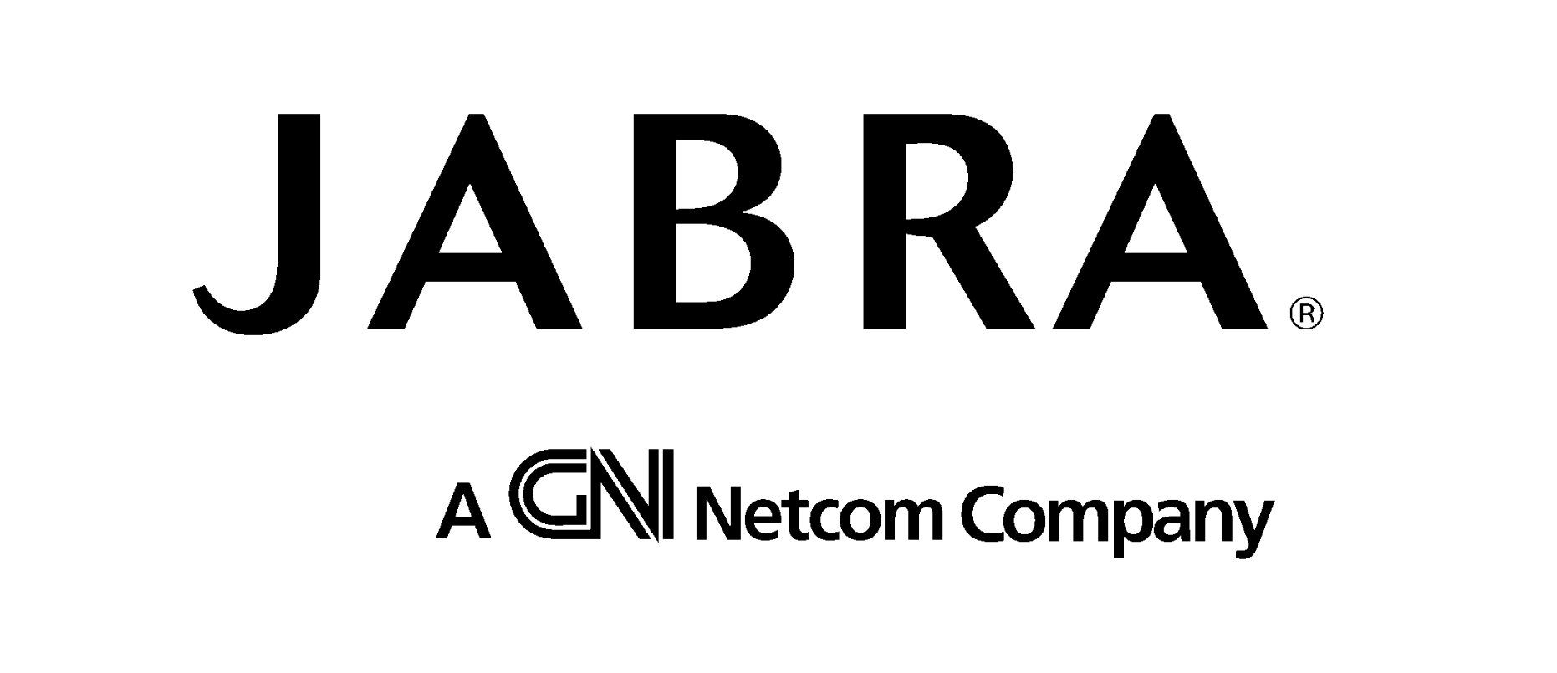

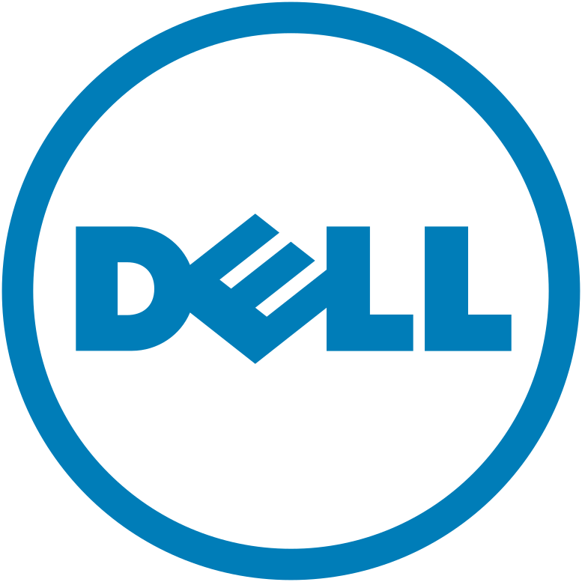
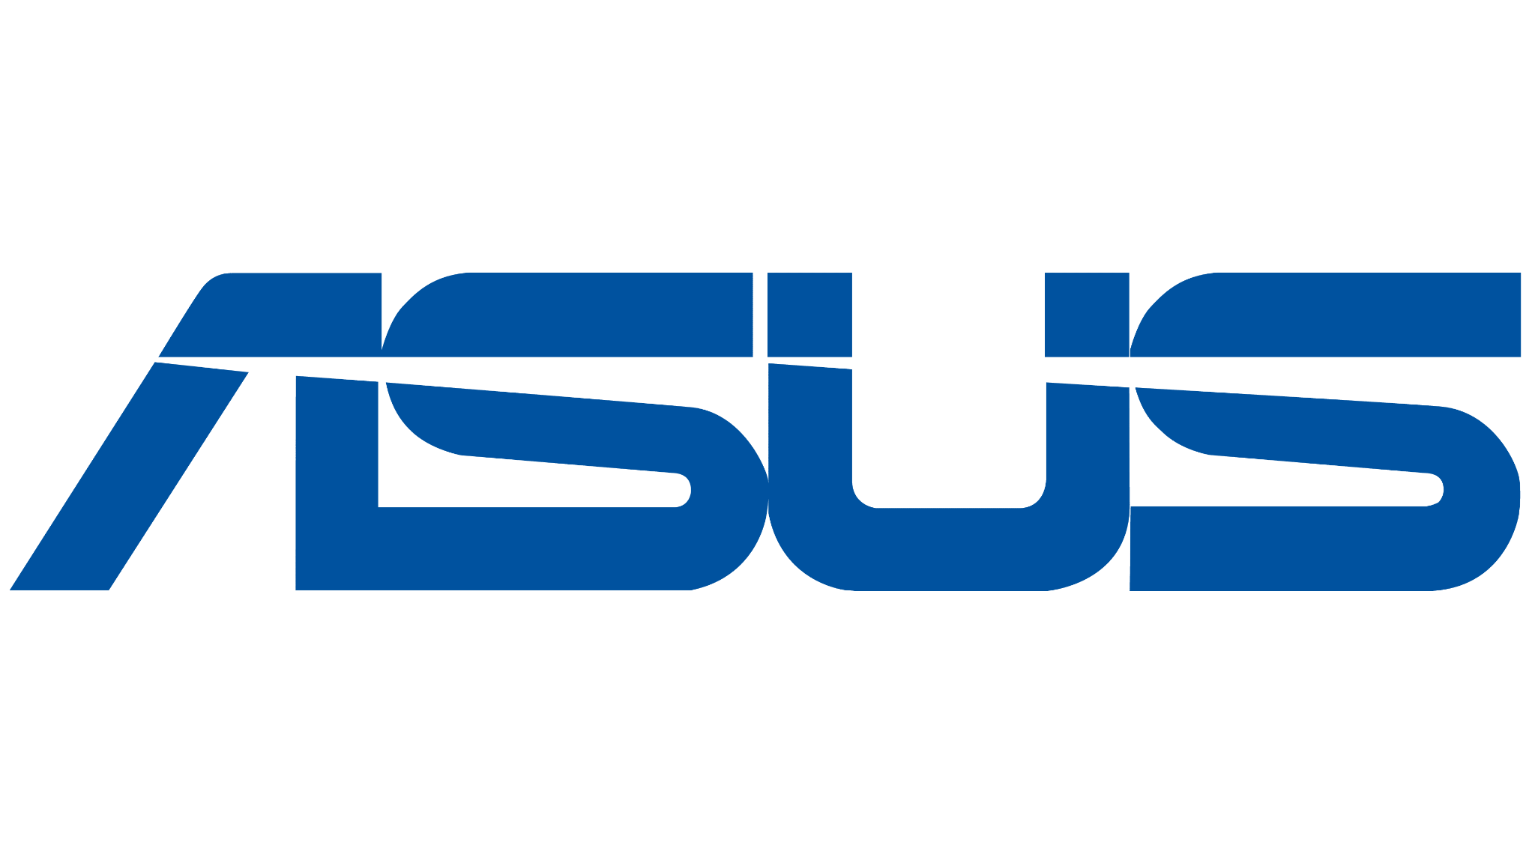


Procure hardware agnostically from Firstbase or continue with existing partners
Firstbase supplied
Firstbase to procure devices on your behalf through Firstbase’s Vendors
Firstbase managed
Firstbase to procure devices on your behalf through your own Vendors
Customer supplied
Customers can use their existing suppliers and ship equipment to Firstbase warehouse for management.
Notes:
And Firstbase is vendor agnostic. Whatever supplier a company wants to use, we can work with. If we don’t have a relationship with someone they need our procurement team will go out and establish that relationship.
We have 3 models in which we can do hardware.
Firstbase supplied, where we are the marketplace and we essentially replace their existing suppliers or VAR. The benefit here is they deal with one vendor globally, not 10s of suppliers in every country.
Firstbase managed, where we procure equipment through a customers existing suppliers and we manage the relationship
Or customer supplied where they ship equipment they procure themselves to our warehouses.

Slide 14
How Firstbase helps companies
>40%
97%
200K
Reduction in IT tickets
Asset retrieval rate
Savings in devices
Notes:
Firstbase have had massive impact inside the accounts they work with
They give customers time back by reducing the number of tickets
They increase the number of devices retrieved, reducing the amount of equipment that must be procured

Slide 15
Case studies

Slide 16




Customer examples
Save Money
Save Time
Improve Security
>40% Reduction in IT Tickets
2 people supporting 2,500 employees
30% Increase in asset retrievals
Reduced time spent on IT equipment management by 8x
Notes:
And this is the direct customer impact we’ve had.
NewRelic are now able to support 2,500 people with 2 x IT people. The industry average is something like a ration of 1 to 150. Using Firstbase is literally 10X more efficient.
Massive time savings by companies like wise and brightwheel
And increase security in companies like OpenGov where we’re increasing how much equipment they get back.

Slide 17

New Relic Transforms IT Operations with Firstbase: From High-Touch Provisioning to Zero-Touch Efficiency
Challenges
High-touch provisioning was time-consuming, often taking up an entire day each week
Company restructuring left only one procurement specialist to manage all 4,000 laptops globally, increasing the IT team's burden
Lack of IT presence in certain regions made deploying, managing, and recovering employee assets difficult
Outcomes
Firstbase automated the entire asset lifecycle, reducing manual tasks and allowing the IT team to focus on strategic initiatives
Implemented a zero-touch provisioning model, enabling seamless device deployment and management
Managed asset recovery efficiently, achieving a 90%+ retrieval rate and ensuring secure data wiping and asset redeployment
Provided global support, handling logistics and procurement globally, including challenging areas like Israel and the UK

Slide 18

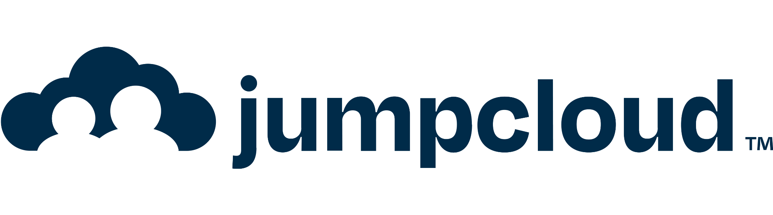






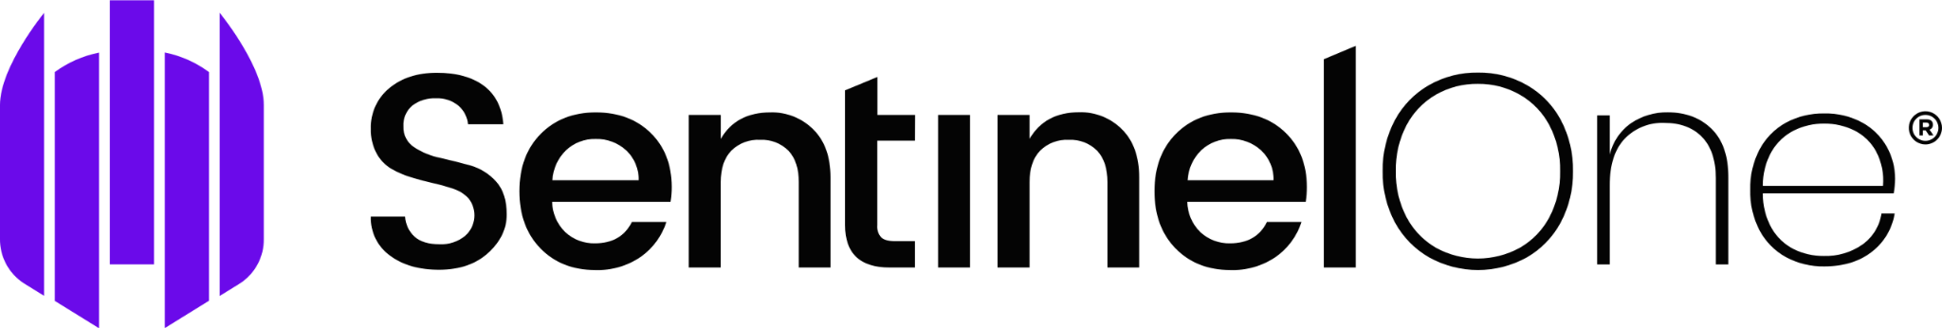
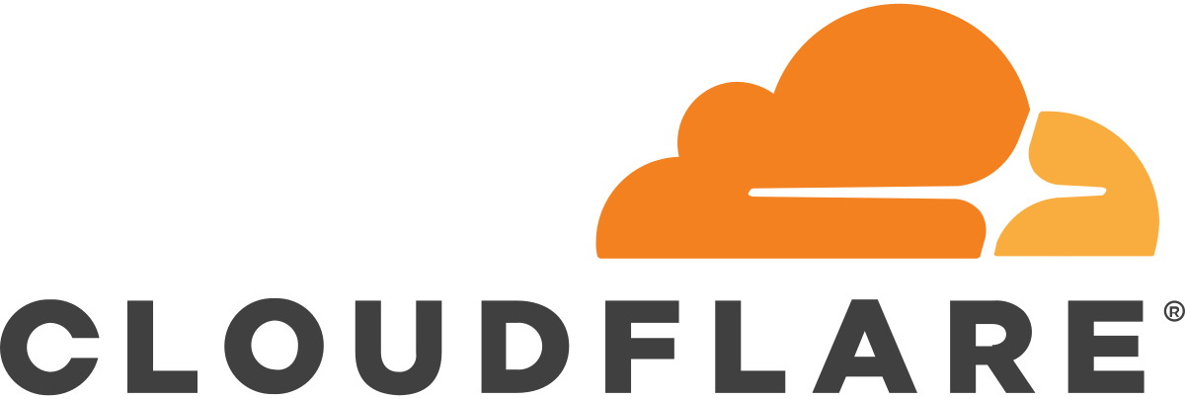







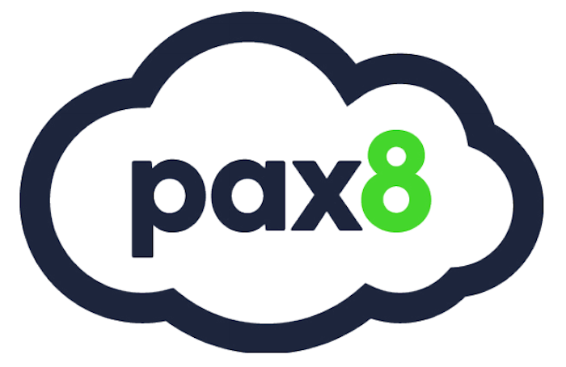
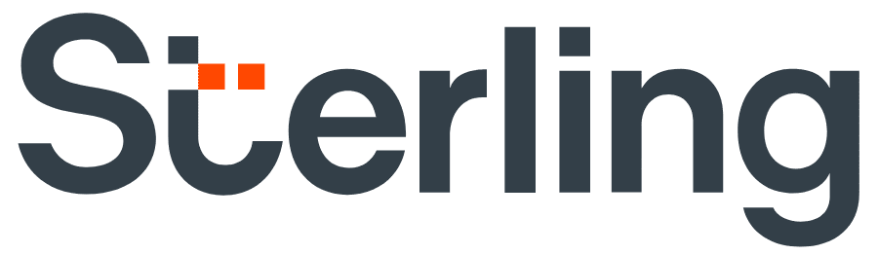


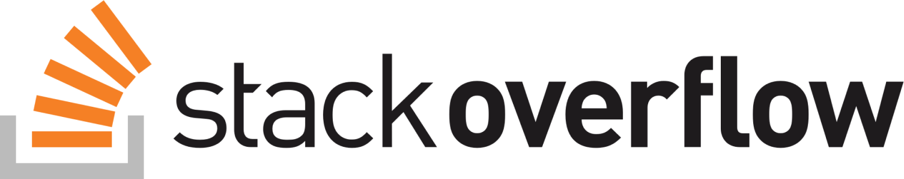

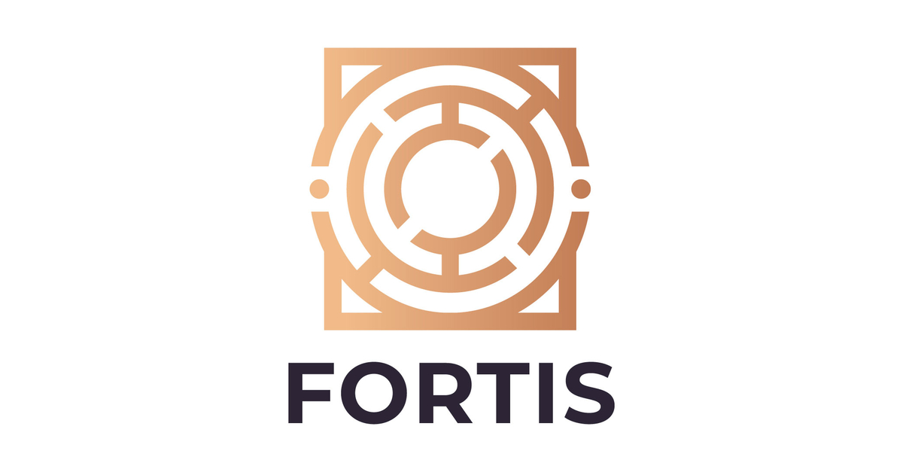







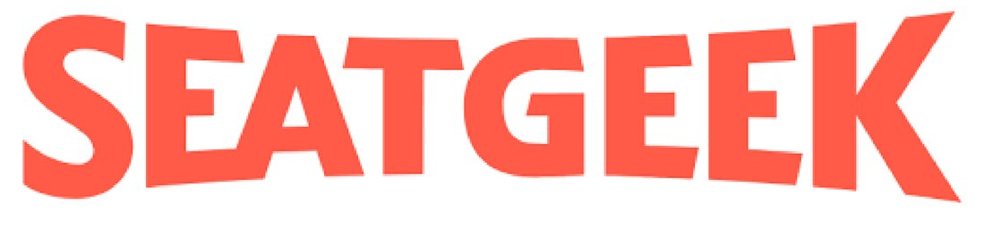
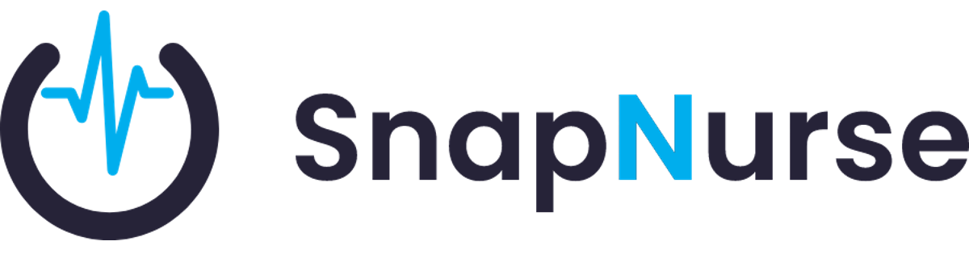


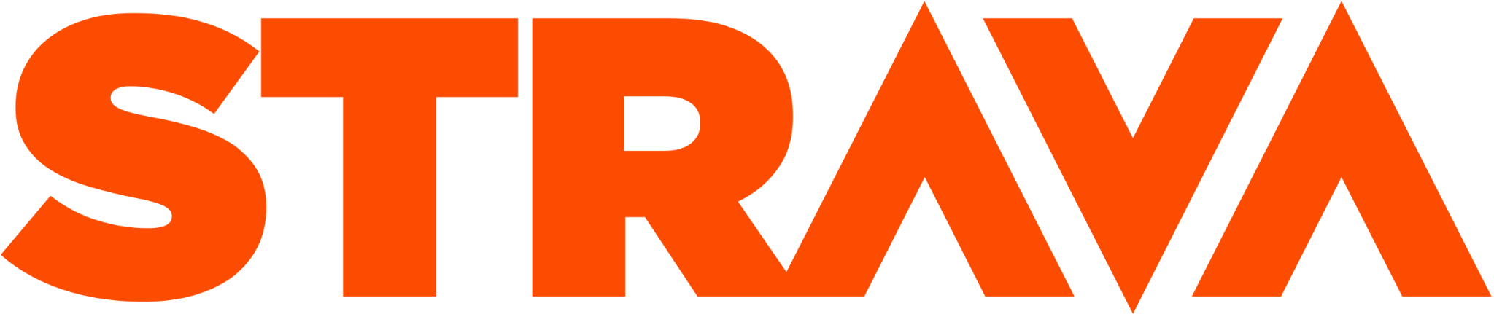
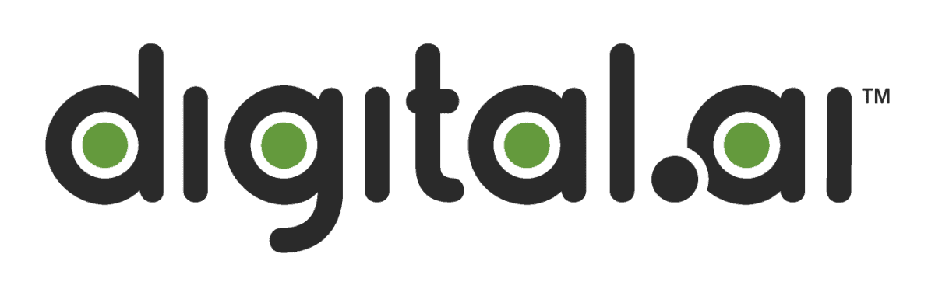

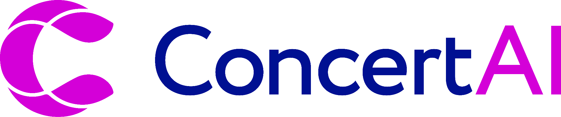

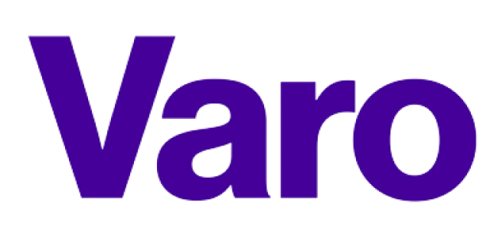


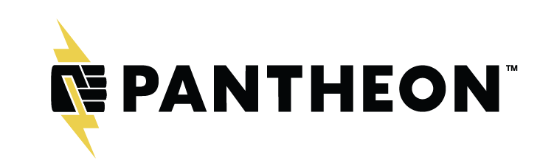

Customer examples

