Slide 1
Cover all your IT bases
with Firstbase
Your Hardware & Logistics solution

Slide 2
What’s happening in the market?

Slide 3



What’s happening in the market
Manual IT asset management incurs massive costs
62% of workers are remote
1.7 billion devices deployed globally
30% of assets are lost, missing, or unaccounted for in large organizations
Notes:
IT assets are typically managed internally through manual processes, lack tracking, and incur massive costs.
With 62% of workers being remote and over 1.7 Billion devices deployed around the world - managing assets manually is daunting and it’s no wonder that 30% of assets are lost, missing, or unaccounted for in large organizations, resulting in massive costs for replacements and security risks.
That is why the market opportunity is huge. Almost every company is remote or hybrid one way or another, meaning that they have at least mobile devices, whether that is iPads and Phones or Laptops.
And a massive issue is many of these devices are lost or stolen.

Slide 4



What’s happening in the market
Manual IT asset management incurs massive costs
It takes an average of 30 minutes to provision an employee laptop manually
43% of employees spend two to three hours a week fixing IT issues
It represents $3,165 of wasted productivity per employee per year
Notes:
And lost assets are not the only issue.
Managing assets manually also causes productivity issues inside companies. IT teams waste time, employees have terrible experiences, and a lot of money is wasted.

Slide 5




Challenges companies face
Manual IT processes for managing employee equipment consume entire days of IT staff time.
HIGH TOUCH & MANUAL PROCESSES
IT teams are overwhelmed trying to manually support growing employee populations, leading to delays and a poor employee experience.
IT STAFFING & BUDGET CONSTRAINTS
Poor equipment retrieval processes expose companies to significant financial losses and security risks.
SECURITY & ASSET RECOVERY
Distributed companies struggle without local IT presence, making expansion challenging.
PROVIDING LOCAL SERVICES
Notes:
More specifically, IT and HR managers at companies struggle with:
High touch and manual processes:
Fragmented ticket submissions for new hires, equipment requests, and offboarding and add to that disjointed systems which creates friction and a lack of productivity.
Companies that have poor to no visibility into equipment tracking need the ability to automatically document tracking information for procurement, retrieval, and disposal.
Without a asset management platform integration, IT staff must manually check out equipment and purchase tickets in multiple project management and systems, leading to increased human error and inefficiencies.
All of these challenges could be solved with bigger IT teams of course but we know companies often face IT staffing and budget constraints.
Not having enough people to do this, and the people they do are wasting time on these activities at the expense of working on key strategic initiatives. How many of the IT leaders you work with would love an extra 2-3 extra sets of hands to do crucial work? Adopting Firstbase can give companies their people back.
As we said earlier, the lack of visibility into asset tracking, human error and inefficiencies can cause security breaches
And finally providing local services efficiently is also something complex for multi country-based companies or distributed team with many offices in a same country
So to sum up this slide: every company has these issues and generally they are managing it manually either with a lot of IT people or in spreadsheets. Companies need to automate employee onboarding, offboarding, and upgrades, increasing productivity and minimizing security risks.

Slide 6
70%
of organizations will adopt a managed device life cycle service offering by 2028.
Notes:
In terms of progress, this is where Gartner think the world is headed.
70% of organizations will adopt a managed life cycle service offering by 2028
Firstbase is already, right now, today, named as one of the key players in this space by Gartner.

Slide 7
Firstbase can help

Slide 8
How Firstbase helps
Firstbase's platform automates the entire equipment lifecycle from procurement to disposal, eliminating manual IT tasks
AUTOMATE PROCESSES
Services and automation off-load IT, allow support ratios to move from 1 IT person being able to support 300 to 2500.
EXTEND YOUR
TEAM
Asset recovery processes achieve 90%+ retrieval rates while ensuring secure data handling and device redeployment.
ASSET RECOVERY & RE-DEPLOYMENT
A global infrastructure network handles equipment deployment across 150+ countries through integrated logistics and compliance systems
GLOBAL NETWORK

Slide 9
A comprehensive solution for
Hardware & Logistics Management
SERVICES
STAGING, REPAIR, RETRIEVAL, REDEPLOYMENT
FIRSTBASE PLATFORM
HARDWARE PROCUREMENT
Notes:
First there is the Firstbase platform, which gives companies a dedicated place for them to manage their hardware such as computers, mice etc. It is a solution that gives the company a view of all their hardware for each employee.
But Firstbase is also is an extension of IT teams as it also takes over all of the physical things that need to happen alongside that:
So first extension is the services: Firstbase can also take care of device shipment or repairs for example
And second extension is Hardware procurement: through the appdirect markapltace, companies can also purchase hardware. Firstbase can also procure hardware on the customer’s behalf.
Overall Firstbase is a company's outsourced Hardware and Logistics management solution. It is a single vendor to handle it all on your customers behalf.

Slide 10
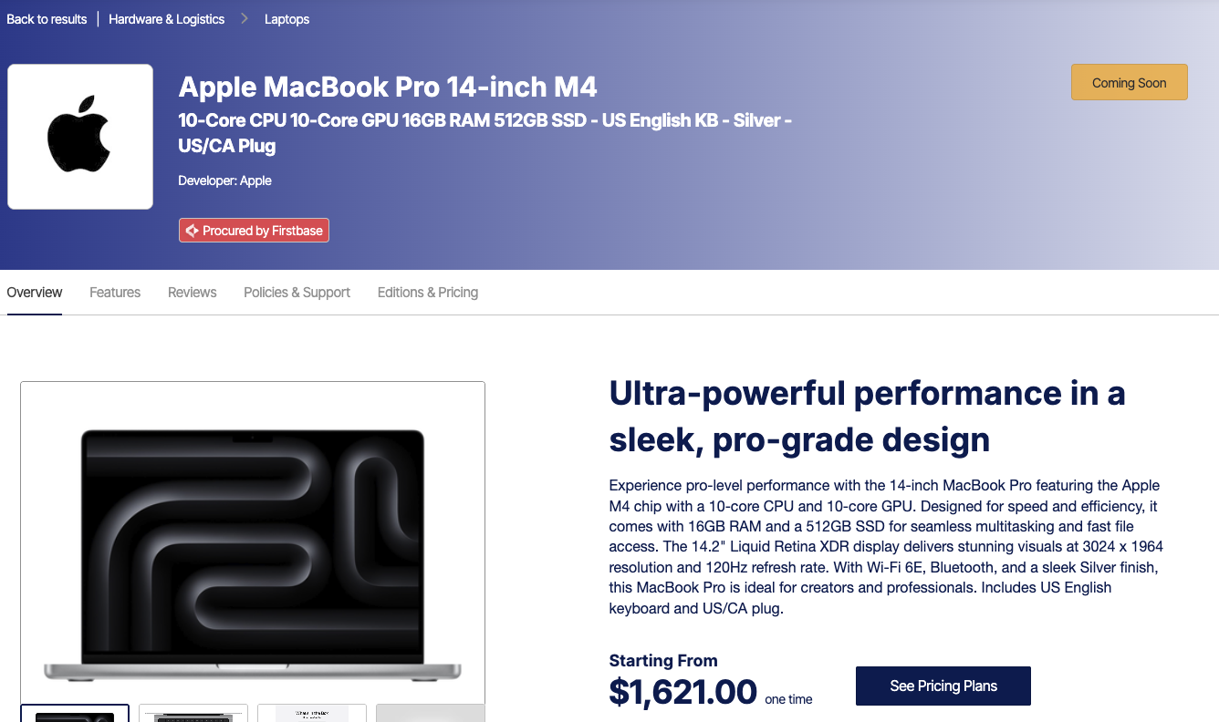
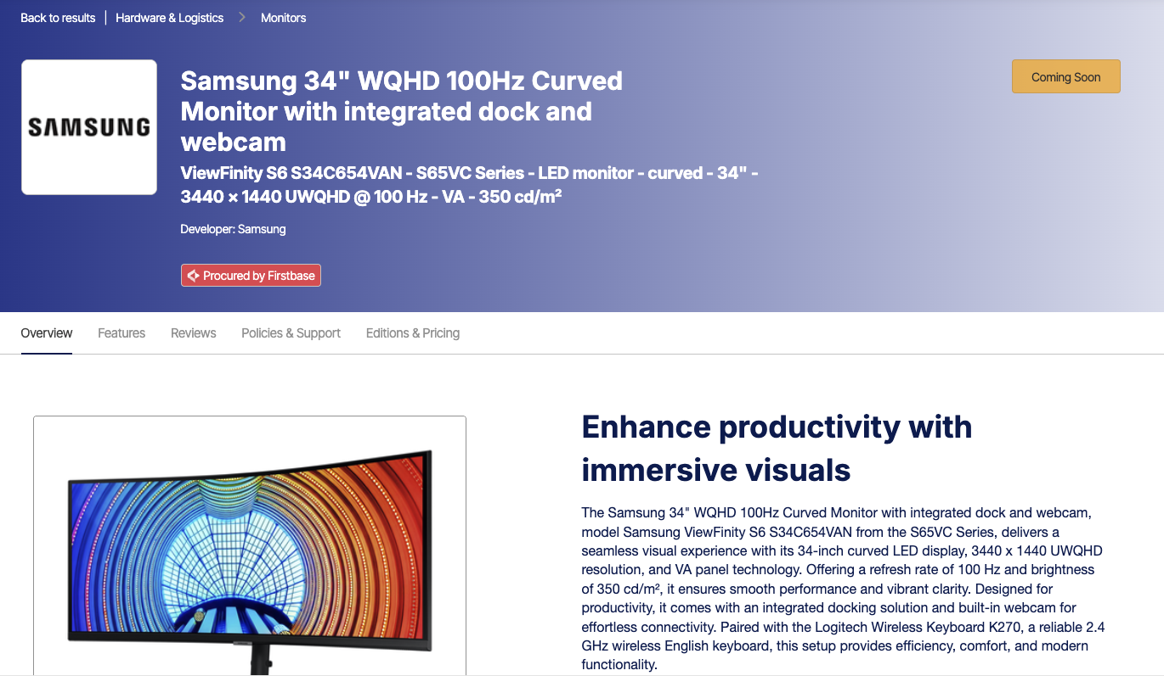




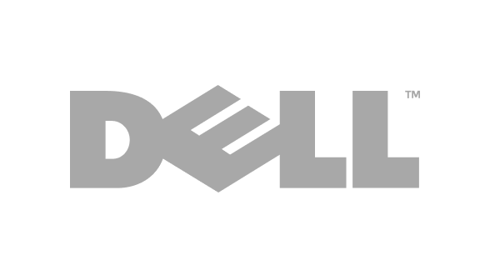
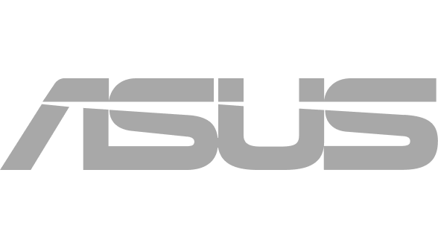
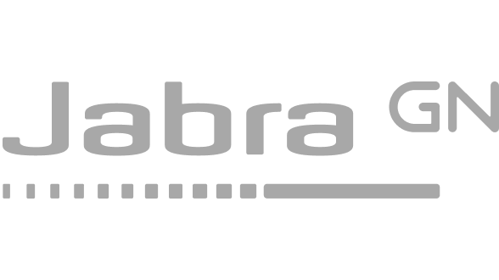

All the hardware you need to run your business
Tap into a hardware catalog powered by industry-leading providers
Notes:
Before diving into the Firstbase platform, we’re excited to announce two major updates that change how you can leverage Firstbase for your business:
First, the Firstbase hardware catalog is now available directly in the AppDirect Marketplace. Customers can purchase devices like laptops, monitors, keyboards, mice, headsets, phones, and even furniture—without needing a Firstbase platform subscription— from leading hardware providers such as Apple, Samsung, LG, and more.
This means faster, simpler hardware procurement—no platform commitment needed.

Slide 11
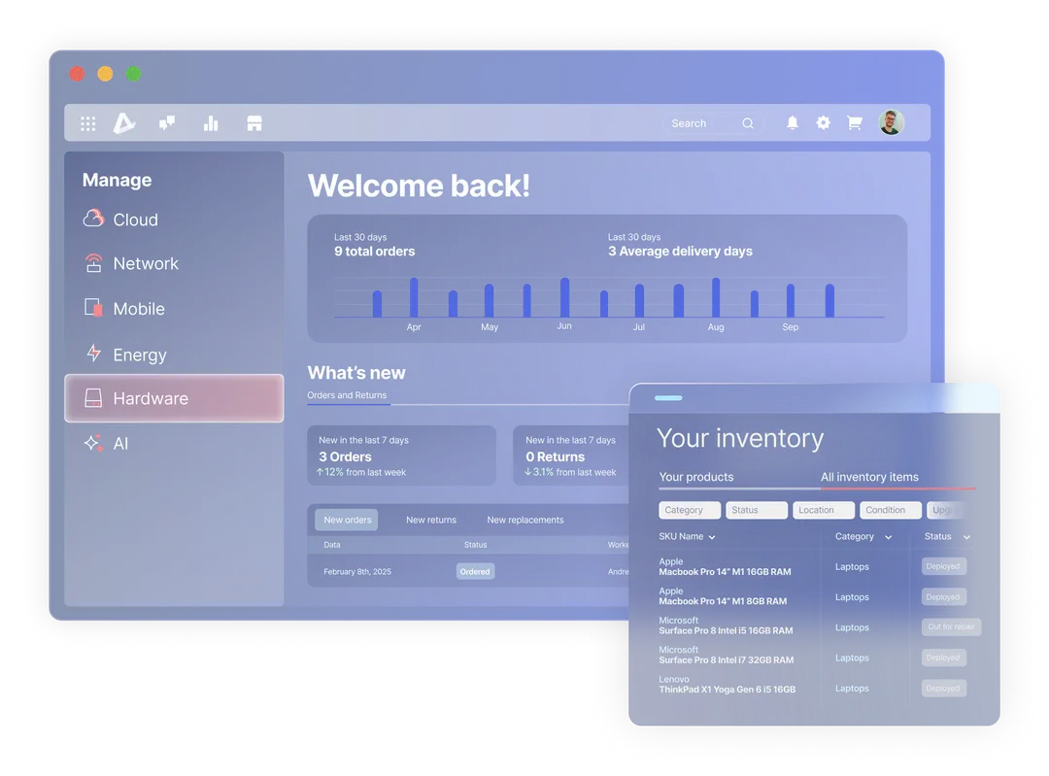



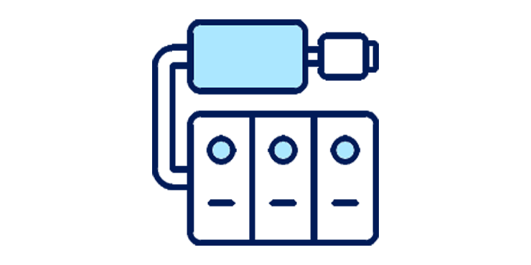
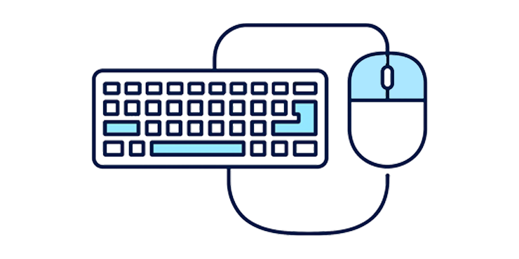



Manage all your hardware in one place
Unlock seamless employee hardware management with the Firstbase free edition:
Track hardware orders
Add and manage up to 50 employees
Manage offices and assets
All directly within the AppDirect Marketplace.
Notes:
Alongside hardware availability, we’re launching Firstbase Free Edition—a self-serve platform for managing hardware for up to 50 employees, completely free, directly from the AppDirect Marketplace.

Slide 12
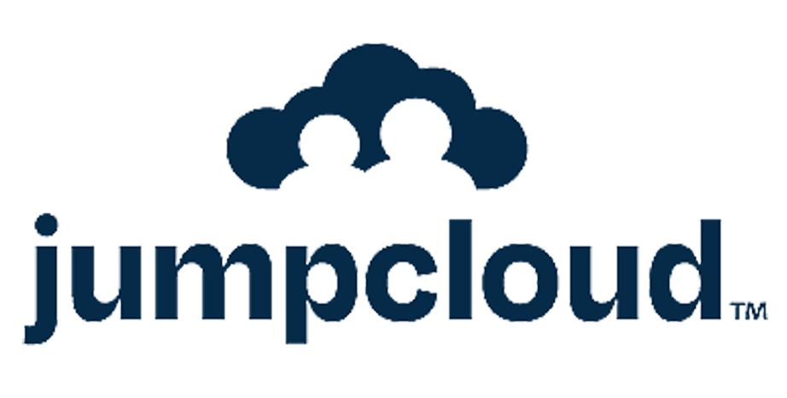










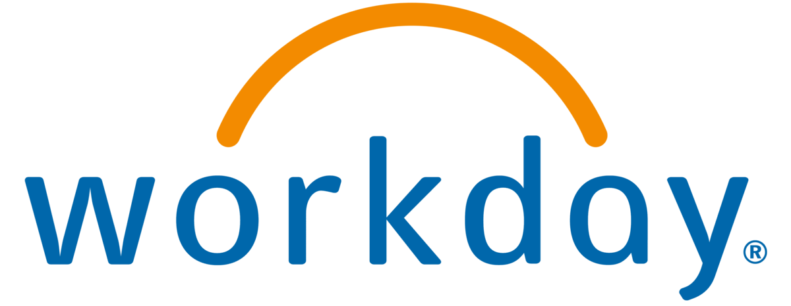



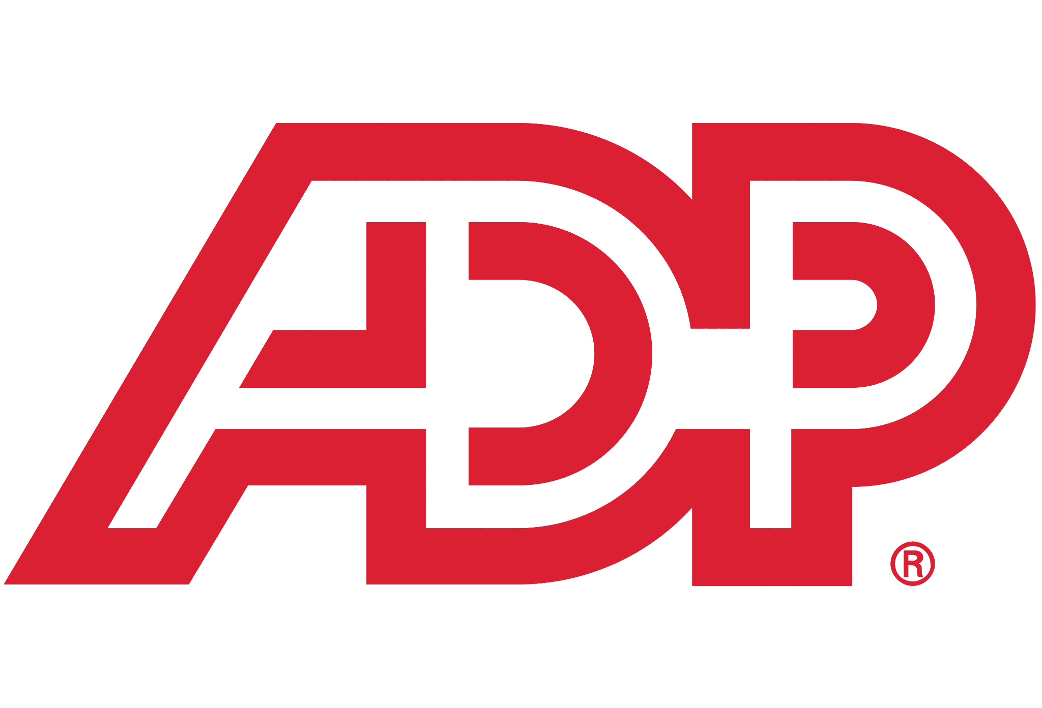

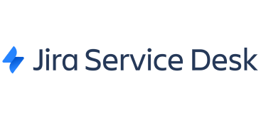
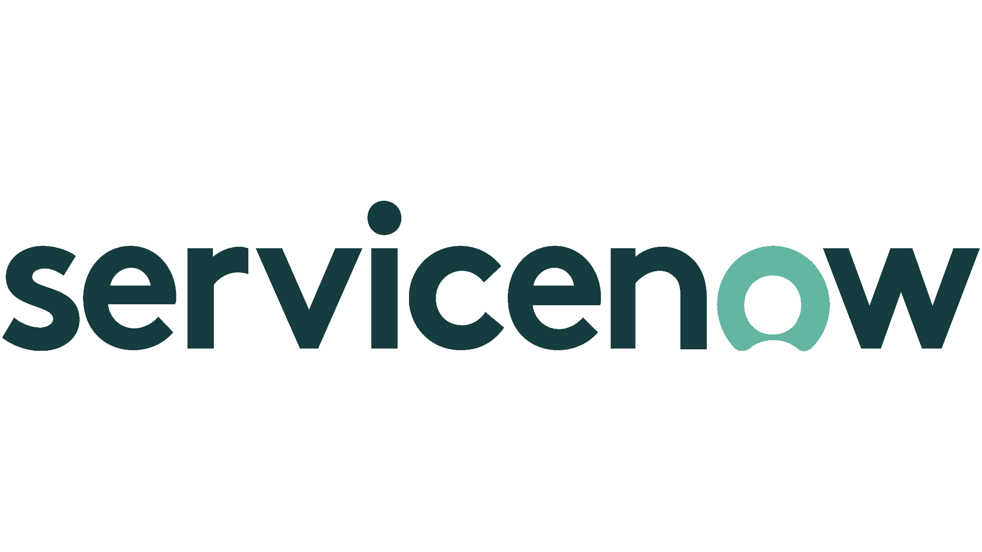
A single platform to equip teams and manage assets
Set up and stage equipment
Automate the lifecycle of every asset in your business.
Ensure the right person has the right equipment at the right time.
Get your equipment to and from employees wherever they are in the world.
Get a full history of actions taken on every device.
Recycle or dispose equipment
Procure equipment
Ship equipment
Retrieve & Store
ONBOARD
OFF-BOARD
Manage logistics
Employee
Off-boarding
Manage suppliers
Track, Manage, Repair
Manage onboarding requests
Notes:
So let’s talk about the Platform
Firstbase, now partnered with AppDirect, is that hardware and IT asset management solution. It lets customers automate the lifecycle of every asset in their business, ensuring the right person has the right equipment at the right time. They get equipment to and from employees wherever they are in the world, providing a full history and visibility of actions taken on every device.
But let’s understand first what we mean by asset management: it involves many moving parts and can be represented by this cycle diagram you see here - an infinite loop of things to manage.
*Go through each piece quickly starting with “Manage onboarding requests” and ending with “Recycle or dispose”*
When each of these components is automated or managed on behalf of customers, customers will see a significant reduction in IT tickets and an increase in IT & HR resources available to tackle other, more strategic initiatives within their business.

Slide 13
Free Edition vs Enterprise
Free
Enterprise
Everything in Free tier plus+
Unlimited employee management
End-to-end lifecycle automation and add-on services
Global logistics
Integrations with enterprise tools
Manage up to 50 employees
Manage offices
Track and manage hardware
Notes:
To make it easy for you to compare the differences between the Free and Enterprise Editions, here is a slide that summarizes them.
With Free you can:
Add and manage up to 50 employees
Create and manage office locations so you can organize teams and equipment
Track assets that has been ordered and manage it
And you’ll also have access to your account details, with the ability to explore upgrade options at any time.
This gives you everything you need to get started. Just keep in mind that in the Free plan, you won’t be able to process returns or replacements and you won’t get access to Firstbase services and advanced features like prepaid package plans, catalog control, integrations, and reporting.
If you are looking for such features to bring IT and HR productivity to next level, then you’d need to move to Enterprise Edition. It includes everything in the Free plan plus:
Unlimited employee management
Advanced end-to-end lifecycle automation
And global-grade logistics, security, and integrations with enterprise tools such as Workday or Jira

Slide 14

Complete Lifecycle Hardware Services
Orders
Equipping new hires
Returns
Retrieving equipment from leavers
Returns + Pickup Scheduling
Inbound receiving
Freight
Storage
Inbound Receiving
Order Mgmt and scheduling
Diagnostic, grading, cleaning, repack
Pick & Pack
OS Restore & Data Erase
Freight
Restock Fee
Asset Disposal (ITAD)
Recycle, Resell, Donate
Repairs
Warranty and Non Warranty
Replacements
Refreshes and Breakfixes
Imaging
US, UK, EU, Canada
Retrieve Equipment
Taking in customer inventory
Hash-ID Extraction
Notes:
As we previously said, alongside the Firstbase platform, your customers can purchase services (also called actions)
Here Firstbase can help customers with their IT management by taking care of orders, returns, asset disposal, repairs, replacements, imaging, equipment retrieval and Hash ID extractions
And again, This device management services help companies buy less IT assets. It lets them maximise the lifecycle of every piece of equipment. And when it's the end of life we automatically dispose of it for them.

Slide 15



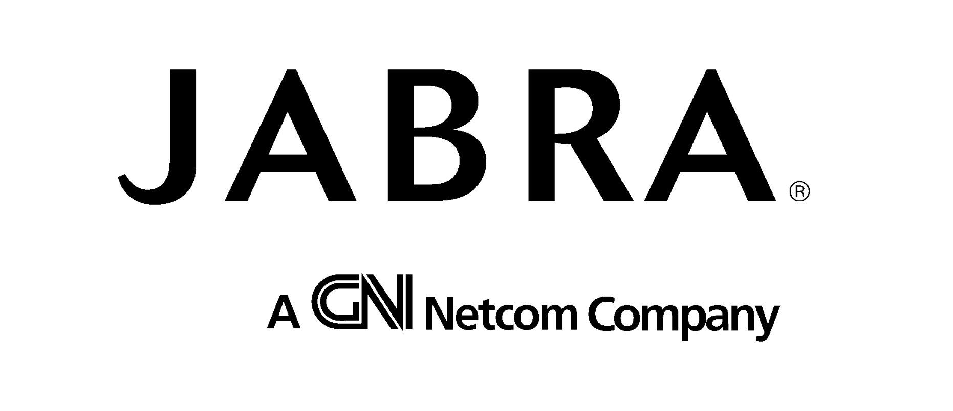

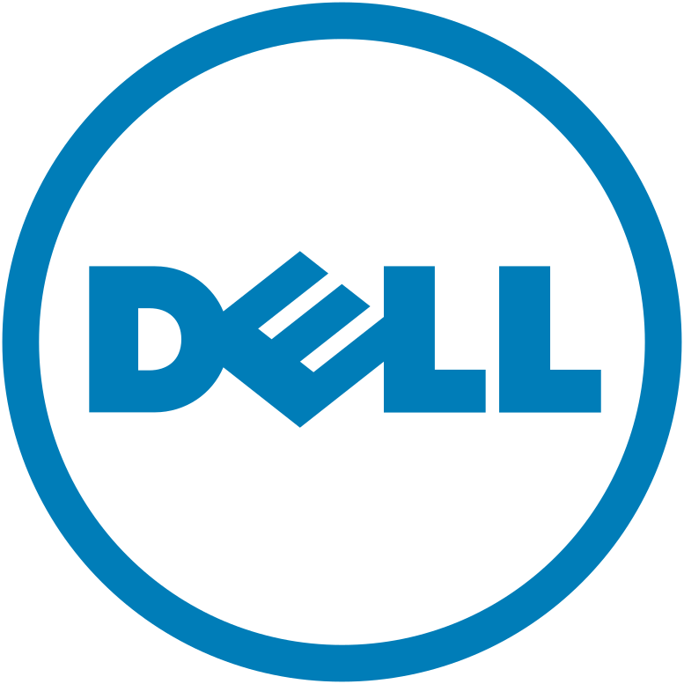
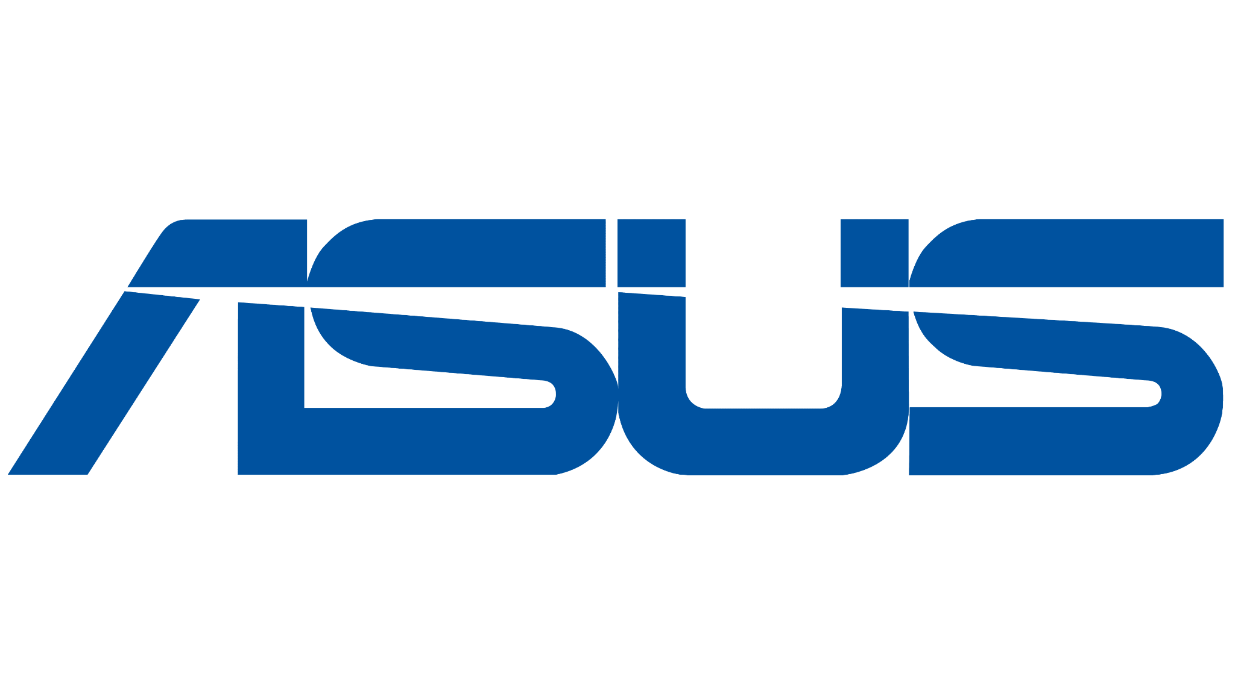


Procure hardware agnostically from Firstbase or continue with existing partners
Firstbase supplied
Firstbase to procure devices on your behalf through Firstbase’s Vendors
Firstbase managed
Firstbase to procure devices on your behalf through your own Vendors
Customer supplied
Customers can use their existing suppliers and ship equipment to Firstbase warehouse for management.
Notes:
And Firstbase is vendor agnostic. Whatever supplier a company wants to use, we can work with. If we don’t have a relationship with someone they need our procurement team will go out and establish that relationship.
We have 3 models in which we can do hardware.
Firstbase supplied, where we are the marketplace and we essentially replace their existing suppliers or VAR. The benefit here is they deal with one vendor globally, not 10s of suppliers in every country.
Firstbase managed, where we procure equipment through a customers existing suppliers and we manage the relationship
Or customer supplied where they ship equipment they procure themselves to our warehouses.

Slide 16

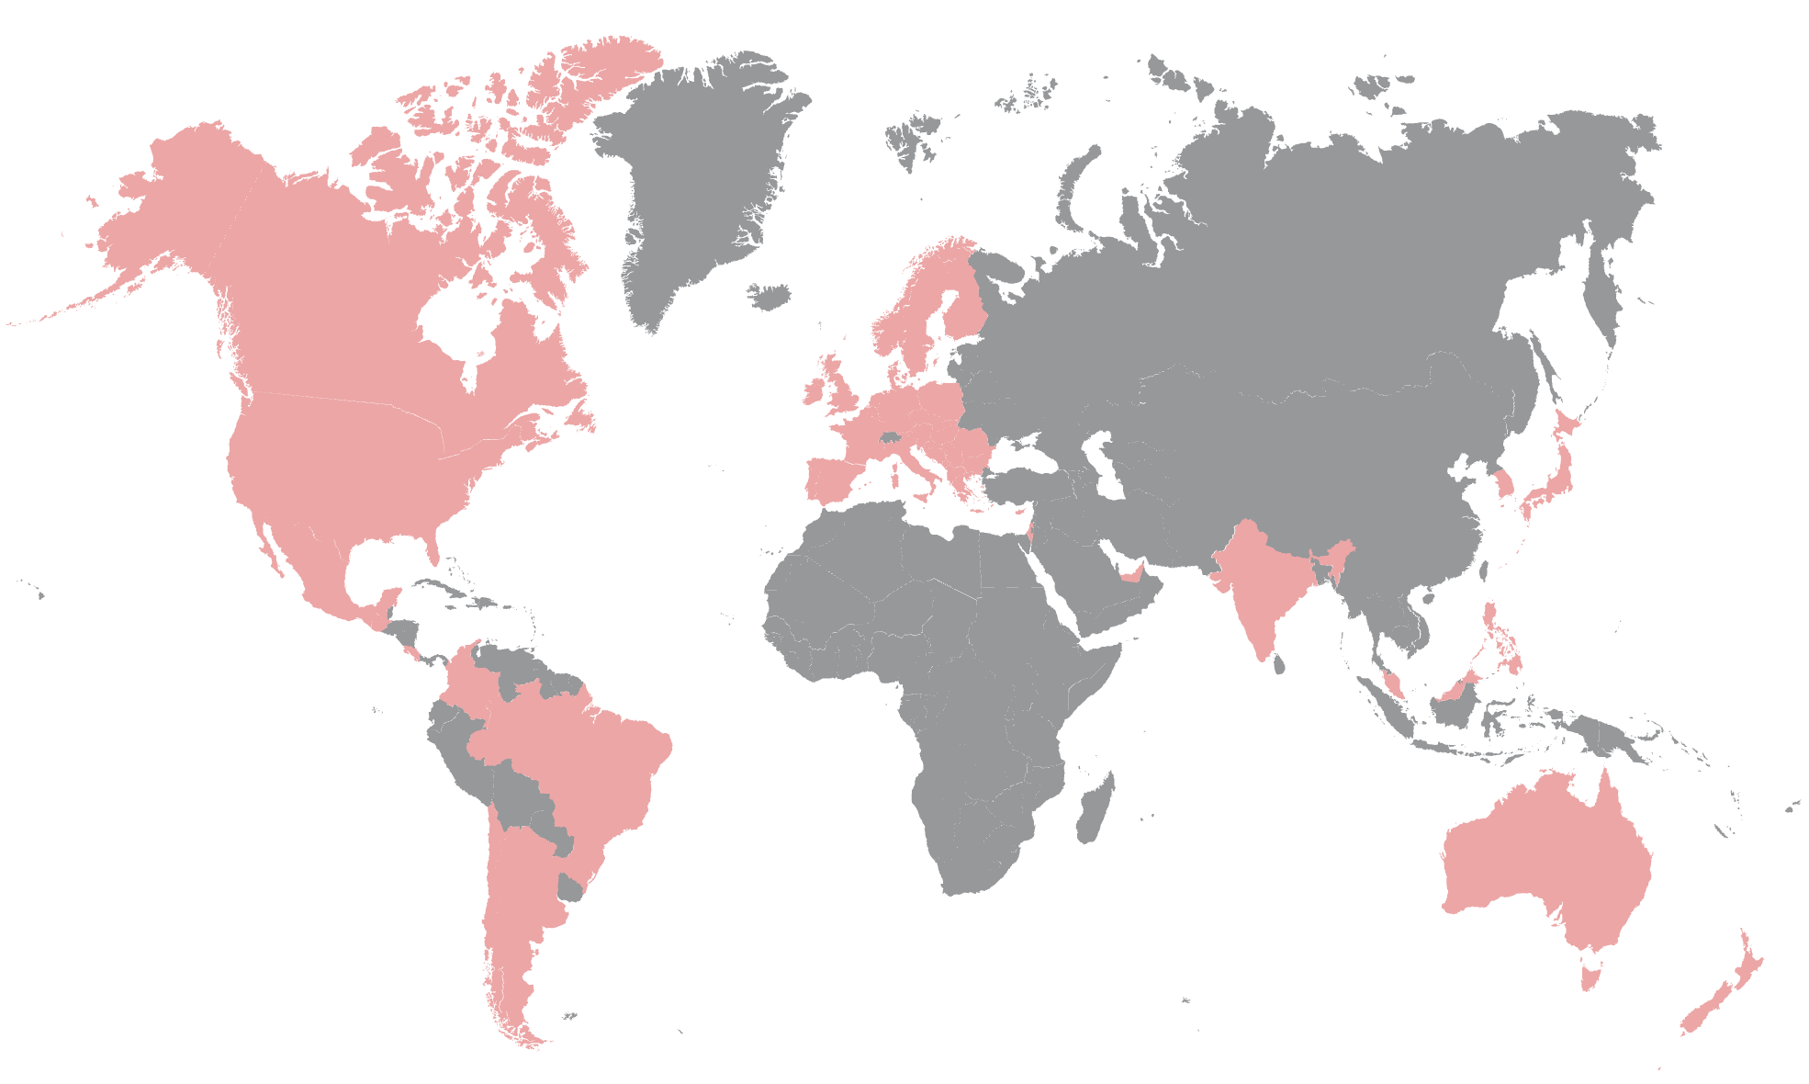




Global Operations Model
Building a Partner Network So Customers Don’t Have To
Integrated SaaS + Physical Ops
A single Integrated platform for end-to-end visibility and lifecycle management.
Regional Warehousing & Logistics
Owned facilities and 3PL partners provide secure storage, regional fulfillment, and cost efficiencies.
Dedicated Support &
Local Expertise
Dedicated teams ensure consistent SLOs and smooth operations worldwide.
Distributed Supply and IT Services Network
Regional solutions for supply, repairs, ITAD, and more.
Notes:
Firstbase is more than just a SaaS application, Firstbase has built out a physical global operations model that aims to deliver a consistent set of services worldwide.
When New Relic were struggling with an increasing distribution of employees the IT resources needed to service each corner of the world needed to scale as well. They simply couldn’t service employees in a consistent manner and were having to establish and maintain a network of suppliers and vendors to even provide a basic service.
The reality is that many companies simply don’t have the expertise, local knowledge or time to build out the necessary infrastructure required to maintain a global operation.
This is where Firstbase continue to invest in their tiered service model building out the partnerships, storage facilities supply chains, and technology investments necessary to centralize the management of lifecycle processes

Slide 17
What if you could achieve
40%
Reduction in IT tickets
97%
Asset retrieval rate
1:2000
IT Support staff to Employees

Slide 18
Case studies

Slide 19




Customer examples
Save Money
Save Time
Improve Security
>40% Reduction in IT Tickets
2 people supporting 2,500 employees
30% Increase in asset retrievals
Reduced time spent on IT equipment management by 8x
Notes:
And this is the direct customer impact we’ve had.
NewRelic are now able to support 2,500 people with 2 x IT people. The industry average is something like a ration of 1 to 150. Using Firstbase is literally 10X more efficient.
Massive time savings by companies like wise and brightwheel
And increase security in companies like OpenGov where we’re increasing how much equipment they get back.

Slide 20

New Relic Transforms IT Operations with Firstbase: From High-Touch Provisioning to Zero-Touch Efficiency
Challenges
High-touch provisioning was time-consuming, often taking up an entire day each week
Company restructuring left only one procurement specialist to manage all 4,000 laptops globally, increasing the IT team's burden
Lack of IT presence in certain regions made deploying, managing, and recovering employee assets difficult
Outcomes
Firstbase automated the entire asset lifecycle, reducing manual tasks and allowing the IT team to focus on strategic initiatives
Implemented a zero-touch provisioning model, enabling seamless device deployment and management
Managed asset recovery efficiently, achieving a 90%+ retrieval rate and ensuring secure data wiping and asset redeployment
Provided global support, handling logistics and procurement globally, including challenging areas like Israel and the UK

Slide 21

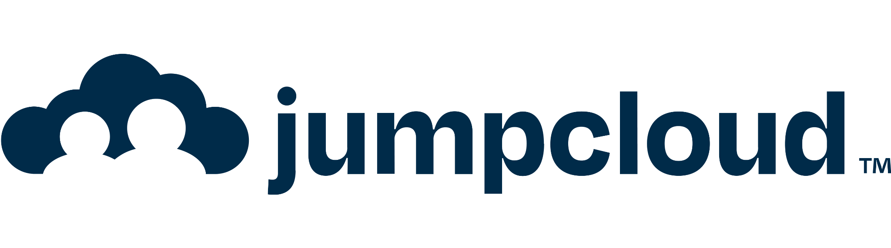


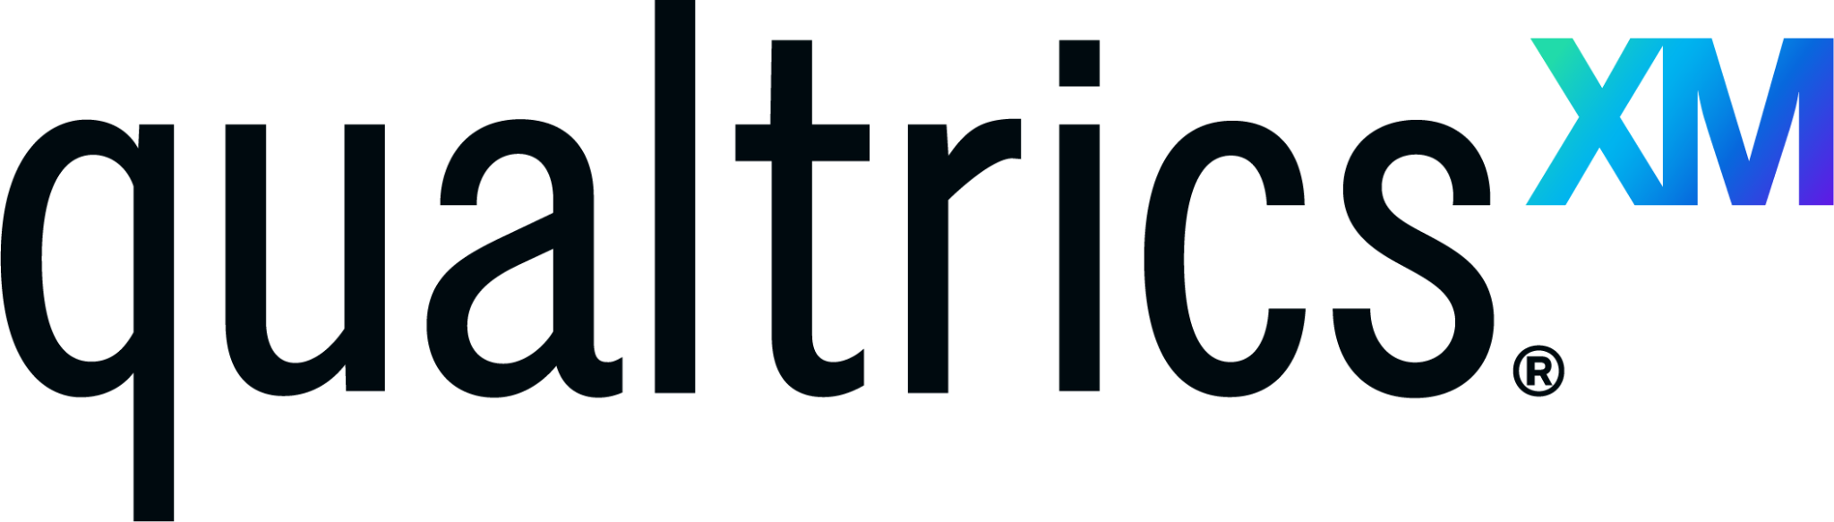




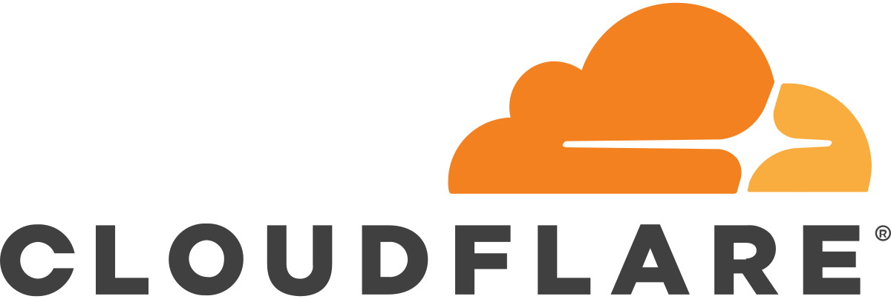







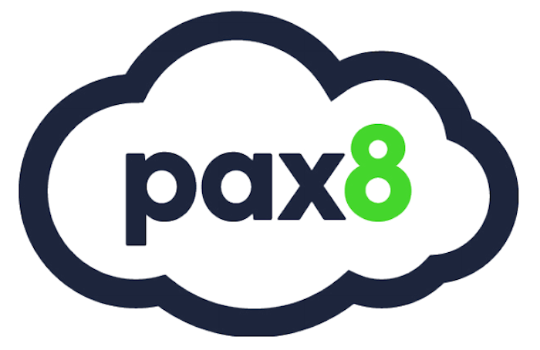
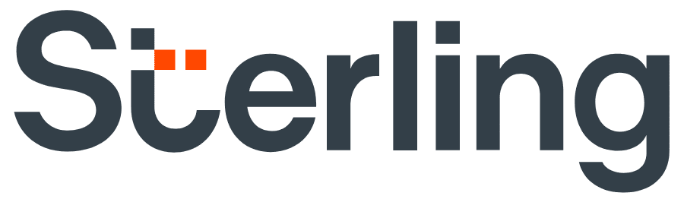




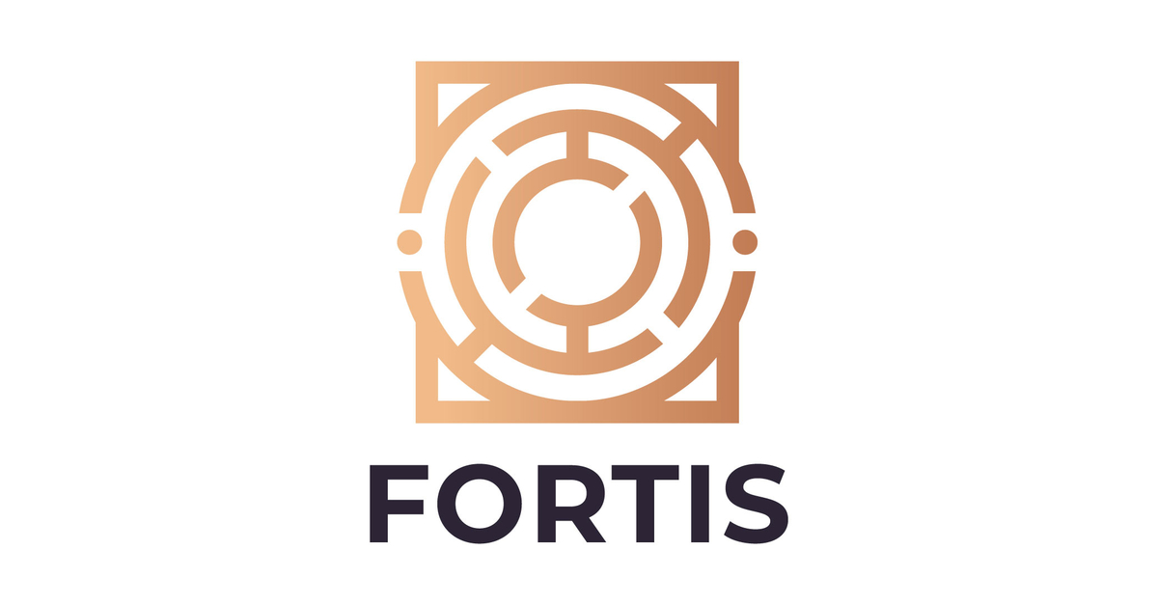







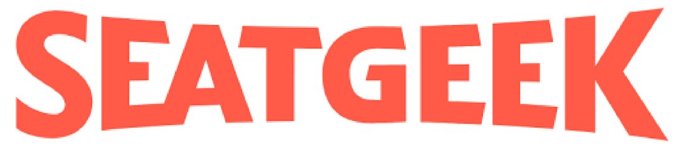
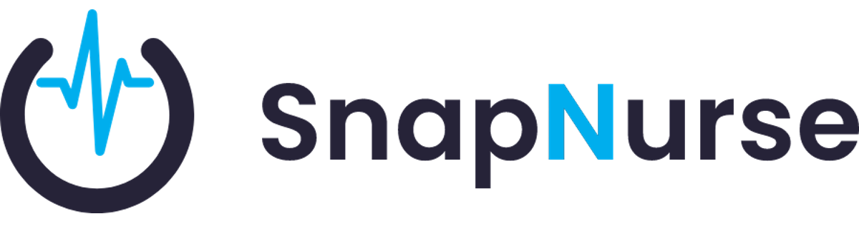


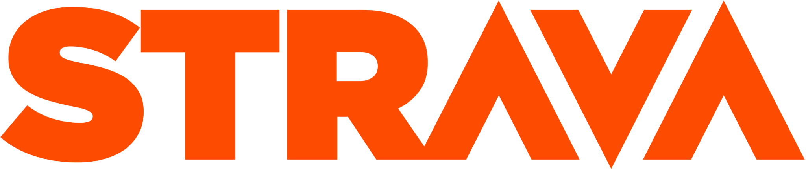
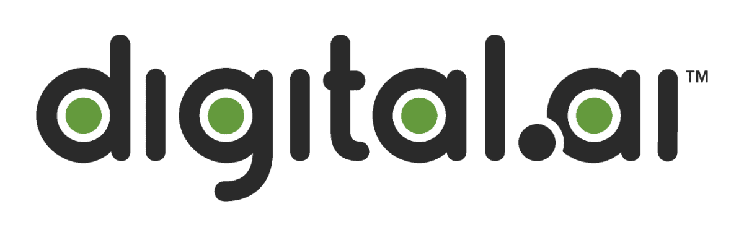

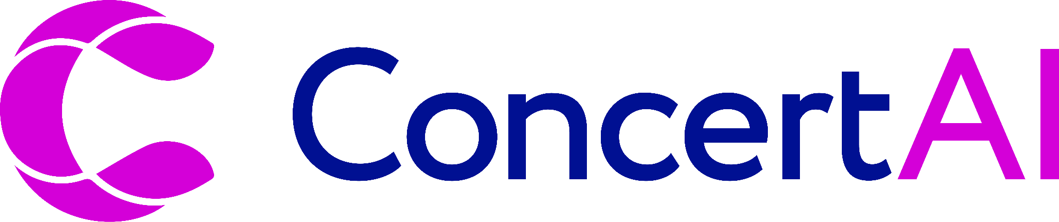




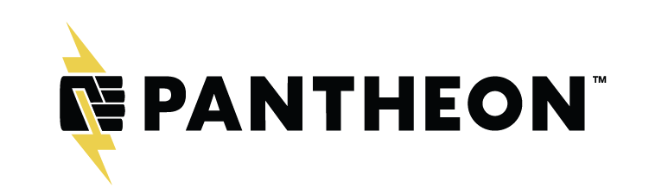

Customer examples

