Slide 1
Network Operations Center
September 2023

Slide 2
AppDirect is introducing new Managed Services
Advisor facing slides

Slide 3
Why is this an exciting opportunity for advisors?
Market Trends
Advisor Benefits
AppDirect Advisors can capitalize on this growing market with access to a network monitoring & management platform & team of 24/7 Network Operations Center (NOC) experts
✔Stay ahead of customer needs
✔Offer managed services without drastically changing their business ✔Become more competitive in the market
✔Capture more share of wallet
Managed Services is on the rise
Demand for managed services has evolved 3fold since 2021, quickly turning into half-a-trillion dollar business
2.
SMBs are changing channel partners
SMBs prefer channel partners with service capabilities & move away from resellers as they continue to adopt managed services
3.
MSPs gaining market share
SMBs are shifting IT spend to MSPs & SIs to meet their need for increased support and consultation

Slide 4
Offer value-added services without drastically changing your business
Become more competitive in the market by offering managed services and support previously only offered by MSPs
Increase value to your customer and solve their business challenges by complementing their existing solutions with managed services
Capture more share of wallet from existing customers by identifying cross-sell/upsell opportunities

Slide 5
What’s happening in the market?

Slide 6
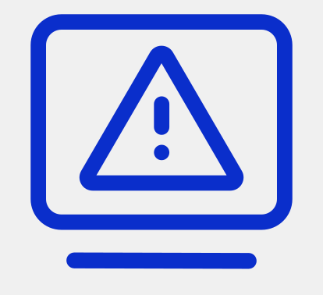
Security, reliability, and performance are top of mind
What’s happening in the market
Always on Culture requires 24x7x365 availability
Downtime & data loss
negatively impact brand reputation and customer experience
1 minute of downtime = up to $10k in lost revenue & productivity
Notes:
Businesses today have security, reliability, and performance top of mind as they continue to try and accelerate business post pandemic. Downtime, data loss, and security breaches can cause a serious impact to a business of any size. Gartner has estimated that every minute of downtime equates to a cost of up to 10k (salaries, systems not at work, lost opportunity and additional business impacts).
https://www.atlassian.com/incident-management/kpis/cost-of-downtime Atlassian, 2023

Slide 7
Staffing and tool configuration are difficult
Demanding consistent responsiveness with minimal idle periods for staff and maintaining the necessary skills makes doing it on your own challenging.
RESOURCE & SKILLS GAP
Having your network information scattered across multiple tools makes it challenging to get a comprehensive view. Your staff, stakeholders, and vendors need to have the right information to identify the scope and root-cause of IT issues
LACK OF VISIBILITY
Configuring, integrating, and maintaining the necessary tech stack to monitor, report, view, and manage network health can be costly and time-consuming.
LACK OF A CENTRALIZED
TOOL

Slide 8
This can be solved with a NOC
The right tools and team enable you to proactively identify and address potential issues before they escalate into major problems.
This helps minimize downtime, data breaches, and other disruptions that can negatively impact business operations.

Slide 9
AppDirect can help

Slide 10
Offer value-added services without drastically changing your business
Become more competitive in the market by offering managed services and support previously only offered by MSPs
Increase value to your customer and solve their business challenges by complementing their existing solutions with managed services
Capture more share of wallet from existing customers by identifying cross-sell/upsell opportunities

Slide 11
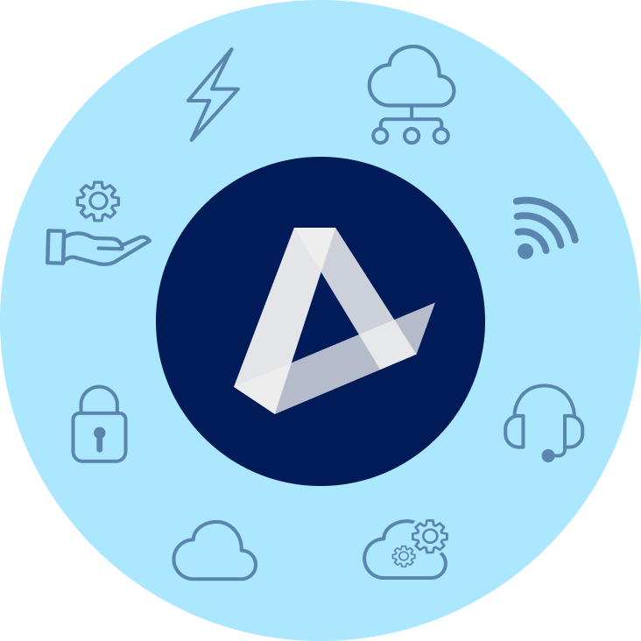
Add NOC solutions to your portfolio with our catalog
ENERGY
CONNECTIVITY & SD-WAN
EV Charging | Water & Waste Electricity | Natural Gas | Solar
Fiber | Cable | Wireless | Satellite | TEM
MANAGED SERVICES
MOBILITY & IoT
NOC | SOC | Professional Services SmartSupport | Asset Management
Wireless Services | Internet of Things (IoT) Managed Mobility | Expense Management (WEM)
SECURITY
CUSTOMER EXPERIENCE (CX)
Physical Security | Network Security Endpoint Security | Cloud Security | SASE
UCaaS | Contact Center | CPaaS | SMS Analytics | Artificial Intelligence (AI)
CLOUD INFRASTRUCTURE
SOFTWARE AS A SERVICE
Public, Private, & Hybrid Cloud Data Center & Colocation | Disaster Recovery
Microsoft | Google | ERP | CRM | Productivity | Business Applications | IT Management | BI
‹#›

Slide 12
AppDirect VNOC
DETECT
UNDERSTAND
Maximize uptime with a best-in-class networking management and monitoring platform, coupled with a team of NOC analysts acting upon alerts 24x7x365
Maximize uptime
RESOLVE

Slide 13
Team of Analysts
As an extension of your IT organization, we proactively manage & ensure the performance of your networked environment.
24x7x365 Monitoring
Incident Management
Customized procedures
Team of NOC analysts that proactively monitor and resolve incidents available 24x7x365 to minimize downtime and ensure seamless operations.
Specialized team of experts delivering high touch incident management depending on your environment and needs.
We follow ITIL standards and create customized troubleshooting procedures.

Slide 14
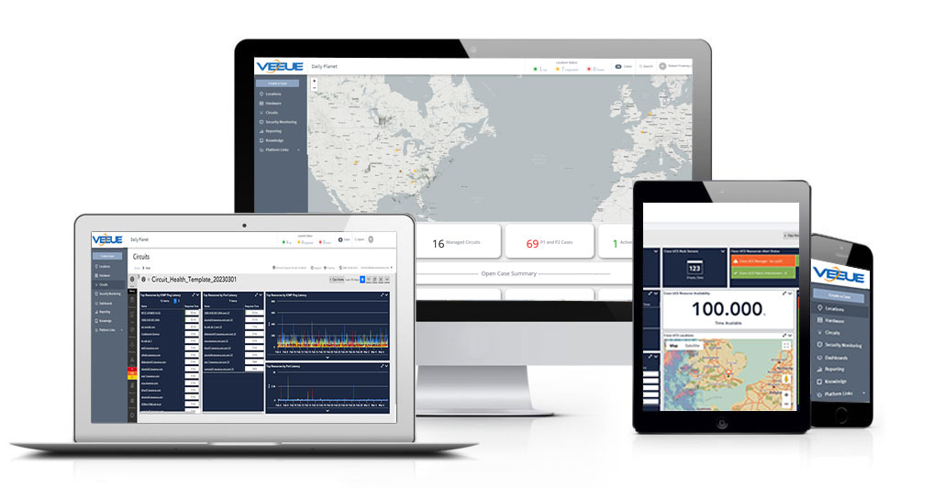
Integrated Toolset
Gain all of the capabilities of ServiceNow and LogicMonitor in a single integrated platform.
Detect
LogicMonitor
Manage & Resolve
ServiceNOW
Gain Insights
Monitor the infrastructure that matters to your business with proactive alerts so network troubles can be swiftly resolved.
Raise and track tickets in real-time to stay aware of ticket status and progress through to resolution.
Simplify and analyze complex data with AI and machine learning to make data-driven decisions about your network.
Notes:
Logmonitor - detect + alert

Slide 15
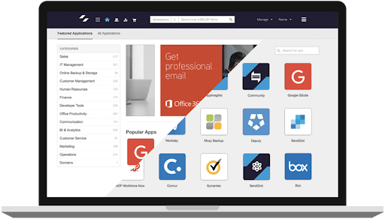
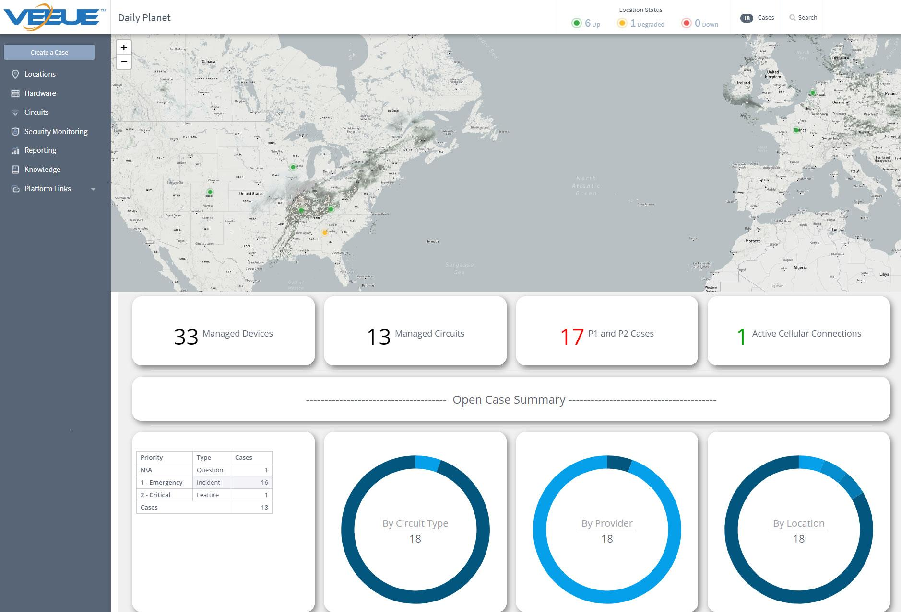
Centralized View of Network Health
A single-pane of glass for your internal and extended teams to monitor everything with an IP Address
Consolidated view of all devices
Alerts & resolution
Dashboards & reporting
Instant alerts and notifications about potential issues to address problems before they escalate.
Historical data analysis and reporting features to identify trends and patterns, aiding in effective capacity planning and resource allocation.
Real-time insights into the health & status of all connected devices and locations (up/down/degraded).

Slide 16
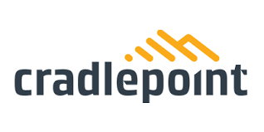
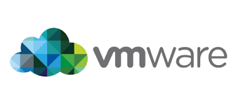
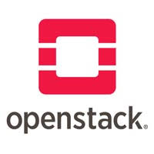
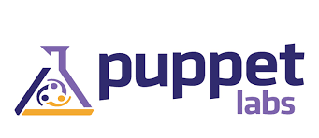
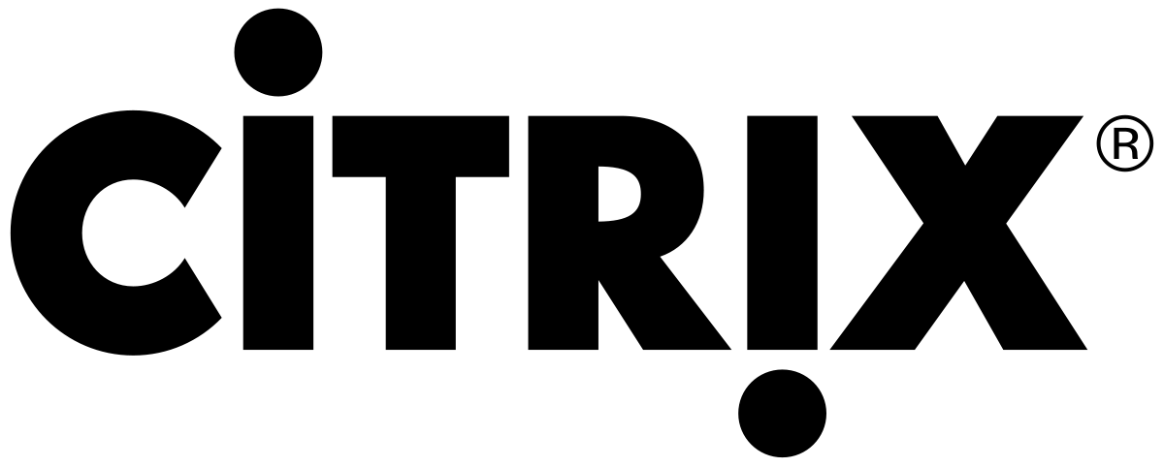
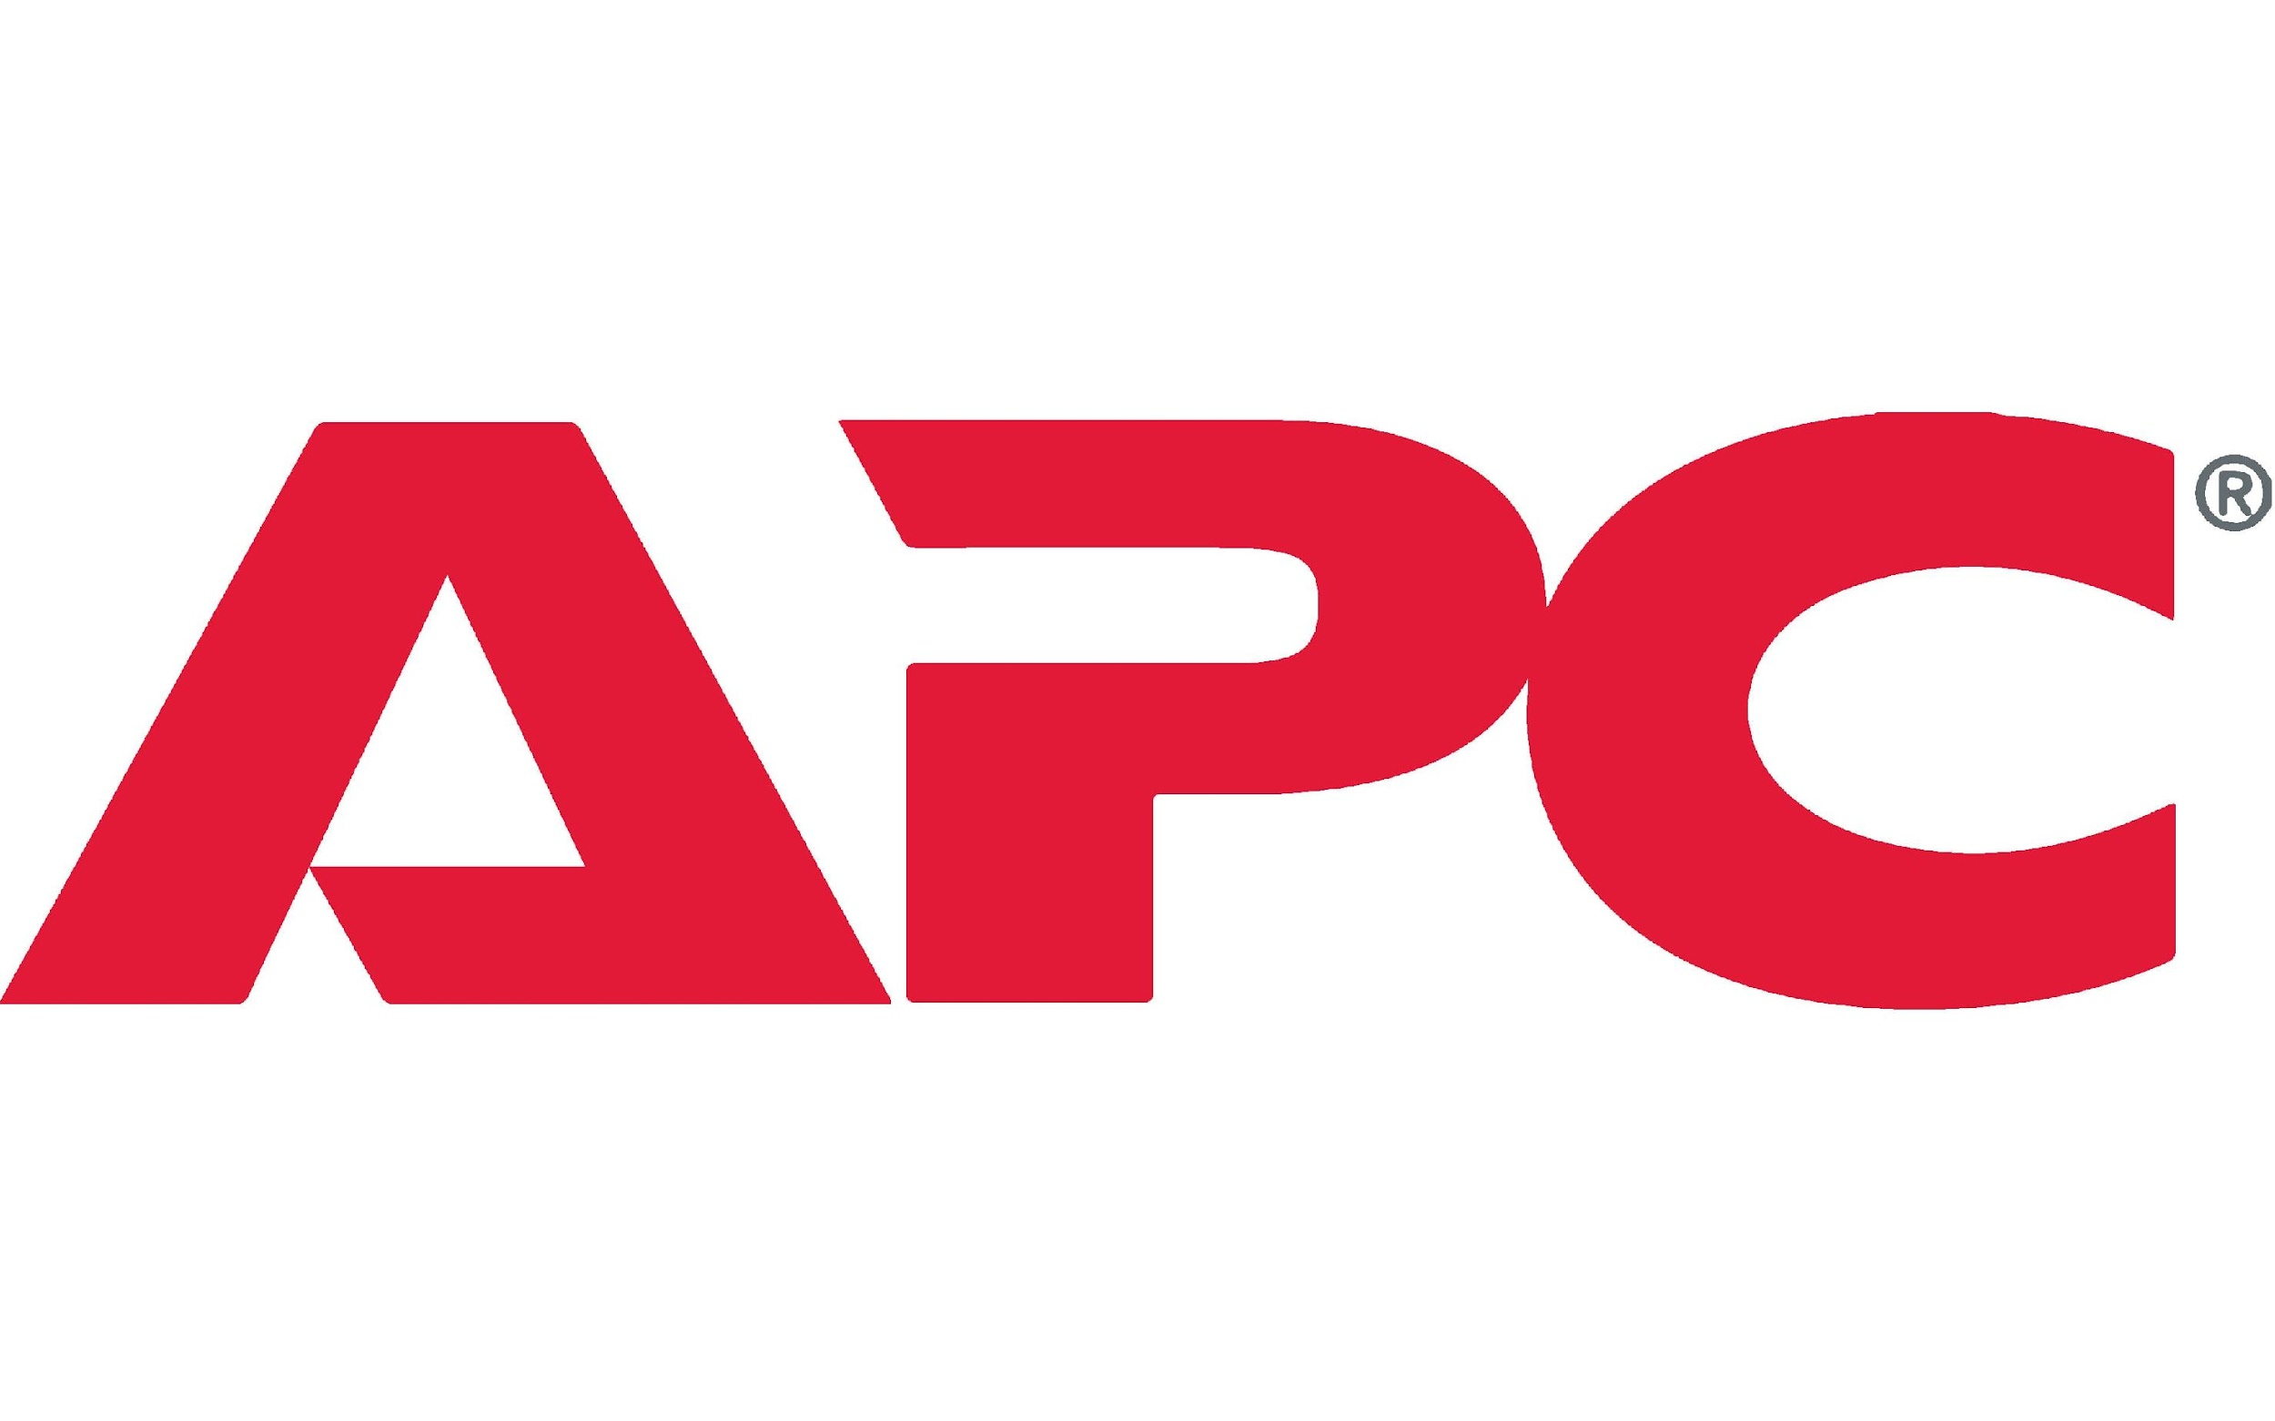
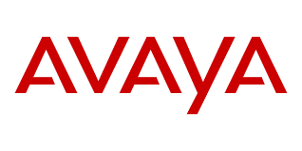
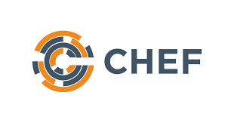
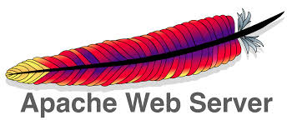
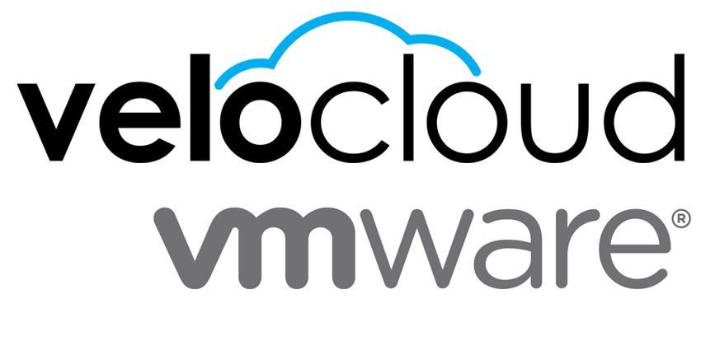
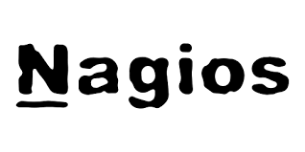
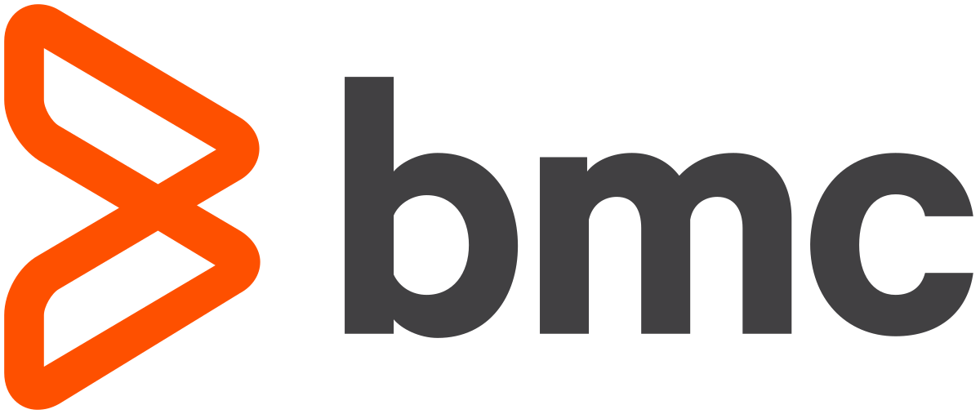
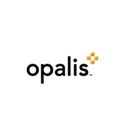
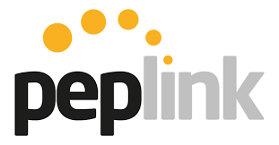
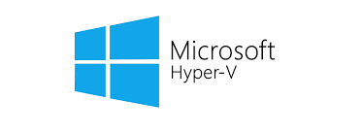
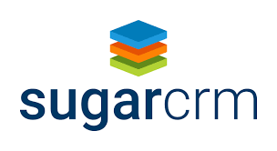
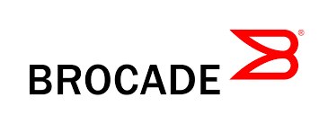
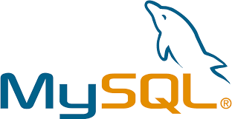
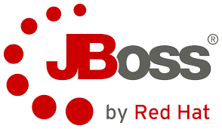
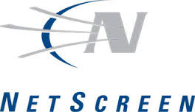
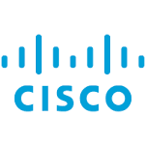
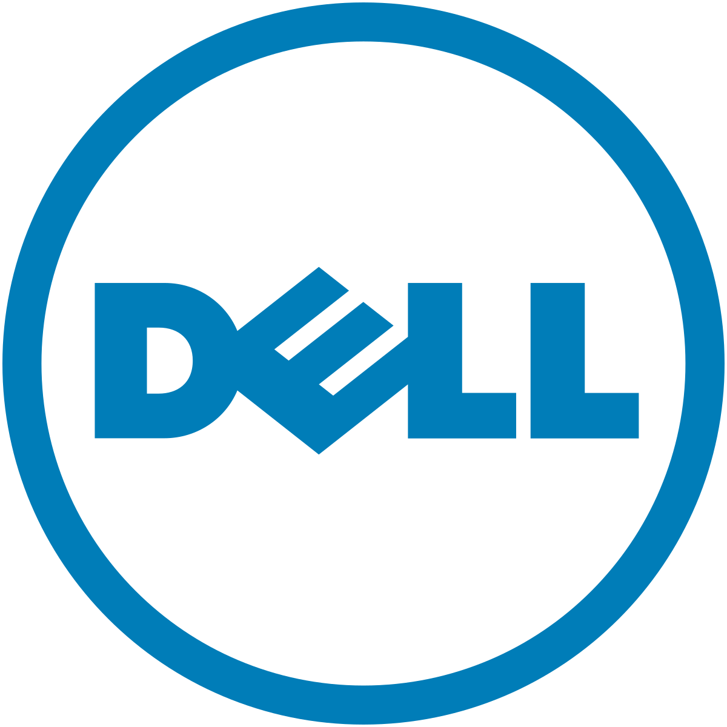
Monitor your end-to-end tech stack
Vendor Agnostic
Your tech stack spans many vendors, so should your monitoring
…and many more
Notes:
The VEEUE+ catalog really opens up complete visibility into the environment. All these various device types, technologies and tools will be loaded into VEEUE+, powered by either Zenoss or LogicMonitor and the end user will have direct access into either Zenoss or LogicMonitors tools.

Slide 17
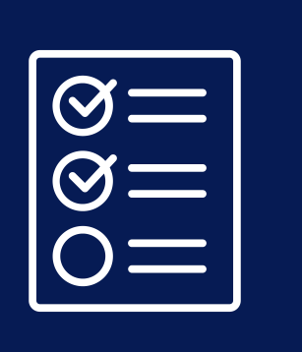
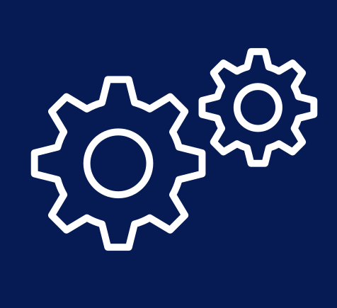
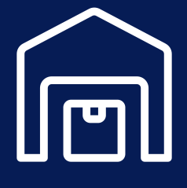
Professional Services
Project Managers that assist in onboarding, organizing and streamlining strategic initiatives, technology upgrades, and lifecycle management.
PROJECT MANAGEMENT
Engineers and subject matter experts to design, configure, and install the solution that meets your needs. Migrate to the latest technological, upgrade networks, and leverage SASE and SD-WAN.
ENGINEERING SERVICES
On-site, on-demand field coverage across the country, helping multi-site companies solve routine or emergency technical tasks.
ON-SITE TECHNICIAN SERVICES
Secure storage facilities to house and deliver lifecycle services for your equipment; including inventory management, staging, configuration, testing, assembly, and more.
WAREHOUSING

Slide 18
SmartSupport
Helping millions on their journey
Calls Annually
Customer Satisfaction
First Call Resolution
100K+
End-user Help Desk services and on-boarding support
93%
End-customers rate us highly for on-boarding, migration, and level 1 help desk support
96%
Most end-customer issues are resolved on the first call.
Notes:
SELL SOLUTIONS FROM APPDIRECT AND OFFER SOUGHT-AFTER PREMIUM HELP DESK SUPPORT
When you sell solutions through AppDirect, you can access white-glove support for related connectivity and cloud services. Businesses are choosing channel partners who offer services that span the product life-cycle: migration, install and setup, onboarding, and end-user support.
SmartSupport statistics:
100k+ Support interactions per year
93% Customer Satisfaction
+78 Net Promoter Score
96% First Call Resolution

Slide 19
Case studies

Slide 20
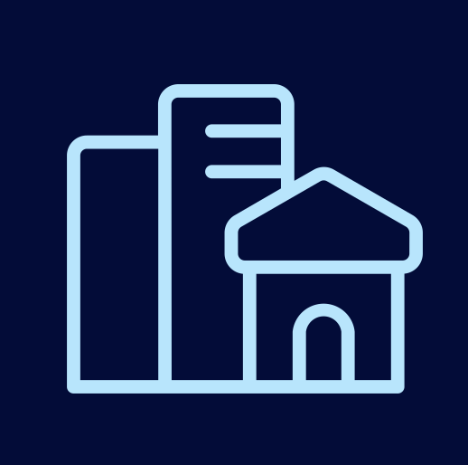
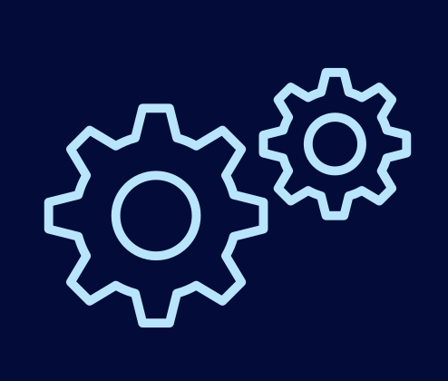
Ideal customers
Our solution is a good fit for:
Organizations with multiple physical locations that need to be monitored
IT teams lacking resources to properly monitor and manage their network
Retail, manufacturing, banking energy/utilities, hospitality
Notes:
Ideal Customers
Multi-location organizations (physical location sprawl) that need to be managed & monitored, companies with multiple network providers
Small or centralized IT teams - but enterprise can also benefit to outsource their support calls and for increased visibility
Main Verticals: organizations with multiple physical locations
Retail is the main vertical due to its tendency to have multiple physical locations- each store has its own connectivity, fire wall, access switches etc. that need constant monitoring and troubleshooted
Hospitality - ex. hotels that outsource NOC after hours
Other verticals: banking, manufacturing
Businesses that are unhappy with their current managed service provider or want to condense monitoring tools

Slide 21
Key NOC win
Won 25K MR-GMV NOC deal over incumbent
Challenge
Solution
Results
Comprehensive WAN management solution to support the complex global WAN network
>1600 monitored IP addresses over 15 countries
Looking for new provider as incumbent was a telco with a non-agnostic service offering
$4600 in recurring commissions
Notes:
There is a lot of money to be made in the energy space! Let’s look at some key energy wins from 2022.

