Slide 1
Optimize your SaaS portfolio
One location for all your SaaS needs
May 2025

Slide 2
What’s happening in the market

Slide 3
Centralized SaaS management is on the rise
95%
50%
of organizations use SaaS
applications to power their
businesses today
of companies using SaaS applications will centralize management on one platform
Notes:
“Today, SaaS is everywhere—95% of organizations use SaaS applications to power their business. But what’s changing is how those apps are being managed.”
“By 2027, half of all companies will adopt a centralized approach using a SaaS Management Platform (SMP) to address their shadow IT concerns. Why? Because the cost of decentralized SaaS is no longer sustainable.”

Slide 4



Organizations are losing visibility into their SaaS stack
Blind spots are costing you
Shadow IT makes up over 1/3rd of the IT SaaS stack
The average company loses $8.3M in unused SaaS licenses
Organizations are 5X more susceptible to a cybersecurity incident without centralized visibility
Notes:
“Let me ask you, do you know exactly how many applications your teams are using right now?”
“Most companies we talk to are surprised to learn that IT only controls about 30% of total SaaS spend. The rest? It’s happening across departments – marketing, sales, HR – all buying tools without IT involvement.”
“This creates what we call shadow IT. And it’s not small—it often makes up over a third of your SaaS stack. Now, let’s talk about what those blind spots are actually costing you:
Companies lose an average of $8.3 million per year on unused SaaS licenses - tools that are bought but sit on the shelf unused.
Even worse, without centralized visibility, you’re 5x more likely to face a cybersecurity incident.
“So the real challenge we see is that companies don’t have the visibility or resources they need to manage their SaaS portfolio effectively.”

Slide 5

Organizations that don’t have centralized visibility into their SaaS will overspend by 25% or more
Notes:
“Here’s the bottom line: Gartner predicts that if you don’t have centralized visibility into your SaaS, you’ll overspend by at least 25%.”
“In today’s economic climate, that kind of waste just isn’t sustainable. The organizations that win are the ones who take proactive control—who shift from reactive cleanup to strategic SaaS management.”
“And that’s exactly where we come in.”

Slide 6
AppDirect can help

Slide 7




A comprehensive solution for smarter SaaS spending
and management
INDUSTRY-LEADING EXPERTISE & CATALOG
UNIFIED BILLING & MANAGEMENT
COST OPTIMIZATION
CENTRALIZED VISIBILITY
Notes:
“We know that finding the right solutions and managing your ongoing subscriptions can be overwhelming, but with AppDirect, you don’t have to navigate it alone. Lean on our expertise to help you identify and manage the best solutions from an industry-leading portfolio of SaaS applications. All your subscriptions are managed in a single location, streamlining operations and empowering your business to spend smarter and make more informed decisions.”
Industry-Leading Expertise & Catalog: “Our vendor-agnostic experts guide you through the complex SaaS landscape, helping you select, implement, and manage the lifecycle of best-in-class solutions from 100+ SaaS providers, all tailored to your unique business needs."
Unified Billing & Management: “AppDirect centralizes all your subscriptions under one unified bill, saving time and reducing complexity with one contract and one platform to manage your subscriptions from.”
Centralized Visibility: “Our subscription management tools grant you full visibility into usage, spend, and security risks across every cloud app, so you can identify blind spots, eliminate waste, and stop shadow IT in its tracks.”
Cost optimization: "We manage vendor relationships and secure the best pricing under a single MSA, helping you stretch your budget further."
"With AppDirect, you gain control and clarity over your SaaS stack, so you can stop wasting money and reduce the risks associated with shadow IT. We help you shift from reactive cleanup to strategic SaaS management, ensuring you're always ahead of the curve."

Slide 8

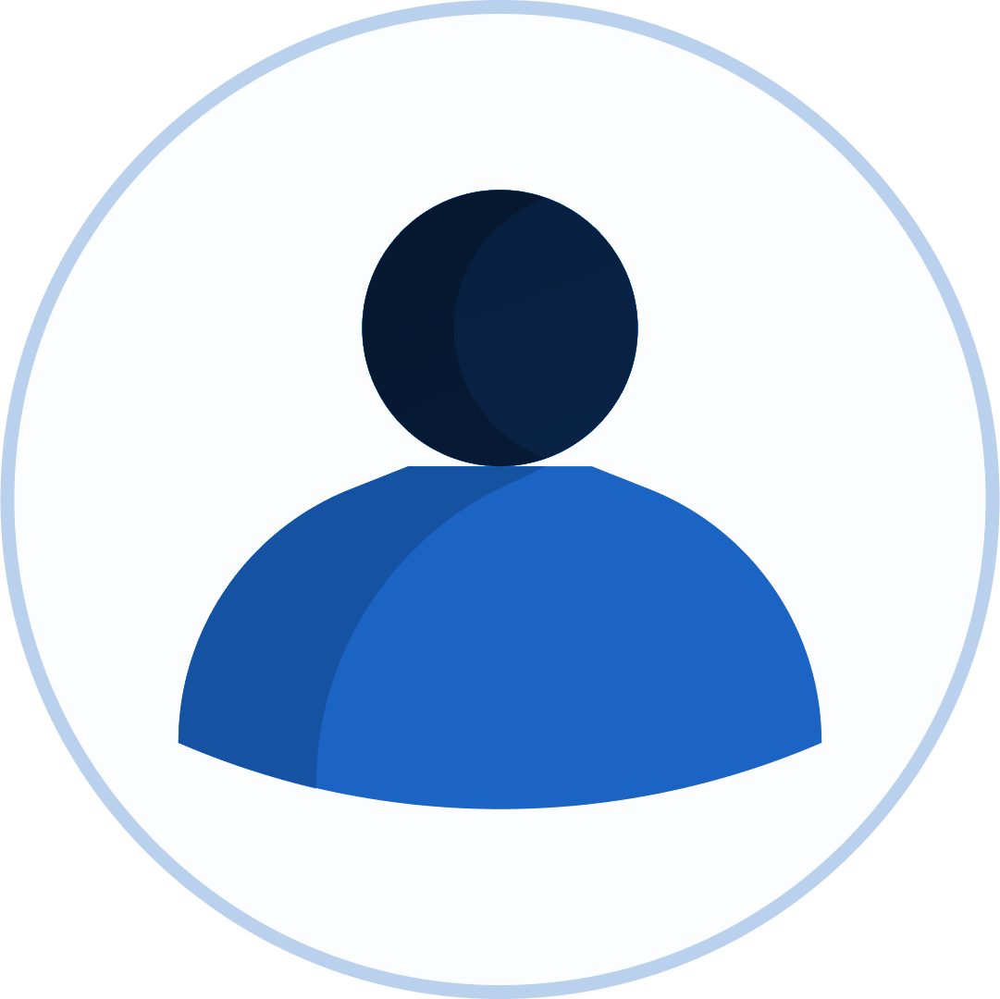
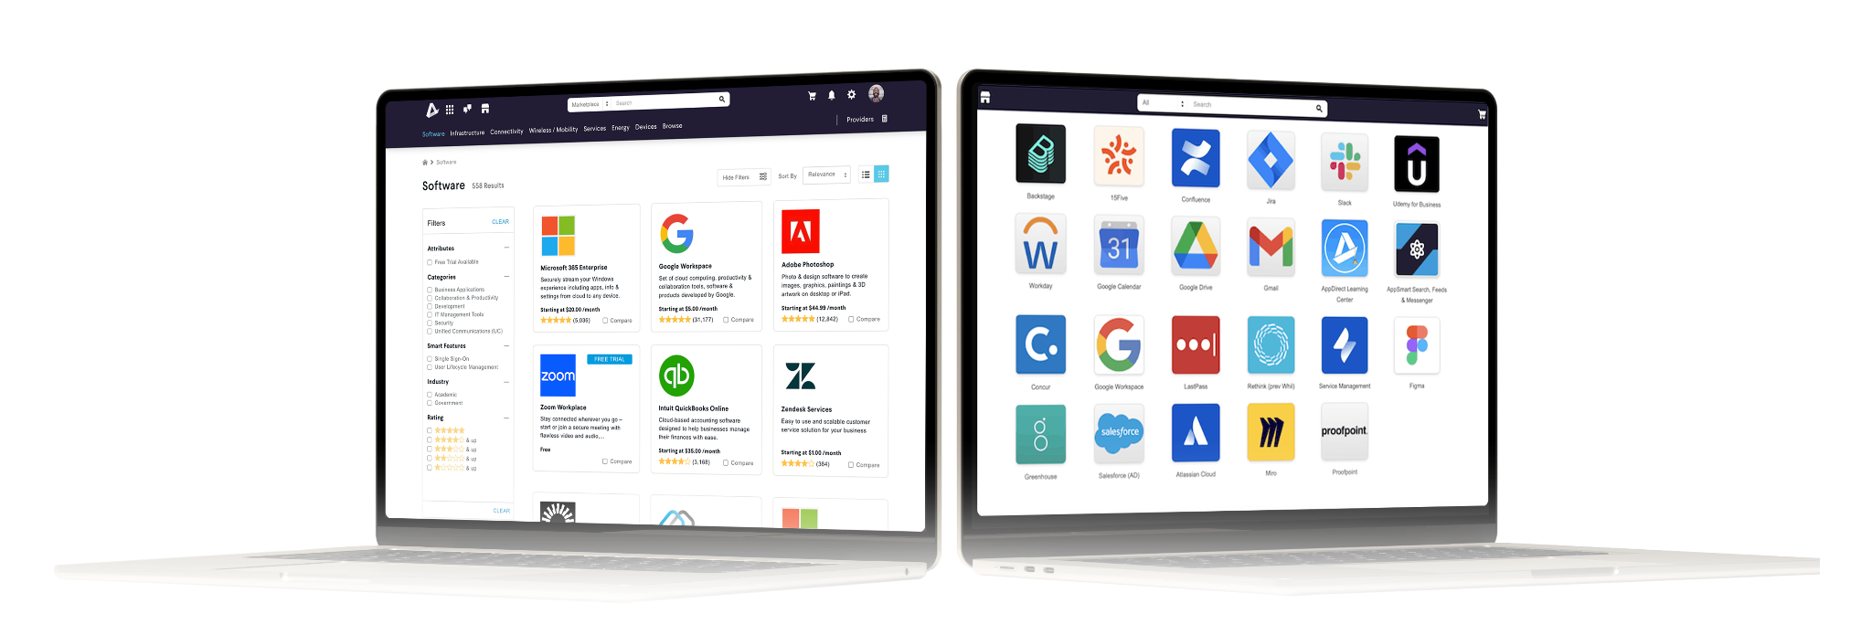
Meet the Relationship-Driven B2B Platform
We connect you with expert advisors and the digital tools you need make it easier to find, buy, and manage your cloud portfolio.

Slide 9
One location to buy and manage your SaaS portfolio
Rely on a team of experts
Find all the SaaS to power your business
Gain centralized access
Notes:
Expert support:
AppDirect’s team of experts is always here to help: “No matter the challenge, you have direct access to our team of experts at AppDirect. Whether it’s consultation, implementation support, or ongoing management, we provide hands-on assistance to ensure you get the most out of your cloud applications and solutions.”
Appdirect Procurement Marketplace:
“If you want to do your own research, you can explore and discover a wide range of cloud applications tailored to your business needs in our marketplace. Whether you’re looking for productivity tools, IT management solutions, or collaboration platforms, everything is available at your fingertips, saving you time and effort.”
Workspace:
“If you prefer to manage your own subscriptions, AppDirect’s tools make it easy to oversee cloud applications, track spend, and update subscriptions. Our centralized workspace and Single Sign-On (SSO) integration ensure secure, convenient access to all your apps, eliminating security risks and login hassles, and streamlining IT operations.”

Slide 10

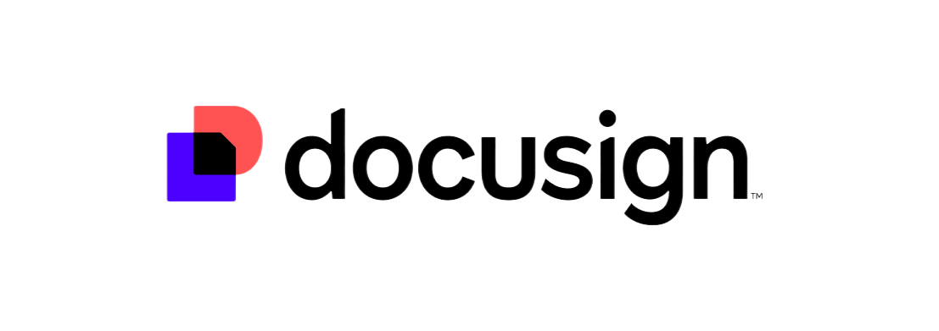


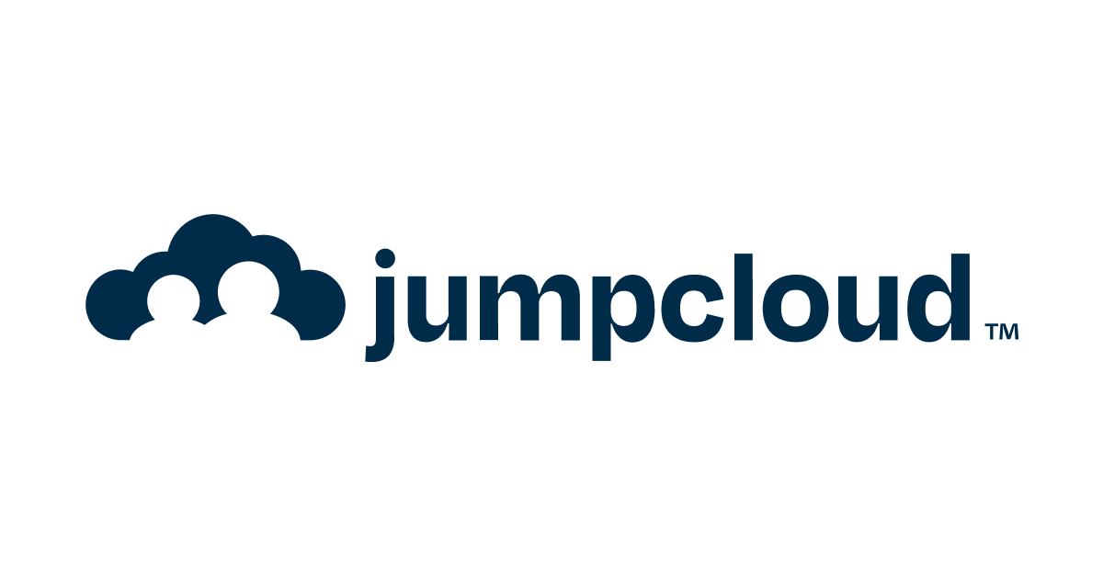

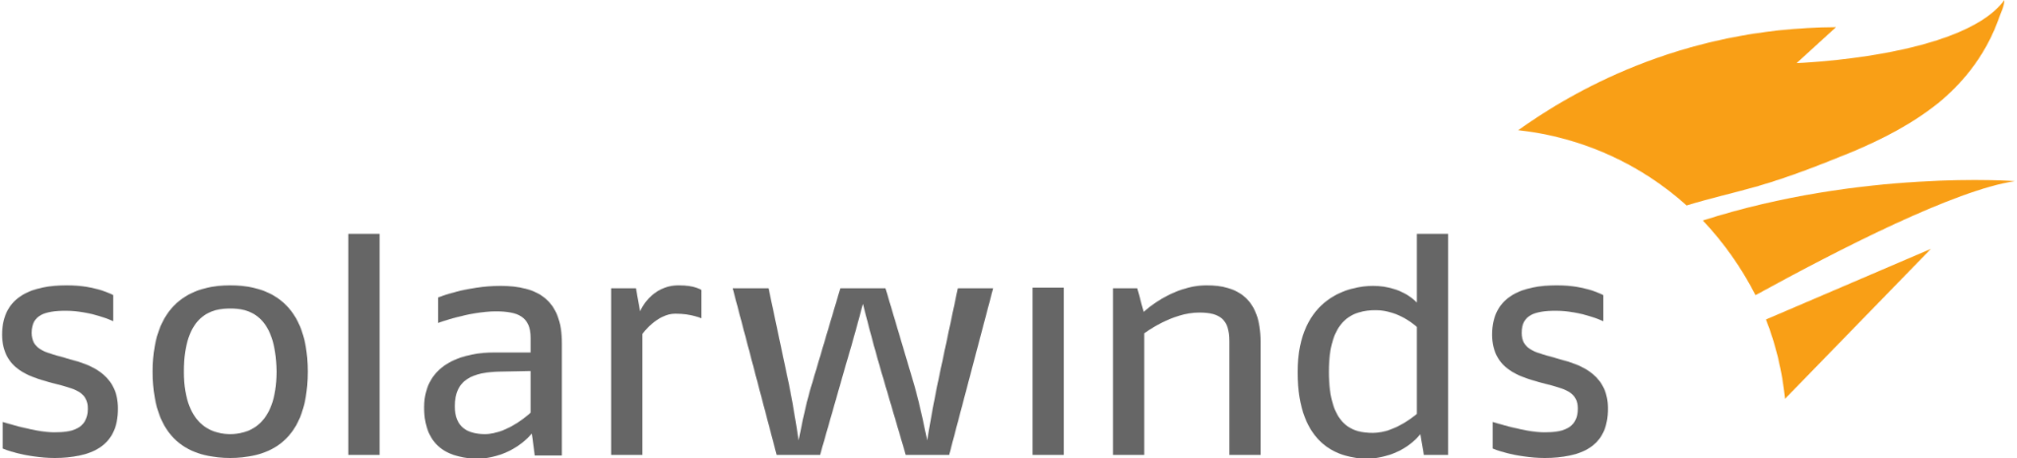
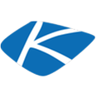

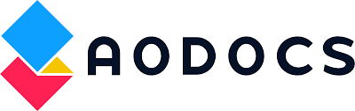
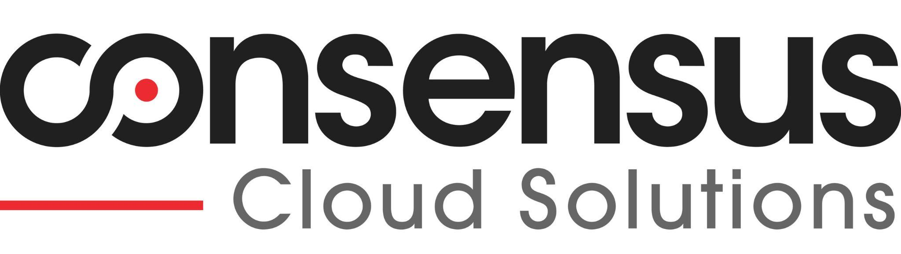
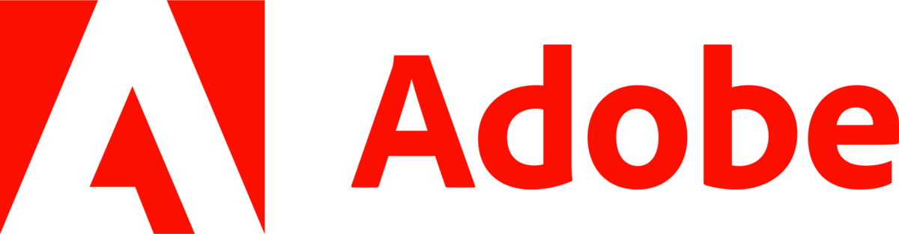

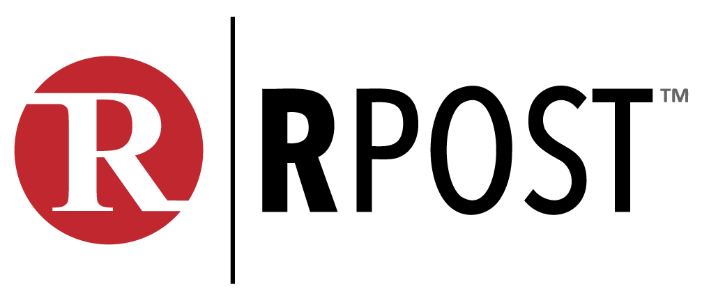
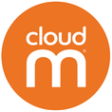
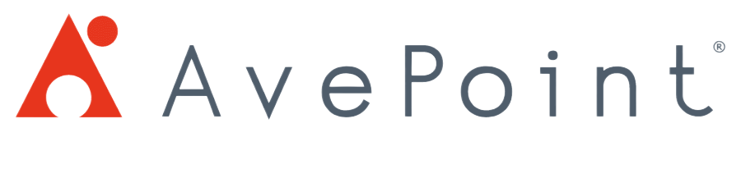

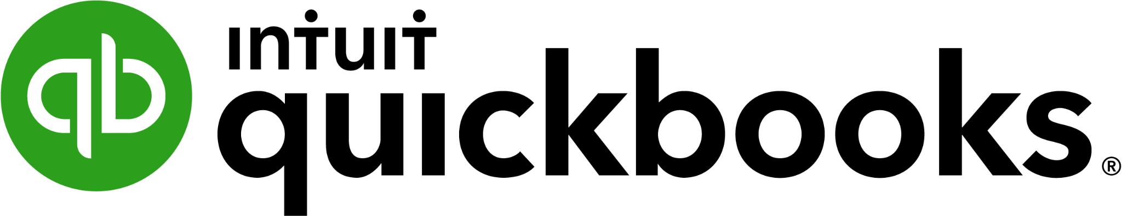
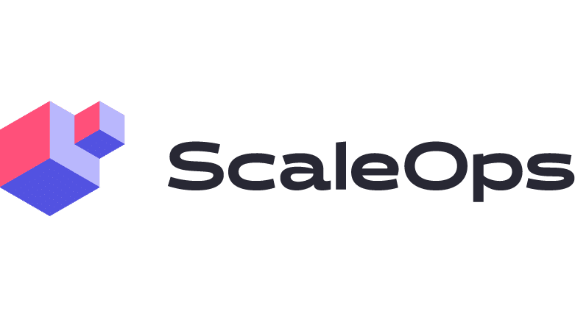

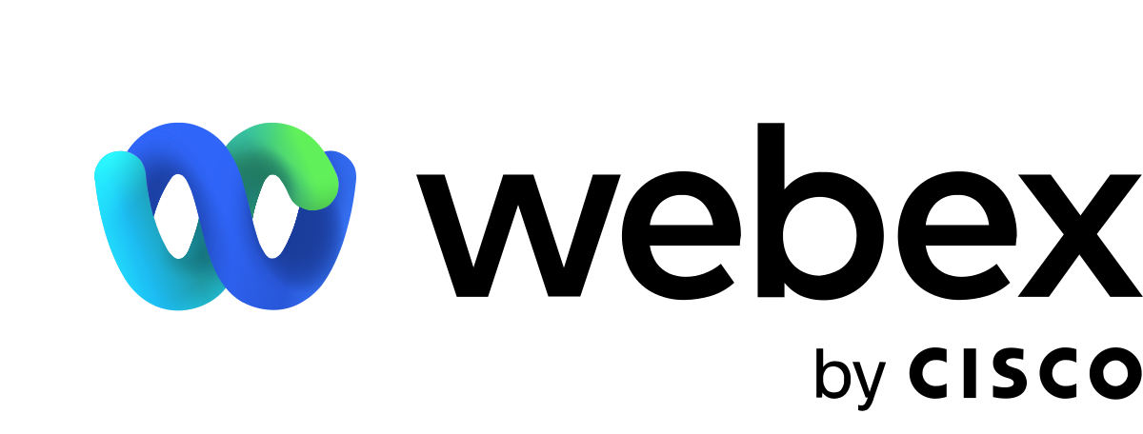

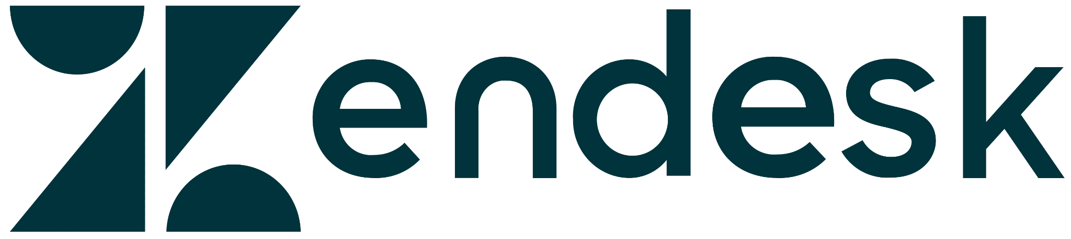

Access an industry-leading SaaS portfolio
PRODUCTIVITY & COLLABORATION
BUSINESS APPLICATIONS
IT MANAGEMENT
Notes:
“We offer a comprehensive catalog featuring all the top industry-leading providers. Find all the apps from brands you trust.”

Slide 11




Lean on us for all of your SaaS needs
5M+
Customers
Served
Migration
On-premise or cloud-to-cloud migration services for Microsoft and Google
96%
Consulting
Expertise and guidance with implementing, optimizing, and managing your Cloud solutions
First Call
Resolution
Support for Cloud Applications
End-to-end technical support and escalation management for admins and end users
93%
Premium Technical Support
Technical support for hardware, connectivity, and Cloud applications
Customer
Satisfaction
Notes:
“We're here to help, with over 5 million customers served, offering comprehensive support from cloud migrations to expert consulting and premium technical assistance."

Slide 12
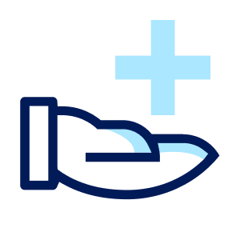


Gain full visibility and control over your SaaS portfolio
Cut costs and save time with our subscription management tools
Marketplace
A single location to buy all your applications from an industry-leading catalog
Spend Management
Save time with a single location to manage and pay subscriptions
Workforce Identity
Reduce IT costs with automated onboarding, centralized access and secure authentication with SSO
Data Management
Gain insights into application spend and usage to drive smarter business decisions
Notes:
Marketplace: “With access to an industry-leading catalog, you can simplify procurement and streamline the process of buying and integrating the apps you need.”
Spend Management: “Save time and reduce costs with centralized subscription management. Manage, track, and pay for all your subscriptions from a single platform, eliminating complexity and ensuring better control over your SaaS spend.”
Workforce Identity: “Secure your business while reducing IT costs. Automate onboarding, provide centralized access, and enable SSO authentication to enhance security and improve user access management—all with minimal effort.”
Data Management: “Make smarter business decisions with actionable insights. Our data management tools give you visibility into application spend and usage, helping you optimize your SaaS portfolio and ensure you're getting the best value from your investments.”

Slide 13

How AppDirect Helped BronxWorks Streamline Cloud
Technology Management
Challenges
Time-consuming, manual processes for reviewing and tracking cloud software subscriptions across 150+ community programs with distinct contracts.
Lack of visibility into cloud IT spending and limited ability to drill down into evolving program needs.
Difficulty in predicting future cloud technology requirements.
Outcomes
Shifted to proactive cloud planning and purchasing, aligning cloud solutions with strategic priorities.
Gained expert guidance from a technology advisor and the AppDirect team, enabling quicker, more confident cloud technology decisions.
Improved ability to anticipate cloud technology needs 6 to 12 months ahead, saving both time and money.
Achieved enhanced ROI tracking for cloud technology spend, with detailed reporting through the AppDirect Procurement Marketplace.
Notes:
Read the full case study here.

