Slide 1
Selling Security with AppDirect
September 2024

Slide 2
Why sell Security services?
Advisor facing slides

Slide 3




What’s happening in the market
Security and compliance are top of mind
42% say security is the most important factor when investing
in new software
83% of organizations are planning to increase their cybersecurity budgets by an average of 19% in the next 12 months
1/3rd of companies have over 20% of their budget dedicated to compliance and risk governance
SMB spend on cybersecurity is projected to increase to $109 billion by 2026

Slide 4



Increase your value and commissions
Sell complementary and additional security services in a unified way to increase your share of wallet.
As your customers explore new solutions and make additional purchases, you’ll benefit from a larger share of their spending.
INCREASE WALLET SHARE
Offer customers solutions from a diverse portfolio to stay ahead of their evolving business needs.
Example: complement cloud infrastructure services with security to keep earning more revenue from your customers.
GAIN RECURRING REVENUE STREAMS
Solidify your position as a trusted partner and increase customer loyalty by providing customers with a one-stop shop for their diverse technology needs, from connectivity to cloud.
INCREASE VALUE TO YOUR CUSTOMERS
Notes:
AppDirect Advisors can capitalize on this growing market with access to a broad catalog of security services to protect their clients’ critical business assets

Slide 5
What’s happening in the market?

Slide 6



Cyber attacks are evolving rapidly
We surveyed the market
94% of SMBs have experience at least one cyber attack in the last year
In 2024, the global average cost of a data breach was ≈$5M – a 10% increase over the last year
The biggest culprit for a data breach was human error

Slide 7



The increasing threat of AI
Cybersecurity has never been more urgent
57% of organizations have reported an increase in AI-driven attacks in the last year
55% of data experts say their biggest concern is the possibility of sensitive information being exposed by LLMs
New attack surfaces introduced by AI are projected to drive a 15% increase in cybersecurity spending in the coming year

Slide 8

What AI means for security
AI cons
AI pros
Selling security around AI
Data Leakage
Phishing
Malware
Misinformation
Deep Fakes
Lower breach costs
Early detection
Analysis & forecasting
Automation
Summarizing
Interaction
AI-powered security assistants
Autonomous security operations
Advanced threat intelligence
Autonomous endpoint security
Continuous learning

Slide 9


Main challenges
Companies need comprehensive security plans and frameworks to protect against, detect, respond to, and recover from security breaches.
A HOLISTIC
STRATEGY
Companies need the right security stack to protect their business, employees, and customers, and to qualify for cybersecurity insurance.
ADEQUATE
TOOLSTACK
Companies need help staying up to date with the latest technology guidance on how to manage new security solutions.
SECURITY
EXPERTISE

Slide 10





Extend your team with our specialists
Solution Engineers
Solution Architects
Boost solution designs with technical expertise in customer discovery and qualification.
Confidently present solutions scoped, designed, and vetted by cybersecurity experts.

Slide 11
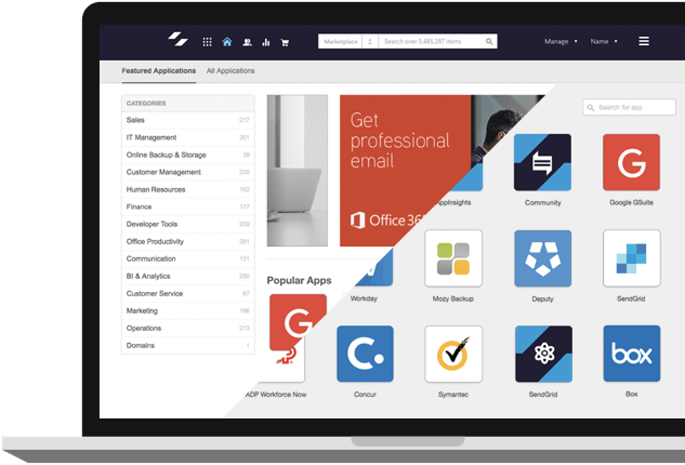
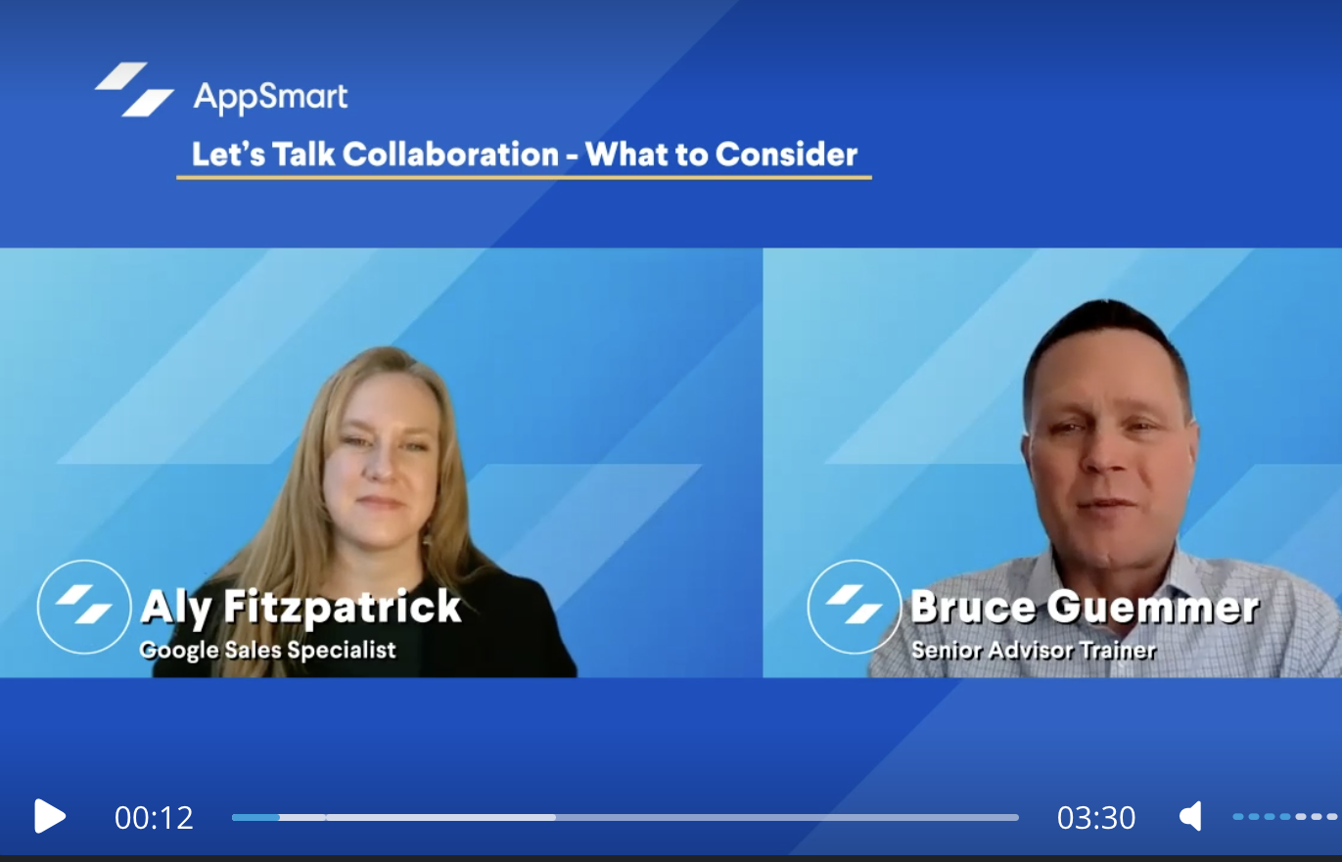
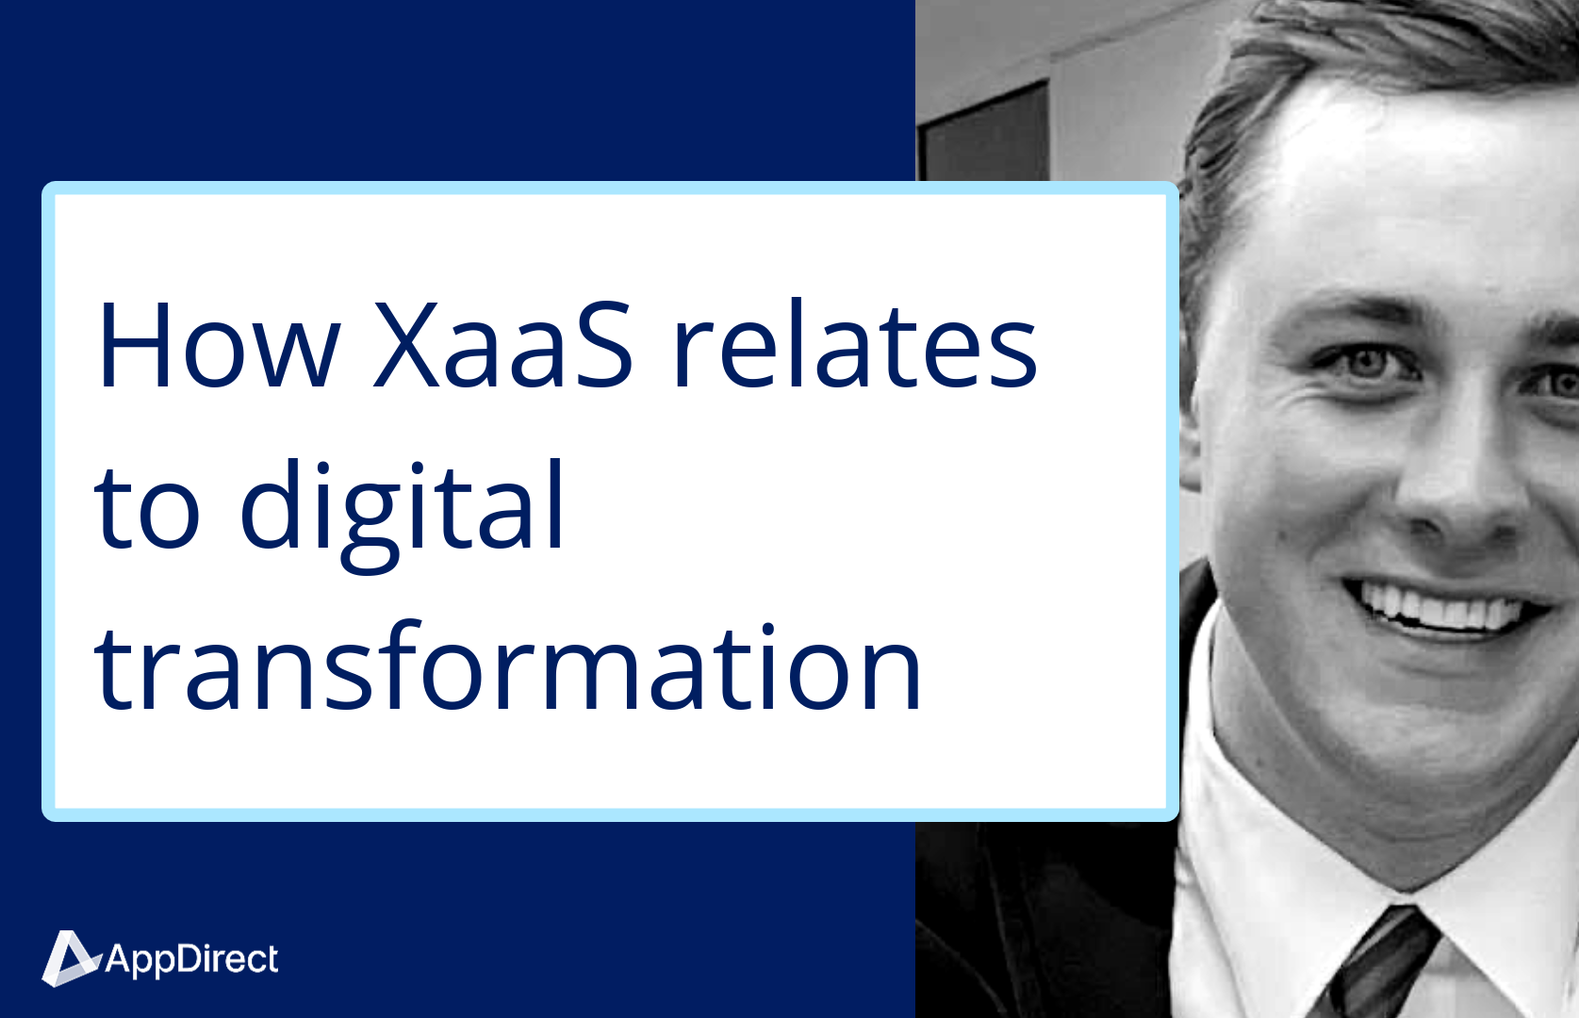



Resources to help you sell
Security
Certificate:
Identify
Level up your security skills and learn to position and sell security with our comprehensive training tools and events
Live workshops
Security Certificate
Resource Kit
Instructor-led sessions with practical sales activities and scenarios. Learn alongside like-minded advisors and technology providers.
Learn at your own pace with short videos, expert interviews, and reference materials.
Co-brandable datasheets, guides, pitch decks, email templates, and more.
Notes:
Security Certificate
New pillar added: Govern
Completing this certificate program will enable you to:
Build the confidence and skills you need to identify and seize opportunities in the evolving cybersecurity field.
Change the perception your customers have of you as you demonstrate your ability to adapt to market demands and support them with expertise, solutions, and resources.

Slide 12
AppDirect can help implement a holistic approach to security

Slide 13

Add Security solutions to your portfolio with our catalog
ENERGY
CONNECTIVITY & SD-WAN
EV Charging | Water & Waste
Electricity | Natural Gas | Solar
Fiber | Cable | Wireless | Satellite | TEM
MANAGED SERVICES
MOBILITY & IoT
NOC | SOC | Professional Services
SmartSupport | Asset Management
Wireless Services | Internet of Things (IoT)
Managed Mobility | Expense Management (WEM)
SECURITY
CUSTOMER EXPERIENCE (CX)
Physical Security | Network Security
Endpoint Security | Cloud Security | SASE | AI
UCaaS | Contact Center | CPaaS | SMS Analytics | Artificial Intelligence (AI)
CLOUD INFRASTRUCTURE
SOFTWARE AS A SERVICE
Public, Private, & Hybrid Cloud
Data Center & Colocation | Disaster Recovery
Microsoft | Google | ERP | CRM | Productivity | Business Applications | IT Management | BI
‹#›

Slide 14
THE LEADING SECURITY SOLUTIONS
PHYSICAL SECURITY
USER SECURITY
Smart Cameras | Smart Locks
Secure Data Centers
Email Security | MFA | SSO | User Training
CIAM
INTELLIGENT INCIDENT DETECTION AND RESPONSE
NETWORK SECURITY
Firewall | SASE | OT Security | ZTNA | IPS | DDoS Mitigation
SIEM | UEBA | SOAR | AI
CLOUD SECURITY
MANAGED SECURITY SERVICES
CSPM | CASB | Container Security | Cloud Workload Protection
SOCaaS | Incident Response | Penetration Testing |
vCISO | Security Assessments | NOC | MDR
ENDPOINT SECURITY
EDR/XDR | DLP | MDM | Vulnerability Management
‹#›

Slide 15
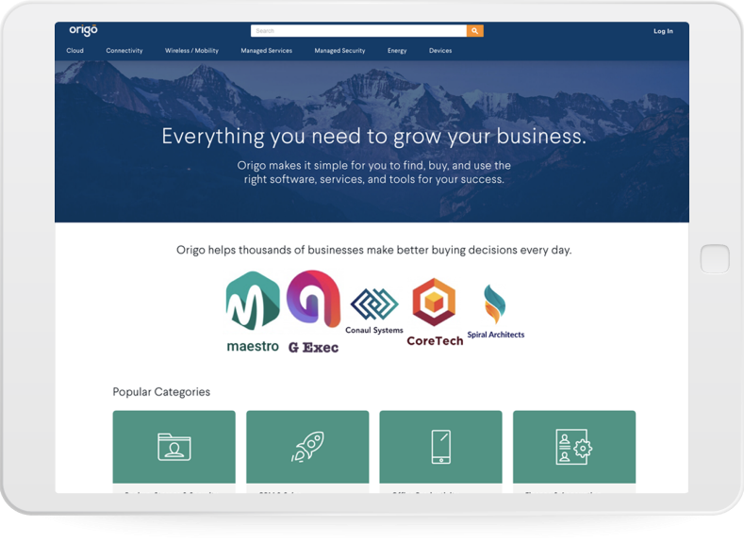
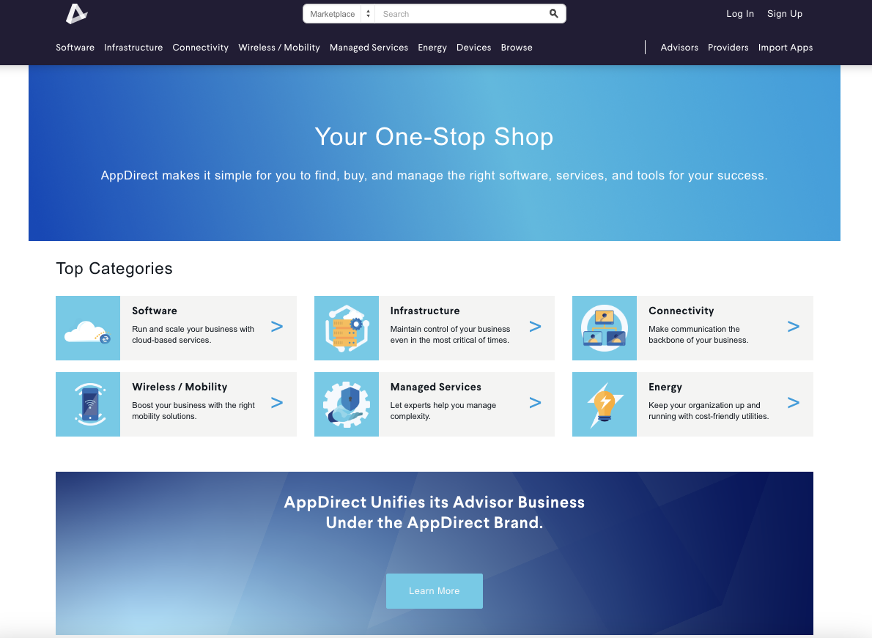
Simplify the experience of finding & buying security solutions
Security Catalog
Expertise
All the security solutions needed to secure a business, from one place.
Leverage our product experts and trainings to increase your security competency.

Slide 16






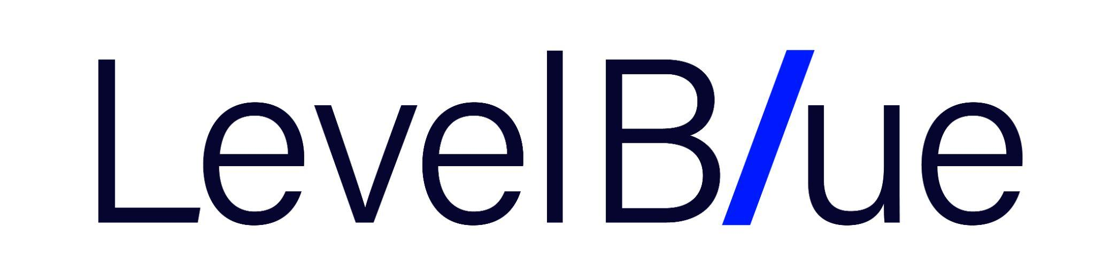














All the leading security providers
Consider security solutions from vendor-agnostic advisors with security experts to guide you.

Slide 17
All the security solutions you need to identify and manage your security risks.
Augment your expertise & extend your teams
End-user security training and compliance
Security Support Services
Vulnerability & Penetration testing
24x7 NOC & SOC
Level 1 help desk support
Find the right toolset
Identity & Access Management (IAM)
Workforce management
Physical security
Cloud security
Endpoint protection
Network security
Phishing detection
Secure Access Service Edge (SASE)
Software-defined WAN (SD-WAN)
Managed Firewall
Web application firewall
Security Information and Events Monitoring (SIEM)
RECOVER
RESPOND
GOVERN
IDENTIFY
DETECT
PROTECT
Recover from an incident
Virus & malware removal
DDoS mitigation
Ransomware response
Backup / Disaster recovery
Notes:
NIST Cybersecurity Framework - New pillar added: Govern

Slide 18


SmartSupport Premium
Premium tech support to troubleshoot any software and device issues
Calls Annually
Customer Satisfaction
First Call Resolution
100K+
End-user Help Desk services from troubleshooting, to installs, to malware removal
93%
End-customers rate us highly for on-boarding, migration, and level 1 help desk support
96%
Most end-customer issues are resolved on the first call.
Notes:
Add-on SmartSupport Premium Tech Support

Slide 19
AppDirect VNOC
DETECT
UNDERSTAND
Maximize uptime with a best-in-class networking management and monitoring platform, coupled with a team of NOC analysts acting upon alerts 24x7x365
Maximize uptime
RESOLVE
Notes:
Add-on VNOC offering

Slide 20
Case studies

Slide 21



Ideal customers
Our solutions are a good fit for:
Companies with employees working remotely
IT teams lacking resources to properly monitor and manage their network
Industries: healthcare,
finance, retail, software, energy
Notes:
But remember, all companies, no matter the size or industry, are at risk!

Slide 22
Key security win
$1.5M went missing when customer attacked while completing merger
Challenge
Solution
Results
HR Director had credentials stolen during merger of an acquired company.
Attacker was able to intercept the planned wire transfer of legacy 401k accounts and provide updated instructions; leading to $1.5M going missing.
AppDirect Solution Engineering worked with the partner and customer to:
Assist with mitigation by recommending a Breach Attorney
Improve the future Cybersecurity posture with a new endpoint protection, education, penetration testing, and SOC services.
Customer recovered the money thanks to the Breach Attorney and Cyber Insurance.
They now have a more robust security posture and a Disaster Recovery playbook to ensure they know how to handle the next event.
Notes:
Additional details…
For the Challenge - The customer had a basic Antivirus for endpoint protection, no eyes on glass (SOC or SIEM), no cyber security training, no password management (including no policies to have end users change their passwords on a regular basis). And no Disaster Recovery (DR) playbook.
The playbook is a document everyone business should have that includes information for how to handle a disaster/emergency. The playbook will also provide details for who to call, who owns what, and steps to take to stop/fix the issues at hand.
For the solution - We can make recommendations for Breach Attorney. But this is not a service AppDirect offers. AppDirect also does NOT offer cyber insurance either

