Slide 1
Network and Mobile
Lifecycle Management
Understand how and where you spend
November 2025
Notes:
Alt 1. Visibility into how you spend and simplified procurement to help you save
Alt 2. Your status quo might be costing you more than it should

Slide 2
What’s happening in the market?

Slide 3
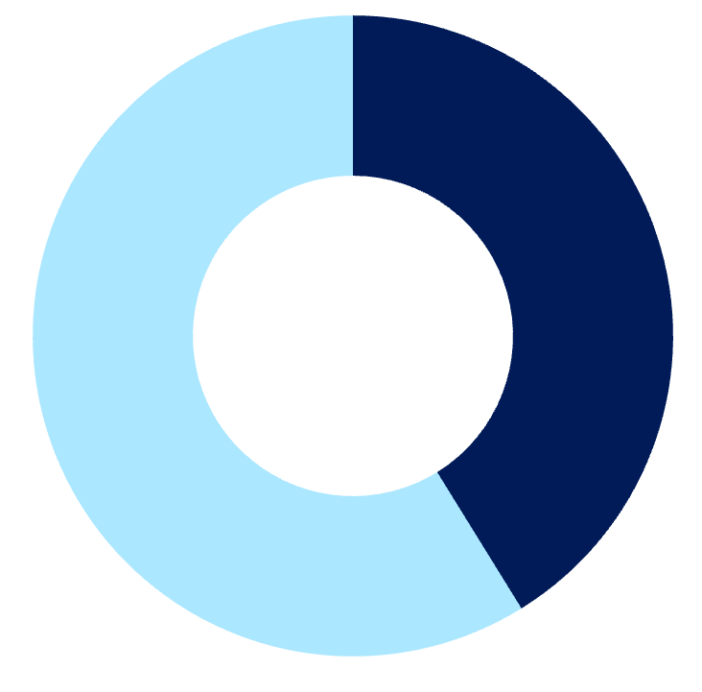
BY THE NUMBERS
What organizations are up against
40%
30%
41%
81
IT projects are delayed due to poor solution design and planning
IT assets go unused due to poor tracking systems
Organizations experience late payments on IT invoices resulting in penalties
Different IT vendors are managed on average by an enterprise organization
Notes:
Fourth stat - results of third party survey with Bospar (not published yet).

Slide 4



How your advisor helps
INDUSTRY
EXPERTISE
Leverage guidance and professional services that evaluate, design, and implement tailored network and mobile solutions that are aligned with your critical business initiatives.
Partner with experts who understand your network and mobile needs and centralize all your vendor relationships under one master agreement and within a single platform for complete visibility and control.
CENTRALIZE
YOUR SPEND
COST
OPTIMIZATION
Benefit from solutions that provide automated network and mobile expense management and analysis tools that reveal the true cost of your technology investments and drive smarter decisions.
Notes:
Tying it back to AppDirect, these are some value proposition that we put together, making it clear how we address the pain points seen on the previous slide – again tying it closely to their main CBI around automating their run activities to save costs & time.
Industry expertise – placing the advisor at the forefront of this – expertise throughout the entire journey, from finding, buying, to managing as we know buyers are increasingly purchasing from the channel.
In our “how we can help” messaging, we are speaking to both the guidance (Advisor) & digital tools (Platform) offered. Initial journey is with the advisor and their team, but we also equip them with the self-serve tools in both the marketplace and the workspace if ever they want to be autonomous players (digitally enabled).

Slide 5
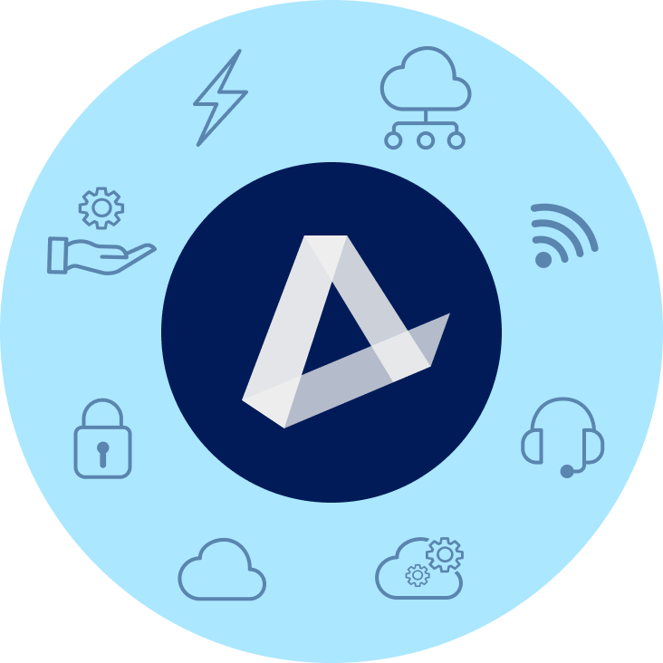








TRANSITION
ENERGY
COMMUNICATIONS SOLUTIONS
EV Charging | Water & Waste
Electricity | Natural Gas | Solar
Data | Network | Mobility & IoT | Satellite
SD-WAN | SASE | TEM | UCaaS | CCaaS
MANAGED & PRO SERVICES
SOFTWARE AS A SERVICE
Network (NOC) & Cloud Monitoring | SOC
Technical Support | Professional Services
Microsoft | Google | ERP | CRM | Productivity
Business Applications | IT Management | BI
HARDWARE & LOGISTICS
ARTIFICIAL INTELLIGENCE
PCs | Laptops | Phones | Monitors | Digital Displays
Hardware Services & Logistics
Large-Language Models | Agentic AI | Copilot | Gemini | Chat Bots | Customer Experience
SECURITY
INFRASTRUCTURE
Physical Security | Network Security
Endpoint Security | Cloud Security
Public, Private, & Hybrid Cloud
Data Center & Colocation | Disaster Recovery
‹#›

Slide 6
Why you need network & mobile lifecycle management

Slide 7
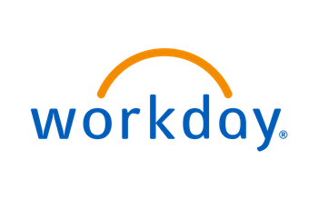


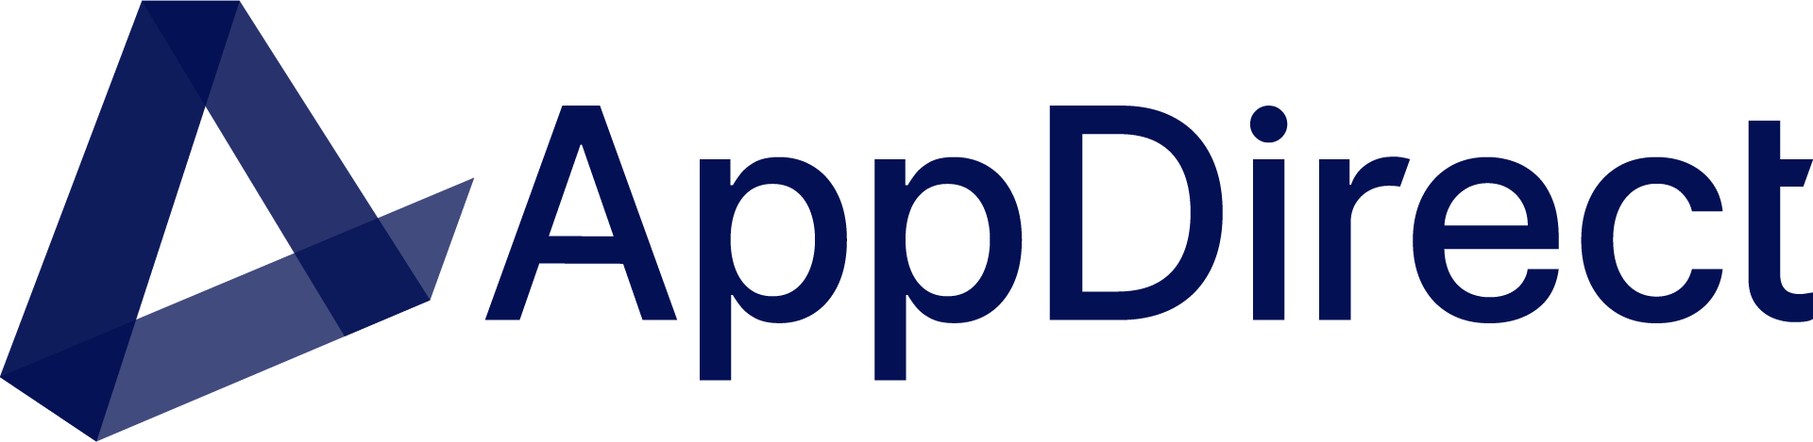
Solving a universal problem
Marketing
has tools to manage the lifecycle of a prospect
Sales
has tools to manage the lifecycle of a customer
HR
has tools to manage the lifecycle of an employee
IT
Now has a tool to manage the lifecycle of recurring IT spend

Slide 8
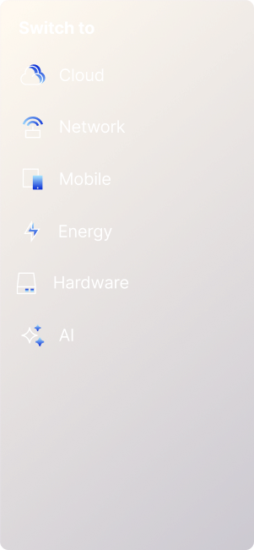

Manage the lifecycle of your assets in one place
Cloud
Hardware
Network
Mobile
AppDirect Platform
“Everything Store”
AI
Energy
Managed Services
Notes:
Now these are the integrated platforms that let you manage your lifecycle.
Through one unified platform, at a high level, you get immediate access to:
AppDirect for cloud and SaaS subscription lifecycle management
Firstbase for complete hardware lifecycle management
vCom for all your network and mobility lifecycle management
Devs.ai to help you securely derive insights from your company data and build agents that automate your organization’s workflows
NOC to monitor your network infrastructure ongoing and prevent downtime
This integration is crucial because fragmented technology environments often stand in the way of successful digital transformation. By providing holistic visibility, our solution ensures your technology roadmap stays aligned with actual usage and costs.
Now let’s dive into each solution.

Slide 9


Managed Services
A suite of IT spend management solutions
Buyers’ Club
Software

Slide 10
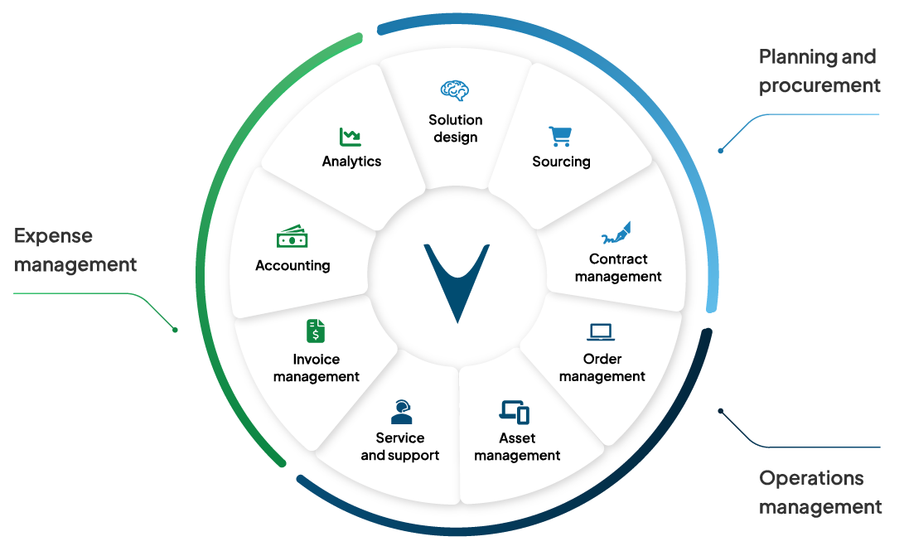
Everything teams need to manage the entire IT lifecycle
Purpose-built software and expert managed services to improve efficiencies, control costs and make informed decisions from data

Slide 11
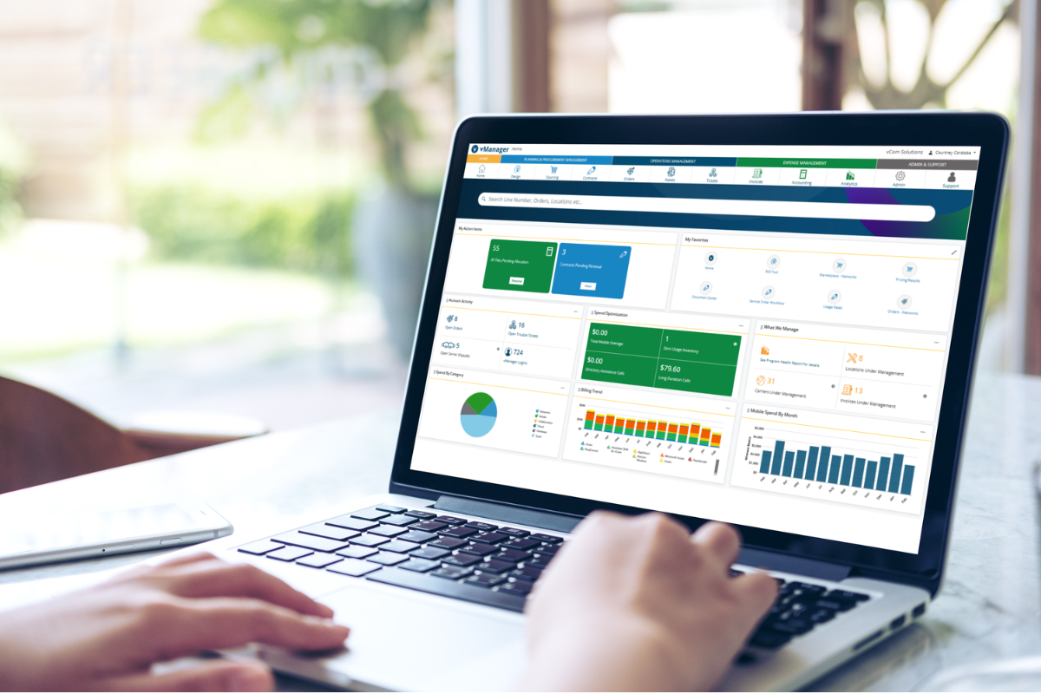


Software that makes managing IT easy
Create a centralized hub for your technology management inside vManager, our AI-powered platform
Every asset. Every vendor. Every location.
Available at your desk or on-the-go with hundreds of features
Backed by expert services and 24/7/365 support
Unlimited user licenses

Slide 12



That deliver
three key values
to customers
Money
Information
Time

Slide 13




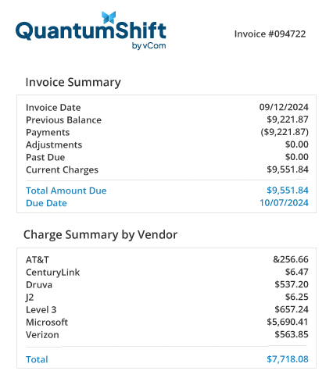

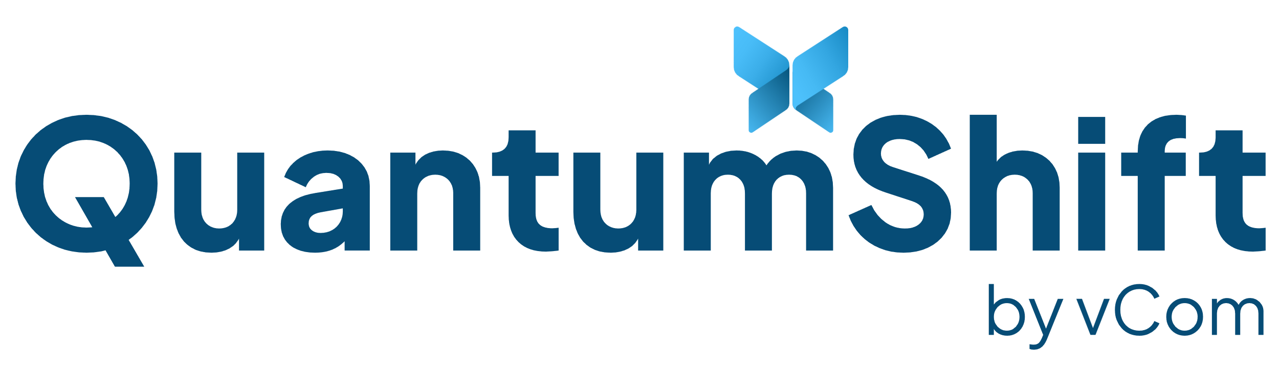
Retail
Brokerage
Wholesale
We can manage a customer’s current environment
We can manage what they source through AppDirect
We can manage what they source through our buyers’ club
With our exclusive wholesale buyers’ club, QuantumShift, organizations gain the additional benefits of:
Smarter buying starts here
Aggregation
Consolidation
Normalization
Integration

Slide 14



Network Lifecycle Management
Mobile Lifecycle Management
Expense
Management Only
Optimize performance and reduce complexity with end-to-end network infrastructure management—from planning and design to deployment, operation, and decommissioning.
Gain complete control over mobile devices and costs with end-to-end management—from sourcing and activation to usage, support, and responsible disposal.
Simplify and streamline how your organization pays, allocates, and analyzes all IT expenses—from networks and mobile to cloud, SaaS, collaboration tools, and beyond.

Slide 15
How AppDirect supports you

Slide 16




Value-Added Services
Project Managers that assist in onboarding, organizing and streamlining strategic initiatives, technology upgrades, and lifecycle management.
PROJECT MANAGEMENT
Complete technical support for your operating systems, security, and device management. Expert help for all your technology - from computers and phones to peripherals and smart devices.
PREMIUM
TECHNICAL SUPPORT
End-to-end network management including 24/7 monitoring, incident response, and on-site support for all your network devices. Complete lifecycle services from procurement and staging to maintenance of your entire network infrastructure.
NETWORK MANAGEMENT
(MONITORING & FIELD SERVICES)
Deliver and manage end-user hardware (laptops, phones, etc); including inventory management, staging, configuration, testing, assembly, retrieval, secure disposal, and more.
HARDWARE & LOGISTICS

Slide 17




Extend your team with our specialists
Solution Engineers
Solution Architects
Boost solution designs with technical expertise in customer discovery and qualification.
Confidently present solutions scoped, designed, and vetted by experts.
Notes:
Procuring technology is increasingly complex—lean on AppDirect as an extension of your sales team.
We provide you with the digital back office and tools you’re used to, and a 250+ bench of back office specialists, engineers, and responsive support teams.
Leverage a team of solution engineers and solution architects to identify business problems and offer expert advice to your customers on the solutions that best fit their business model.
From engaging the providers to deal registration, demonstration, quoting, and post-sales support, AppDirect is there every step of the way.

Slide 18
Case studies

Slide 19








Success Story: CPI Security
CPI Security, a leading provider of home monitoring and alarm solutions, offers an all-in-one integrated system for its customers. However, their IT environment lacked a similarly unified solution.
IT Assets Included
vCom Partner Advisor
1,500 Mobile Devices
Customer Challenges
Other engaged vendors demanded significant effort from an already overstretched IT team
Limited visibility into the mobile environment, resulted in overspending on unused lines
Managing MACD (Moves, Adds, Changes, Deletes) processes consumed valuable time and resources

Slide 20


Outcomes
Over $11K in monthly mobile savings for customer
Partner Opportunity and Engagement
More efficient mobile management for orders/changes and expenses
OPKALLA was originally engaged by TSD
Two dedicated prep calls reviewing function and customer needs
$5,899.99 in partner monthly commissions earned, with more coming as services transferred to QuantumShift
CPI was inconsistent to commit, but vCom team stayed engaged and ultimately closed the deal
“We’ve been working with multiple mobility solutions for years… I think vCom has an AWESOME ability and we’re looking for more ways to engage vCom.”
Aaron Bock, OPKALLA Managing Partner
Solution
Initial management of existing environment assumed by vCom with future-focused transition plan
Immediate visibility into current environment to identify overspend and unnecessary plans
MACD order management and automated financial reporting from day one in vManager

Slide 21




Success Story
Outcomes
Family owned since 1921, Wilbur-Ellis is a leading international marketer and distributor of agricultural products, animal nutrition and specialty chemicals and ingredients.
Reduced costs, improved network speeds and better governance
Single support team with reduced downtime and improved satisfaction
Challenges
IT silos at 250 locations
Automated processes that save days of labor each month
No centralized visibility into services or spend
Non-payment shut offs and late fees
Solution
Centralized assets within vManager
“vCom is a great resource, helping us service and source products, cutting costs and improving our ability to deliver.”
Standardization across branches to take advantage of pricing volumes
Tactical execution and team extension
Notes:
GENERAL – BEST OF

Slide 22

Success Story
Outcomes
Goodwill of Central and Southern Indiana operates more than 70 retail locations, charter schools for adults and youth, a maternal-child health program, a childcare center, and more.
Single invoice for all locations, carriers and products
Streamlined support with one team for all issues
Challenges
Significant cost savings going back to the bottom line
Small IT team stretched to capacity
Service tickets for 20 carriers covering 120 locations
Lack of visibility into inventory
Solution
“vCom is the gold standard for our IT service vendor partnerships. Our support headaches went away because vCom takes care of it and chases our tickets. Plus, we know that we’re going to get the best prices that we can get.”
Moved services under vCom management
Assigned consistent, dedicated team to manage all trouble tickets
Leveraged vManager for centralized control of spend
Notes:
GENERAL – BEST OF

Slide 23
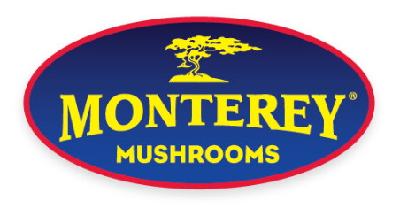
Success Story
Outcomes
Founded in 1971, Monterey Mushrooms is a leading vertically- integrated researcher, developer, grower, and marketer of premium mushrooms, mushroom genetics, and mushroom ingredients.
Increased visibility, doubled network capability and improved reliability
Automated generation of GL-coded AP file for upload into accounting system
Challenges
Lack of visibility and control over telecom expenses
More efficient management for orders/changes and repairs
Processing more than 150 bills per month
Facility managers unable to understand their costs
“Because we have the right management tools, we’ve been able to streamline our telecom environment to keep our costs flat, despite providing increased speed and volume for our users.”
Solution
Moved all services under vCom management​
Employed vManager to improve visibility and automate cost allocation
Designed and managed migration to improved data network
Notes:
GENERAL – BEST OF

Slide 24
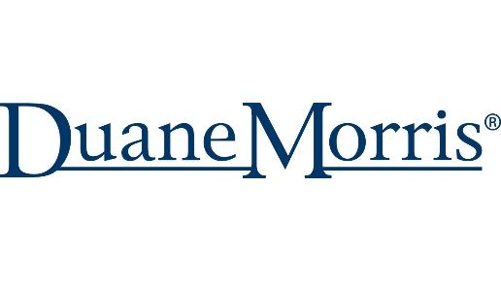
Success Story
Outcomes
Among the 100 largest law firms in the world, Duane Morris LLP has more than 900 attorneys in offices across the United States and internationally.
Single invoice for all offices, carriers and products
Single support team nationwide
Challenges
Automated processes that save days of labor each month
Multi-site and multi-carrier network infrastructure
Lack of visibility into technology spend and inventory
150+ monthly invoices, including GL coding and AP posting
“vCom helps us greatly streamline our own process and handle far more work with the same resources. We also know exactly what services we have across the enterprise and what our cost truly is.”
Solution
Moved all services under vCom management​
Leveraged vManager for operational and accounting management of spend
Managed migration to new technology
Notes:
GENERAL – BEST OF

Slide 25

Success Story
Outcomes
Stanford Health Care is part of Stanford Medicine, a leading academic health system that includes the Stanford University School of Medicine, Stanford Health Care, and Stanford Children’s Health, with Lucile Packard Children's Hospital.
Extended IT team with subject matter expertise
Single invoice for all telecom expenses
Challenges
Cost and time savings due to visibility and automation provided by vManager
Multiple carrier networks
Tracking inventory and validating rates inside 50+ invoices each month
Limited resources for major infrastructure projects
“vCom was instrumental in supporting our network implementation. They drove the carriers to meet their timelines and requirement with their expertise, dedication and exceptional project management skills.”
Solution
Consolidated management of voice and data services under vCom
Sourced and implemented high-speed data services to support telemedicine
Designed, sourced and implemented fully redundant network architecture
Notes:
GENERAL – BEST OF

Slide 26
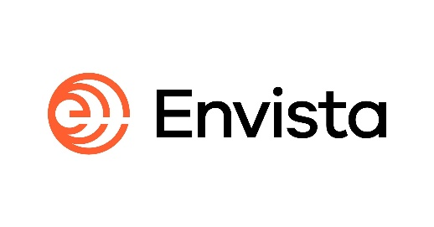
Success Story
Outcomes
Envista is a global family of more than 30 trusted dental brands currently operating in 120+ countries worldwide.
60% decrease in network costs - $3M in three years
Centralized portal resulting in 10 hours per week saved
Challenges
Automated payment reduced late fees and ensures business continuity
Two few resources to manage a global migration to SD-WAN
Limited visibility into global providers
No centralization – swiveling between multiple portals
Solution
“I can 100% recommend vCom. There was always a 100% timely response…the team always makes an effort to stay close to us to understand what we were doing.”
Managed daily migration details for each of the 100 global locations
Global access to local CLECs provider / more provider options in each country
Negotiated termination/migration of contracted services with no penalties
Notes:
GENERAL – BEST OF

Slide 27
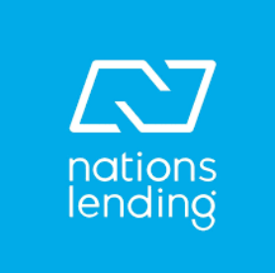
Success Story
Outcomes
Founded in 2003, Nations Lending Corporation™ is one of the fastest-growing mortgage lenders in the U.S.
Significant cost reduction and late fee avoidance
Time savings for multiple departments
Challenges
Ability to scale quickly without creating a new department
Three employees managing 90 locations
Redundant IT payments
No documentation or visibility into inventory
Solution
“vCom is the best fit for us because it allows the flexibility to scale without adding more people. Over time, it can save a department's worth of budget and time.”
Account consolidation
Invoice management
RFP management
Notes:
GENERAL – BEST OF

Slide 28

Success Story
Outcomes
Established in 1975 and headquartered in California, Tri Counties Bank has assets of almost $10 billion.
Single invoice for all offices, carriers and products​
Single support team nationwide​
Challenges
Automated processes that save days of labor each month
Multi-site and multi-carrier network infrastructure​
Lack of visibility into technology spend and inventory​
150+ monthly invoices, including GL coding and AP Posting
“Because we have the right management tools, we’ve been able to streamline our telecom environment to keep our costs flat, despite providing increased speed and volume for our users.”
Solution
Moved all services under vCom management​
Leveraged vManager for operational and accounting management of spend​
Managed migrations to new technology
Notes:
GENERAL – BEST OF

