Slide 1
vCom Network & Mobility Lifecycle Management
Understand how and where you spend
February 2025
Notes:
Alt 1. Visibility into how you spend and simplified procurement to help you save
Alt 2. Your status quo might be costing you more than it should

Slide 2
What’s happening in the market

Slide 3



What’s happening in the market
Inefficient network and mobility lifecycle management incurs massive costs
30% IT budget is wasted due to lack of visibility on spend
$5.45 M average annual cost to replace lost mobile devices
45% of organizations overpay for technology and telecom expenses
Notes:
IT assets are typically managed internally through manual processes, lack tracking, and incur massive costs.
Enterprises incur substantial financial burdens due to the loss of mobile devices, with the average annual expenditure on replacing these devices amounting to approximately $5.45 million, according to Imprivata (Samsung SDS, 2024)
45% of organizations struggle with overspending on IT hardware and software, which strategic sourcing solutions help mitigate. (Source: Gartner)

Slide 4
Challenges companies like yours face
Your status quo might be costing you more than it should
Manual spreadsheets and inefficient processes
Too many needs, vendors, and complex integrations
Disjointed systems, slow invoices, and hidden costs
73%
95%
67%
of unplanned downtime is caused by human error
of senior IT executives plan to consolidate vendors
of organizations report insufficient data visibility and governance
Notes:
73% of unplanned downtime is caused by human error, which can be minimized with automation tools and managed IT operations. (Source: Uptime Institute)
Ninety-five percent of senior IT executives plan to consolidate vendors within a year, according to a recent poll by CIO. And 75% of organizations plan to consolidate their cybersecurity vendors (Source: BizTech, 2024).

Slide 5



How your advisor helps
INDUSTRY
EXPERTISE
Leverage guidance and professional services that evaluate, design, and implement tailored network and mobility solutions that are aligned with your critical business initiatives.
Partner with experts who understand your network and mobility needs and centralize all your vendor relationships under one master agreement and within a single platform for complete visibility and control.
CENTRALIZE
YOUR SPEND
COST
OPTIMIZATION
Benefit from solutions that provide automated network and mobility expense management and analysis tools that reveal the true cost of your technology investments and drive smarter decisions.
Notes:
Tying it back to AppDirect, these are some value proposition that we put together, making it clear how we address the pain points seen on the previous slide – again tying it closely to their main CBI around automating their run activities to save costs & time.
Industry expertise – placing the advisor at the forefront of this – expertise throughout the entire journey, from finding, buying, to managing as we know buyers are increasingly purchasing from the channel.
In our “how we can help” messaging, we are speaking to both the guidance (Advisor) & digital tools (Platform) offered. Initial journey is with the advisor and their team, but we also equip them with the self-serve tools in both the marketplace and the workspace if ever they want to be autonomous players (digitally enabled).

Slide 6
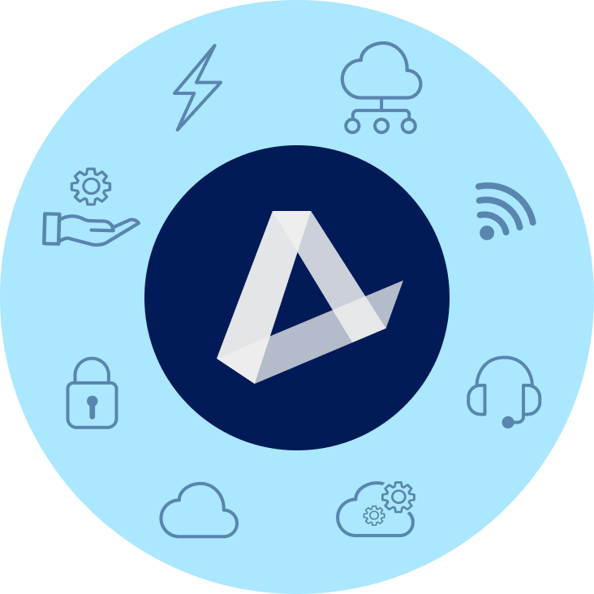
Centralize your spend and save time and money
ENERGY
CONNECTIVITY & SD-WAN
EV Charging | Water & Waste
Electricity | Natural Gas | Solar
Fiber | Cable | Wireless | Satellite | TEM
MANAGED SERVICES
MOBILITY & IoT
NOC | SOC | Professional Services
SmartSupport | Asset Management
Wireless Services | Internet of Things (IoT)
Managed Mobility | Expense Management (WEM)
SECURITY
CUSTOMER EXPERIENCE (CX)
Physical Security | Network Security
Endpoint Security | Cloud Security | SASE
UCaaS | Contact Center | CPaaS | SMS Analytics | Artificial Intelligence (AI)
CLOUD INFRASTRUCTURE
SOFTWARE AS A SERVICE
Public, Private, & Hybrid Cloud
Data Center & Colocation | Disaster Recovery
Microsoft | Google | ERP | CRM | Productivity | Business Applications | IT Management | BI
‹#›
Notes:
Are you selling connectivity? Also have a strategic partner vCom that can help you manage its lifecycle

Slide 7
Introducing vCom
Why you need lifecycle management

Slide 8

Companies have reached a crossroads – adapt and evolve or fall behind

Slide 9


Getting stuck in the status quo
Let’s face it. Managing technology assets and expenses is no picnic. Over the years, IT and Finance teams have done what was necessary, adopting manual approaches, mostly spreadsheets and one-time audits, to cope. However, today’s pace of change, the growing tech ecosystem and competition for talent has made it difficult to keep up. Old habits and traditional approaches are not producing the best results and teams are exhausted, getting stuck in the status quo.
Notes:
Problems our solution will tackle
Smaller teams so overwhelmed easily
Controlling costs
High staff turnover and lack of specialized skills
Data loss
Security (both monitoring and managing)
Managing both in-office and remote employees

Slide 10

Taking you from good to great
Siloed Centralized
Sporadic Continuous
Manual Automatic
Reduction Optimization
Reactive Proactive

Slide 11


Enterprise solutions made just for you
Everything IT and Finance teams need to improve efficiencies, control costs and make informed decisions from data, including:
Planning &
Procurement
Operations
Management
Expense
Management
Solution Design
Order Management
Invoice Management
Sourcing
Asset Management
Accounting
Contract Management
Service & Support
Analytics

Slide 12



Planning and Procurement
Get tools and expertise to buy at the absolute best price from a vendor agnostic partner
Solution Design
Sourcing
Contract Management
Infrastructure Audit
Vendor Agnostic Marketplace
Contract Negotiations and Review
Vendor Scorecard
Proposal and Quote Management
Document Center
RFP Development
Custom Pricing Catalog
Aggregated Buying Power
Capacity Planning
Vendor Availability Finder
Subject Matter Expertise

Slide 13



Operations Management
Accurately track and manage your IT assets, orders, projects, and tickets without worry
Order Management
Asset
Management
Service and Support
Moves, Adds, Changes, Disconnects (MACD) Order Portal
Centralized Asset Database
Vendor Ticketing Portal
Customer Managed Assets
Vendor Escalation and Troubleshooting
MACD Project Management
Asset to Invoice Linking
Customer Managed Tickets
Network Operations Center (NOC) and Traffic Monitoring

Slide 14



Expense Management
Simplify and streamline how you pay, allocate and analyze your IT expenses
Invoice Management
Accounting
Analytics
Invoice Database
Managed Pay with Payment Tracking
100+ Reports and Charts
Invoice Language Standardization
Automated General Ledger (GL) Coding and Cost Center Allocations
Community Intelligence
Automated Invoice
Approval Workflow
Utilization Reporting
Batched Accounts Payable (AP) Posting Files
Mobile Cost Optimization (with Mobile Lifecycle Management)
Variance Flagging gnd Resolution (with Mobile Lifecycle Management)

Slide 15
How AppDirect supports you

Slide 16




Value-Added Services
Project Managers that assist in onboarding, organizing and streamlining strategic initiatives, technology upgrades, and lifecycle management.
PROJECT MANAGEMENT
Complete technical support for your operating systems, security, and device management. Expert help for all your technology - from computers and phones to peripherals and smart devices.
PREMIUM
TECHNICAL SUPPORT
End-to-end network management including 24/7 monitoring, incident response, and on-site support for all your network devices. Complete lifecycle services from procurement and staging to maintenance of your entire network infrastructure.
NETWORK MANAGEMENT
(MONITORING & FIELD SERVICES)
Secure storage facilities to house and deliver lifecycle services for your equipment; including inventory management, staging, configuration, testing, assembly, and more.
IT ASSET MANAGEMENT
(HARDWARE LIFECYCLE MANAGEMENT)

Slide 17
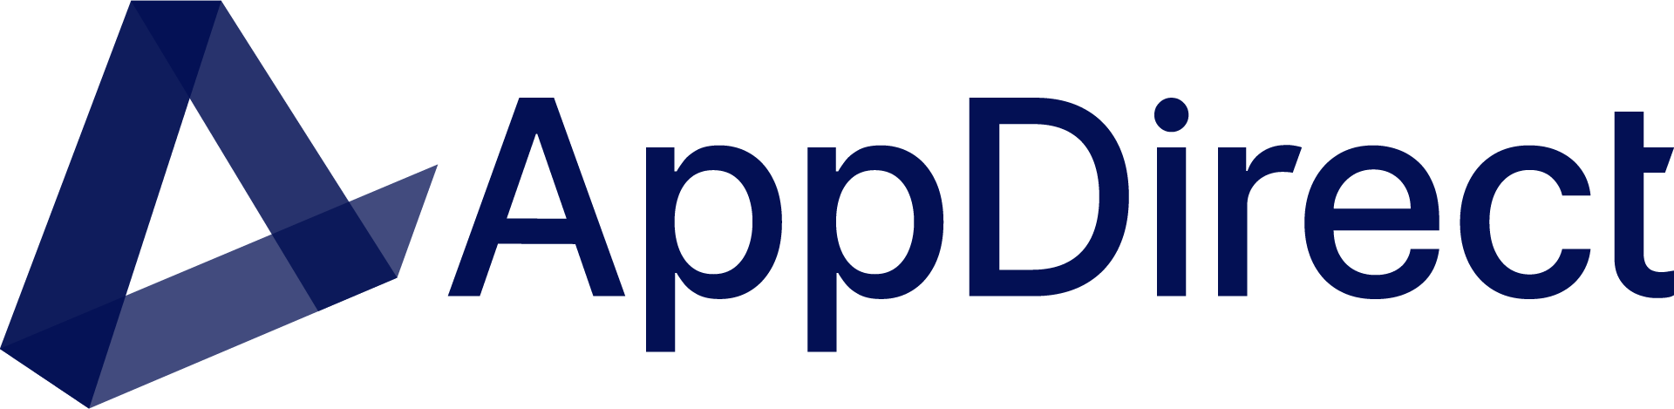




Extend your team with our specialists
Solution Engineers
Solution Architects
Boost solution designs with technical expertise in customer discovery and qualification.
Confidently present solutions scoped, designed, and vetted by experts.
Notes:
Procuring technology is increasingly complex—lean on AppDirect as an extension of your sales team.
We provide you with the digital back office and tools you’re used to, and a 250+ bench of back office specialists, engineers, and responsive support teams.
Leverage a team of solution engineers and solution architects to identify business problems and offer expert advice to your customers on the solutions that best fit their business model.
From engaging the providers to deal registration, demonstration, quoting, and post-sales support, AppDirect is there every step of the way.

Slide 18
Case studies

Slide 19

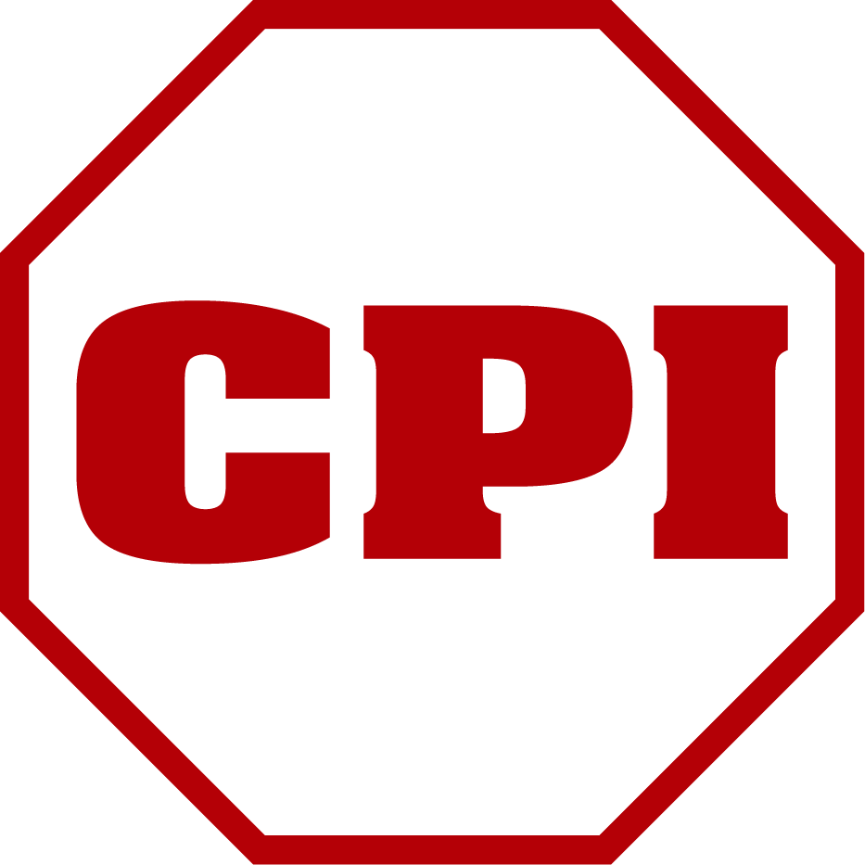






Success Story: CPI Security
CPI Security, a leading provider of home monitoring and alarm solutions, offers an all-in-one integrated system for its customers. However, their IT environment lacked a similarly unified solution.
IT Assets Included
vCom Partner Advisor
1,500 Mobile Devices
Customer Challenges
Other engaged vendors demanded significant effort from an already overstretched IT team
Limited visibility into the mobile environment, resulted in overspending on unused lines
Managing MACD (Moves, Adds, Changes, Deletes) processes consumed valuable time and resources

Slide 20


Outcomes
Over $11K in monthly mobile savings for customer
Partner Opportunity and Engagement
More efficient mobile management for orders/changes and expenses
OPKALLA was originally engaged by TSD
Two dedicated prep calls reviewing function and customer needs
$5,899.99 in partner monthly commissions earned, with more coming as services transferred to QuantumShift
CPI was inconsistent to commit, but vCom team stayed engaged and ultimately closed the deal
“We’ve been working with multiple mobility solutions for years… I think vCom has an AWESOME ability and we’re looking for more ways to engage vCom.”
Aaron Bock, OPKALLA Managing Partner
Solution
Initial management of existing environment assumed by vCom with future-focused transition plan
Immediate visibility into current environment to identify overspend and unnecessary plans
MACD order management and automated financial reporting from day one in vManager

Slide 21




Success Story
Outcomes
Family owned since 1921, Wilbur-Ellis is a leading international marketer and distributor of agricultural products, animal nutrition and specialty chemicals and ingredients.
Reduced costs, improved network speeds and better governance
Single support team with reduced downtime and improved satisfaction
Challenges
IT silos at 250 locations
Automated processes that save days of labor each month
No centralized visibility into services or spend
Non-payment shut offs and late fees
Solution
Centralized assets within vManager
“vCom is a great resource, helping us service and source products, cutting costs and improving our ability to deliver.”
Standardization across branches to take advantage of pricing volumes
Tactical execution and team extension
Notes:
GENERAL – BEST OF

Slide 22

Success Story
Outcomes
Goodwill of Central and Southern Indiana operates more than 70 retail locations, charter schools for adults and youth, a maternal-child health program, a childcare center, and more.
Single invoice for all locations, carriers and products
Streamlined support with one team for all issues
Challenges
Significant cost savings going back to the bottom line
Small IT team stretched to capacity
Service tickets for 20 carriers covering 120 locations
Lack of visibility into inventory
Solution
“vCom is the gold standard for our IT service vendor partnerships. Our support headaches went away because vCom takes care of it and chases our tickets. Plus, we know that we’re going to get the best prices that we can get.”
Moved services under vCom management
Assigned consistent, dedicated team to manage all trouble tickets
Leveraged vManager for centralized control of spend
Notes:
GENERAL – BEST OF

Slide 23
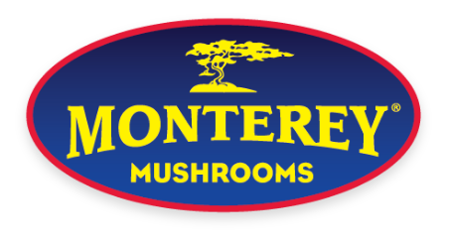
Success Story
Outcomes
Founded in 1971, Monterey Mushrooms is a leading vertically- integrated researcher, developer, grower, and marketer of premium mushrooms, mushroom genetics, and mushroom ingredients.
Increased visibility, doubled network capability and improved reliability
Automated generation of GL-coded AP file for upload into accounting system
Challenges
Lack of visibility and control over telecom expenses
More efficient management for orders/changes and repairs
Processing more than 150 bills per month
Facility managers unable to understand their costs
“Because we have the right management tools, we’ve been able to streamline our telecom environment to keep our costs flat, despite providing increased speed and volume for our users.”
Solution
Moved all services under vCom management​
Employed vManager to improve visibility and automate cost allocation
Designed and managed migration to improved data network
Notes:
GENERAL – BEST OF

Slide 24
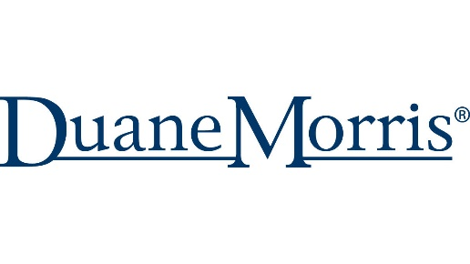
Success Story
Outcomes
Among the 100 largest law firms in the world, Duane Morris LLP has more than 900 attorneys in offices across the United States and internationally.
Single invoice for all offices, carriers and products
Single support team nationwide
Challenges
Automated processes that save days of labor each month
Multi-site and multi-carrier network infrastructure
Lack of visibility into technology spend and inventory
150+ monthly invoices, including GL coding and AP posting
“vCom helps us greatly streamline our own process and handle far more work with the same resources. We also know exactly what services we have across the enterprise and what our cost truly is.”
Solution
Moved all services under vCom management​
Leveraged vManager for operational and accounting management of spend
Managed migration to new technology
Notes:
GENERAL – BEST OF

Slide 25

Success Story
Outcomes
Stanford Health Care is part of Stanford Medicine, a leading academic health system that includes the Stanford University School of Medicine, Stanford Health Care, and Stanford Children’s Health, with Lucile Packard Children's Hospital.
Extended IT team with subject matter expertise
Single invoice for all telecom expenses
Challenges
Cost and time savings due to visibility and automation provided by vManager
Multiple carrier networks
Tracking inventory and validating rates inside 50+ invoices each month
Limited resources for major infrastructure projects
“vCom was instrumental in supporting our network implementation. They drove the carriers to meet their timelines and requirement with their expertise, dedication and exceptional project management skills.”
Solution
Consolidated management of voice and data services under vCom
Sourced and implemented high-speed data services to support telemedicine
Designed, sourced and implemented fully redundant network architecture
Notes:
GENERAL – BEST OF

Slide 26
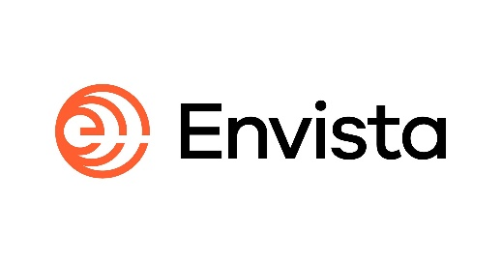
Success Story
Outcomes
Envista is a global family of more than 30 trusted dental brands currently operating in 120+ countries worldwide.
60% decrease in network costs - $3M in three years
Centralized portal resulting in 10 hours per week saved
Challenges
Automated payment reduced late fees and ensures business continuity
Two few resources to manage a global migration to SD-WAN
Limited visibility into global providers
No centralization – swiveling between multiple portals
Solution
“I can 100% recommend vCom. There was always a 100% timely response…the team always makes an effort to stay close to us to understand what we were doing.”
Managed daily migration details for each of the 100 global locations
Global access to local CLECs provider / more provider options in each country
Negotiated termination/migration of contracted services with no penalties
Notes:
GENERAL – BEST OF

Slide 27
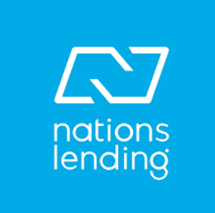
Success Story
Outcomes
Founded in 2003, Nations Lending Corporation™ is one of the fastest-growing mortgage lenders in the U.S.
Significant cost reduction and late fee avoidance
Time savings for multiple departments
Challenges
Ability to scale quickly without creating a new department
Three employees managing 90 locations
Redundant IT payments
No documentation or visibility into inventory
Solution
“vCom is the best fit for us because it allows the flexibility to scale without adding more people. Over time, it can save a department's worth of budget and time.”
Account consolidation
Invoice management
RFP management
Notes:
GENERAL – BEST OF

Slide 28

Success Story
Outcomes
Established in 1975 and headquartered in California, Tri Counties Bank has assets of almost $10 billion.
Single invoice for all offices, carriers and products​
Single support team nationwide​
Challenges
Automated processes that save days of labor each month
Multi-site and multi-carrier network infrastructure​
Lack of visibility into technology spend and inventory​
150+ monthly invoices, including GL coding and AP Posting
“Because we have the right management tools, we’ve been able to streamline our telecom environment to keep our costs flat, despite providing increased speed and volume for our users.”
Solution
Moved all services under vCom management​
Leveraged vManager for operational and accounting management of spend​
Managed migrations to new technology
Notes:
GENERAL – BEST OF

